Slide 1
SMART SUPPLY CHAINS · MCA SEMESTER 3 PROJECT
ChainShield
Transportation System
Resilient Logistics & Dynamic Supply Chain Optimization
Group No. 59
Bhavik A. Visani (D51) · Diya Shah (D36) · Shruti Somani (D42)
Guided by Prof. Dhaval Shah
LJ Institute of Computer Application | LJK University
Notes:
Opening slide. Introduce the project name, the track (Smart Supply Chains), and the team before moving to the problem statement.

Slide 2
THE PROBLEM
Disruptions are found only after it's too late
Reactive monitoring
1
Managers learn about a delay only after a customer reports a missed delivery.
Siloed signals
2
Weather, congestion, cargo risk, and delay history are never fused into one score.
Ad-hoc rerouting
3
When a disruption is found, the reroute decision relies on guesswork, not data.
ChainShield Transportation System | MCA Semester 3 | Group 59
2
Notes:
Set up the pain point in three concrete failure modes, before showing the solution on the next slide.

Slide 3
OBJECTIVE
Catch disruptions before they cascade
Continuously score every active shipment's disruption risk
GOAL
Reactive
→
Preemptive
Auto-flag disruptions the instant a risk threshold is crossed
Instantly propose ranked, optimised route alternatives
Notify managers, then field operators, the moment a decision is made
Give each role — admin, manager, operator — its own focused dashboard
ChainShield Transportation System | MCA Semester 3 | Group 59
3
Notes:
Five concrete objectives, then the one-line framing on the right: moving the org from reactive to preemptive.

Slide 4
PROPOSED SOLUTION
How ChainShield works
1
2
3
4
MONITOR
DETECT
REROUTE
NOTIFY
→
→
→
Every active shipment is scored on a recurring interval using live weather, congestion, cargo, and history signals.
Reaching MEDIUM risk auto-creates a disruption and alerts managers live — escalated if it reaches HIGH.
3–5 ranked options (hold, hub reroute, mode switch) with time, ₹ cost and residual-risk trade-offs.
The manager's choice is pushed instantly to the assigned field operator's dashboard.
ChainShield Transportation System | MCA Semester 3 | Group 59
4
Notes:
Walk through the four-step loop left to right — this is the core mechanic of the whole system.

Slide 5
RISK ENGINE
A transparent, weighted risk score
COMPOSITE SCORE THRESHOLDS
≥ 70
HIGH
Disruption escalated, options re-planned, everyone alerted
≥ 50
MEDIUM
Disruption auto-created with ranked route options
≥ 30
AT-RISK
Flagged and watched on dashboards and the live map
< 30
LOW
No action — risk score updated silently
ChainShield Transportation System | MCA Semester 3 | Group 59
5
Notes:
The pie chart shows how the four signals are weighted into one composite score; the right column shows what the system does at each threshold.

Slide 6

SYSTEM DESIGN
System architecture
ChainShield Transportation System | MCA Semester 3 | Group 59
6
Notes:
Layered architecture: Flask/Jinja2 presentation layer, core services in the middle, SQLAlchemy data layer, SQLite database, all packaged in Docker.

Slide 7
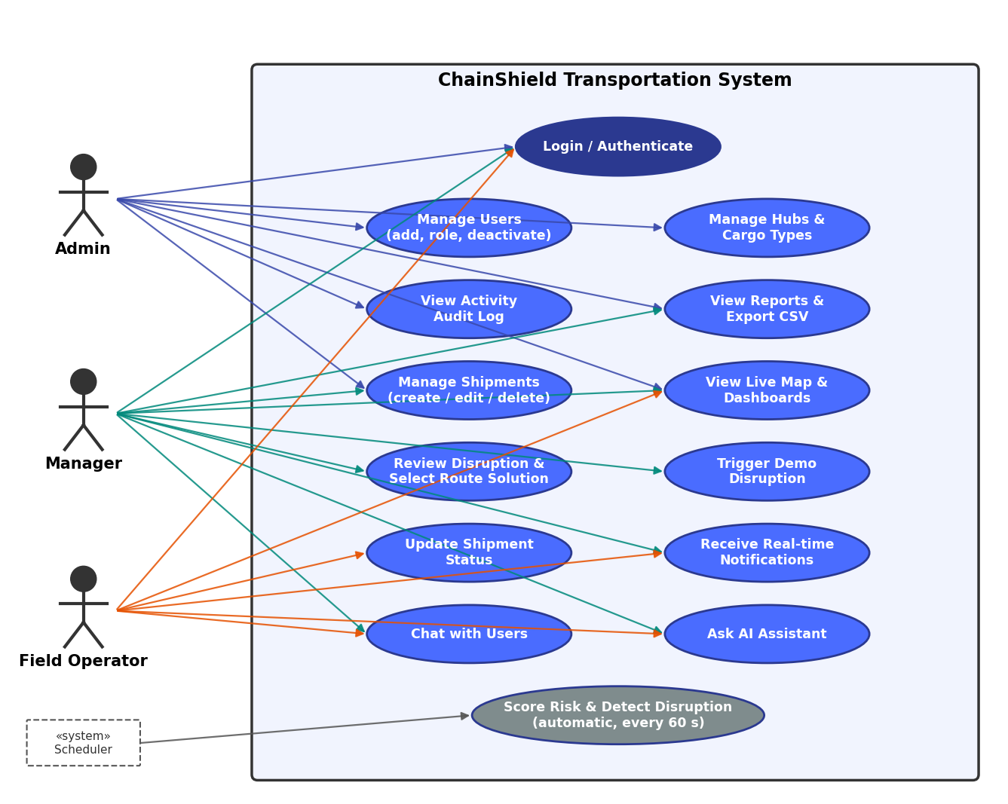
SYSTEM DESIGN
Use case diagram
ChainShield Transportation System | MCA Semester 3 | Group 59
7
Notes:
Three roles — Admin, Manager, Field Operator — each with a distinct set of use cases inside the system boundary.

Slide 8
CORE COMPONENTS
What ChainShield does
RE
Risk Engine
RS
Route Solver
NC
Notify & Chat
Scores every shipment on a recurring schedule
Hold / hub reroute / mode switch, ranked by risk, time & cost
Real-time alerts and chat over WebSockets
AP
Admin & Reports
AI
AI Assistant
LM
Live Map
Users, hubs, cargo, audit log and CSV reports
Gemini Q&A grounded in live data, offline fallback
Live positions, routes and disruption zones
ChainShield Transportation System | MCA Semester 3 | Group 59
8
Notes:
Six core components map directly to the six service/blueprint modules in the codebase.

Slide 9
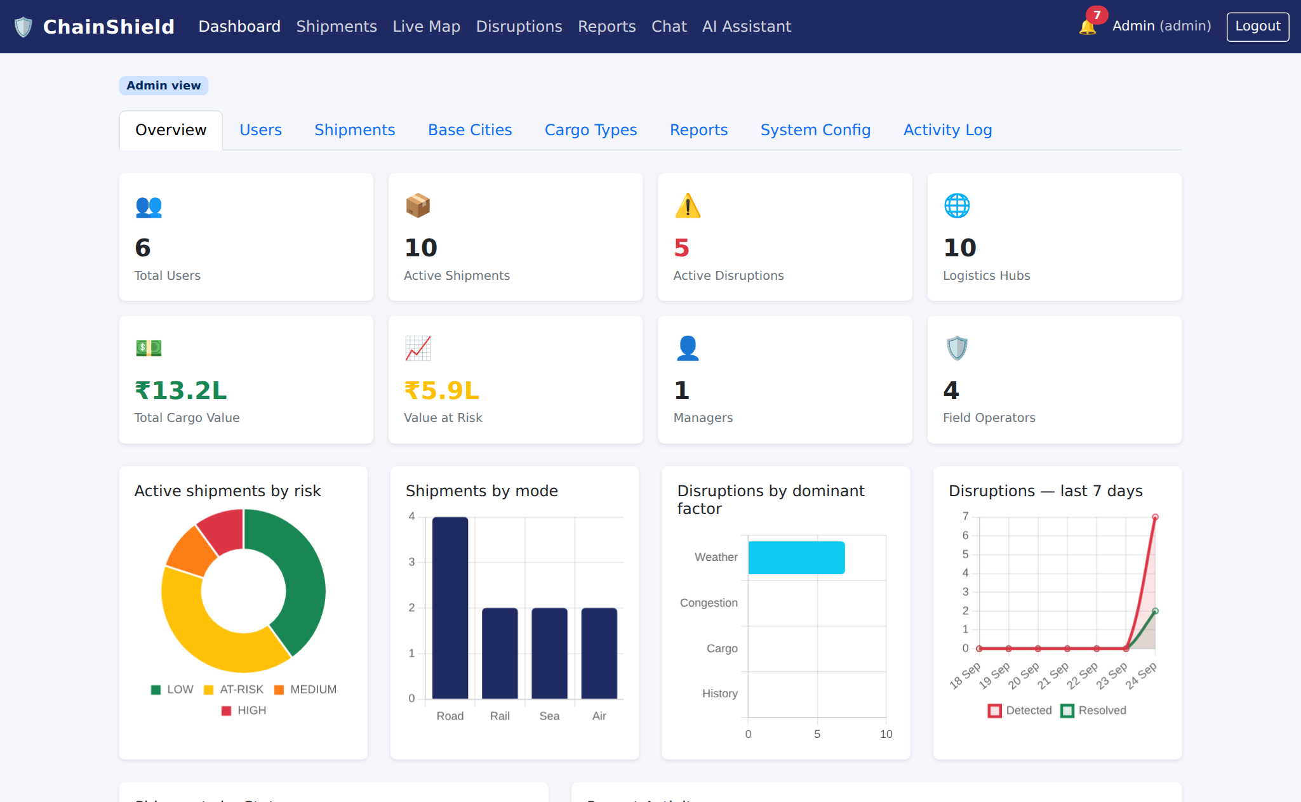
LIVE DEMO
Admin dashboard — live KPIs and charts
ChainShield Transportation System | MCA Semester 3 | Group 59
9

Slide 10
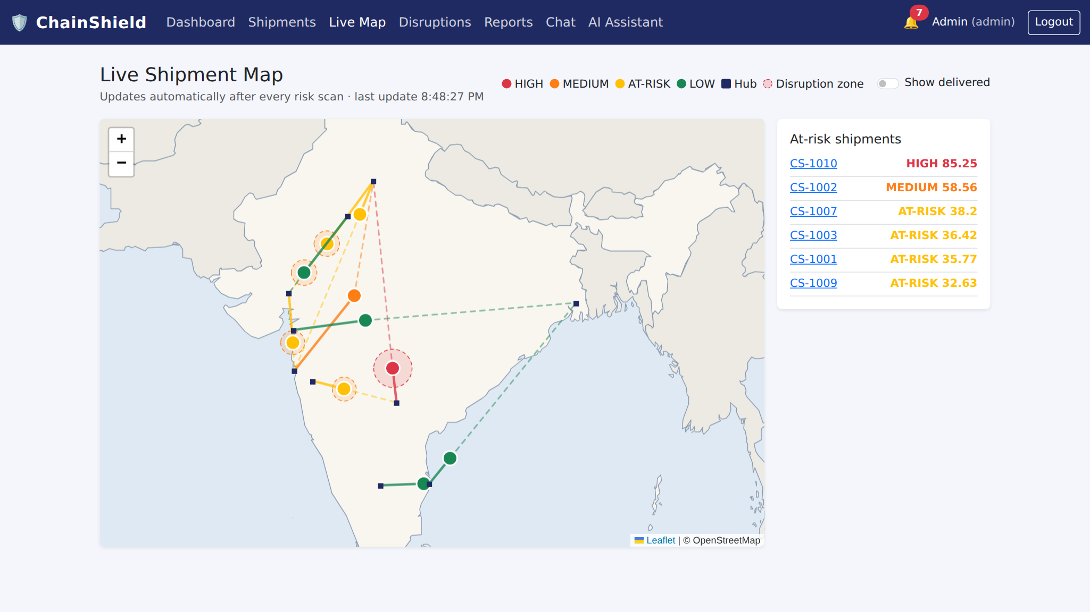
LIVE DEMO
Live shipment map with disruption zones
ChainShield Transportation System | MCA Semester 3 | Group 59
10

Slide 11
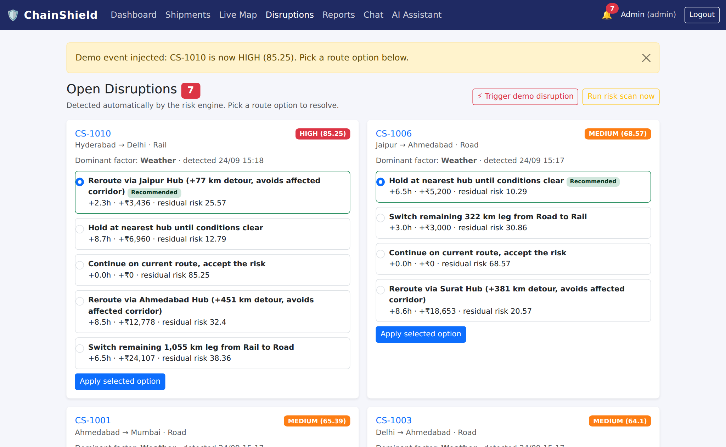
LIVE DEMO
Disruptions with ranked route options
ChainShield Transportation System | MCA Semester 3 | Group 59
11

Slide 12
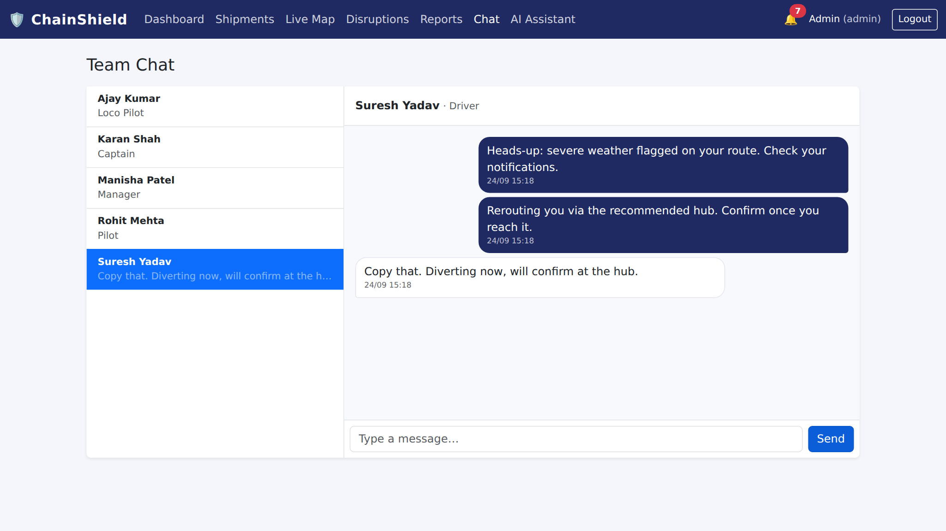
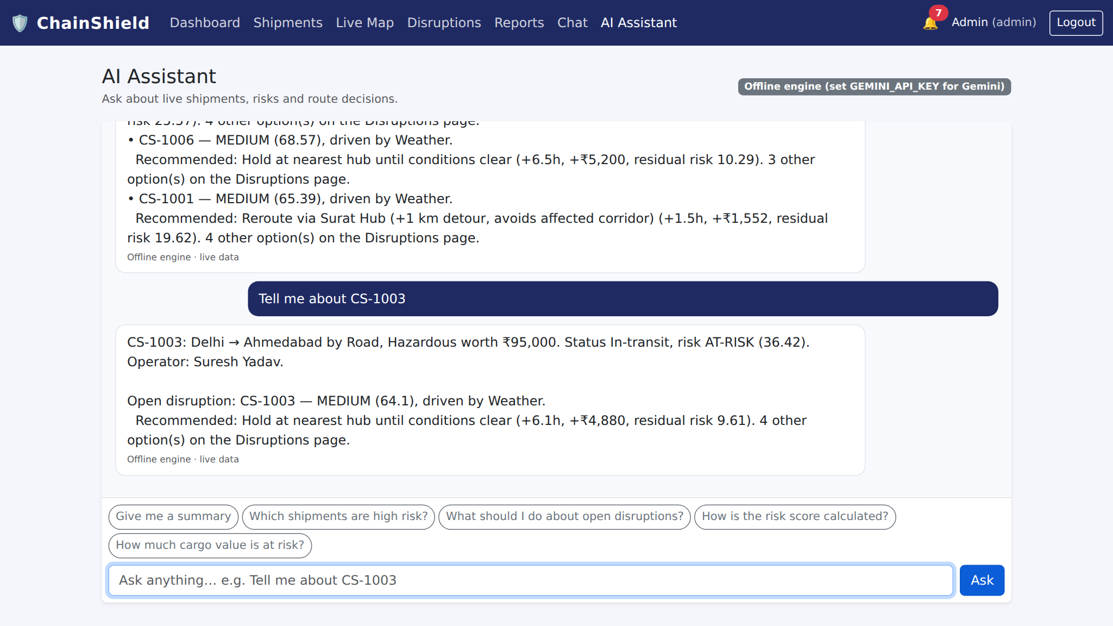
LIVE DEMO
Real-time chat and AI assistant
ChainShield Transportation System | MCA Semester 3 | Group 59
12

Slide 13
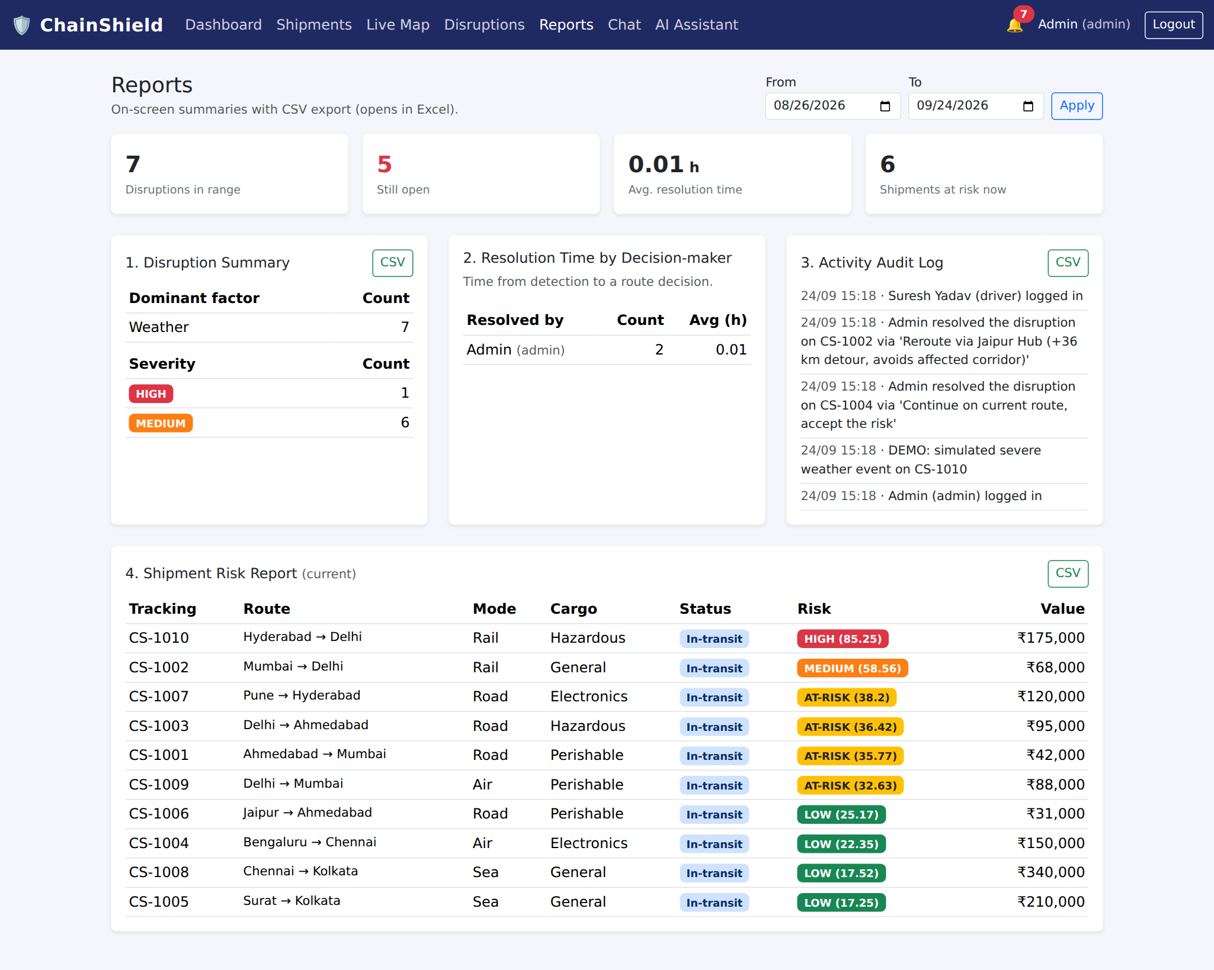
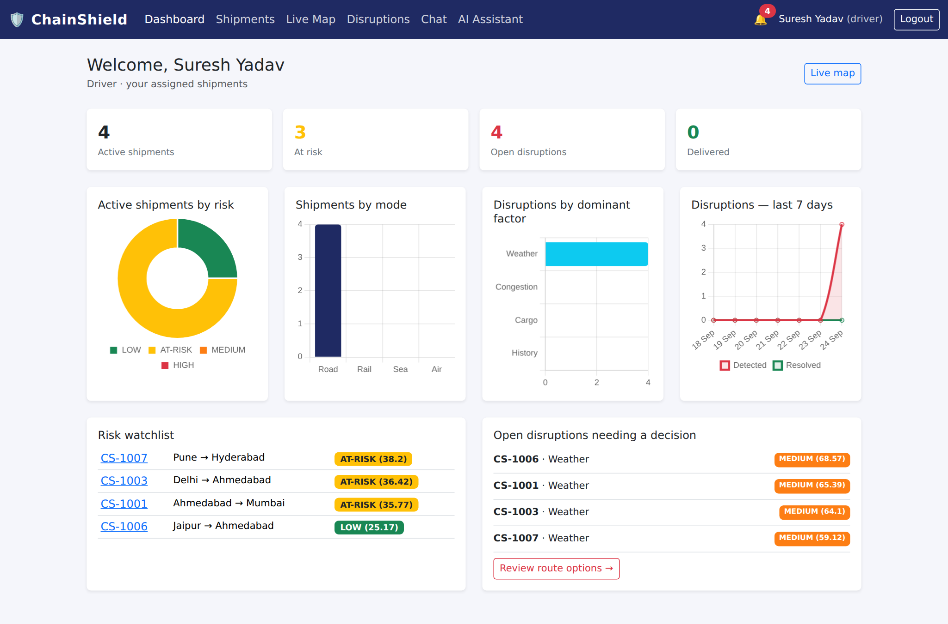
LIVE DEMO
Reports and role-based dashboards
ChainShield Transportation System | MCA Semester 3 | Group 59
13

Slide 14
TECHNOLOGY
Technology stack
BACKEND
FRONTEND
DATA & INFRA
EXTERNAL APIS
Python 3.10
Flask
Flask-SQLAlchemy
Flask-Login
Flask-SocketIO
APScheduler
Jinja2 Templates
Bootstrap 5
JavaScript
Leaflet.js
Chart.js
SQLite
Docker
Docker Compose
Gunicorn + eventlet
Google Gemini API
OpenWeatherMap API
ChainShield Transportation System | MCA Semester 3 | Group 59
14
Notes:
Same stack confirmed for the rebuild: Flask + SQLite + Docker, kept deliberately simple and self-contained for an academic build.

Slide 15
PROGRESS
Project status — all milestones complete
✓
Requirement Analysis & System Design
DONE
✓
Environment Setup & Docker
DONE
✓
Authentication & Role-based Access
DONE
✓
Risk Engine, Route Solver & Disruptions
DONE
✓
Dashboards, Live Map, Chat & AI Assistant
DONE
✓
Reports, Testing (101 checks) & Docker Deploy
DONE
ChainShield Transportation System | MCA Semester 3 | Group 59
15
Notes:
Three milestones complete — documentation, environment/Docker, and authentication. Next: the risk engine and the three role-based dashboards.

Slide 16
TESTING
Test results — 101 automated checks, 0 failures
✓
Auth, roles & account deactivation
PASS
✓
Risk formula, disruption creation & escalation
PASS
✓
Route solver ranking & resolution alerts
PASS
✓
Real-time notifications & chat (Socket.IO)
PASS
✓
Reports, CSV export, admin CRUD, demo mode
PASS
✓
Docker build & run (Gunicorn + eventlet)
PASS
ChainShield Transportation System | MCA Semester 3 | Group 59
16

Slide 17
CONCLUSION
From reactive tracking to preemptive logistics
ChainShield turns scattered weather, congestion, cargo, and history signals into one transparent risk score per shipment — and pairs every detected disruption with a ranked, actionable route solution, so delays are caught before they cascade.
4
20
101
60s
Weighted risk factors
Functional requirements
Automated checks passed
Risk scan interval
ChainShield Transportation System | MCA Semester 3 | Group 59
17
Notes:
Close on the headline reframing — reactive to preemptive — backed by four quick stats that summarise the system's scope.

Slide 18
Thank You
Questions & Discussion
Bhavik A. Visani · Diya Shah · Shruti Somani
Group No. 59 | Guided by Prof. Dhaval Shah
Notes:
Invite questions from the guide.

