Slide 1
A PROJECT REPORT ON · MCA SEMESTER 3 · 2026-27
ChainShield Transportation System
Real-Time Disruption Prediction & Route Optimisation for Logistics
Prepared By (Group No. 59)
Bhavik A. Visani (D51 – 25004401110170)
Diya Shah (D36 – 25003401110017)
Shruti Somani (D42 – 25004401110259)
Guided By
Prof. Dhaval Shah
LJ Institute of Computer Application | Affiliated to LJK University

Slide 2
CONTENTS
Index
1
Introduction
5
Testing
Problem Definition · Objective of the New System · Core Components · Project Profile · Need of the New System · Scope of the New System · Advantages and Limitations of the Proposed System · Proposed Time Line Chart · Targeted Users
Test Cases
2
Requirement Determination and Analysis
6
Proposed Enhancement
Requirement Determination · Requirement Specification
3
System Design
7
Conclusion
Use Case Diagram · Data Dictionary · User Interface Design · Report Design
4
Development
8
Bibliography
Coding Standards · Implementation Details · Output Screens
ChainShield Transportation System | MCA Semester 3 | Group No. 59
2

Slide 3
1. INTRODUCTION
1.1 Problem Definition
Hundreds of shipments move at once across road, rail, sea and air
Exposed to weather, hub/port congestion, customs holds, breakdowns, sensitive cargo
Disruptions are noticed only after the delivery date has slipped
Manual tracking — phone calls, spreadsheets, e-mail
Late detection → fewer route options, higher recovery cost, lost trust
No system scores risk continuously and recommends a corrective route in advance
ChainShield Transportation System | MCA Semester 3 | Group No. 59
3

Slide 4
1. INTRODUCTION
1.2 Objective of the New System
Continuously analyse weather, congestion, cargo and history for every shipment
Detect disruptions early with a transparent weighted risk score
Auto-generate ranked route options: hold, hub reroute, mode switch
Notify managers and field operators in real time
Role-based dashboards for Admin, Manager and Field Operator
Low-cost, self-hosted deployment with Flask + Docker
ChainShield Transportation System | MCA Semester 3 | Group No. 59
4

Slide 5
1. INTRODUCTION
1.3 Core Components
Risk Engine — 4-factor score every 60 s
Disruption Manager — opens at MEDIUM, escalates at HIGH
Route Solver — hold / hub reroute / mode switch, ranked
Notifications & Chat — real-time over Socket.IO
Admin Panel & Reports — users, hubs, cargo, audit log, CSV
AI Assistant — Gemini with offline fallback
Live Map — positions, routes, disruption zones
ChainShield Transportation System | MCA Semester 3 | Group No. 59
5

Slide 6
1. INTRODUCTION
1.4 Project Profile
Particulars | Details
Project Title | ChainShield Transportation System
Group | Group No. 59
Team Members | Bhavik A. Visani (D51) · Diya Shah (D36) · Shruti Somani (D42)
Guide | Prof. Dhaval Shah
Domain | Logistics & Supply Chain Management
Front End | HTML5, CSS3, Bootstrap 5, Jinja2, JavaScript, Leaflet.js, Chart.js
Back End / DB | Python 3.10, Flask, Flask-SQLAlchemy / SQLite
Tools & APIs | Socket.IO, APScheduler, Gemini API, OpenWeatherMap, Docker, Git
Duration | Aug 2026 – Nov 2026 (Semester 3)
ChainShield Transportation System | MCA Semester 3 | Group No. 59
6

Slide 7
1. INTRODUCTION
1.5 Need of the New System
Reactive monitoring — problems found after complaints
Tracking shows location, not upcoming risk
Weather, congestion, cargo and history data in silos
Rerouting based on guesswork, not data
Operators informed late by phone or radio
No audit trail of decisions
ChainShield Transportation System | MCA Semester 3 | Group No. 59
7

Slide 8
1. INTRODUCTION
1.6 Scope of the New System
In scope
Out of scope
Risk scoring of every active shipment
Live GPS / telematics hardware
Auto disruption + ranked route solutions
Payment, billing and SLA modules
Manager, operator and admin dashboards
Multi-tenant (many companies)
Shipment CRUD with validation
Reports with date filter + CSV export
AI assistant and live map
Demo mode for presentations
ChainShield Transportation System | MCA Semester 3 | Group No. 59
8

Slide 9
1. INTRODUCTION
1.7 Advantages and Limitations of the Proposed System
Advantages
Limitations
Preemptive, not reactive
Near-real-time (60 s interval)
Transparent weighted scoring
Public / simulated data feeds
Operator notified within seconds
SQLite — single server only
Role-based views, less overload
AI answers are advisory
Cheap, portable Docker deployment
ChainShield Transportation System | MCA Semester 3 | Group No. 59
9

Slide 10
1. INTRODUCTION
1.8 Proposed Time Line Chart
Sr. | Phase | Aug 2026 |  |  |  | Sep 2026 |  |  |  | Oct 2026 |  |  |  | Nov 2026
 |  | W1 | W2 | W3 | W4 | W1 | W2 | W3 | W4 | W1 | W2 | W3 | W4 | W1 | W2 | W3 | W4
1 | Requirement Gathering (R.G.)
2 | Requirement Analysis & SRS
3 | System Design (Use Case, DB, UI)
4 | Environment & Docker Setup
5 | Coding / Development
6 | UI Enhancement (Themes, Mobile)
7 | Testing
8 | Implementation / Deployment
9 | Documentation
10 | Final Review, Submission & Viva
W1 = days 1–7 · W2 = 8–14 · W3 = 15–21 · W4 = 22 to month-end · Documentation runs through every phase
ChainShield Transportation System | MCA Semester 3 | Group No. 59
10

Slide 11
1. INTRODUCTION
1.9 Targeted Users
Administrator — users & roles, hubs, cargo types, config, audit log; all manager rights
Manager — creates shipments, reviews disruptions, applies route solution, reports, AI
Field Operators — Driver (road), Loco Pilot (rail), Pilot (air), Captain (sea)
Operators see only their shipments, update status, get instant route alerts, chat
Scheduler (system actor) — scans risk every 60 s, opens disruptions, sends alerts
Indirect — customers, partners and management benefit from fewer delays
ChainShield Transportation System | MCA Semester 3 | Group No. 59
11

Slide 12
2. REQUIREMENT DETERMINATION AND ANALYSIS
2.1 Requirement Determination
Sources: group discussion, study of manual tracking, analysis of user roles
Login required for every user
Continuous, automatic risk evaluation
Auto disruption at MEDIUM (≥ 50), escalation at HIGH (≥ 70)
≥ 3 ranked route alternatives per disruption
Instant notification to field operators
Admin management + audit trail; demo mode
ChainShield Transportation System | MCA Semester 3 | Group No. 59
12

Slide 13
2. REQUIREMENT DETERMINATION AND ANALYSIS
2.2 Requirement Specification
Functional
Non-Functional
Platform
Login + role-based access
Performance — refresh ≤ 60 s
Python 3.10 + Flask
Shipment CRUD
Usability — responsive, themes
SQLite
Scheduled risk scoring
Portability — Docker
Bootstrap 5, Leaflet, Chart.js
Auto disruption alerts
Reliability — transactional
Docker + Gunicorn
Ranked route solutions
Real-time notifications & chat
Security — hashing, CSRF, roles
Gemini + OpenWeatherMap
Admin CRUD + audit log
Maintainability — blueprints
Windows 11 / any Docker OS
AI assistant, reports + CSV, live map
ChainShield Transportation System | MCA Semester 3 | Group No. 59
13

Slide 14
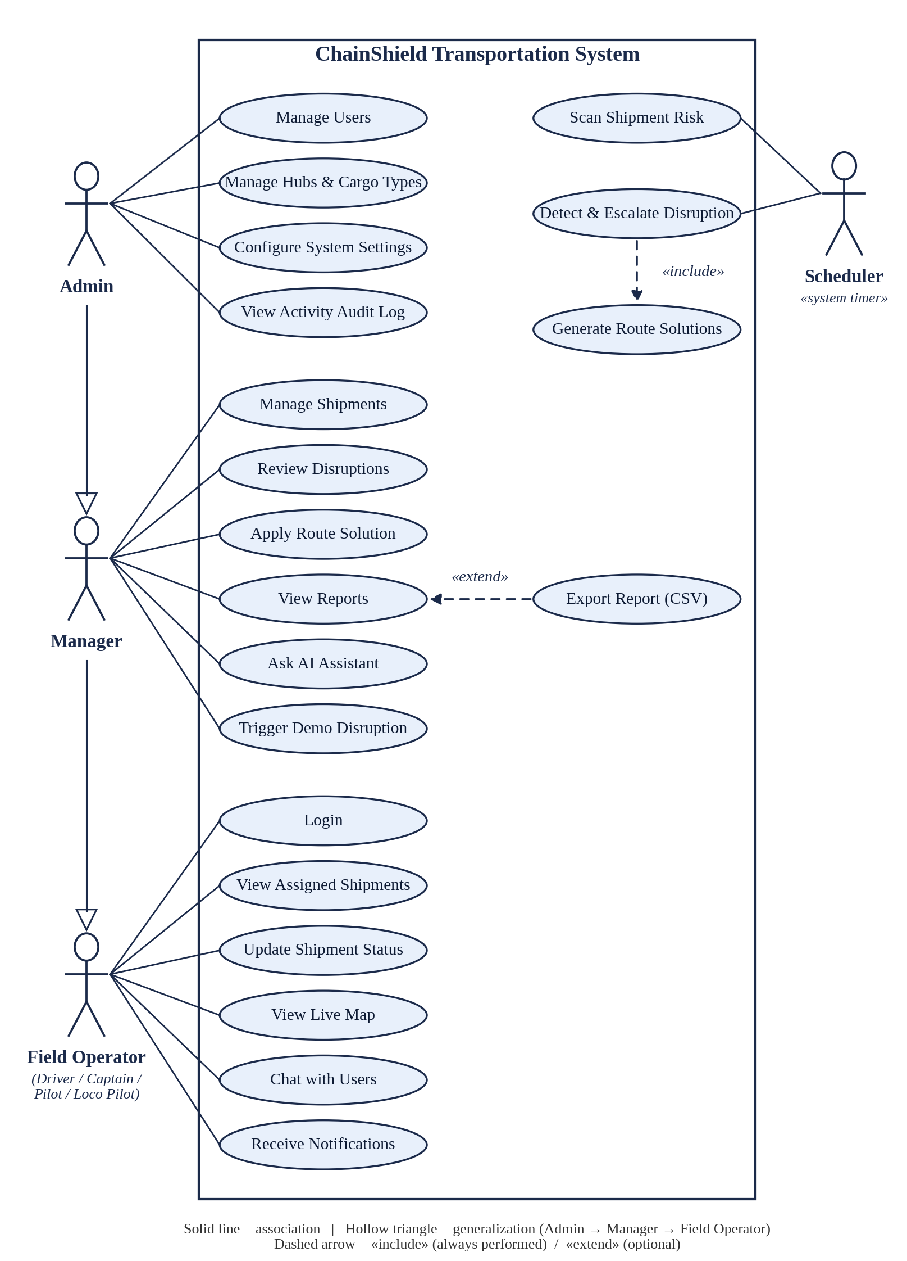
3. SYSTEM DESIGN
3.1 Use Case Diagram
Actors: Admin, Manager, Field Operator, Scheduler
Generalization: Admin → Manager → Field Operator (inherits use cases)
«include»: Detect & Escalate Disruption → Generate Route Solutions (always)
«extend»: Export Report (CSV) → View Reports (optional)
Straight lines, no overlapping
ChainShield Transportation System | MCA Semester 3 | Group No. 59
14

Slide 15

3. SYSTEM DESIGN
3.1 System Architecture
ChainShield Transportation System | MCA Semester 3 | Group No. 59
15

Slide 16
3. SYSTEM DESIGN
3.2 Data Dictionary (1/4) — Sample record: id = 1
Table: users
Table: hubs
Table: cargo_types
Field Name | Type (Size) | Sample (id = 1)
id | INTEGER | 1
name | VARCHAR(100) | Admin
email | VARCHAR(100) | admin@chainshield.com
password_hash | VARCHAR(255) | scrypt:32768:8:1$jCqB…
role | VARCHAR(20) | admin
phone | VARCHAR(20) | NULL
is_active | BOOLEAN | 1
created_at | DATETIME | 2026-08-25 03:48:26
Field Name | Type (Size) | Sample (id = 1)
id | INTEGER | 1
name | VARCHAR(100) | Ahmedabad Hub
location | VARCHAR(150) | Ahmedabad, Gujarat
lat | FLOAT | 23.0225
lng | FLOAT | 72.5714
Field Name | Type (Size) | Sample (id = 1)
id | INTEGER | 1
name | VARCHAR(50) | General
sensitivity_weight | FLOAT | 0.3
ChainShield Transportation System | MCA Semester 3 | Group No. 59
16

Slide 17
3. SYSTEM DESIGN
3.2 Data Dictionary (2/4) — Sample record: id = 1
Table: shipments — Every shipment with its route, cargo, assigned operator, live position and current risk.
Field Name | Data Type (Size) | Constraint | Sample (id = 1)
id | INTEGER | PRIMARY KEY | 1
tracking_no | VARCHAR(30) | NOT NULL, UNIQUE | CS-1001
origin | VARCHAR(100) | NULL | Ahmedabad
destination | VARCHAR(100) | NULL | Mumbai
cargo_type_id | INTEGER | FOREIGN KEY → cargo_types(id), NULL | 2 (Perishable)
transport_mode | VARCHAR(20) | NULL | Road
status | VARCHAR(20) | DEFAULT 'In-transit' | In-transit
current_lat | FLOAT | NULL | 22.30
current_lng | FLOAT | NULL | 72.62
risk_score | FLOAT | DEFAULT 0.0, range 0 – 100 | 0.0
risk_level | VARCHAR(15) | DEFAULT 'LOW' | LOW
cargo_value | FLOAT | DEFAULT 0.0 | 42000.00
assigned_operator_id | INTEGER | FOREIGN KEY → users(id), NULL | 8 (Suresh Yadav, driver)
hub_id | INTEGER | FOREIGN KEY → hubs(id), NULL | 1 (Ahmedabad Hub)
created_at | DATETIME | DEFAULT current date-time (UTC) | 2026-09-07 06:24:35
ChainShield Transportation System | MCA Semester 3 | Group No. 59
17

Slide 18
3. SYSTEM DESIGN
3.2 Data Dictionary (3/4) — Sample record: id = 1
Table: disruptions
Table: route_solutions
Field Name | Type (Size) | Sample (id = 1)
id | INTEGER | 1
shipment_id | INTEGER | 3 (CS-1003)
type | VARCHAR(30) | Cargo
severity | VARCHAR(15) | HIGH
risk_score | FLOAT | 79.69
status | VARCHAR(15) | Resolved
detected_at | DATETIME | 2026-10-10 20:06:57
resolved_at | DATETIME | 2026-10-11 05:45:02
resolved_by | INTEGER | 1 (Admin)
Field Name | Type (Size) | Sample (id = 1)
id | INTEGER | 1
disruption_id | INTEGER | 1
option_no | INTEGER | 1
description | TEXT | Reroute via Jaipur Hub (+0 km detour, avoids affected corridor)
extra_time_hours | FLOAT | 1.5
extra_cost | FLOAT | 1501.22
risk_score | FLOAT | 23.91
selected | BOOLEAN | 0
ChainShield Transportation System | MCA Semester 3 | Group No. 59
18

Slide 19
3. SYSTEM DESIGN
3.2 Data Dictionary (4/4) — Sample record: id = 1
Table: notifications
Table: messages
Table: activity_log
Field Name | Type (Size) | Sample (id = 1)
id | INTEGER | 1
user_id | INTEGER | 1 (Admin)
message | VARCHAR(255) | MEDIUM risk on CS-1003 (Delhi → Ahmedabad) — Cargo, score 56.53. Route options ready.
is_read | BOOLEAN | 0
created_at | DATETIME | 2026-10-10 20:06:57
Field Name | Type (Size) | Sample (id = 1)
id | INTEGER | 1
sender_id | INTEGER | 8 (Suresh Yadav)
receiver_id | INTEGER | 1 (Admin)
chat_id | VARCHAR(10) | 1-8
content | TEXT | Hello
sent_at | DATETIME | 2026-09-24 13:22:49
Field Name | Type (Size) | Sample (id = 1)
id | INTEGER | 1
user_id | INTEGER | 1 (Admin)
action | VARCHAR(255) | Admin resolved the disruption on CS-1002 via 'Hold at current hub until conditions clear'
timestamp | DATETIME | 2026-09-07 07:15:49
ChainShield Transportation System | MCA Semester 3 | Group No. 59
19

Slide 20
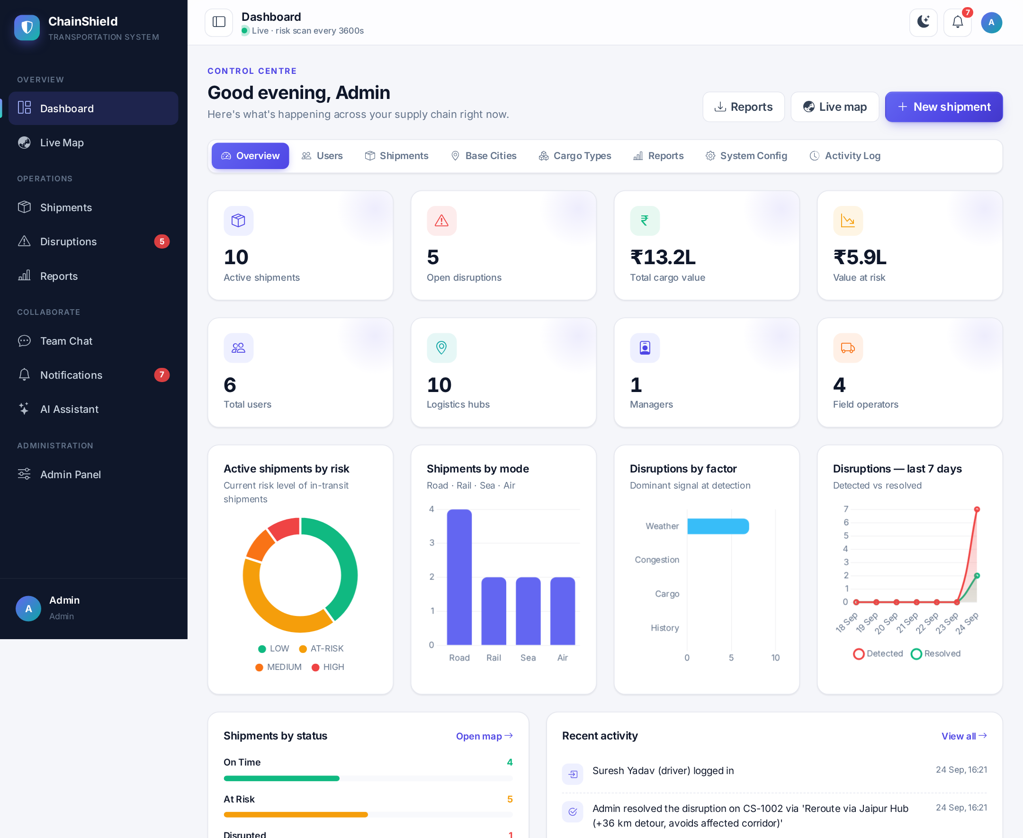
3. SYSTEM DESIGN
3.3 User Interface Design
Jinja2 + Bootstrap 5 with a custom design system
Shared shell: collapsible sidebar, top bar, notification bell
Fixed risk colours: LOW green, AT-RISK amber, MEDIUM orange, HIGH red
Light / dark themes, fully responsive
Admin panel tabs: Overview, Users, Shipments, Base Cities, Cargo, Reports, Config, Activity Log
Admin Panel — Overview Dashboard
ChainShield Transportation System | MCA Semester 3 | Group No. 59
20

Slide 21
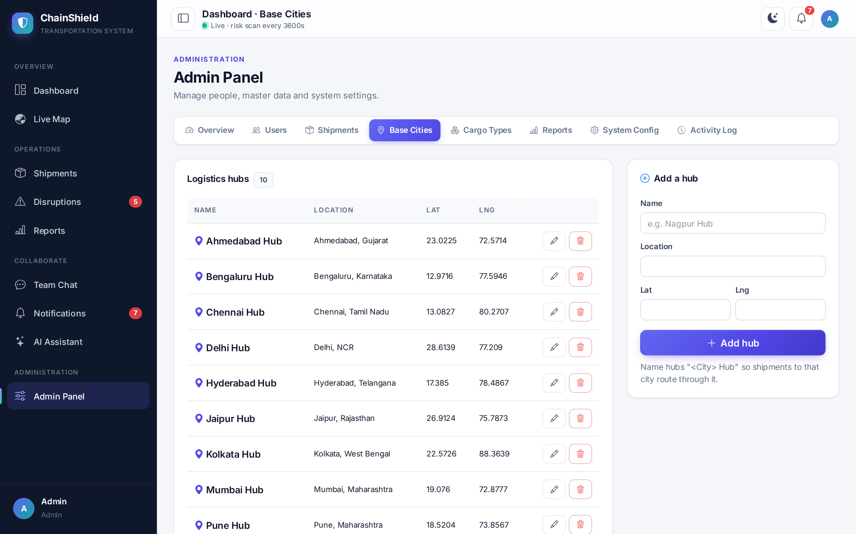
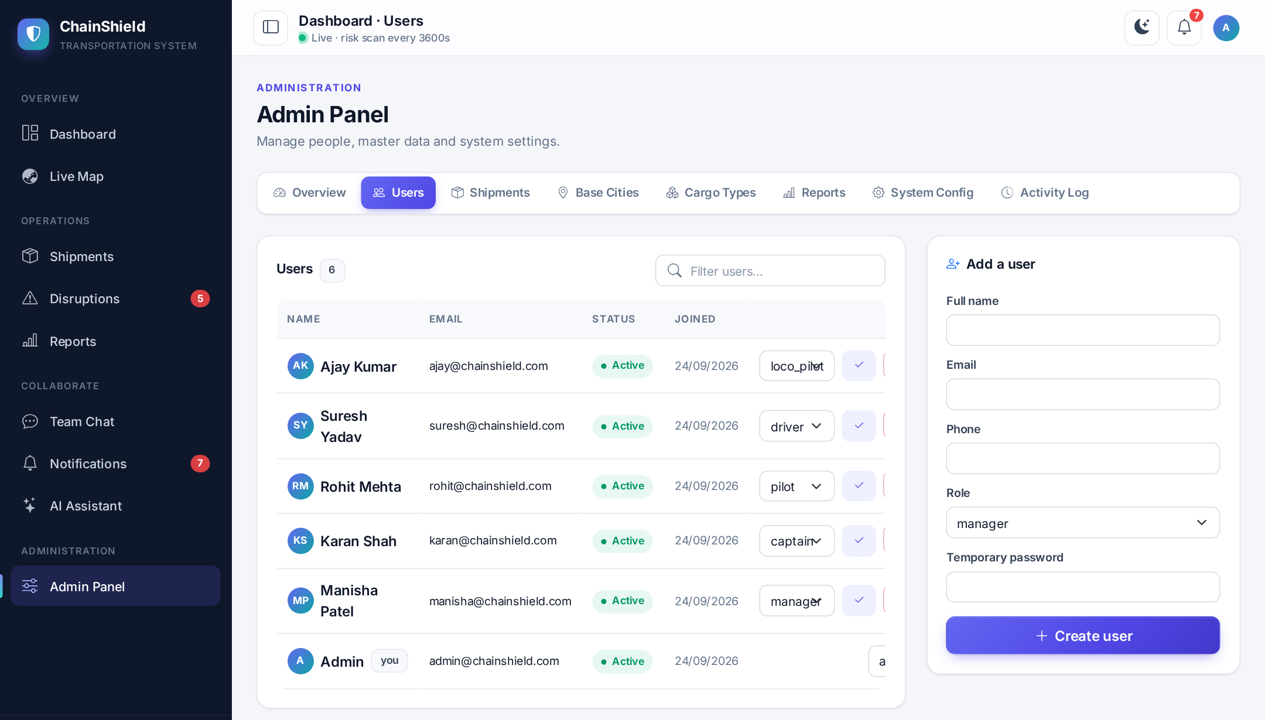
3. SYSTEM DESIGN
3.3 User Interface Design — Admin Panel
Admin Panel — User Management
Admin Panel — Logistics Hubs
ChainShield Transportation System | MCA Semester 3 | Group No. 59
21

Slide 22
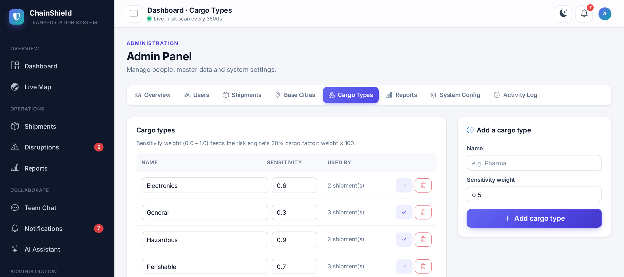
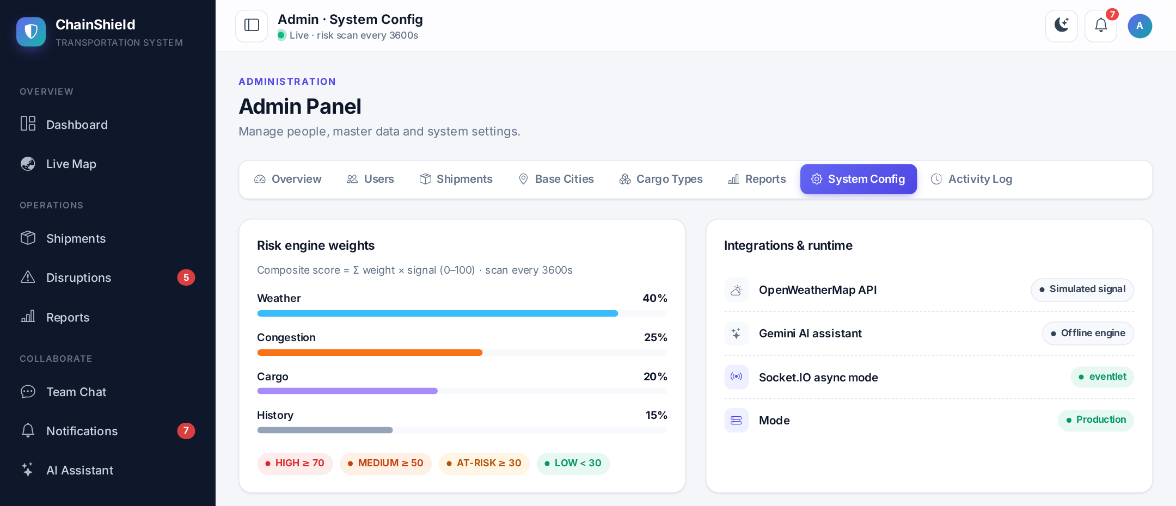
3. SYSTEM DESIGN
3.3 User Interface Design — Admin Panel
Admin Panel — Cargo Types
Admin Panel — System Configuration
ChainShield Transportation System | MCA Semester 3 | Group No. 59
22

Slide 23
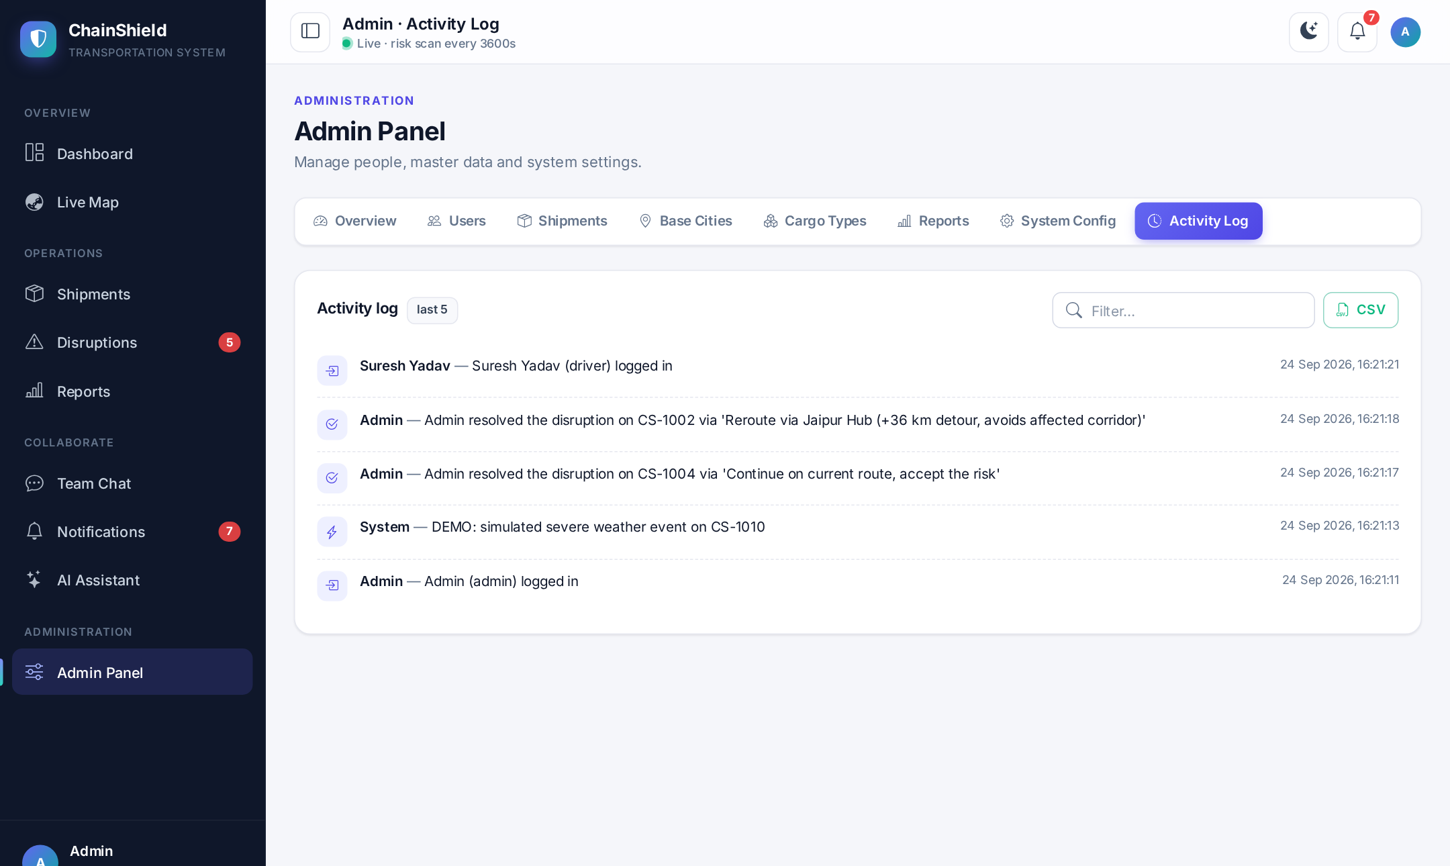
3. SYSTEM DESIGN
3.3 User Interface Design — Admin Panel
Admin Panel — Activity Audit Log
ChainShield Transportation System | MCA Semester 3 | Group No. 59
23

Slide 24

3. SYSTEM DESIGN
3.4 Report Design
Available to Admin and Manager
From – To date-range filter
1. Disruption Summary (CSV)
2. Resolution Time per decision-maker
3. Activity Audit Log (CSV)
4. Shipment Risk (CSV)
CSV opens directly in Excel
ChainShield Transportation System | MCA Semester 3 | Group No. 59
24

Slide 25
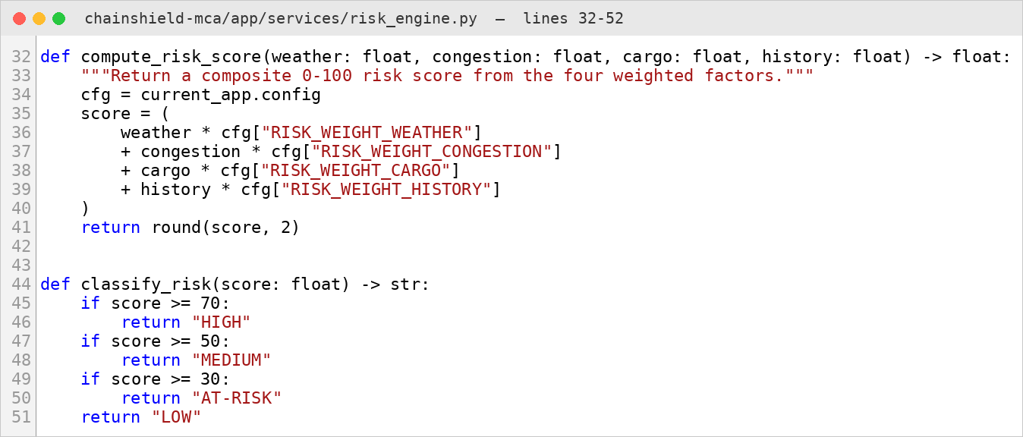
4. DEVELOPMENT
4.1 Coding Standards (1/9)
1. PEP 8 Naming, Type Hints and Docstrings
All Python code follows PEP 8: 4-space indentation, snake_case for functions and variables, PascalCase for classes and UPPER_CASE for constants.
Functions carry type hints and a docstring, so every member of the group can read and review another member's code without explanation.
Example: compute_risk_score() and classify_risk() in app/services/risk_engine.py; the constant ALERT_LEVELS; the class RouteSolution in app/models.py.
Screenshot — Naming, type hints and docstring in the risk engine
ChainShield Transportation System | MCA Semester 3 | Group No. 59
25

Slide 26
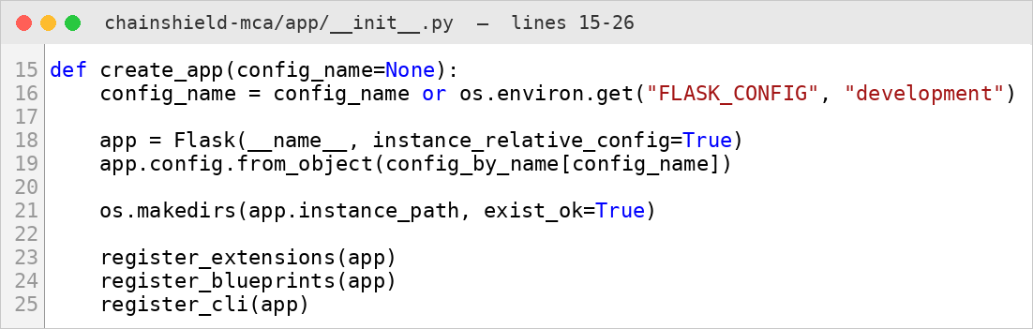
4. DEVELOPMENT
4.1 Coding Standards (2/9)
2. Application Factory Pattern
The Flask application is never created at import time; create_app() builds it from a named configuration (development, testing or production).
This lets the same code run on a laptop, inside the automated tests and inside Docker, each with its own settings.
Screenshot — create_app() in app/__init__.py
Example: create_app("testing") gives the test suite a fresh in-memory database, while Docker calls create_app("production").
ChainShield Transportation System | MCA Semester 3 | Group No. 59
26

Slide 27
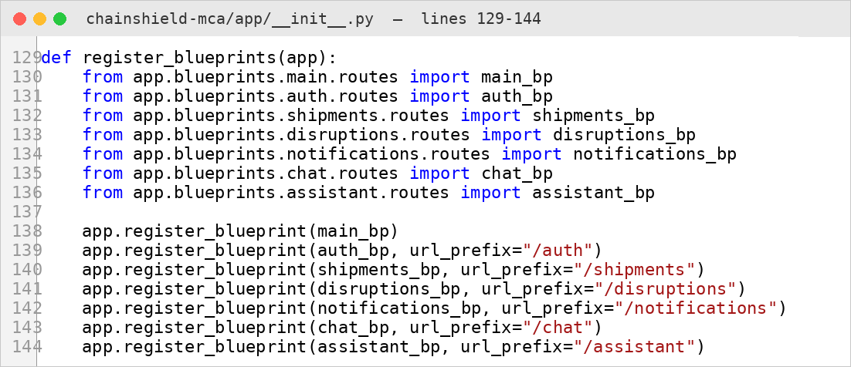
4. DEVELOPMENT
4.1 Coding Standards (3/9)
3. Modular Blueprint Structure
Each feature lives in its own Flask blueprint with its own URL prefix, routes and templates.
A feature can therefore be changed, tested or disabled without touching the others.
Example: shipments_bp serves everything under /shipments, disruptions_bp under /disruptions and chat_bp under /chat.
Screenshot — Blueprint registration in app/__init__.py
ChainShield Transportation System | MCA Semester 3 | Group No. 59
27

Slide 28
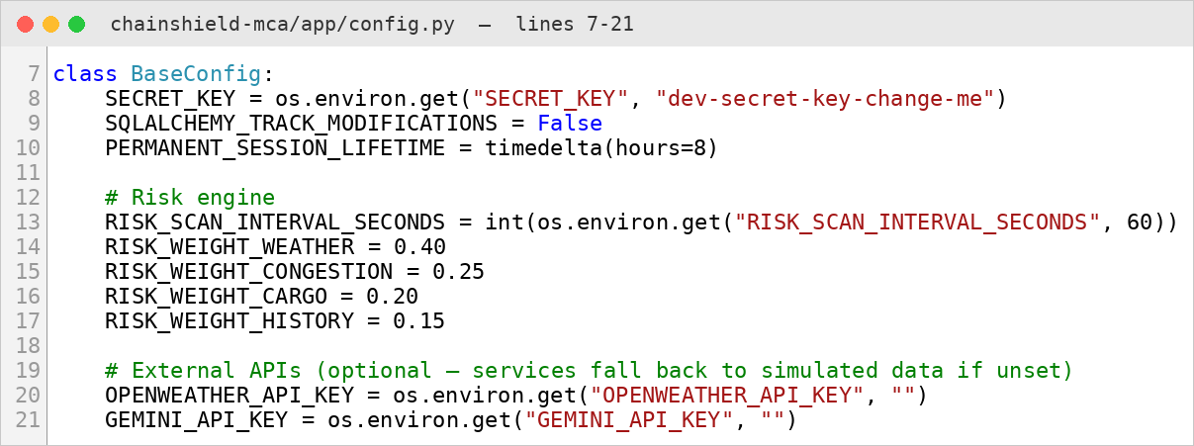
4. DEVELOPMENT
4.1 Coding Standards (4/9)
4. Single Source of Configuration — No Hard-coded Secrets
Risk weights, the scan interval and model names are defined once in app/config.py; API keys and the secret key are read from a .env file.
The .env file is excluded from Git and Docker, so no password or key is ever committed to the repository.
Example: RISK_WEIGHT_WEATHER = 0.40 is read by the risk engine; GEMINI_API_KEY = os.environ.get("GEMINI_API_KEY", "").
Screenshot — Centralised settings in app/config.py
ChainShield Transportation System | MCA Semester 3 | Group No. 59
28

Slide 29
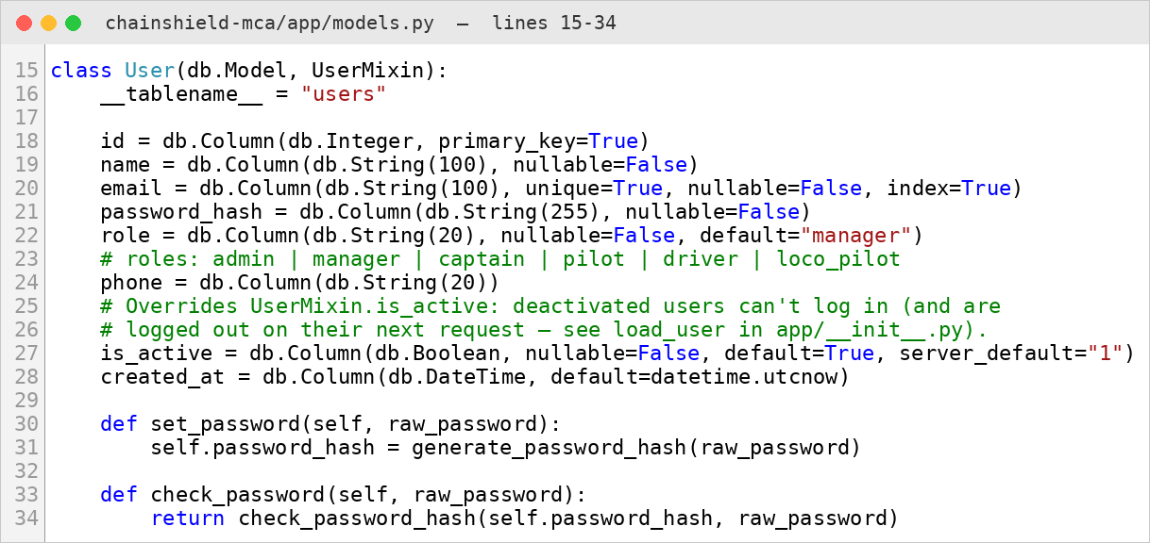
4. DEVELOPMENT
4.1 Coding Standards (5/9)
5. ORM Models Instead of Raw SQL
All nine tables are Python classes in app/models.py, and every query goes through Flask-SQLAlchemy.
Queries are parameterised automatically, which prevents SQL injection, and the database can be moved to PostgreSQL by changing only DATABASE_URL.
Example: User.query.filter_by(email=form.email.data).first() instead of a hand-written SELECT statement.
Screenshot — The User model with password hashing helpers
ChainShield Transportation System | MCA Semester 3 | Group No. 59
29

Slide 30
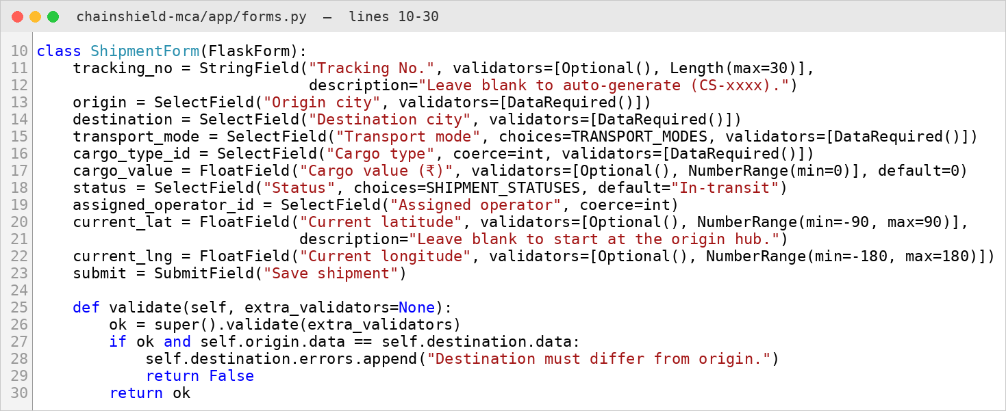
4. DEVELOPMENT
4.1 Coding Standards (6/9)
6. Server-side Form Validation
Every form is validated on the server with Flask-WTF before anything is saved, because browser-side checks can be bypassed.
Business rules that span two fields are written in a validate() method of the form class.
Example: ShipmentForm rejects a shipment whose destination equals its origin and any latitude outside −90 to 90.
Screenshot — ShipmentForm in app/forms.py
ChainShield Transportation System | MCA Semester 3 | Group No. 59
30

Slide 31
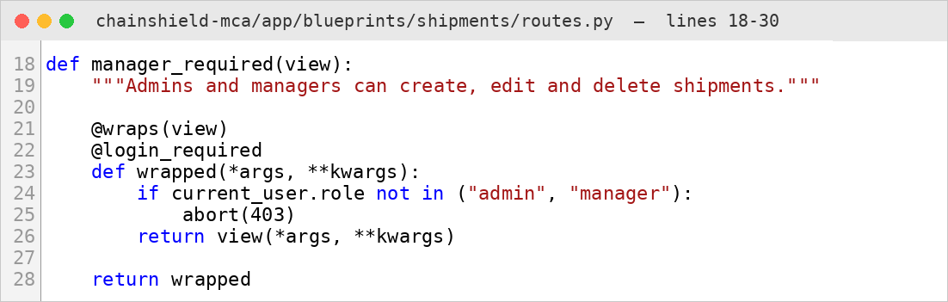
4. DEVELOPMENT
4.1 Coding Standards (7/9)
7. Security by Default — Role Decorators
Access rules are written once as decorators and placed on top of each route, so no page can forget its permission check.
Together with CSRF tokens on every form, Werkzeug password hashing and Jinja2 auto-escaping, this protects against the common web attacks.
Screenshot — manager_required decorator in the shipments blueprint
Example: @manager_required on /shipments/new returns 403 Forbidden to drivers, pilots, captains and loco pilots.
ChainShield Transportation System | MCA Semester 3 | Group No. 59
31

Slide 32
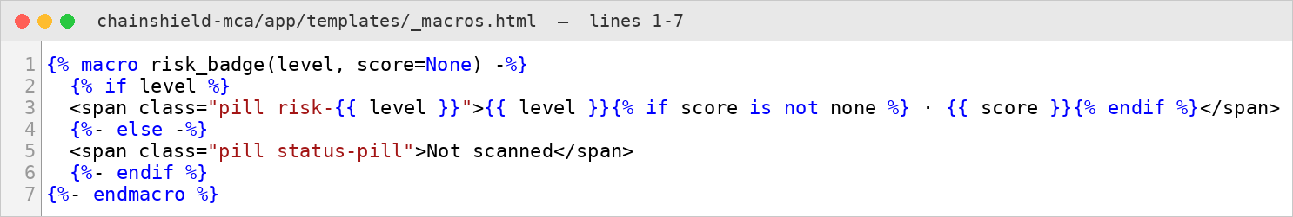
4. DEVELOPMENT
4.1 Coding Standards (8/9)
8. Template Inheritance and Reusable Macros
base.html defines the sidebar, top bar and scripts once, and every page only fills its content block.
Repeated interface pieces are Jinja2 macros, so a design change is made in exactly one place.
Screenshot — risk_badge macro in app/templates/_macros.html
Example: {{ risk_badge(s.risk_level, s.risk_score) }} draws the same coloured risk pill on the dashboard, shipment list and map pop-ups.
ChainShield Transportation System | MCA Semester 3 | Group No. 59
32

Slide 33
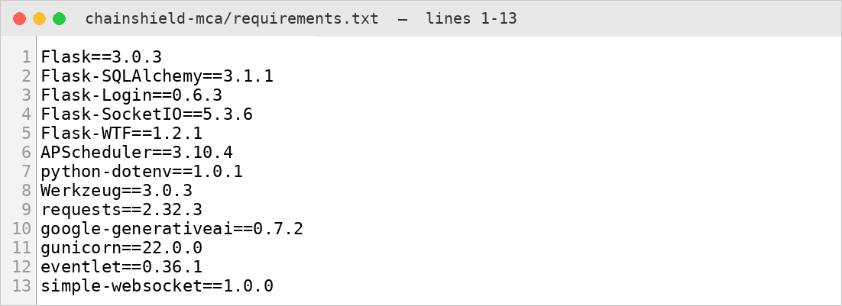
4. DEVELOPMENT
4.1 Coding Standards (9/9)
9. Version Control and Pinned Dependencies
Git records every feature with a descriptive commit message, and every library version is pinned in requirements.txt.
The Dockerfile installs exactly these versions on Python 3.10, so the application behaves identically on every machine.
Example: Commit “Add admin CRUD, reports with CSV export, demo mode and map zones”; Flask==3.0.3 in requirements.txt.
Screenshot — Pinned dependencies in requirements.txt
ChainShield Transportation System | MCA Semester 3 | Group No. 59
33

Slide 34
4. DEVELOPMENT
4.2 Implementation Details
Risk Engine: 0.40 W + 0.25 C + 0.20 Cargo + 0.15 History (each 0–100)
Thresholds: ≥70 HIGH, ≥50 MEDIUM, ≥30 AT-RISK, else LOW
Route Solver: hold / continue / 2 hub reroutes / mode switch
Ranking: 0.60 risk + 0.25 time + 0.15 cost → Option 1 recommended
Socket.IO personal rooms; live map & charts refresh without polling
AI Assistant: Gemini on live data, offline fallback
Security: hashing, CSRF, role checks; Docker + Gunicorn + eventlet
ChainShield Transportation System | MCA Semester 3 | Group No. 59
34

Slide 35
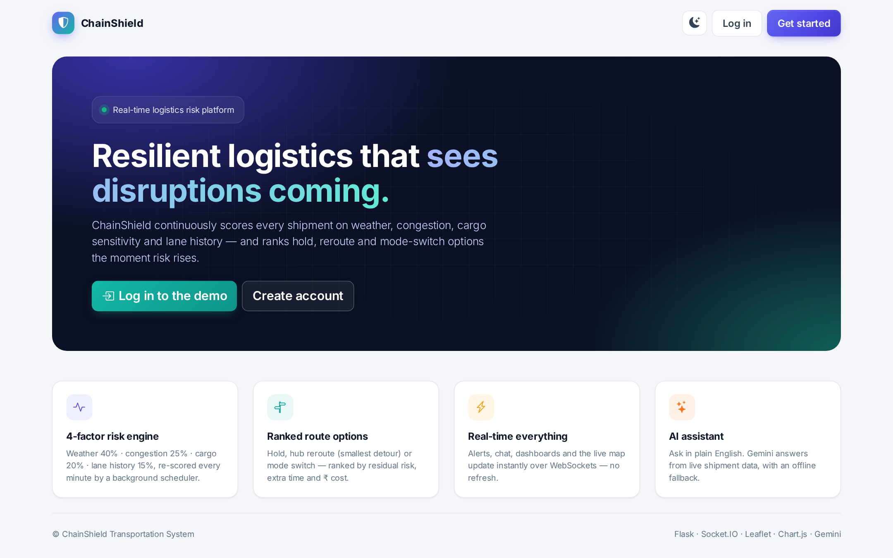
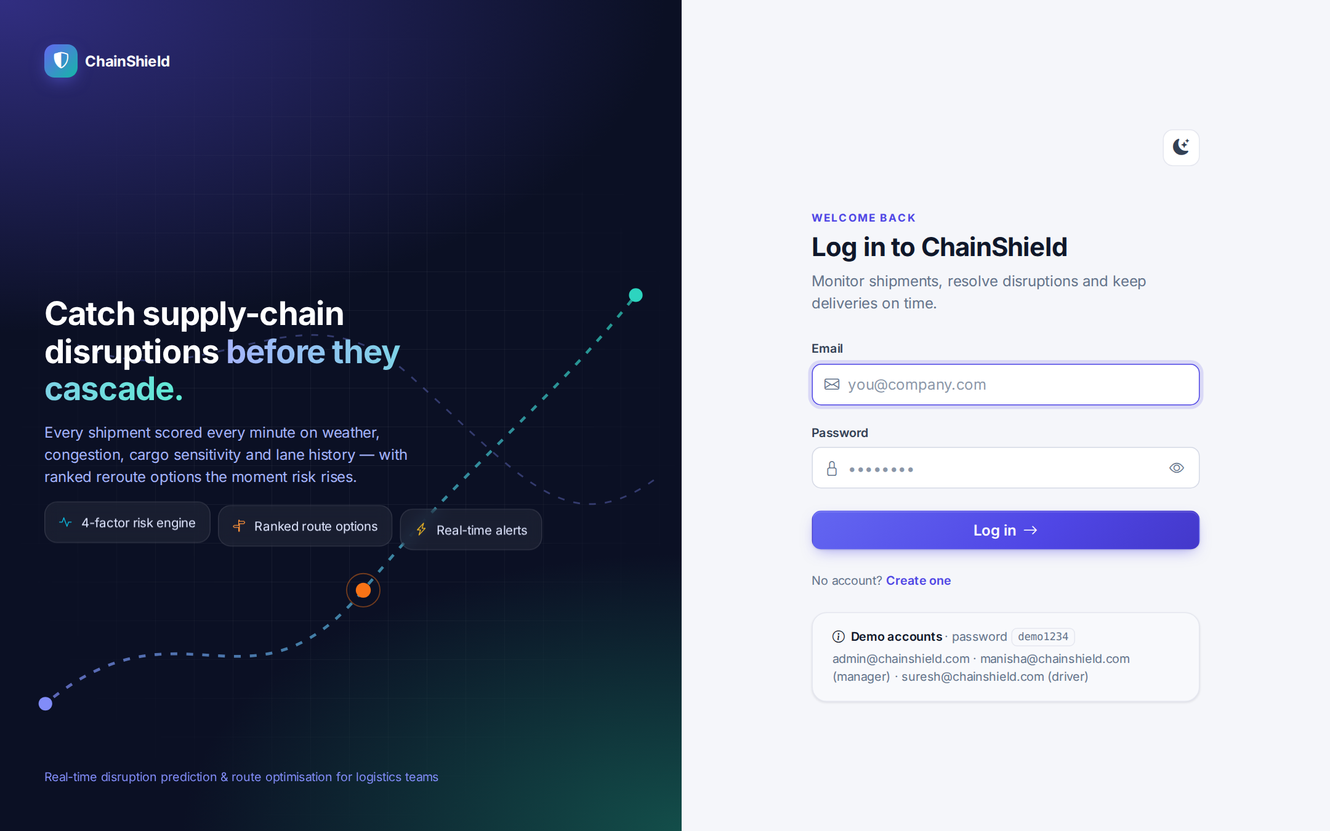
4. DEVELOPMENT
4.3 Output Screens (1/8)
Landing Page
Login Screen
ChainShield Transportation System | MCA Semester 3 | Group No. 59
35

Slide 36
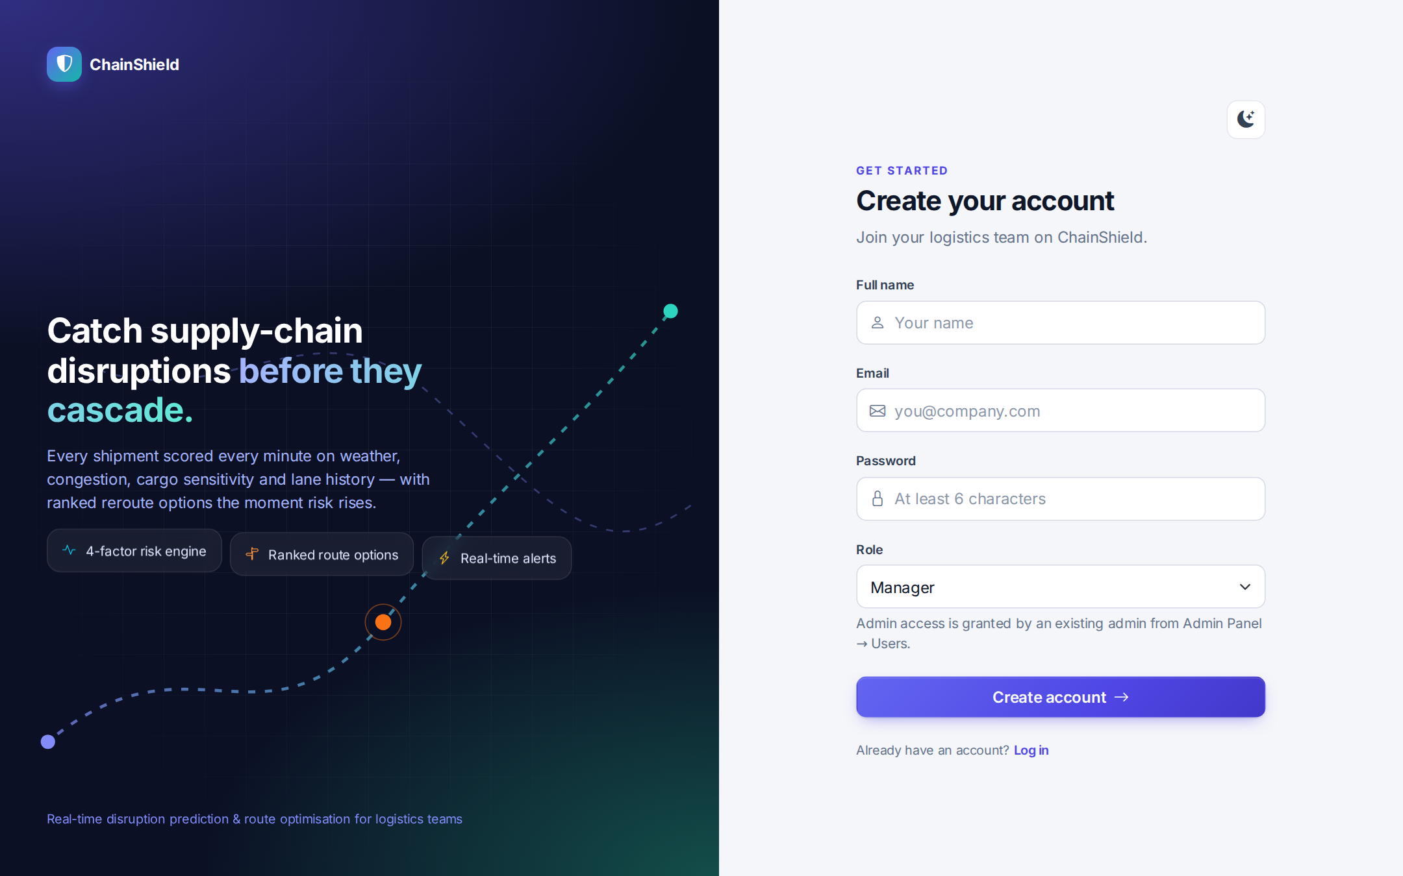

4. DEVELOPMENT
4.3 Output Screens (2/8)
Registration Screen
Live Shipment Map with Disruption Zones
ChainShield Transportation System | MCA Semester 3 | Group No. 59
36

Slide 37
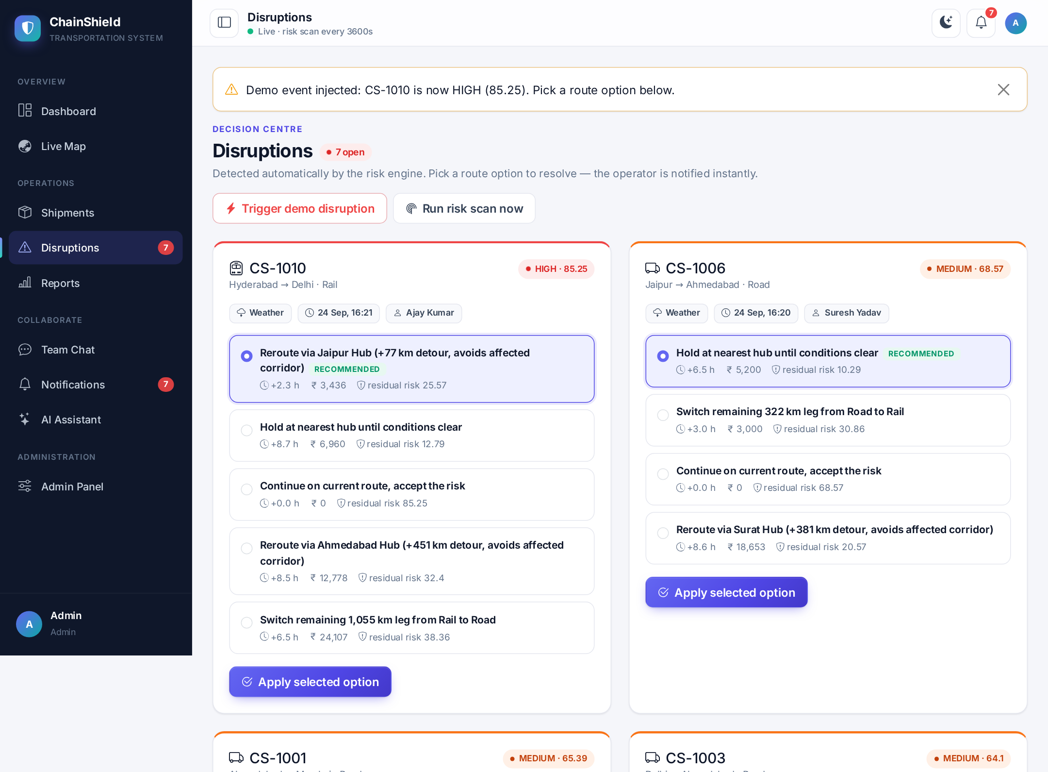
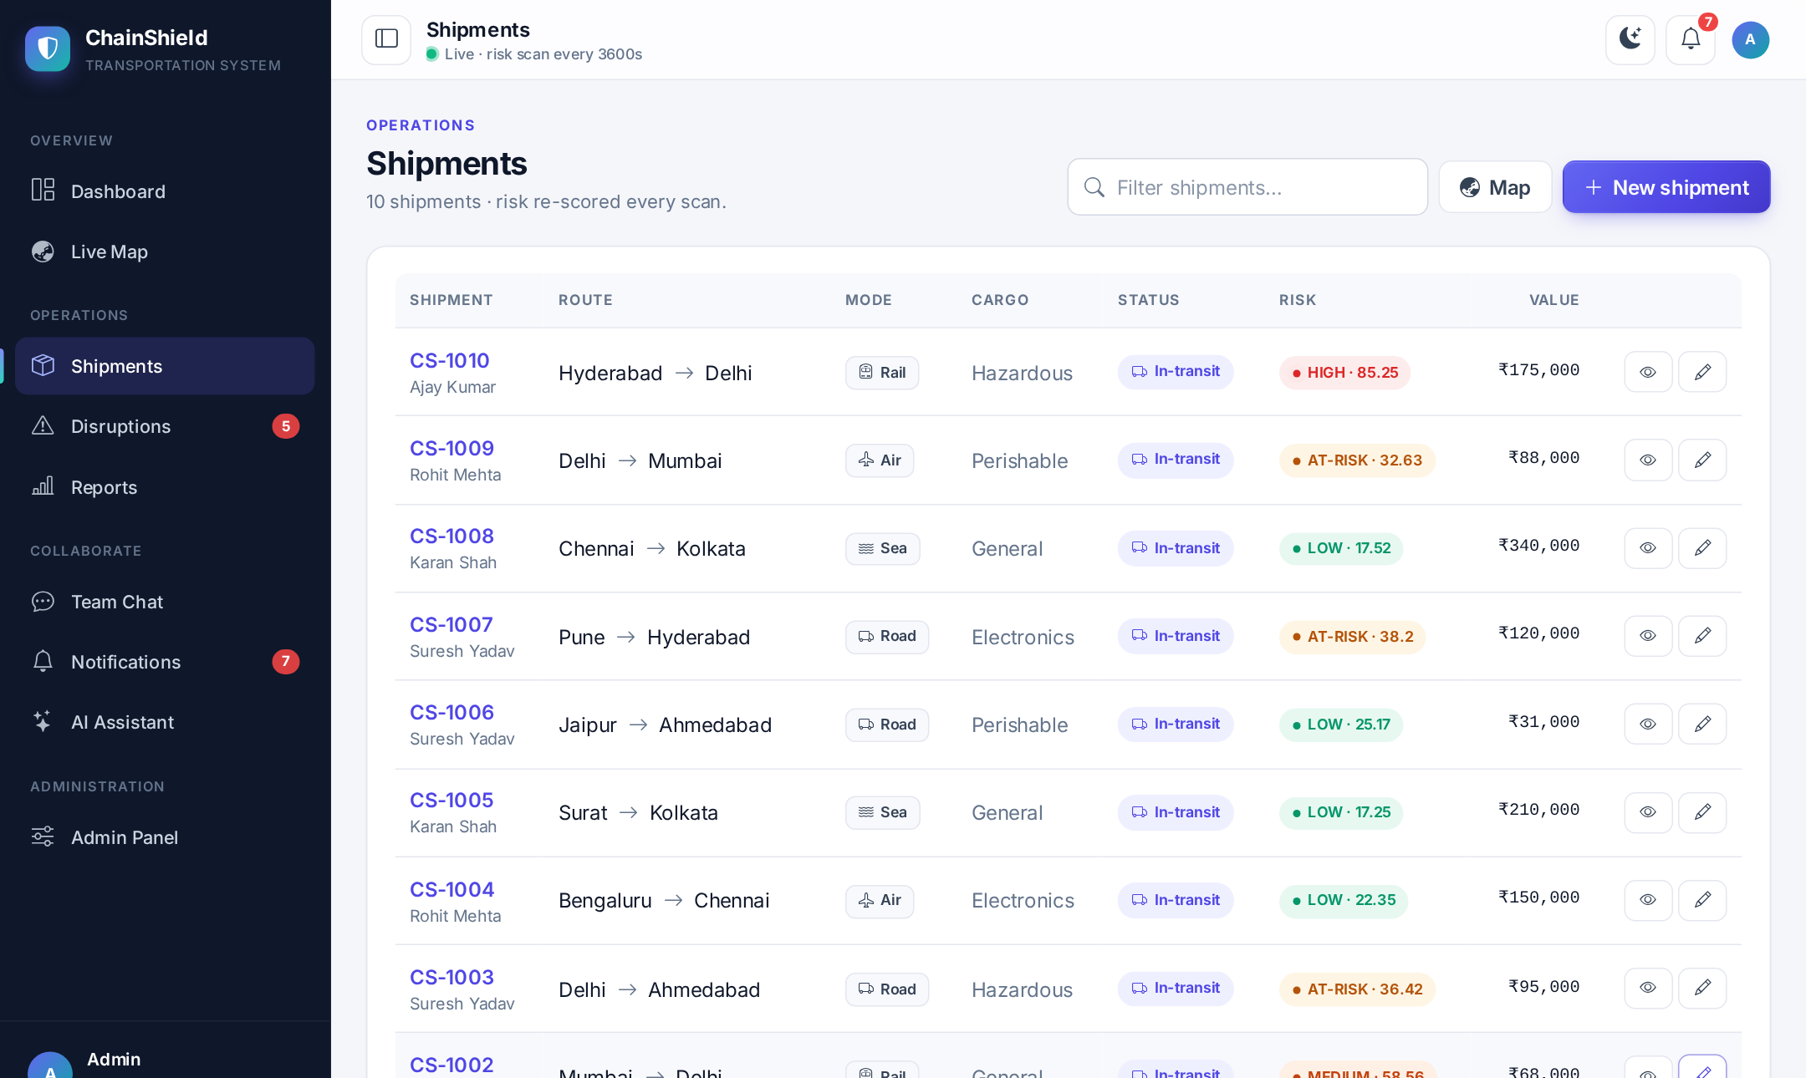
4. DEVELOPMENT
4.3 Output Screens (3/8)
Shipment List
Disruptions with Ranked Route Options
ChainShield Transportation System | MCA Semester 3 | Group No. 59
37

Slide 38
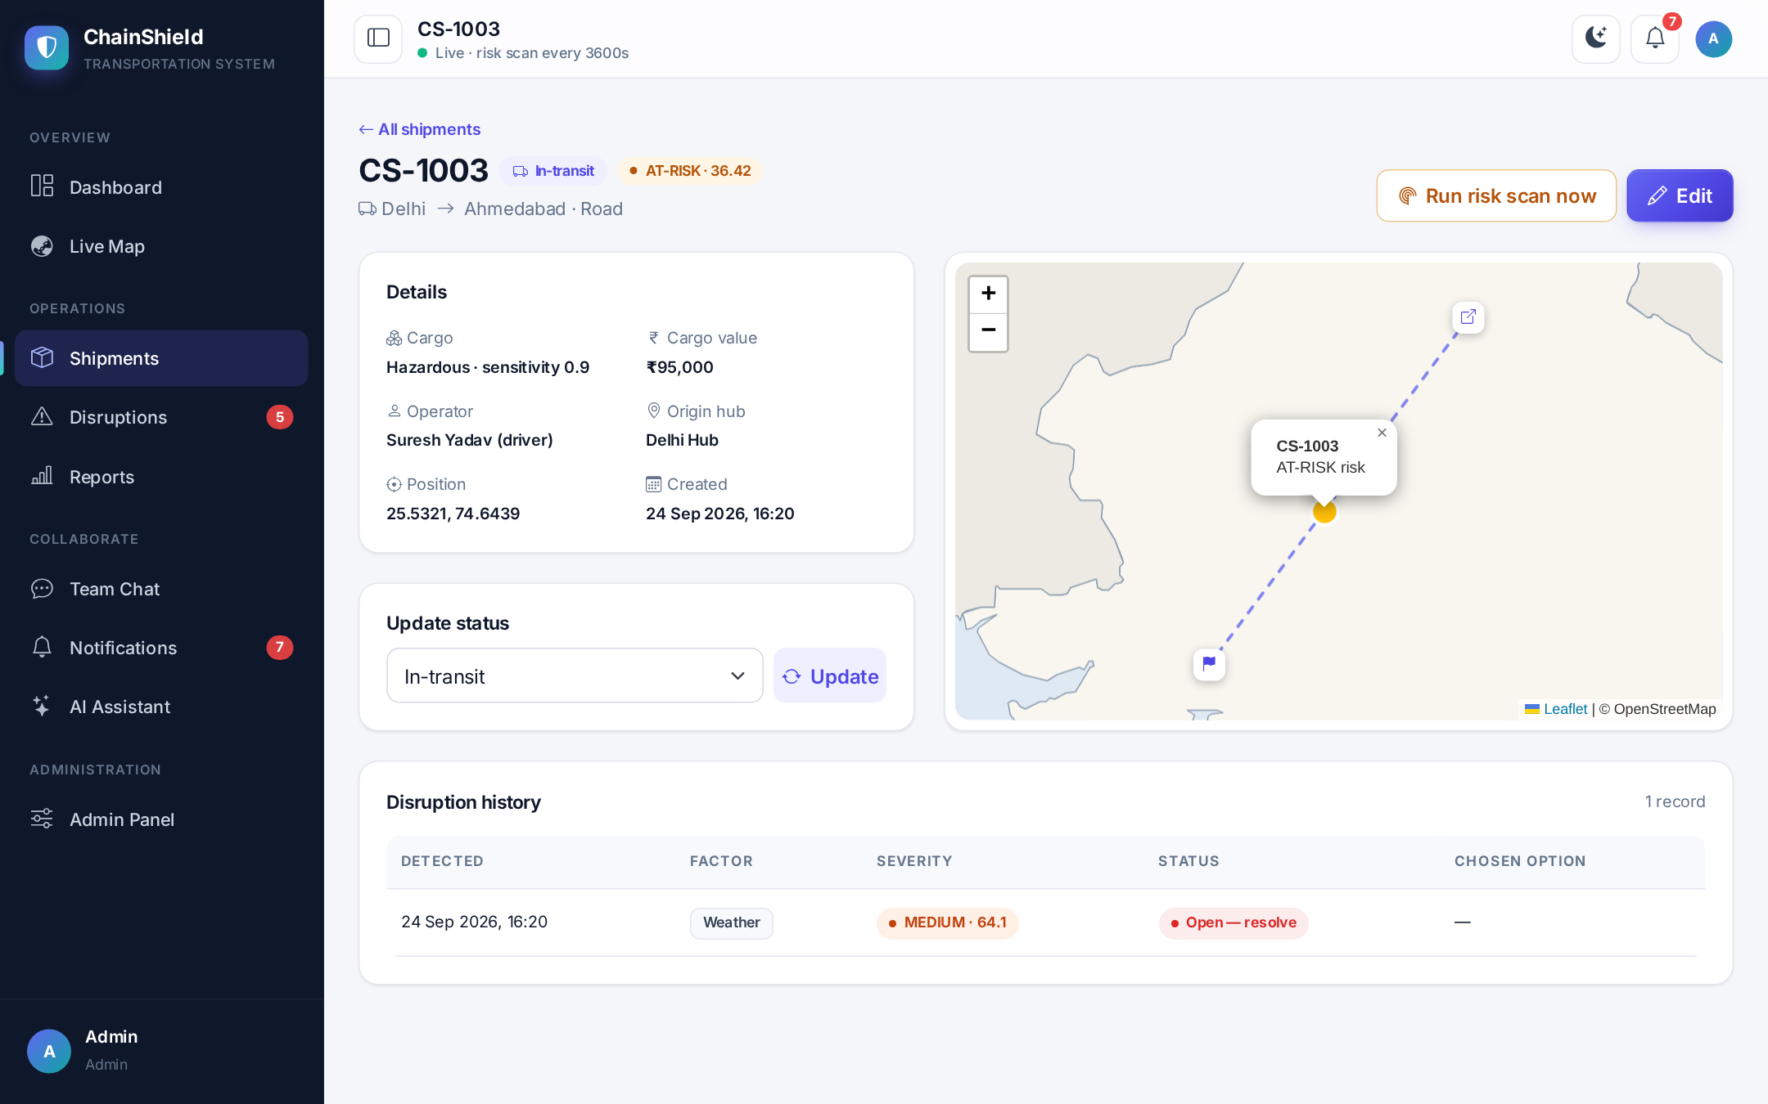
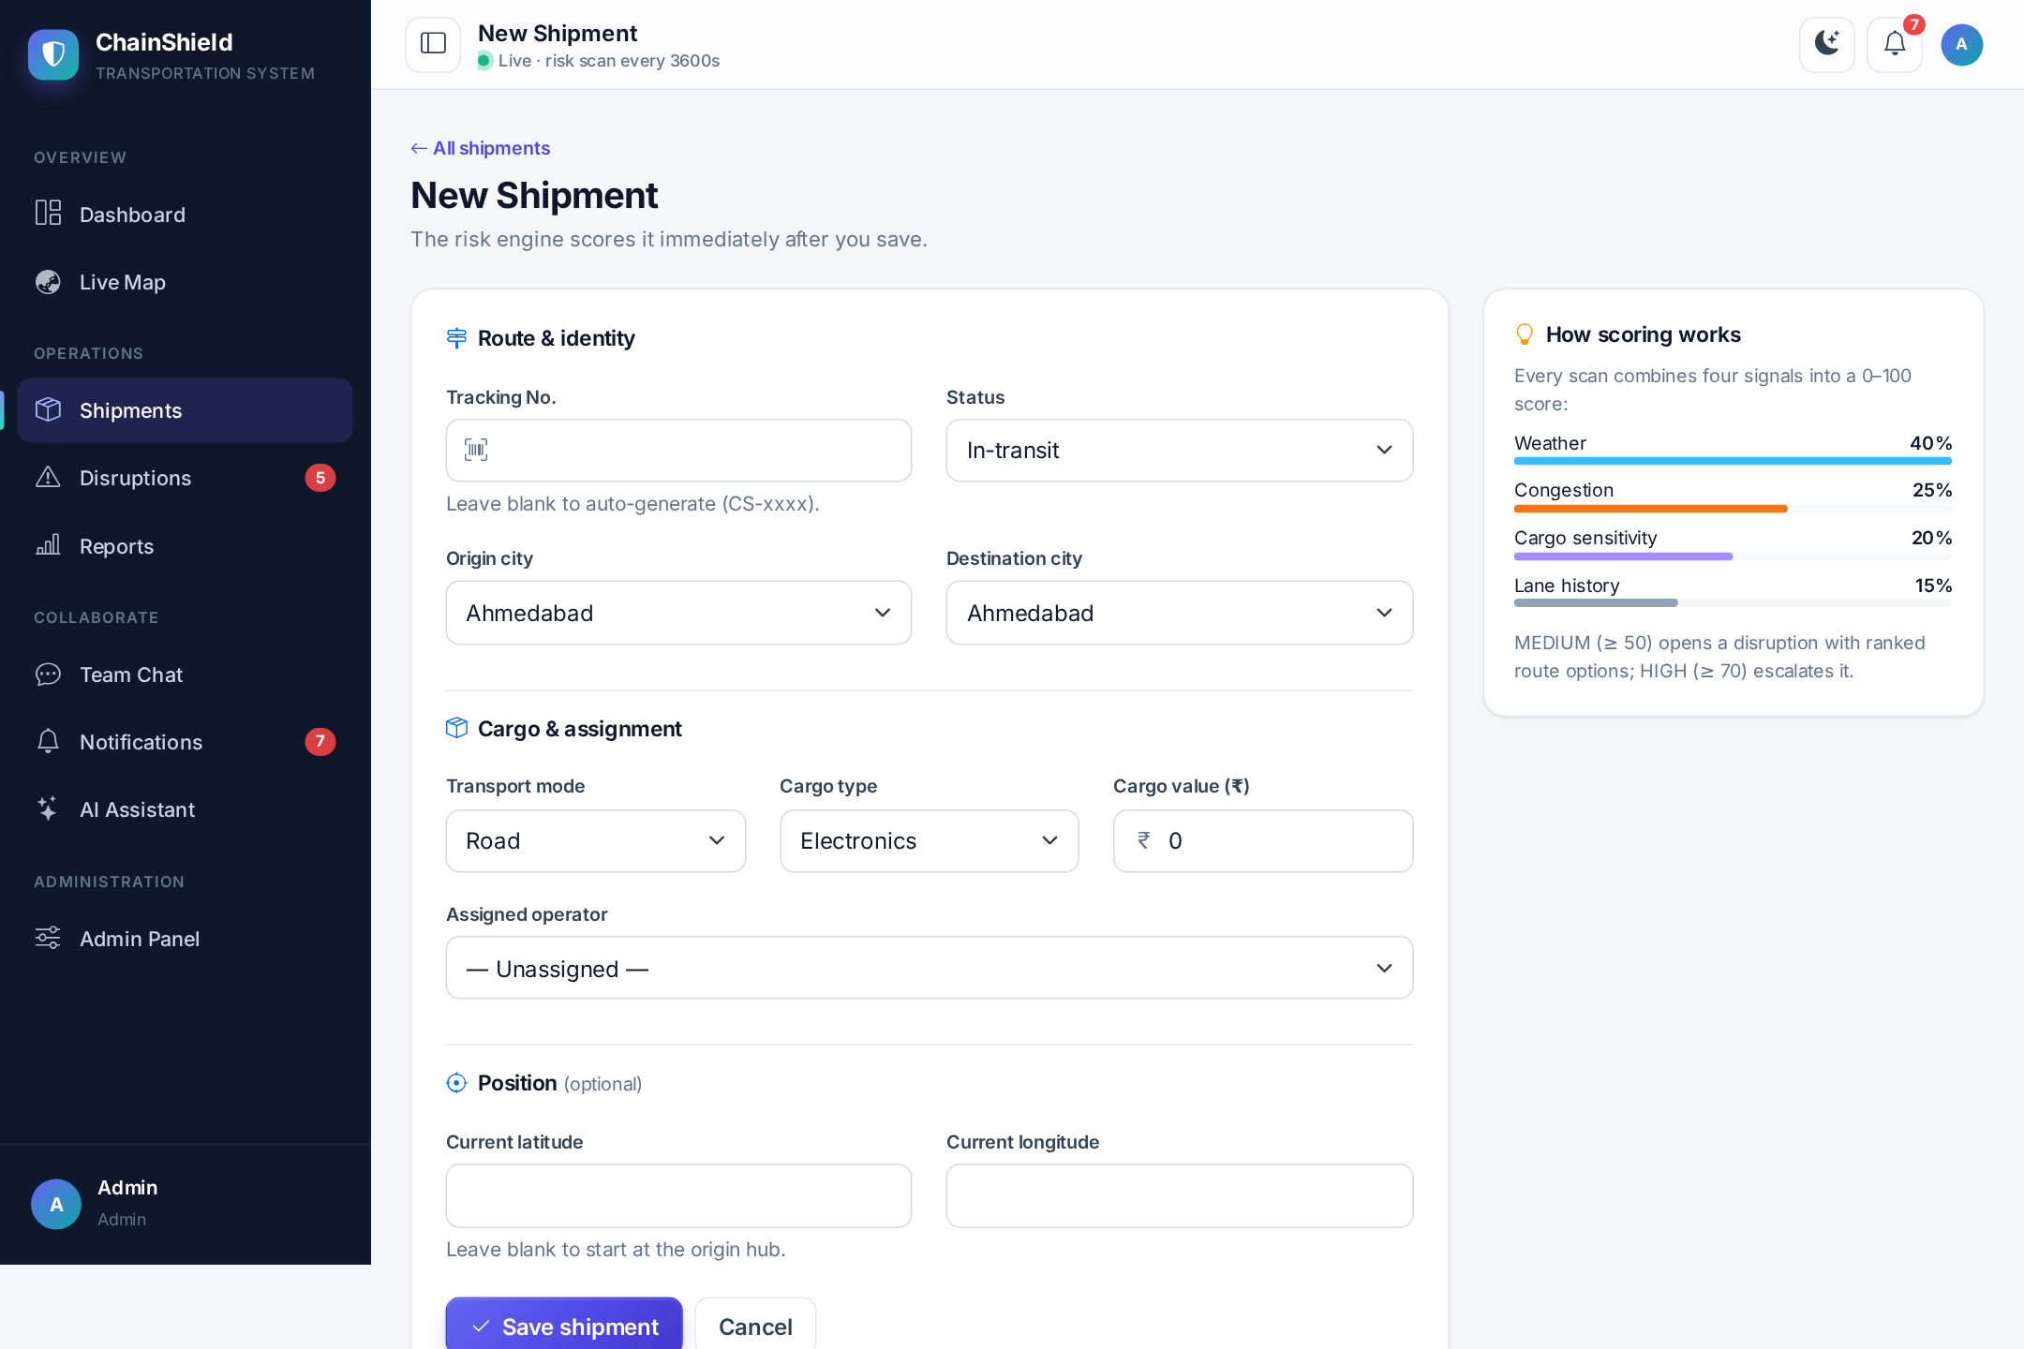
4. DEVELOPMENT
4.3 Output Screens (4/8)
Shipment Detail with Mini-map and History
Create Shipment Form
ChainShield Transportation System | MCA Semester 3 | Group No. 59
38

Slide 39


4. DEVELOPMENT
4.3 Output Screens (5/8)
Real-time Team Chat
Field Operator (Driver) Dashboard
ChainShield Transportation System | MCA Semester 3 | Group No. 59
39

Slide 40

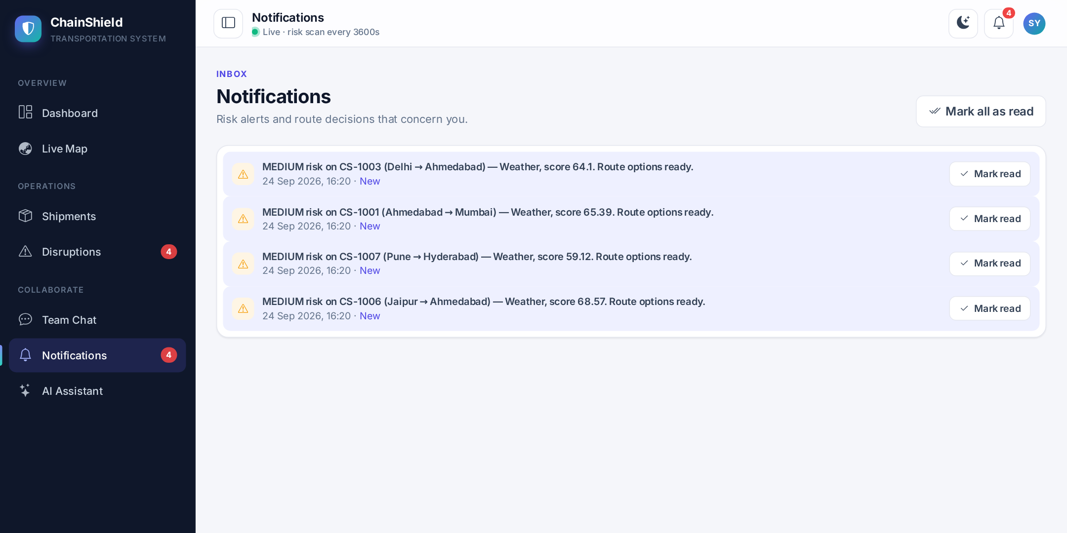
4. DEVELOPMENT
4.3 Output Screens (6/8)
Notification Feed
AI Assistant with Suggested Questions
ChainShield Transportation System | MCA Semester 3 | Group No. 59
40

Slide 41

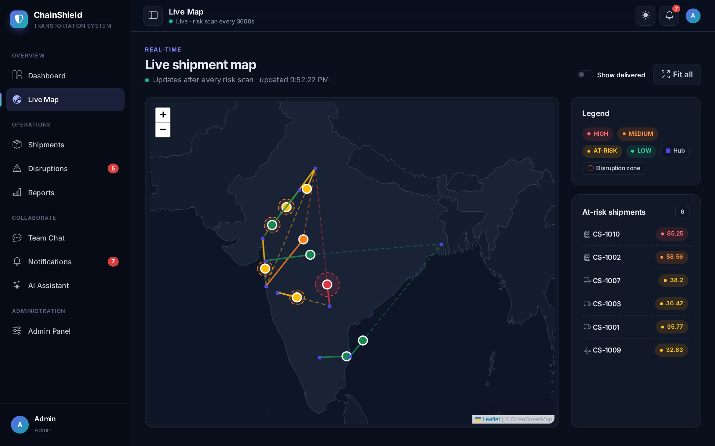
4. DEVELOPMENT
4.3 Output Screens (7/8)
Dark Theme — Dashboard
Dark Theme — Live Map
ChainShield Transportation System | MCA Semester 3 | Group No. 59
41

Slide 42

4. DEVELOPMENT
4.3 Output Screens (8/8)
Mobile Views — Dashboard, Disruptions, Live Map and Navigation Drawer
ChainShield Transportation System | MCA Semester 3 | Group No. 59
42

Slide 43
5. TESTING
5.1 Test Cases (1/2) — 101 automated checks, 0 failures
ID | Test Case | Test Data | Expected Result | Status
TC001 | User Login | email = manisha@chainshield.com, password = demo1234 | User is authenticated and redirected to the role-specific dashboard. | Pass
TC002 | Risk Score Calculation | Weather = 80, Congestion = 60, Cargo = 50, History = 40 | Score = 0.40×80 + 0.25×60 + 0.20×50 + 0.15×40 = 63 (MEDIUM) | Pass
TC003 | Automatic Disruption & Escalation | Scan 1: score 55 (MEDIUM); Scan 2: score 74 (HIGH) | One disruption opened at MEDIUM with ≥ 3 ranked solutions, then escalated to HIGH with re-planned options. | Pass
TC004 | Route Solution & Notification | Manager selects Option 1 “Reroute via Jaipur Hub” | Disruption becomes Resolved; operator receives a live notification; action logged. | Pass
TC005 | Admin CRUD (Cargo Type) | name = Pharma, weight 0.9 → 0.85; weight 1.5 (invalid) | Cargo type saved, edited and deleted; weight outside 0.0–1.0 rejected. | Pass
TC006 | Docker Container Startup | docker compose up --build | Image builds; Gunicorn + eventlet starts on port 5000; /health returns ok. | Pass
TC007 | Role-Based Access Control | GET /dashboard/users, /shipments/new, /reports | 403 Forbidden for admin/manager pages; 404 for other operators' shipments. | Pass
ChainShield Transportation System | MCA Semester 3 | Group No. 59
43

Slide 44
5. TESTING
5.1 Test Cases (2/2) — 101 automated checks, 0 failures
ID | Test Case | Test Data | Expected Result | Status
TC008 | Real-time Chat Delivery | Admin sends “Hold CS-1001 at Surat” | Message saved and appears instantly in the driver's open chat. | Pass
TC009 | AI Assistant with Fallback | “Give me a summary” with valid and invalid key | Gemini answer with valid key; offline engine answers with invalid key. | Pass
TC010 | Reports and CSV Export | /reports?from=2026-09-01&to=2026-09-30; disruptions.csv | Four reports shown; CSV opens in Excel; filter limits rows. | Pass
TC011 | User Deactivation | Admin clicks Deactivate | Login refused with message; open session logged out. | Pass
TC012 | Demo Disruption Trigger | Click “Trigger demo disruption” | HIGH disruption with ranked options, map zone and live alert appear. | Pass
TC013 | Responsive Layout and Themes | Open 8 main pages; toggle dark mode | No sideways scrolling on phone; drawer works; theme remembered. | Pass
ChainShield Transportation System | MCA Semester 3 | Group No. 59
44

Slide 45
6. PROPOSED ENHANCEMENT
6 Proposed Enhancement
Real GPS / telematics feeds
PostgreSQL for production scale
ML-based risk prediction
Mobile app / PWA for operators
Multi-tenant support
SMS & WhatsApp alerts
Customs & port APIs
Smarter AI assistant
PDF reports & scheduled e-mails
ChainShield Transportation System | MCA Semester 3 | Group No. 59
45

Slide 46
7. CONCLUSION
7 Conclusion
4
9
101
60 s
Weighted risk factors
Database tables
Automated checks passed
Risk scan interval
Moves logistics from reactive to preemptive
Every disruption paired with ranked route options
Self-hosted Flask + SQLite + Docker
Fully built, tested and deployable
ChainShield Transportation System | MCA Semester 3 | Group No. 59
46

Slide 47
8. BIBLIOGRAPHY
8 Bibliography
Books
Websites
Flask Web Development — M. Grinberg
flask.palletsprojects.com
Python Crash Course — E. Matthes
docs.python.org
Fundamentals of Database Systems — Elmasri & Navathe
sqlite.org / docs.docker.com
Software Engineering — I. Sommerville
getbootstrap.com / leafletjs.com
flask-socketio / apscheduler docs
ai.google.dev (Gemini) / openweathermap.org
ChainShield Transportation System | MCA Semester 3 | Group No. 59
47

Slide 48
Thank You
Questions & Discussion
Bhavik A. Visani · Diya Shah · Shruti Somani
Group No. 59 | Guided by Prof. Dhaval Shah | LJ Institute of Computer Application

