Slide 1
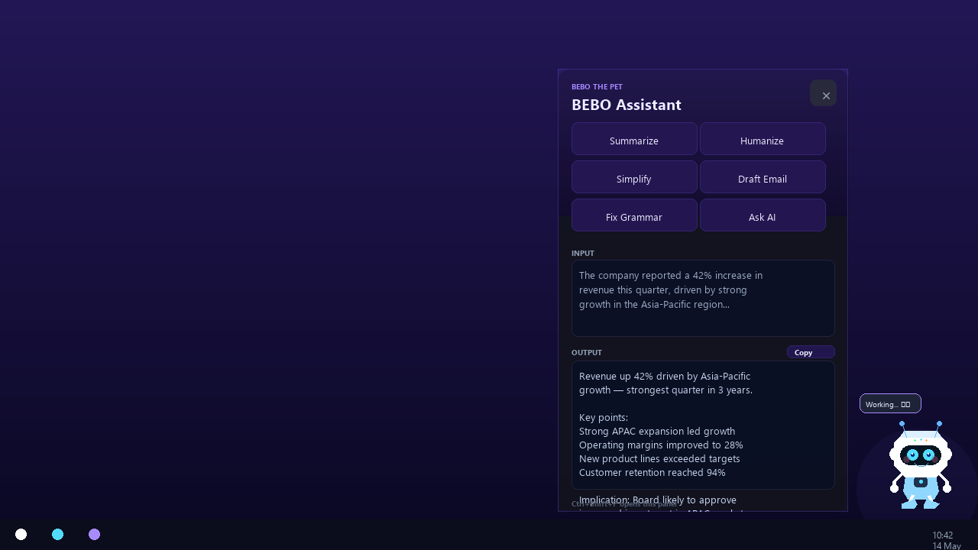
BEBO the PET
Your AI Desktop Companion:
Always On, Always Ready
Built by Bhavik Thakkar
Lal Bahadur Shastri Institute of Management
Powered by GPT-OSS 120B × Groq × Electron

Slide 2
We Lose Hours Switching Context Every Day
↩
App Switching Kills Focus
⏳
Browser AI Takes Too Long
Constant context switching destroys deep work and flow state every single day
Opening ChatGPT or a browser tab creates 30+ seconds of friction every time
🧠
Repetitive Tasks Eat Your Day
🖥
No AI Lives on Your Desktop
Summarizing, emailing, fixing grammar — done manually, repeatedly, all day long
There is no AI that stays permanently visible and ready without a window switch
What if your AI was always one click away — right on your desktop?

Slide 3
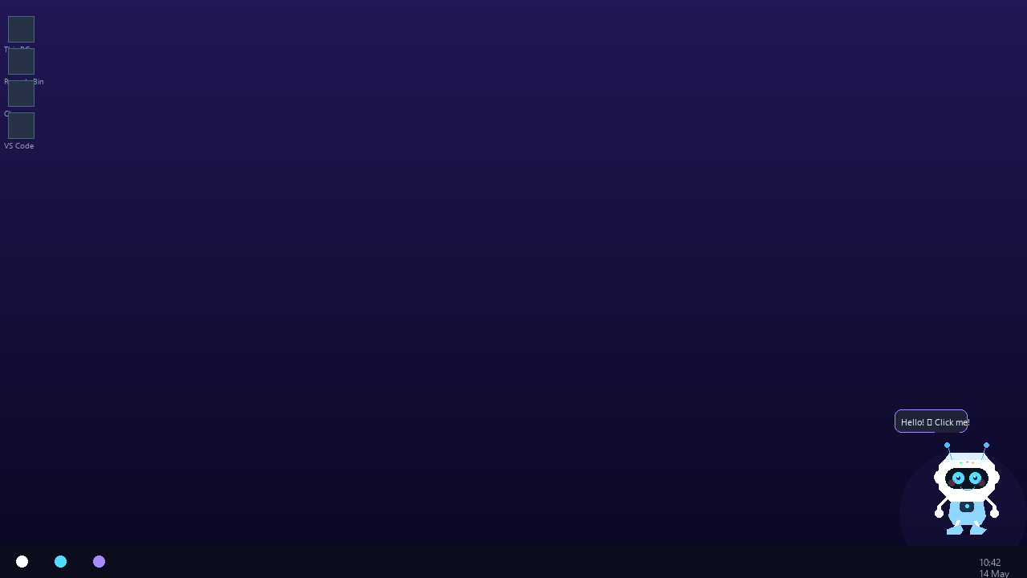
Meet BEBO — Your Desktop AI Pet
A tiny animated robot that lives on your Windows desktop.
Always visible. Always on top. Click once — get AI superpowers.
🐾
⚡
🤖
Lives on desktop
permanently
One click to
open AI panel
Powered by
GPT-OSS 120B
Always On Top • Draggable • Animated States • Zero Browser • Free to Run

Slide 4
How BEBO Works
1
2
3
4
5
🤖
›
👆
›
📋
›
✍
›
⚡
BEBO sits on
your desktop
You click
BEBO
Panel opens
next to BEBO
Paste text,
pick an action
AI result in
under 2 seconds
No browser. No tab switching. No loading screens.

Slide 5
6 Powerful AI Functions — All Free
📝
Summarize
🧑
Humanize
🔍
Simplify
Condense any article, report, or email into key points instantly
Transform robotic AI text into warm, genuine human writing
Make complex legal, technical, or academic text instantly clear
📧
Draft Email
✏
Fix Grammar
💬
Ask AI
Write professional ready-to-send emails from rough notes
Fix all errors silently — preserves your exact voice and style
Free-form prompt — ask anything, get expert-level answers
All powered by GPT-OSS 120B • 1,000 free requests/day via Groq • No credit card

Slide 6
Built on a Modern, Lightweight Stack
Electron v29
Node.js
Groq API
Native Windows desktop app framework — web tech as a real app
Main process runtime — IPC, AI calls, window management
Ultra-fast AI inference — free tier, ~1s response time
GPT-OSS 120B
HTML / CSS / JS
dotenv
OpenAI's open-weight large language model
Renderer — pet animations, panel UI, dark theme
Secure API key management — keys never touch the code
100% free to run • No subscription • No cloud storage • Stateless by design

Slide 7
Dual-Window Electron Architecture
Main Process — Node.js
Renderer Process — Browser
index.js — Entry Point
pet/index.html — Pet Markup
windows.js — Window Manager
IPC
Bridge
pet/pet.css — Animations
ipc-router.js — Event Router
pet/pet.js — State Machine
←
→
ai-service.js — Groq + Prompts
panel/index.html — Panel UI
shortcuts.js — Global Hotkeys
panel/panel.css — Dark Theme
tray.js — System Tray
panel/panel.js — AI Handler
contextIsolation: true • nodeIntegration: false • Secure preload IPC bridges on both windows

Slide 8
Expert-Grade Prompt Engineering
ROLE
Sets expert framing — tells the model exactly who it is
Temperature Tuning — Per Task
Fix Grammar
0.05
Deterministic
OBJECTIVE
Defines precisely what the task must accomplish
Summarize
0.20
Accurate
Draft Email
0.25
Structured
CONTEXT
Explains the user's situation and what they need
Simplify
0.30
Clear
Ask AI
0.50
Balanced
INSTRUCTIONS
Precise rules: format, tone, length, what to avoid
Humanize
0.65
Creative
Every response passes through stripMarkdown() — guaranteed clean plain text, always

Slide 9
Why Groq + GPT-OSS 120B?
Feature
Gemini Free
Groq + GPT-OSS
Daily Requests
20 / day
1,000 / day ✅
Response Speed
Medium
Ultra Fast (~1s) ✅
Cost
Free
Free ✅
Credit Card Required
No
No ✅
Output Quality
Best
95% equivalent ✅
Availability
Limited regions
Global ✅
1,000 free requests/day = ~40 AI tasks per hour, all day, every day

Slide 10
Built Solo with AI-Assisted Development
1
2
3
4
5
6
7
💡
🏗
🐾
🖥
🤖
📝
✨
Concept
Architecture
Pet Window
Panel UI
AI Integration
Prompts
UX Polish
Desktop AI pet
always visible
Dual-window
Electron design
CSS animations
+ state machine
Dark theme
IPC wiring
Gemini → Groq
migration
ROLE/OBJ/CTX
system
Toggle, resize
drag, position
Tools Used:
Claude AI
Claude Code
Groq
Electron
Node.js
VS Code
"Built entirely solo using AI-assisted development — Claude handled architecture, debugging, and prompt engineering in real time."

Slide 11
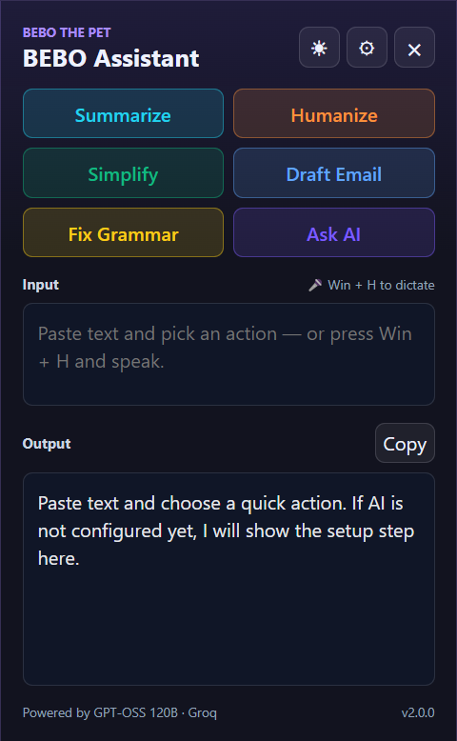
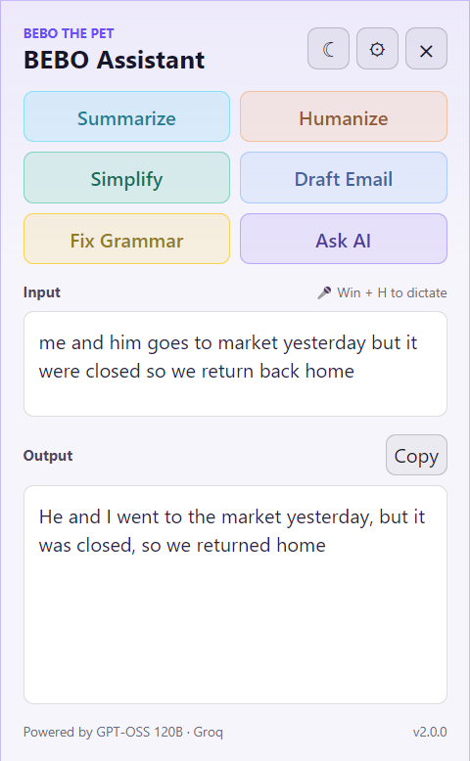

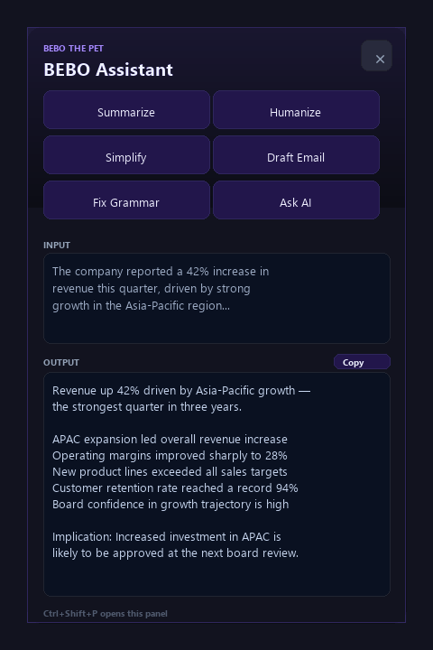
BEBO in Action
Sits in screen corner • Animated • Drag anywhere
Opens next to BEBO • Resizable • Clean design
Editable output • One-click Copy • Under 2s
Panel opens next to BEBO's position • Resizable • Editable output • One-click Copy

Slide 12
Thoughtful UX Details That Matter
Panel always opens next to BEBO — follows the pet wherever you drag it on screen
Fully resizable panel — but resets to default size every reopen for a clean slate
🎯
📐
Output is editable — modify AI results directly in the output box before copying
Click BEBO to open, click again to close — a natural, intuitive toggle behavior
✏
🔄
Ctrl+Shift+P toggles the panel globally — works from any app, any window
Speech bubble shows live AI status — Working... / Done. / Capturing screen...
⌨
🫧

Slide 13
What's Next for BEBO
Near Term — v0.2
Future — v1.0
🎙 Voice input — Win+H dictation
🧠 Custom AI personas and personalities
🔌 Plugin system — add your own functions
📜 Dark / light panel themes
🖥 Voice replies — BEBO talks back
🚀 Auto-start + update alerts
🍎 macOS port
⌨ Custom hotkey per function
📱 Mobile companion app
BEBO is modular — every feature is an independent, stackable component

Slide 14
The Bigger Picture
⚡
🆓
🧩
0-Click Access
Truly Free
Modular by Design
AI is always one click from wherever you are on screen — no window switch, no friction
1,000 requests/day, no credit card, no subscription, no data stored anywhere
Every function is swappable, addable, removable — built to grow with you
"BEBO proves that powerful AI doesn't need a browser, a subscription, or a context switch.
It just needs to live where you work."
This is what ambient AI looks like.

Slide 15
Thank You
Questions? Let's talk.
BEBO the PET
Bhavik Thakkar
Lal Bahadur Shastri Institute of Management
github.com/bhavik8025
bhavikthakkar8025@gmail.com
Built with Electron • Groq • GPT-OSS 120B • Claude AI

Slide 16
BEBO vs. ChatGPT, Gemini & Claude
Compared on free tiers only — the way students actually use AI
They're not competitors.
They're different tools.
ChatGPT Free
GPT-4o mini — Unlimited*
*rate limited, browser only
ChatGPT, Gemini, and Claude are general-purpose AI platforms — they can do almost anything.
BEBO does 6 things — and does them faster, with zero friction, right on your desktop.
The real question isn't which AI is smarter. It's which one you'll actually use every day.
Gemini Free
~50–100 requests / day
regional limits apply
Claude Free
~20–30 messages / day
Haiku / Sonnet, browser only
BEBO Free
1,000 requests / day
Always on desktop. No browser.
Every platform here is free. The difference is friction, limits, and where it lives.

Slide 17
6 Tasks. Honest Scores.
Quality of output on free tier | Expert prompts vs. casual use | BEBO's edge is speed + access, not raw intelligence
Task
ChatGPT
Gemini
Claude
BEBO
Summarize
⭐⭐⭐⭐
⭐⭐⭐⭐
⭐⭐⭐⭐⭐
⭐⭐⭐⭐
Fastest ⚡
Humanize
⭐⭐⭐
⭐⭐⭐
⭐⭐⭐⭐⭐
⭐⭐⭐⭐
1,000×/day
Simplify
⭐⭐⭐⭐
⭐⭐⭐⭐
⭐⭐⭐⭐⭐
⭐⭐⭐⭐
One click
Draft Email
⭐⭐⭐⭐
⭐⭐⭐
⭐⭐⭐⭐⭐
⭐⭐⭐⭐
Fastest ⚡
Fix Grammar
⭐⭐⭐⭐
⭐⭐⭐⭐
⭐⭐⭐⭐⭐
⭐⭐⭐⭐⭐
Tied #1 ✅
Ask AI
⭐⭐⭐⭐⭐
⭐⭐⭐⭐
⭐⭐⭐⭐⭐
⭐⭐⭐
Use GPT here
BEBO uses GPT-OSS 120B via Groq. Quality is competitive — not #1 — but expert prompts built into every button close the gap significantly for daily tasks.

Slide 18
Why BEBO Wins for Everyday Use
Not the smartest AI. The most usable one.
⚡
Zero Friction
💸
Truly Free
🎯
Built-in Expert Prompts
Click once. Result in 2 seconds.
No browser, no login, no new tab. Ever.
1,000 requests/day on Groq free tier.
Claude gives you 20. BEBO gives you 1,000.
Every button fires a precision prompt.
No need to know how to prompt — BEBO does it for you.
BEBO is better when...
Use ChatGPT / Claude when...
› You need fast answers without switching windows
› You need deep reasoning or complex research
› You repeat the same AI tasks every day
› You want to browse the web for live information
› You're fixing grammar, summarizing, drafting emails
› You're doing a long multi-turn conversation
› You want free AI with no daily message anxiety
› You need image or file understanding
"ChatGPT is a Swiss Army knife. BEBO is the knife already in your hand."
BEBO is built on Electron + Node.js + Groq API • Free to run • Built by a student, for students

Slide 19
BEBO is the Fastest AI Workflow — By Far
⚡ API Response Speed
🖥 Full Workflow Speed (realistic)
Model | Tok/s | 200-tok task
BEBO (Groq + GPT-OSS 120B) | ~500 | 0.4–0.6s ★
Gemini 2.0 Flash | ~200–300 | 0.8–1.2s
GPT-4o mini | ~100–150 | 1.5–2.5s
Claude 3.5 Haiku | ~100–150 | 1.5–2.5s
GPT-4o (limited free) | ~80–100 | 2.0–3.0s
Tool | Total Time
BEBO | ~3–4 sec ★
Gemini 2.0 Flash | ~10–13 sec
ChatGPT (GPT-4o mini) | ~11–14 sec
Claude (browser) | ~12–15 sec
✅ BEBO Wins on Speed
Groq LPUs — no GPU can match it.
Gemini 2.0 Flash is closing the gap but
BEBO still 3–5× faster end-to-end.
❌ Others Win
Complex reasoning, coding,
image understanding, memory,
long documents, real-time data.
Source: Groq published benchmarks · measured workflow timing (browser already open)

