Slide 1
Artist Recognition for Fine Art Paintings with Deep Learning
Bhavika Tekwani, Jaecheon Jeong, Melanie Baker

Slide 2
Problem Description
Classify Impressionist paintings by artist (multiclass classification).
Dataset: Wikiart (27.6 GB) containing 27 genres.
We want to classify paintings by artist in the Impressionism genre.
We extract a subset of 15 artists and 40 paintings per artist.

Slide 3
Motivation
Automatic tagging of paintings by artist & genre.
Authenticating paintings by artist.
Better search

Slide 4
Hardware & Software Setup
Hardware
i5 and i7 processors with 8 GB RAM
No GPUs used for deep learning.
Software
Python 3.6
Scikit-learn
Pandas
OpenCV2
PyTorch
Tensorflow & Keras
Additionally, we used Git for source control.

Slide 5
Approach
Compare traditional machine learning models (SVMs, Random Forests, etc) with Convolutional Neural Networks (CNNs).
Create a subset of 15 artists & 40 paintings for each.
Use 60% of the data for training (360 images), 40% for test (240 images).
Compare methods in terms of accuracy metrics per class (artist), and overall accuracy.

Slide 6
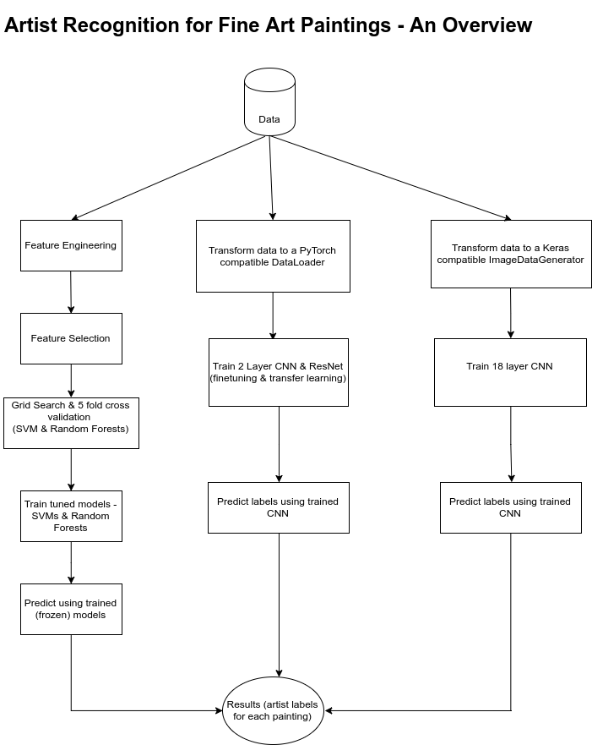

Slide 7
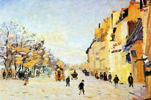
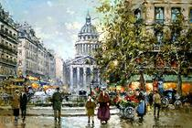
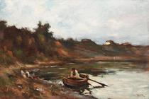
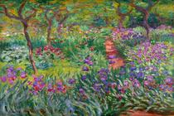
Dataset
Adam Baltatu Alfred Sisley Antoine Blanchard Arkhip Kuindzhi Armand Guillaumin Auguste Rodin Berthe Morisot Camille Pissarro Childe Hassam
Claude Monet Constantin Artachino Cornelis Vreedenburgh Edgar Degas Edouard Manet Eugene Boudin

Slide 8
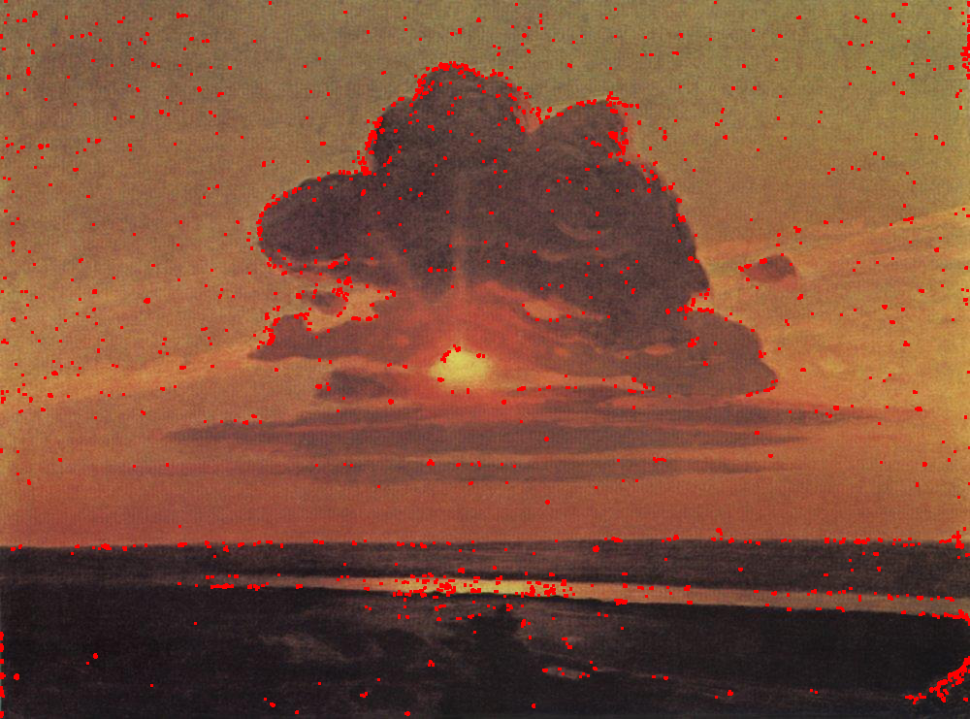
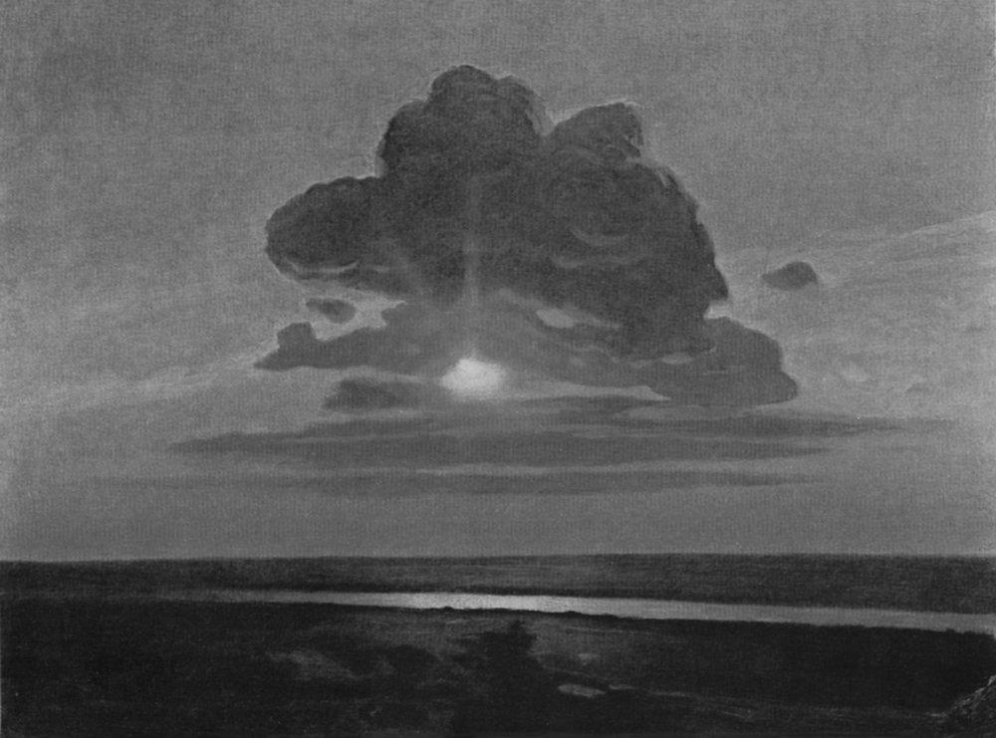
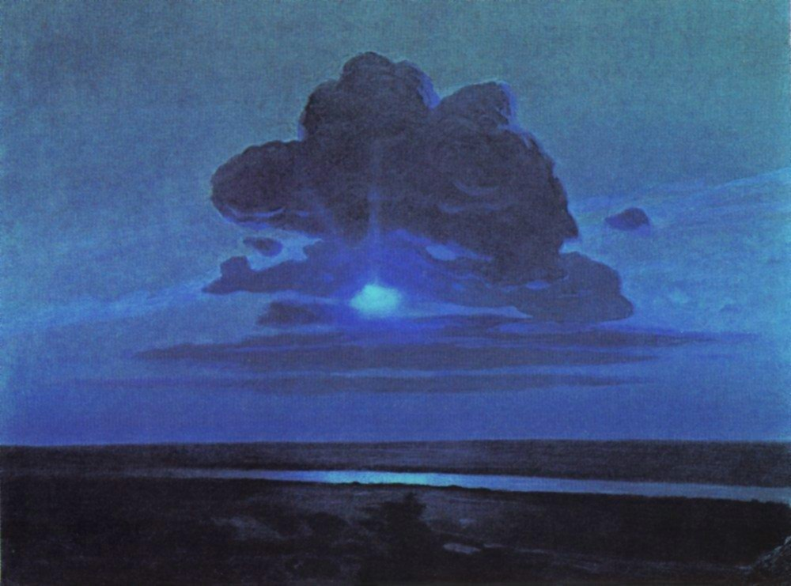
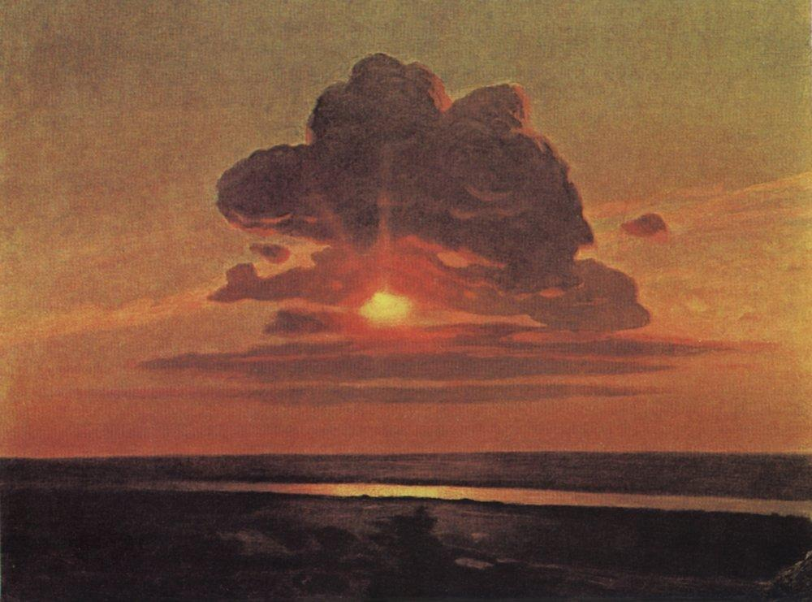
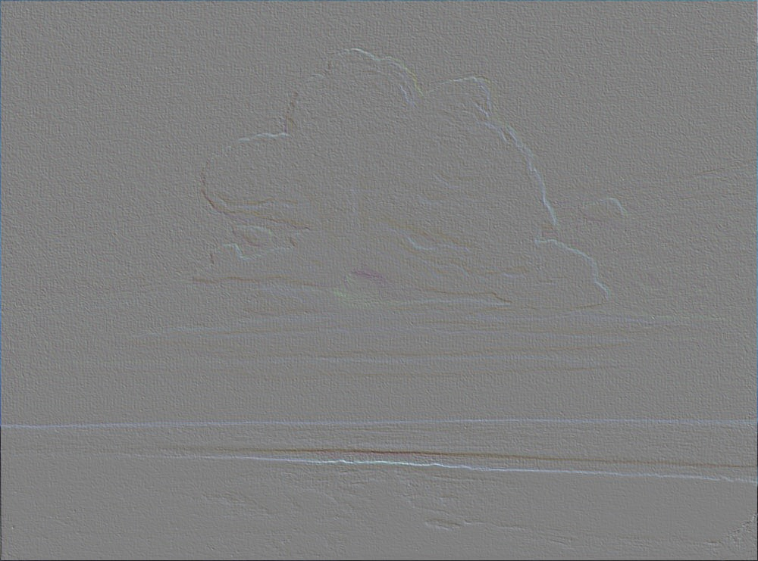

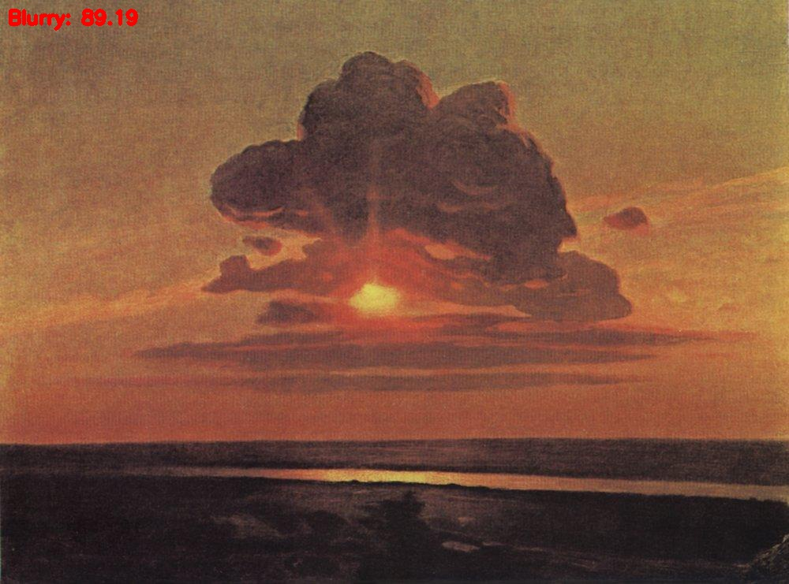
Feature Engineering
EDGE
BRIGHT
BRIGHT
SMOOTH
Original Image
EMBOSS
CONTOUR
BLUR
Original Image : arkhip-kuindzhi’s painting, Red Sunset

Slide 9
SVM & Random Forest
Feature selection : Recursive Elimination Feature Cross-Validated
selection of the best number of features
Optimal Parameter Search : GridSearchCV
Cross Validation : StratifiedKFold( 3 folds)
Train and Predict Model
Support Vector Machine
Random Forest

Slide 10
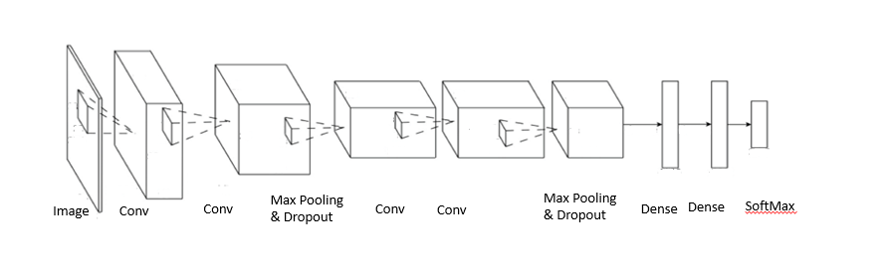
CNN-Keras/Tensorflow
Developed an 18 layer CNN
Architecture is based off a network that performed classification well for the CIFAR-10 dataset
Starts with a series of Convolutions followed by Max Pooling and Dropout layers which feed into a fully connected network that ends with a softmax layer to classify the images
The only data augmentation used was horizontal flipping of images
Takes ~3.5 hours to train 15 classes/360 images
Used batch size of 15, 100 epochs and images were resized 210x140

Slide 11
Baseline 2 layer CNN
A simple CNN with only 2 convolutional layers built using PyTorch.
Resized image to 32 * 32. No other transformations.
Architecture:
Layer
Conv2D [in=3, out=6, kernel=5, stride = 1, padding = 0]
MaxPool2D [kernel =2, stride = 2]
Conv2D [in=6, out=16, kernel=5, stride=1, padding=0]
Linear [in = 400, out = 120]
Linear [in = 120, out = 84]
Linear [in = 84, out = 15]

Slide 12
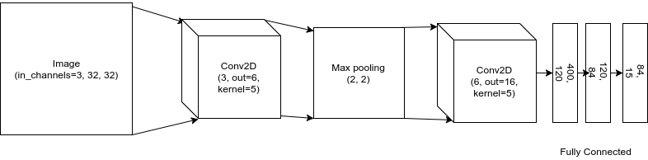
Baseline 2 layer CNN
Used batch size as 4 and ran 100 epochs.
Varied learning rate from 1e-1 to 1e-5.
Loss: cross entropy loss optimized using Stochastic Gradient Descent.

Slide 13
ResNet-18
ResNet-18 is the simplest residual network, other variations are ResNet50, ResNet-101, ResNet-152, etc.
ResNet-18 did well on the ImageNet dataset with 1000 classes.
We attempt a transfer learning approach with ResNet-18 using the pretrained model in PyTorch.

Slide 14
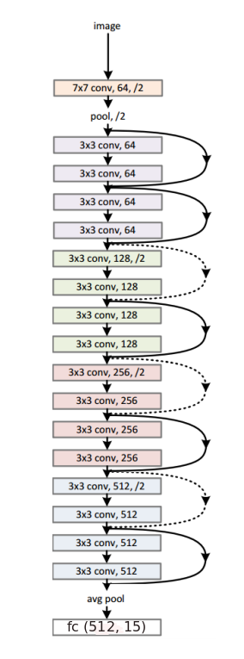
ResNet-18
First, we use the pretrained ResNet-18 model. This is the transfer learning approach.
The last layer is fully connected & we modify it to give us a 15-class output instead of 1000 classes.
Next, we fine tune the model by training it on our dataset.
Images are resized to 224 * 224 to be compatible with the input sizes for ResNet-18.

Slide 15
Results
Model | Accuracy | Precision | Recall
Support Vector Machine (SVM) | 18.75%
Random Forest | 38.33%
CNN - 2 Layer (PyTorch) | 8.75% | 76.56% | 8.75%
CNN - 18 Layers (TF + Keras) | 32% | 39% | 32%
ResNet-18 (pretrained) | 7.9% | 63.7% | 7.9%
Resnet-18 (fine tuned) | 10.83% | 53.26% | 10.83%
Notes:
CNN_2 Layer, best learning rate = 0.001
ResNet-18 (pretrained), best learning rate = 1e-05
ResNet-18 (finetuned), best learning rate = 0.001

Slide 16
Class Model | 0 | 1 | 2 | 3 | 4 | 5 | 6 | 7 | 8 | 9 | 10 | 11 | 12 | 13 | 14
Support Vector Machine (SVM)
Random Forest
CNN - 2 Layer (PyTorch) | 8 | 30 | 25 | 6 | 6 | 25 | 4 | 10 | 3 | 12 | 0 | 0 | 0 | 0 | 0
CNN - 18 Layers (TF + Keras) | 19 | 38 | 100 | 6 | 13 | 38 | 19 | 56 | 31 | 19 | 25 | 0 | 56 | 38 | 44
ResNet-18 (pretrained)
Resnet-18 (fine tuned) | 34 | 25 | 50 | 43 | 25 | 25 | 25 | 29 | 37 | 0 | 50 | 18 | 31 | 25 | 25

Slide 17
Improvements & Further Work
Use image transformations for deep learning approaches.
Attempt classification using genre as class label
Increase training dataset: add more images per class as Wikiart is rich in this regard.

Slide 18
References
[1] A. Blessing and K. Wen, Using machine learning for identification of art paintings,
Tech. Rep., 2010.
[2] B. Saleh and A. Elgammal, Large-scale classification of fine-art paintings: Learning
the right metric on the right feature, ArXiv Prepr. ArXiv150500855, 2015.
[3] Y. Hong and J. Kim, Art Painting Identification using Convolutional Neural
Network, Int. J. Appl. Eng. Res., vol. 12, no. 4, pp. 532–539, 2017.
[4] Creating Computer Vision and Machine Learning Algorithms That Can Analyze
Works of Art - MATLAB & Simulink. [Online]. Available:
https://www.mathworks.com/company/newsletters/articles/creating-computer-vision-and-machine-learning-algorithms-that-can-analyze-works-of-art.html. [Accessed: 18-Sep-2017].
[5] Wei Ren Tan, Chee Seng Chan, Hernan E. Aguirre and Kiyoshi Tanaka, Ceci n'est pas une pipe: {A} deep convolutional network for fine-art paintings classification. http://web.fsktm.um.edu.my/~cschan/doc/ICIP2016.pdf

