Slide 1
Quora Question Pairs - Kaggle
Bhavika Tekwani

Slide 2
Problem Description
100 million people visit Quora every month.
People often post the same questions but framed differently.
We want to make content discovery easier - search & relevance, recommendations, autocomplete, etc
The goal is to discover whether two questions have the same intent!

Slide 3
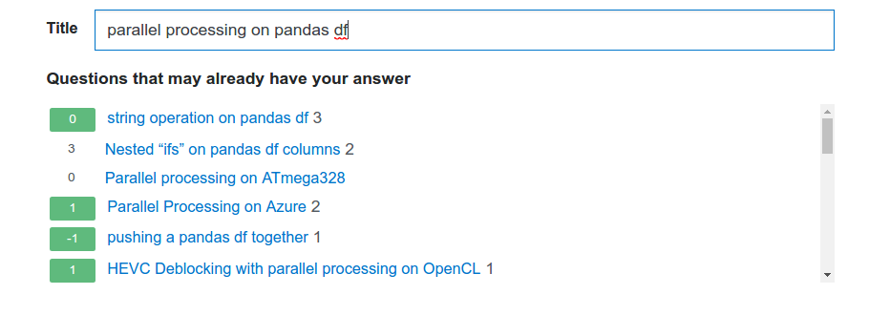
Duplicate question detection in the wild
Fig. 1 Stack Overflow - Ask page (05/02/2017)

Slide 4
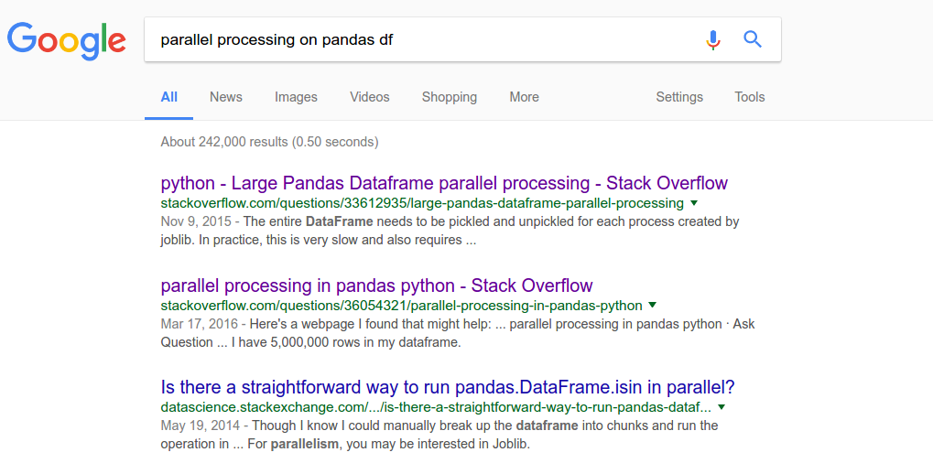
Duplicate question detection in the wild
Fig. 2 Google Search results (05/02/2017)

Slide 5
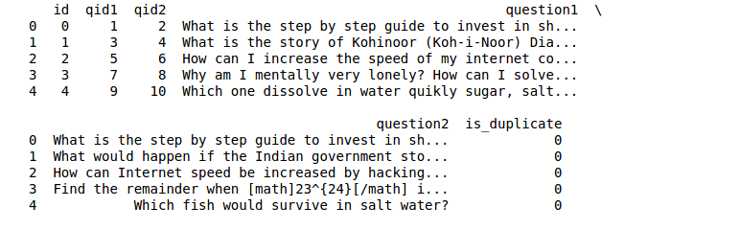
Data
404289 question pairs in the train set (64 MB)
2345795 question pairs in the test set (314 MB)

Slide 6
Data
Imbalance: Only 37% of the question pairs are marked as duplicates
The goal is to predict is_duplicate as a value between 0 and 1 for the test set.
Observation: Some labels in the train set look incorrect.

Slide 7
Evaluation
Log loss between the predicted values and ground truth. Averaged over N question pairs to generate a leaderboard score.
The test set has computer generated question pairs as an anti-cheating measure.
Leaderboard scores are calculated on 35% of the test set.

Slide 8
Feature Engineering
Preprocessing
Stopword removal
Corrected typos
Tidied up text¹ (“kms” -> kilometres, “the US”, “USA” -> America)
Stemming using Porter stemmer
Features based on lengths and word counts
Fuzzy features - ratio, partial ratio, token set ratio, token sort ratio, etc
Wordshare - number of common words in a pair, normalized
[1] List of corrections created by user ‘currie32’ on Kaggle

Slide 9
Feature Engineering
Word2Vec
Convert each question (in a pair) to a vector of 300 elements - Word2Vec -> Sent2Vec
Use these vectors for distance calculations
Calculate skew and kurtosis of each vector
Distance metrics
Cosine
Euclidean
Jaccard
Cityblock, etc
Word Mover’s Distance

Slide 10
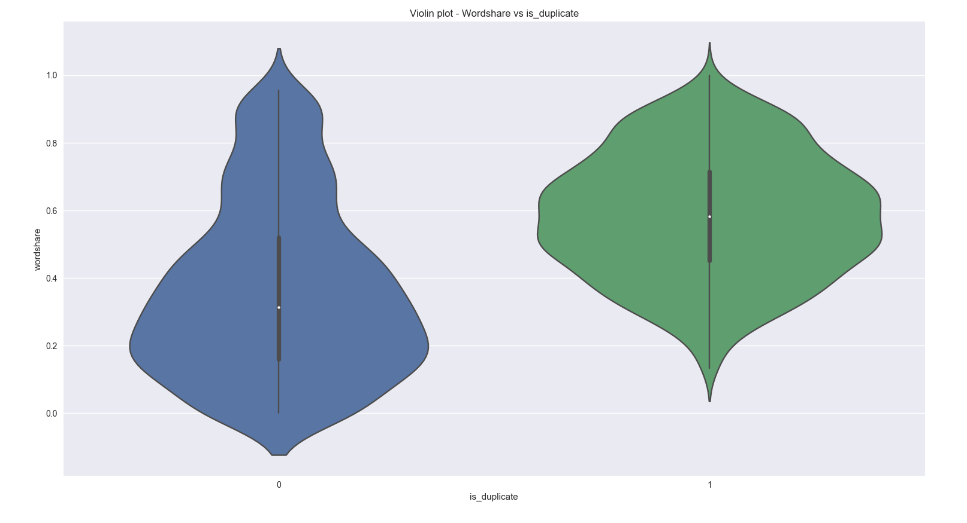
Which features should we use?

Slide 11
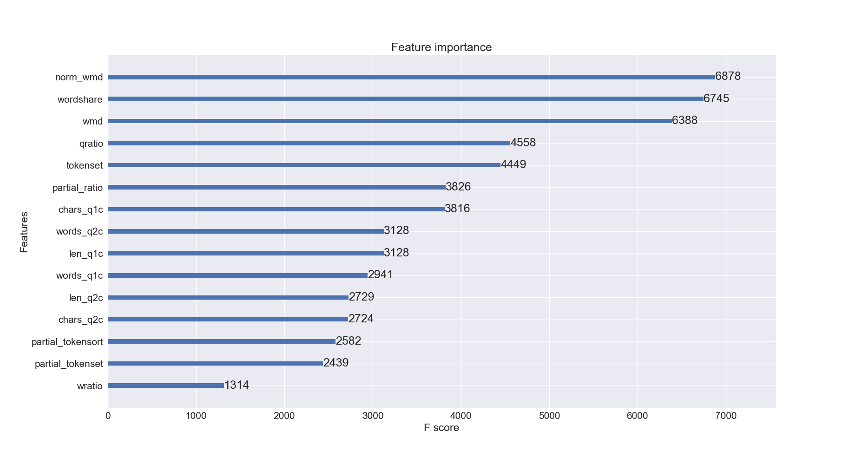

Slide 12
Models
Baseline model: XGBoost
Cross validation: 5 fold CV with 80-20 train/test split.
Feature sets:
All length and word count features - 7 [FS-1]
Fuzzy features - 6 [FS-2]
Word Mover’s Distance & Normalized Word Mover’s Distance - 2 [FS-3]
Distance metrics, skew and kurtosis - 11 [FS-4]

Slide 13
Results
Model | Features | Log loss (Kaggle)
XGBoost | FS-1 + FS-2 + Wordshare | 0.63380
XGBoost [optimized] | Wordshare | 0.46868
XGBoost [optimized] | Wordshare + FS-3 | 0.41594 [#1348]
Blend model - 5 regressors (Random Forest, Extra Trees, Gradient Boosting, Logistic Regression) | FS-1 + FS-2 + FS-3 + Wordshare | 0.41859 [#1383]

Slide 14
Further Work
Train GRUs and LSTMs - compare the performance with XGBoost
Deal with imbalance in the train set
Try new features
Punctuation - count question marks?
POS tags to identify (verb, noun) combinations that are often used in the same context
Process text again without removing punctuation

Slide 15
Tools
Visualization: matplotlib, seaborn
Data analysis: numpy, pandas, scikit-learn, XGBoost
NLP: fuzzywuzzy, pyemd, nltk, gensim
Pretrained models: Word2Vec

