Slide 1
Cloud-Based Food Surplus Prediction and Hyperlocal Redistribution Network
CNAD PROJECT REVIEW – 3
TEAM MEMBERS
2420030073 – Y. Bhavika
2420030038 – N. Keerthi Sri
2420030149 – Y. Adarsh Rishi
Under the Guidance of: V. Vinisha
Cloud-Native Application Development and Container Orchestration (24CND3101)

Slide 2
Outline of Review 3
1
Problem, objectives and literature gap
2
Innovation and proposed solution
3
Review 1 & 2 feedback and actions
4
System architecture and microservices
5
Implementation progress and technology stack
6
Challenges, solutions and prototype results
7
Feasibility, timeline and next milestones
8
Expected impact and conclusion
2

Slide 3
Problem Statement
1
Food surplus is generated daily by restaurants, supermarkets, hotels, cafeterias, events, and households.
2
Usable surplus is often identified too late or becomes difficult to redistribute before it becomes unusable.
3
Donors and nearby beneficiaries may not be connected quickly enough, causing avoidable food waste.
4
Existing processes may rely on manual coordination and may not predict where and when surplus will occur.
5
A cloud-based, location-aware system is needed to predict surplus and coordinate timely hyperlocal redistribution.
3

Slide 4
Research Objectives
Cloud Platform
Prediction
Verified Matching
Develop a cloud-based platform for registering and monitoring food surplus.
Use historical and real-time information to predict expected surplus quantity and timing.
Match available food with nearby verified NGOs, community kitchens, shelters, and food banks.
Matching Factors
Notifications & Tracking
Dashboards
Consider proximity, food type, quantity, urgency, receiver capacity, and pickup availability.
Provide notifications, pickup updates, and end-to-end redistribution tracking.
Show surplus trends, prediction results, active requests, successful redistributions, and impact metrics.
4

Slide 5
Literature Survey / Existing Solution Areas
Area | Existing Focus | Gap Relevant to This Project
Food surplus prediction | Uses historical/current data to estimate surplus quantity and timing. | Prediction needs to connect directly with redistribution.
Food donation platforms | Register available food and connect donors with recipients. | Limited emphasis on early surplus prediction and urgency.
Location-aware matching | Uses geographic proximity to identify nearby receivers. | Matching should also consider food type, quantity, capacity, and pickup availability.
Cloud-based coordination | Centralized data and scalable access for multiple users. | Needs integrated prediction, matching, notifications, and tracking services.
5

Slide 6
Problem Gap Identification
One Workflow
Early Prediction
Beyond Distance
Combines prediction, hyperlocal matching, notifications, and tracking.
Identifies expected surplus before it becomes an urgent waste problem.
Matching also considers food type, quantity, urgency, receiver capacity, and pickup availability.
Service-Oriented
Cloud Approach
Separate services for users, surplus registration, prediction, matching, notifications, and tracking.
Centralized storage, scalable processing, and real-time communication for donors, volunteers, and recipients.
6

Slide 7
Innovation, Creativity, and Novelty
Predict Before Waste
Hyperlocal Intelligence
Service-Oriented Design
Forecast likely surplus quantity and timing using historical and real-time information.
Match surplus with nearby verified receivers using multiple practical constraints.
Separate prediction, matching, notifications, tracking, and user services.
Real-Time Coordination
Impact Analytics
Alerts, pickup updates, and status changes across the redistribution process.
Track surplus trends, active requests, successful redistributions, and impact metrics.
7

Slide 8
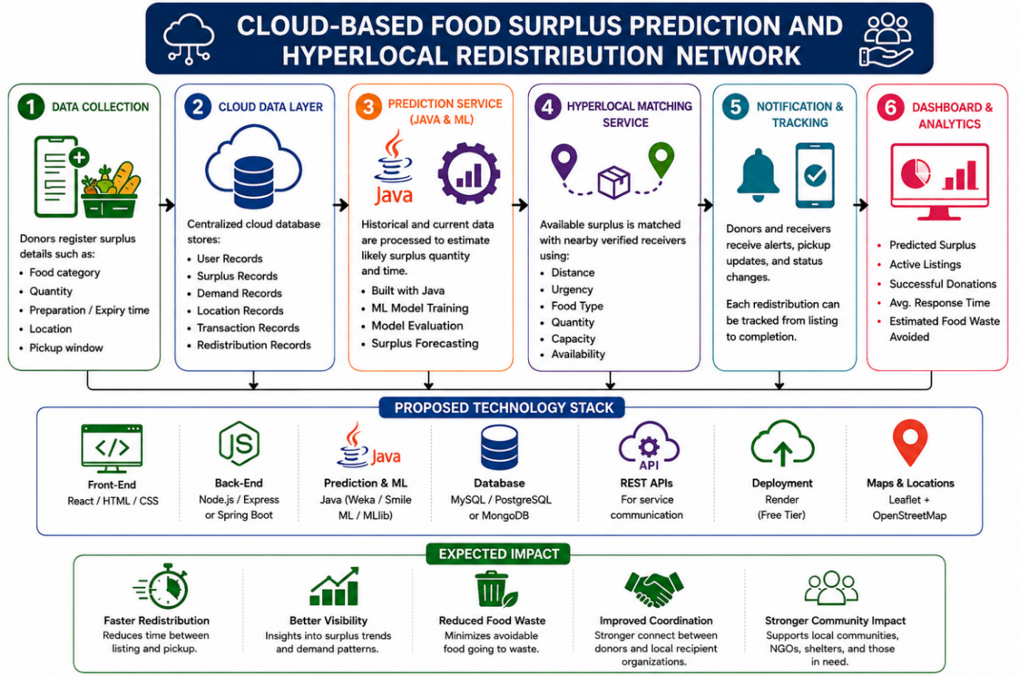
Proposed Solution Workflow
How it works
Inputs: food type, quantity, preparation/expiry time, demand patterns, day of week, location, previous surplus records
ML module estimates expected surplus quantity and timing
Alerts and matching with verified NGOs, kitchens, shelters, food banks
Service-oriented architecture keeps each function manageable
8

Slide 9
Review 1 & 2 Summary and Key Feedback
Strengths
Feedback
Actions Taken
Clear problem statement
Comprehensive research
Well-defined objectives
Focus on microservices implementation
Emphasize cloud scalability
Include security considerations
Designed service architecture
Started backend development
Created UI mockups
9

Slide 10
System Architecture & Microservices Design
User Service
Surplus Registration
Prediction Engine
Matching & Allocation
Notification Service
Tracking Service
Analytics Dashboard
Cloud Storage (AWS S3)
Services communicate through REST APIs, with an API gateway and security layer in front.
10

Slide 11
Implementation Progress Status
Backend Services (Java/Spring Boot)
70%
React Frontend UI
55%
Prediction ML Model
60%
Database Schema & Integration
80%
API Gateway & Security
45%
Cloud Deployment Setup
40%
11

Slide 12
Technology Stack & Integration
Frontend | React, HTML/CSS, Leaflet Maps, OpenStreetMap API
Backend | Spring Boot, Java, RESTful APIs, Microservices
ML/Prediction | Java ML libraries, Time-series forecasting
Database | PostgreSQL, Caching Layer (Redis)
Cloud/Deployment | Render, AWS S3, Docker containers
Tools | Git, Maven, Postman, JUnit Testing
12

Slide 13
Challenges Encountered & Solutions
Prediction accuracy with limited historical data
→
Data augmentation and ensemble methods
Real-time location tracking complexity
→
Leaflet integrated with batch geocoding APIs
Microservices communication latency
→
API caching and message queues
Data consistency across services
→
Event-driven architecture with database transactions
13

Slide 14
Demo & Prototype Results
User Registration
Surplus Registration
Map Integration
Prediction Engine
✓ Donor & recipient sign-up completed
✓ Role-based access control implemented
✓ Form validation working
✓ Image upload to S3 functional
✓ Leaflet maps displaying donors/recipients
✓ Real-time location filtering
✓ Basic ML model achieving 65% accuracy
✓ Prediction API endpoint working
14

Slide 15
Feasibility and Project Plan
Technical
Operational
Scalability
Expected Outcome
React/HTML/CSS, Spring Boot/Java, Java-based ML, database services, REST APIs, Render, Leaflet + OpenStreetMap.
Supports donors, volunteers, and recipient organizations through role-based services and tracking.
Cloud-based, service-oriented architecture supports centralized storage and scalable processing.
Faster redistribution, reduced food waste, improved transparency, stronger coordination.
Requirements
Data
Prediction
Services
UI & Matching
Testing
Deployment
15

Slide 16
Timeline & Next Milestones
1
2
3
4
Week 1-2
Week 3-4
Week 5-6
Week 7-8
Complete frontend UI
Integrate payment system
Notification service
Advanced matching algorithm
Security audit
Performance optimization
Final testing
Deployment & demo
16

Slide 17
Expected Impact & Conclusion
Faster Redistribution
Better Visibility
Reduced Food Waste
Improved Coordination
Stronger Community Impact
Less time between listing and pickup
Insights into surplus trends and demand patterns
Minimizes avoidable food going to waste
Stronger link between donors and local recipients
Supports communities, NGOs, shelters, and those in need
Conclusion & future work
Prediction, hyperlocal matching, notifications, and tracking come together in one cloud-native workflow. Next: finish the UI, notification service, advanced matching, security audit, and deployment.
17

Slide 18
Thank You!
Questions & Discussion

