Slide 1

News Aggregator
A Live News Website Made With React.Js

Slide 2
Introduction
NewsHub – React News Aggregator
A News Aggregator is an application or website that collects news articles from multiple sources and presents them in one centralized platform.
A modern and responsive web application built using React.js.
Aggregates real-time news articles from trusted sources such as BBC, CNN, Reuters, The New York Times, and more.
Provides a centralized platform where users can explore news across multiple categories like Business, Technology, Health, Sports, and Entertainment.
Features an intuitive user interface with category filters, search functionality, and bookmarks for personalized news access.

Slide 3
Objectives
1
Centralize News
3
Category-based Filtering
2
Bookmarking of Articles
4
Real-time search
multiple trusted sources (BBC, CNN, Reuters, etc.).
Technology, Business, Sports, Health, etc.
For later reading purposes
To maintain search history.

Slide 4
Features
Modes
Categories
Search Options
Notifications
Filter By News Source
Recently Viewed
Bookmarks
Share Options

Slide 5
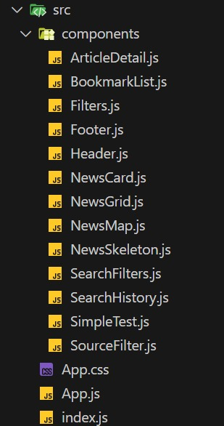
Project Structure

Slide 6
Development Process
Step 1 : Project Setup
Step 2 : UI/UX Design
Step 3 : Core Functionality
Initialized using React.js with create-react-app and dependencies were installed in package.json
Responsive layout was created with App.css and components were designed for navigation
News articles are fetched from NewsAPI using an API key and Features implemented
Step 4 : Enhancements
Step 5 : Testing & Deployment
Advanced features were integrated and local storage is used
Loading/error states were added, along with animations for smooth UX

Slide 7
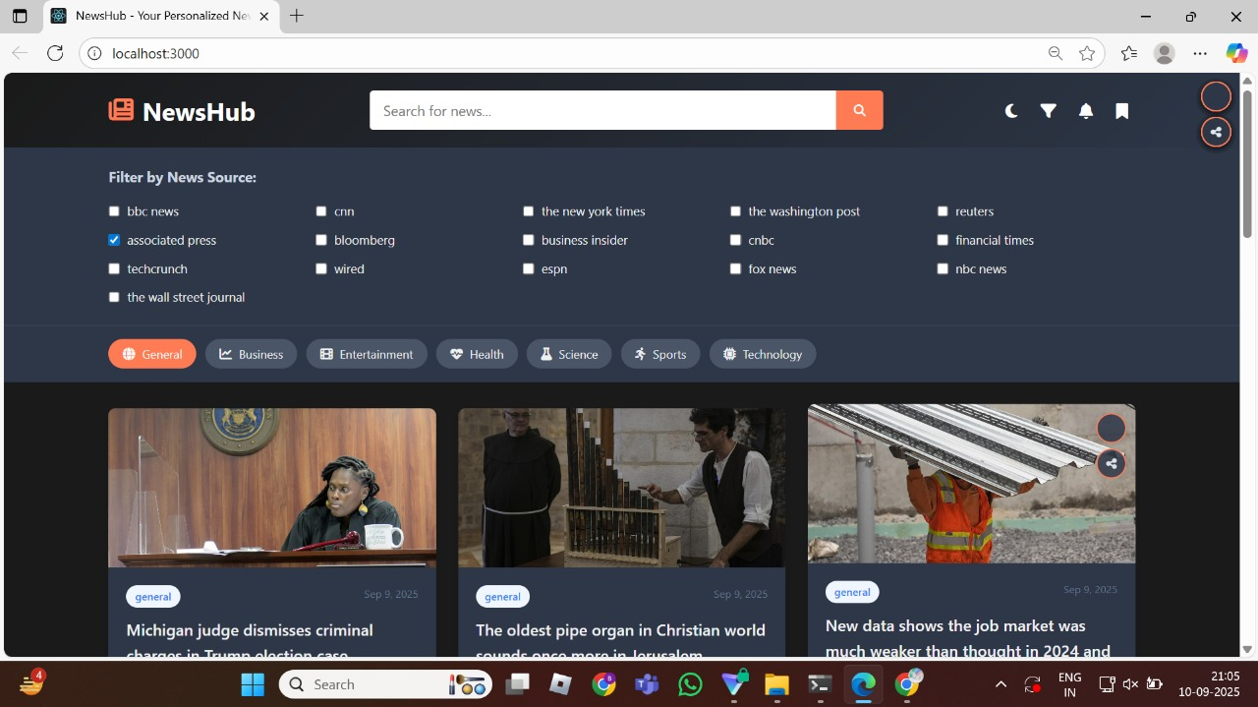

Slide 8
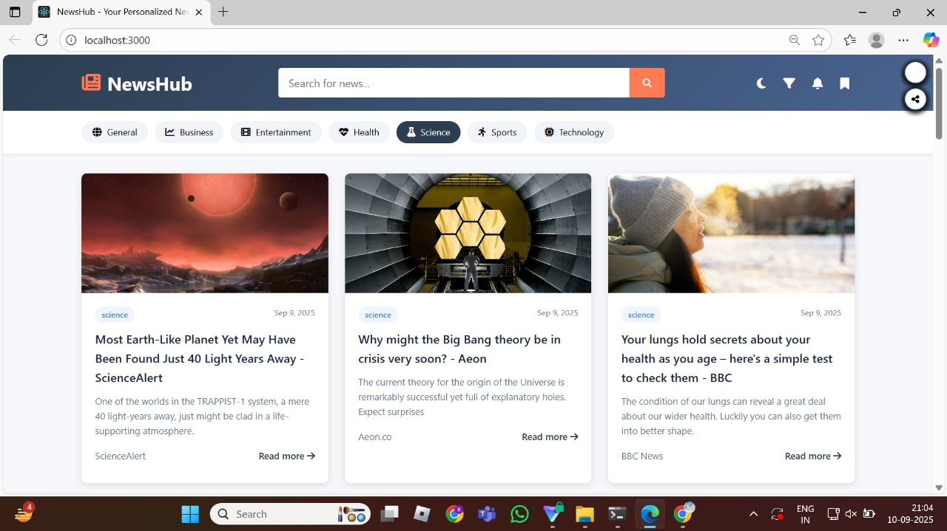

Slide 9
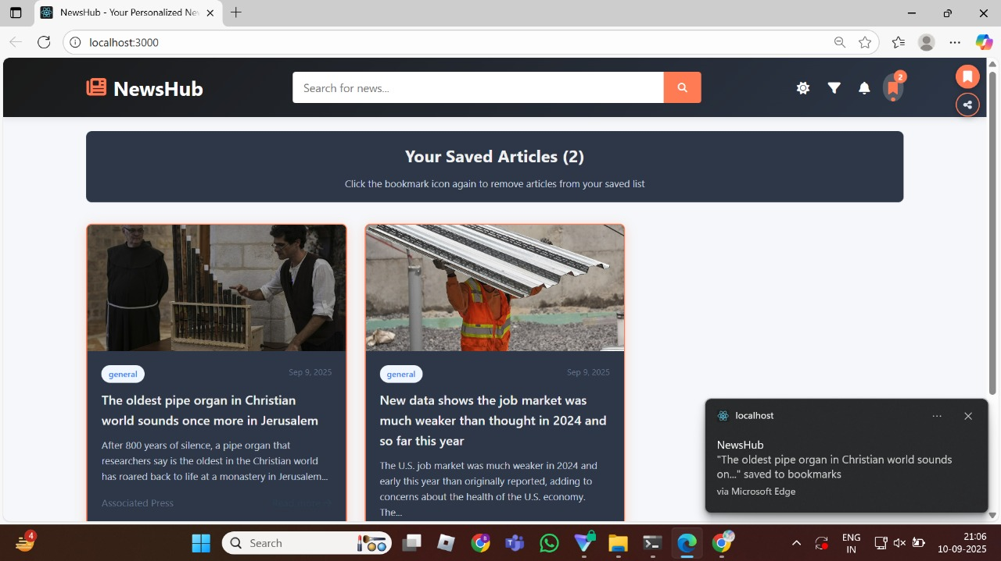
2022
001

Slide 10
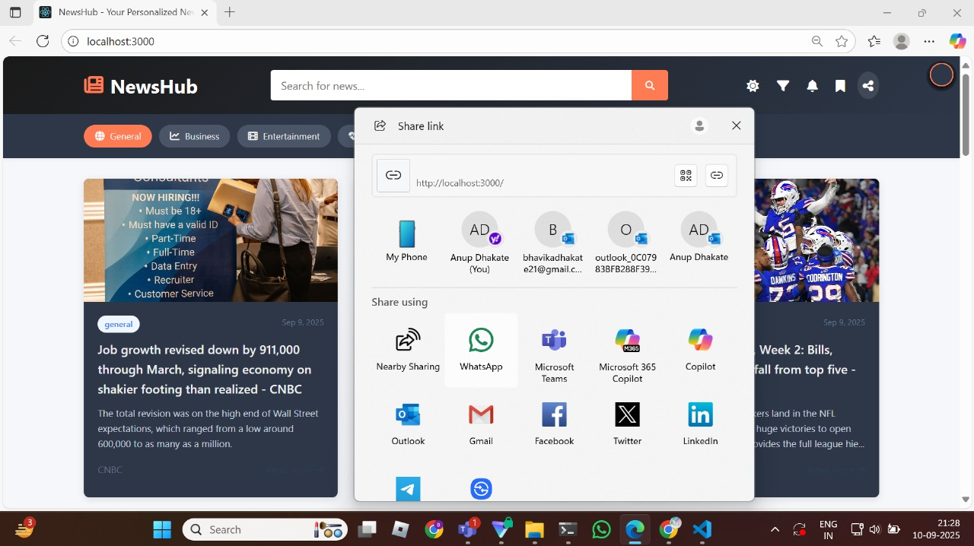

Slide 11
Conclusion
Enhances news accessibility through filters, bookmarks, and personalization features.
Offers a responsive UI ensuring smooth user experience across devices.
Future Enhancements:
AI-based personalized news recommendations
Multi-language news accessibility
Offline reading support
NewsHub establishes a scalable, modern, and user-friendly news aggregator.

Slide 12
Thank You !

