Slide 2
Hospital Equipment Availability Checking Website
Submitted to:
Department of Computer Science and Engineering

Slide 3
Supervised by: Prof. Ronak Jain
Team Members
1. Ansh Joshi (0827CS201036)
2. Bhavik Mundra (0827CS201057)
3. Bhavik Sharma (0827CS201058)
4. Bhavika Darpe (0827CS201059)

Slide 4
Project Presentation Outline
Abstract
Introduction
Problem Statement
Survey of Existing Systems
Project Objectives
Requirement Analysis
Designs/UML Diagrams
Solution Proposed
The Outcome Discussion
Conclusions and Limitations

Slide 5
Abstract
There are currently very few websites available to inform individuals of the existence of open beds at a hospital. Most individuals are unaware of which hospitals have vacant beds and the requisite equipment.
People check the availability by calling on the hospital number, available on internet.
It is possible that the number offered is inaccurate, forcing them to endure great suffering before receiving the proper assistance they need.
To overcome this problem, we have come up with an idea of a web application which will inform people regarding the vacancy of beds and availability of equipment in a particular hospital.

Slide 6
Introduction
In this project, a website will be created to get the information about the occupancy of beds and necessary equipment for the patients in a particular hospital, especially in emergency cases.
The patients can easily find the location of desired hospital as well as the information about the number of empty beds present.
The motivation to build this website is that it will help people to get information regarding the availability of beds and other resources easily.
Also, the government can keep a check on govt. and private hospitals through this web application, and accordingly can provide necessary facilities to improve the healthcare system of the state.

Slide 7
The Problem Statement
To get the information about the occupancy of beds and necessary equipment for the patients in a particular hospital, especially in emergency cases. An electronic system will be brought into usage to identify these and make patients aware and easy to find.

Slide 8
Survey of Existing Systems
There are currently very less websites available to inform about the availability of vacant beds.
For example:
Govt. of Delhi created a website which informs about the availability of covid beds only. Disadvantage of this website is that it is limited only to Delhi. Also, the information is not updated timely.
Another example is that there are few hospitals like Kokilaben Hospital that provide this service, but it is limited to them only.
Advantage of our website over other existing systems is that, we will create this for state/country level. We will ensure that hospital administration keeps their record updated.

Slide 9
Objectives
The main objective of this project is to get the information about the availability of bed and necessary items for the patients, especially in emergency cases.
Additionally, this product provides information about staff and doctors availability, facilities available in the hospital, location, reviews of hospital, etc.
The aim of this web application is to quantify Immediate Bed Availability (IBA) in a hospital and treat needs of hospitalized patients whose needs could be met outside a traditional hospital setting.

Slide 10
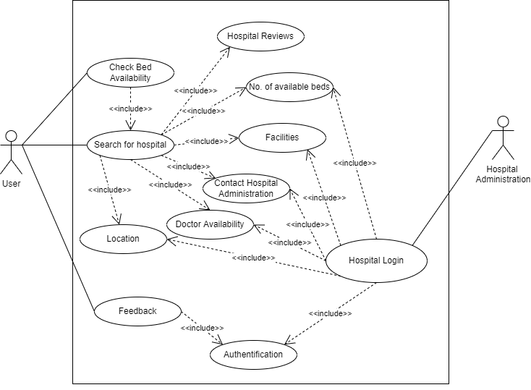
USE-CASE DIAGRAM

Slide 11
Requirement Analysis
Functional Requirements:
1. Login:
This functionality is available for hospital administration only. A user cannot login as this website is made only for information sharing, user cannot take appointment or anything from this website. Hospital administration need to login time to time to keep the information updated.

Slide 12
Requirement Analysis
2. Check bed availability/ Check particular hospital:
The user may check the availability of beds at a certain hospital by providing the hospital name, or they can search for beds in a specific city in addition to a specific hospital. However the beds can’t be booked in advance and patient needs to visit the hospital for the same. Additionally, the hospital administration can be called for assistance and to find out the availability of the doctors. The hospital administration manages provision of all the facilities through hospital management tools.

Slide 13
Requirement Analysis
3. Feedback:
The user may also offer feedback and ideas that are verified by the hospital administration. Feedbacks will help the community for hospital selection and hospital to improvise for its betterment.

Slide 14
Requirement Analysis
Non-Functional Requirements:
This website can run on any web browser.
Security
Usability
Scalability
Performance
Maintainability

Slide 15




Solution Proposed
The website is designed to be linked to an existing facility manager system to gather information about the number of beds and their physical location in each room. The process model used for this web application development is Prototype model. We will be using following languages for developing this website:
HTML 5
CSS 3
PHP
JavaScript
MySQL

Slide 16
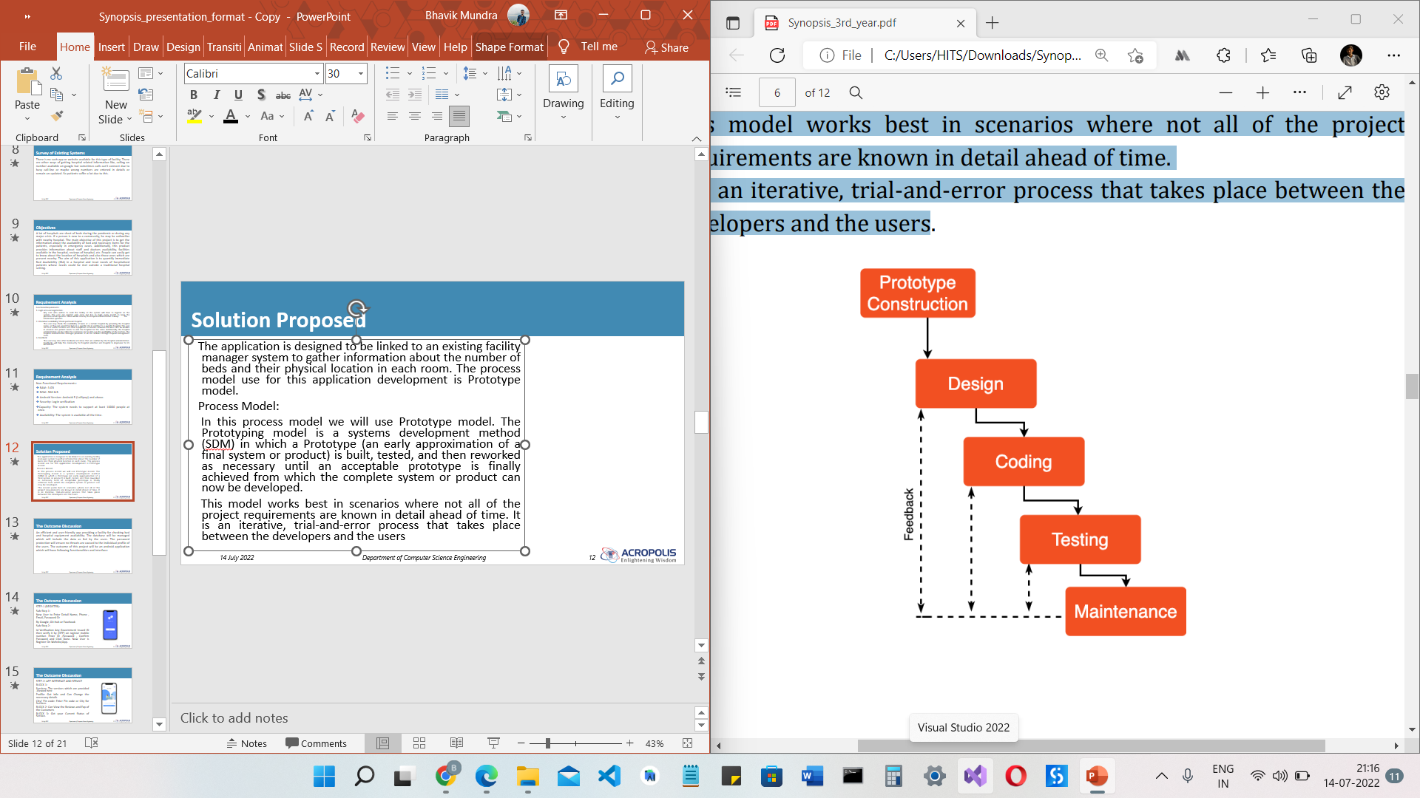
Solution Proposed
Process Model:
In this process model we will use Prototype model. The Prototyping model is a software development method (SDM) in which a Prototype (an early approximation of a final system or product) is built, tested, and then reworked as necessary until an acceptable prototype is finally achieved from which the complete system or product can now be developed.

Slide 17
The Outcome Discussion
An efficient and user-friendly website the database will be managed which will include the data as fed by the hospital administration. The website will provide following facilities:
Search a Hospital
Check Bed Availability
Sort Hospital List
Check Doctor’s availability
Equipment’s available
Prices of beds and equipment
Location of the Hospital
Contact information of Hospitals

Slide 18
Conclusion and Limitation
Conclusions:
The computerized system provides an efficient way to avail the facilities without consuming much time. It is easy for the users to keep track of empty beds as information will always remain updated.
Limitations:
Correct record should be filled.
Update records timely.

Slide 19
Acknowledgment
We are very grateful to our teachers and professors who gave us a chance to work on this project. We would like to thank him for giving us valuable suggestions and ideas.
We would also like to thank our college for providing us all the necessary resources for the project. All in all, we would like to thank everyone involved in this project and helped us with their suggestions to make the project better.

Slide 20
Q&A

Slide 21
THANKS

