Slide 1




VERIALPHA
A REGIME-AWARE AI TRADING SYSTEM WITH RELIABLE BACKTEST
Group 17
BHAVIKA BHOJWANI
LAKSHYA SITLANI
VISHAL SINGH
VERIALPHA
Presented By:

Slide 2

OVERVIEW
Problem Statement
Proposed Solution
Financial markets continuously shift between bull, bear, sideways, and high-volatility regimes, making single-strategy trading models unreliable. Most existing RL trading systems rely on one agent and a single backtest, often leading to overfitting and poor real-world performance.
High-Level Strategic Agent (PPO): Detects market regimes and selects the optimal trading strategy with dynamic risk allocation.
Low-Level Execution Agent (SAC/DDQN): Executes trades while minimizing slippage and transaction costs.
Certification Pipeline: Eliminates overfitted models using robust validation and statistical tests.
Live Paper Trading: Monitors real-time performance against backtests through an integrity dashboard.

Slide 3

OBJECTIVE
Develop a Hierarchical RL System: Build PPO-based strategy selection with SAC/DDQN-based trade execution for Indian equity markets.
Implement Confidence-Based Risk Management: Dynamically allocate capital and abstain from trading in uncertain market regimes.
Ensure Model Reliability: Validate models using walk-forward testing, PBO, and Deflated Sharpe Ratio to prevent overfitting.
Evaluate Performance: Benchmark against baseline DRL models using risk-adjusted return metrics and statistical validation.

Slide 4
LITERATURE REVIEW
PAPER | TITLE | KEYPOINTS | GAP
[1].https://arxiv.org/abs/2012.12620 | Deep Stock Trading: A Hierarchical Reinforcement Learning Framework for Portfolio Optimization and Order Execution | Two-level hierarchical RL combining portfolio weight allocation with order execution | Operates at the portfolio level rather than being conditioned on market regime
[2].https://ojs.aaai.org/index.php/AAAI/article/view/16142 | Commission Fee is not Enough: A Hierarchical Reinforced Framework for Portfolio Management | High-level agent sets portfolio weights; low-level agent handles execution | Portfolio-level design, not regime-conditioned
[3].https://doi.org/10.3390/ai6080183 | A Deep Reinforcement Learning Framework for Strategic Indian NIFTY 50 Index Trading | Benchmarks DQN, DDQN, and Dueling DDQN on 15-min NIFTY 50 OHLC data with technical indicators | Each architecture is a single fixed policy; no regime classifier or hierarchical conditioning

Slide 5
PAPER | TITLE | KEYPOINTS | GAP
[4].https://aaai.org/papers/00643-deeptrader-a-deep-reinforcement-learning-approach-for-risk-return-balanced-portfolio-management-with-market-conditions-embedding/ | DeepTrader: A Deep Reinforcement Learning Approach for Risk-Return Balanced Portfolio Management with Market Conditions Embedding | Introduces a Market Scoring Unit and Asset Scoring Unit to embed market conditions into RL | Embeds a regime signal directly but doesn't use a separate, dedicated classifier
[5].https://arxiv.org/abs/2201.09058 | DeepScalper: A Risk-Aware Reinforcement Learning Framework to Capture Fleeting Intraday Trading Opportunities | Risk-aware reward shaping for intraday RL trading | Risk-aware but not hierarchical or regime-based
[6].https://personal.ntu.edu.sg/boan/papers/TIST23_RLFintech.pdf | Reinforcement Learning for Quantitative Trading | Comparative survey of RL trading methods | Explicitly flags regime-adaptation as an open research gap
[7].https://arxiv.org/abs/2307.11685 | Towards Generalizable Reinforcement Learning for Trade Execution | Studies generalization of RL trade-execution policies across market conditions | Execution-only; no explicit regime classifier
[8].https://arxiv.org/abs/2309.12891 | sEarnHFT: Efficient Hierarchical Reinforcement Learning for High Frequency Trading | 3-stage hierarchical RL with an agent pool and a minute-level router | Built for crypto HFT; relies on a heavy multi-agent pool (hundreds of agents)
[9].https://arxiv.org/abs/2406.14537 | MacroHFT: Memory Augmented Context-Aware Reinforcement Learning on High Frequency Trading | Memory-augmented, context-aware RL using sub-agents per regime plus a hyper-agent | HFT-focused with a heavier memory-augmented architecture

Slide 6
PAPER | TITLE | KEYPOINTS | GAP
[10].https://arxiv.org/abs/2410.14927 | Hierarchical Reinforced Trader (HRT): A Bi-Level Approach for Optimizing Stock Selection and Execution | Bi-level design: high-level controller (HLC) sets direction, low-level controller (LLC) executes | Directional views only; no supervised regime classifier
[11].https://arxiv.org/abs/2507.18560 | HARLF: Hierarchical Reinforcement Learning and Lightweight LLM-Driven Sentiment Integration for Financial Portfolio Optimization | 3-tier hierarchy (base/meta/super agents) integrating LLM-based sentiment | Heavier LLM stack, harder to reproduce within a one-semester timeline
[12].https://www.mdpi.com/2079-9292/15/6/1334 | Regime-Aware LightGBM for Stock Market Forecasting: A Validated Walk-Forward Framework with Statistical Rigor and Explainable AI Analysis | LightGBM classifier conditioned on rolling HMM-detected regimes, with walk-forward validation and XAI | Classifier only — no downstream RL execution agent coupled to it
[13].iMachine_Learning-Driven_Market_Regime_Analysis_in_Equity_Markets_A_Gaussian_Hidden_Markov_Model_Approach | Machine Learning-Driven Market Regime Analysis in Equity Markets: A Gaussian Hidden Markov Model Approach | Multivariate Gaussian HMM + PCA identifying 9 distinct market regimes | Detection only; no coupling to an RL execution system
[14].https://arxiv.org/pdf/2604.10996 | When Valid Signals Fail: Regime Boundaries Between LLM Features and RL Trading Policies | Diagnostic analysis of failure modes when LLM/regime features are injected into RL policies | Purely diagnostic — identifies the problem but proposes no hybrid solution
[15].https://doi.org/10.3390/sym18010112 | Deep Reinforcement Learning for Financial Trading: Enhanced by Cluster Embedding and Zero-Shot Prediction | Cluster Embedding-PPO (CE-PPO) for zero-shot prediction, structuring inputs before the RL agent sees them | Uses unsupervised cluster embedding, not a supervised regime classifier

Slide 7
TOOLS AND TECHNIQUES
CATEGORY | TOOLS/TECHNQUES
Language | Python 3.11
RL frameworks | Stable-Baselines3 (PPO, SAC), custom Dueling DDQN in PyTorch, Gymnasium custom environments
Hierarchical RL | Options framework with regime-conditioned termination β(s); separated reward objectives per level
Regime detection | Gaussian HMM (hmmlearn) primary; change-point confidence; K-Means/GMM compariso
Data | yfinance / NSE bhavcopy (historical daily), Zerodha Kite Connect (minute bars + live paper trading), FRED (India VIX / macro)

Slide 8
TOOLS AND TECHNIQUES
CATEGORY | TOOLS/TECHNQUES
Feature engineering | Pandas, NumPy, ta / TA-Lib (RSI, MACD, EMA, ATR, ADX, Bollinger, OBV, Stoch-RSI, VWAP)
Validation & statistics | Rolling walk-forward with purged folds; Probability of Backtest Overfitting (CSCV); Deflated / Probabilistic Sharpe Ratio (Bailey & López de Prado); Jobson–Korkie test with Memmel correction; block-bootstrap confidence intervals
Cost modelling | Fixed bps spread + STT/brokerage + square-root market-impact law
Dashboard | Streamlit + Plotly
Engineering | Git/GitHub, pytest, GitHub Actions CI, Docker (optional)

Slide 9
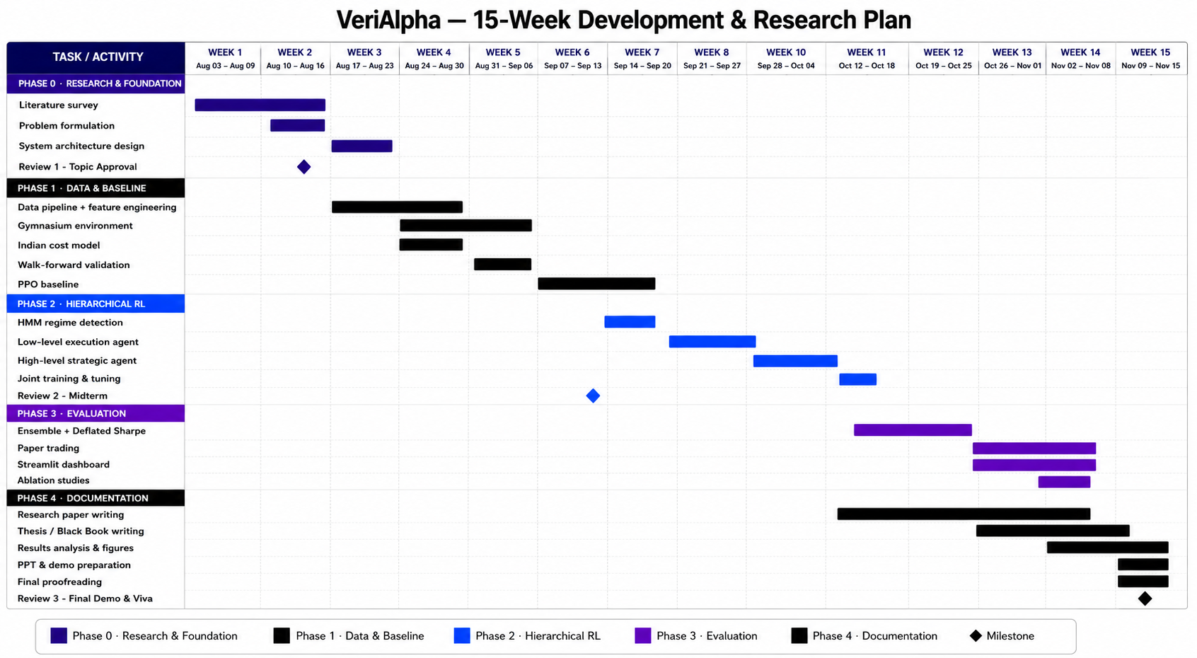
PLAN

Slide 10
REFERENCES
[1] Anonymous, Deep Stock Trading: A Hierarchical Reinforcement Learning Framework for Portfolio Optimization and Order Execution, arXiv:2012.12620, 2020.
[2] Wang, R., Wei, H., An, B., Feng, Z., & Yao, J., Commission Fee is not Enough: A Hierarchical Reinforced Framework for Portfolio Management, AAAI Conference on Artificial Intelligence, 2021.
[3] Mishra, R. G., Sharma, D., Gadhavi, M., Pant, S., & Kumar, A., A Deep Reinforcement Learning Framework for Strategic Indian NIFTY 50 Index Trading, AI, 2025.
[4] Wang, Z., Huang, B., Tu, S., Zhang, K., & Xu, L., DeepTrader: A Deep Reinforcement Learning Approach for Risk-Return Balanced Portfolio Management, AAAI, 2021.
[5] Sun, S., Xue, W., Wang, R., et al., DeepScalper: A Risk-Aware Reinforcement Learning Framework to Capture Fleeting Intraday Trading Opportunities, CIKM, 2022.
[6] Sun, S., Wang, R., & An, B., Reinforcement Learning for Quantitative Trading, ACM Transactions on Intelligent Systems and Technology, 2023.
[7] Zhang, C., Duan, Y., Chen, X., et al., Towards Generalizable Reinforcement Learning for Trade Execution, arXiv:2307.11685, 2023.

Slide 11
REFERENCES
[8] Qin, M., Sun, S., Zhang, W., et al., EarnHFT: Efficient Hierarchical Reinforcement Learning for High Frequency Trading, AAAI, 2024.
[9] Niu, H., et al., MacroHFT: Memory Augmented Context-Aware Reinforcement Learning on High Frequency Trading, KDD, 2024.
[10] Anonymous, Hierarchical Reinforced Trader (HRT): A Bi-Level Approach for Optimizing Stock Selection and Execution, arXiv:2410.14927, 2024.
[11] Coriat, B., & Benhamou, E., HARLF: Hierarchical Reinforcement Learning and Lightweight LLM-Driven Sentiment Integration for Financial Portfolio Optimization, IJCAI FinLLM Workshop, 2025.
[12] Pagliaro, A., Regime-Aware LightGBM for Stock Market Forecasting: A Validated Walk-Forward Framework with Statistical Rigor and Explainable AI Analysis, Electronics, 2026.
[13] Anonymous, Machine Learning-Driven Market Regime Analysis in Equity Markets: A Gaussian Hidden Markov Model Approach, 2025.
[14] Anonymous, When Valid Signals Fail: Regime Boundaries Between LLM Features and RL Trading Policies, arXiv:2604.10996, 2026.
[15] Anonymous, Deep Reinforcement Learning for Financial Trading: Enhanced by Cluster Embedding and Zero-Shot Prediction, Symmetry, 2026.

Slide 12
THANKYOU

