Slide 1
IPL DATA
Submitted By:
Bhavika Arora (2210990220)

Slide 2
Index
Objective
Introduction
Problem statement
Methodology, Approach & Techniques
Source Code (screenshots)
Result
Conclusion
Reference

Slide 3
Objective
1. Explore and visualize IPL data to uncover insights into player performance, team strategies, match outcomes, and trends using various data visualization techniques.
2. Develop predictive machine learning models to forecast match results, player performance, or team rankings based on historical IPL data, evaluating model accuracy and effectiveness.
3. Conduct in-depth player performance analysis to identify top performers in batting, bowling, fielding, strike rates, economy rates, and other key metrics, presenting findings through visualizations or rankings.
4. Optimize team strategies by analyzing historical data for batting orders, bowling rotations, fielding positions, and suggest data-driven improvements to enhance overall team performance.

Slide 4
Introduction
1. The Indian Premier League (IPL) is a widely popular cricket league known for its competitive matches, talented players, and significant impact on the sports industry.
2. This data project utilizes Python programming and data analysis techniques to explore IPL data, focusing on player performance, team strategies, match outcomes, fan engagement, and revenue generation.
3. By delving into IPL data through data exploration, visualization, predictive modeling, and strategic analysis, the project aims to uncover valuable insights that contribute to a deeper understanding of IPL and inform decision-making in cricket management, fantasy leagues, and sports analytics.

Slide 5
Problem statement
Develop a Python-based data analysis solution for IPL that:
1. Analyzes historical data to identify trends in player performance, team strategies, match outcomes, and fan engagement.
2. Builds predictive models for match results, player performances, and team rankings, evaluating model accuracy.
3. Creates interactive visualizations and dashboards for user-friendly exploration of IPL data.
4. Offers data-driven recommendations for optimizing team strategies, player performances, fan engagement, and revenue generation.
5. Provides actionable insights for strategic decision-making in cricket management, fantasy leagues, sponsorship, marketing, and sports analytics related to the IPL.

Slide 6
Methodology, Approach & Techniques
1. Data Collection: Gather comprehensive IPL data from reliable sources, including player statistics, match results, team strategies, fan engagement metrics, and revenue data.
2. Data Preprocessing: Cleanse the data by handling missing values, removing duplicates, standardizing formats, and encoding categorical variables for analysis.
3. Exploratory Data Analysis (EDA): Understand data distributions, correlations, outliers, and key insights using statistical methods and visualizations such as histograms, scatter plots, and heatmaps.
4. Feature Engineering: Create or transform features to enhance predictive modeling, such as calculating batting averages, bowling strike rates, player rankings, and team performance metrics.
5. Predictive Modeling: Build machine learning models (e.g., regression, classification, clustering) for match outcomes, player performances, and team rankings, using techniques.

Slide 7
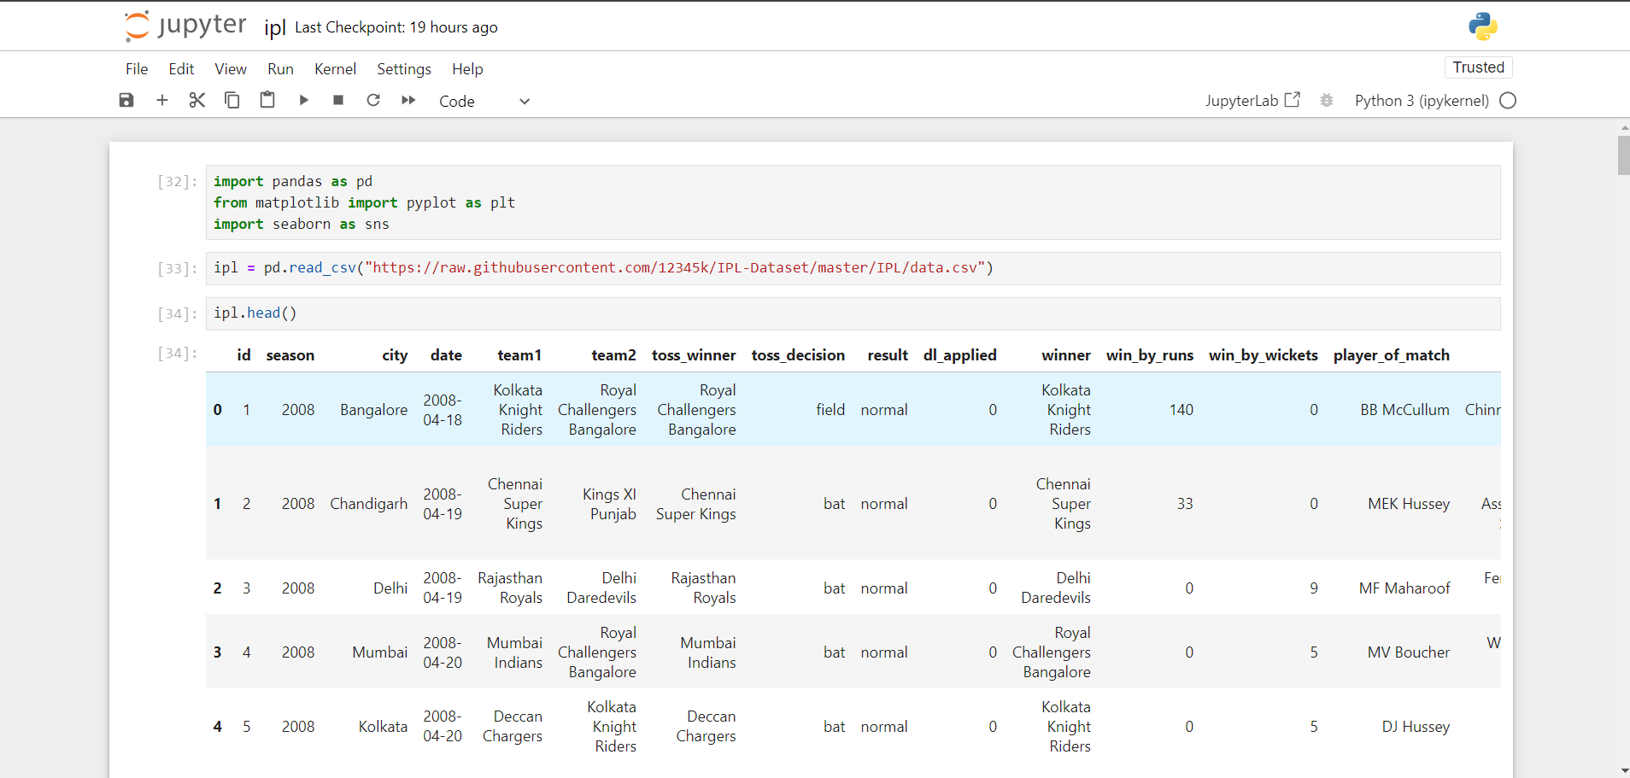
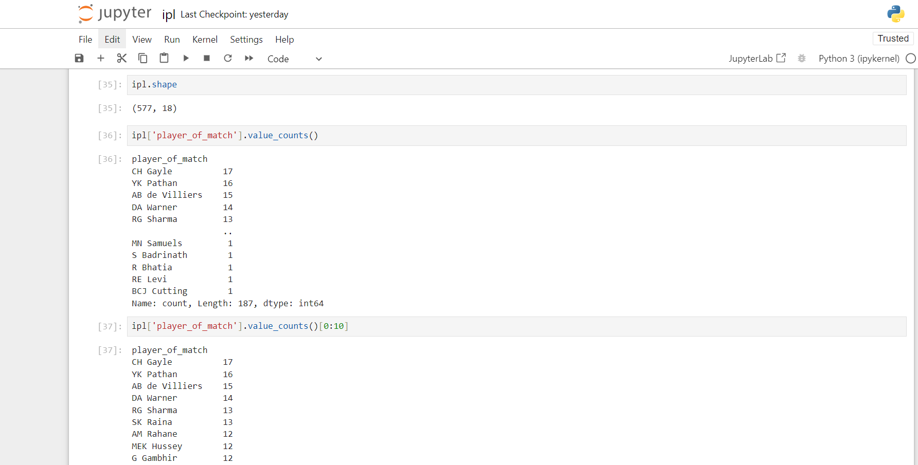
Source Code (screenshots)

Slide 8
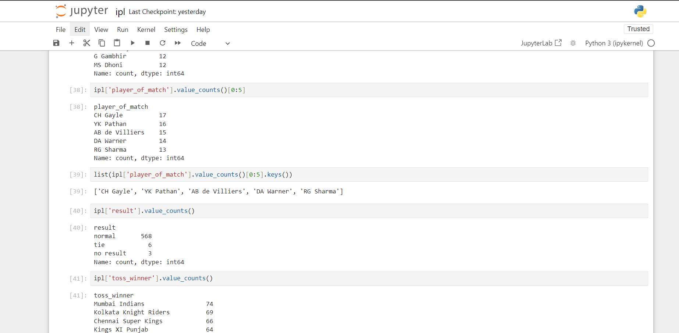
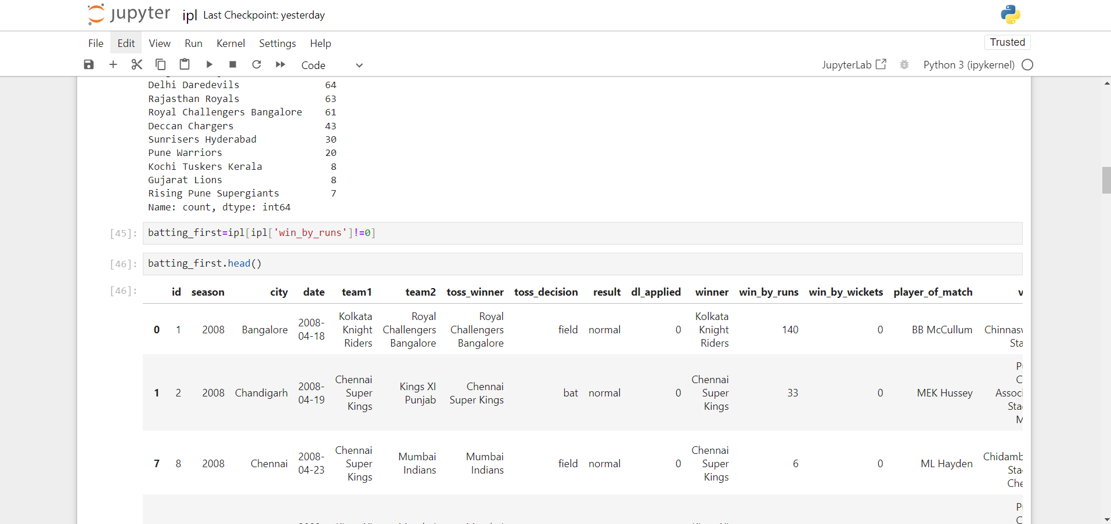
Source Code (screenshots)

Slide 9
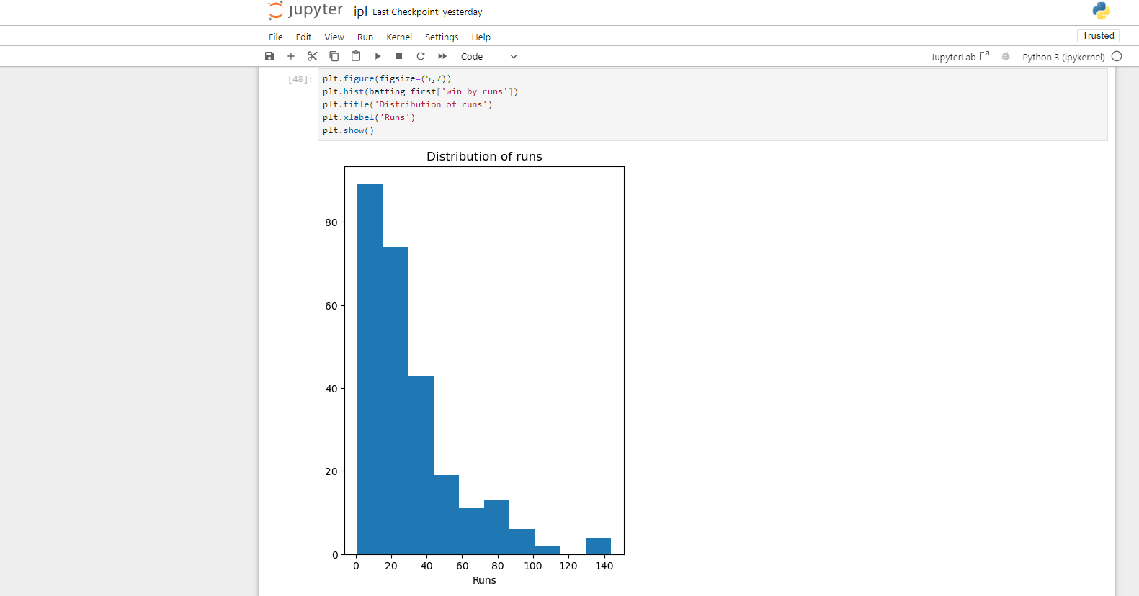
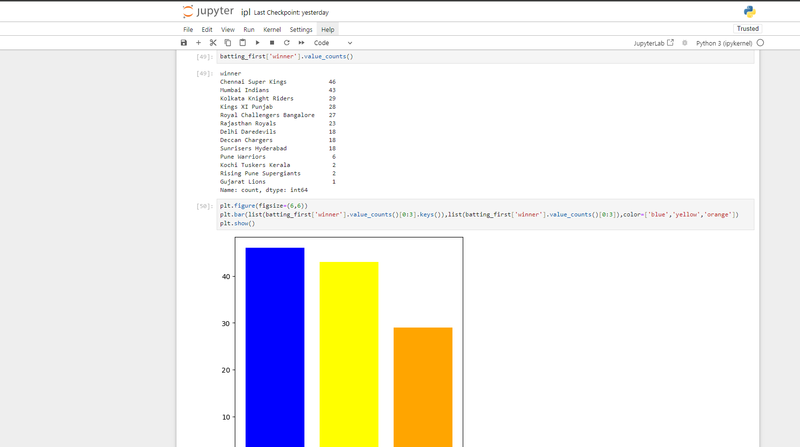
Source Code (screenshots)

Slide 10
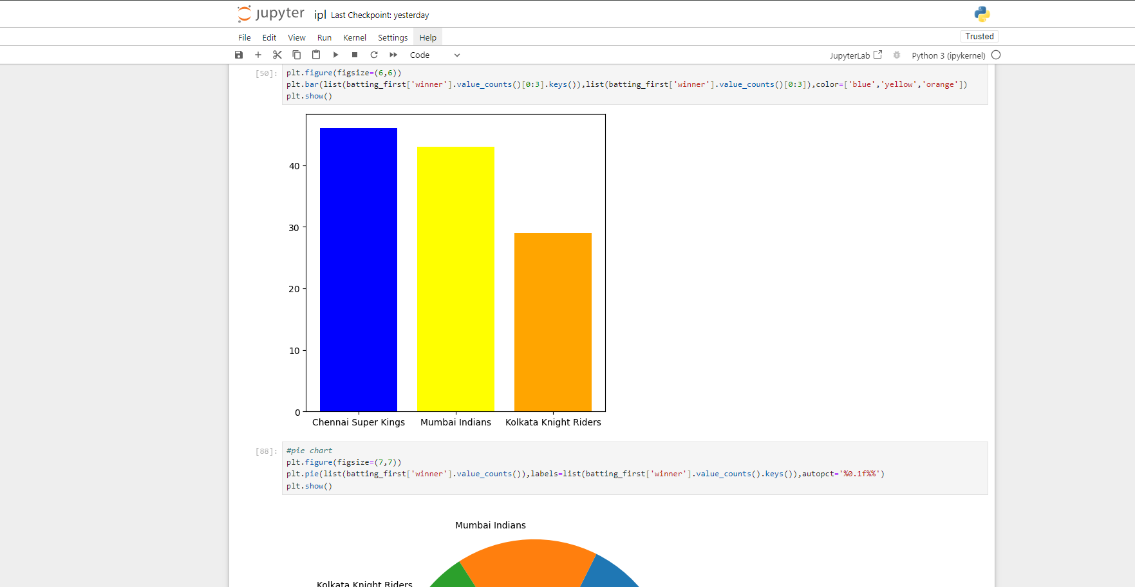
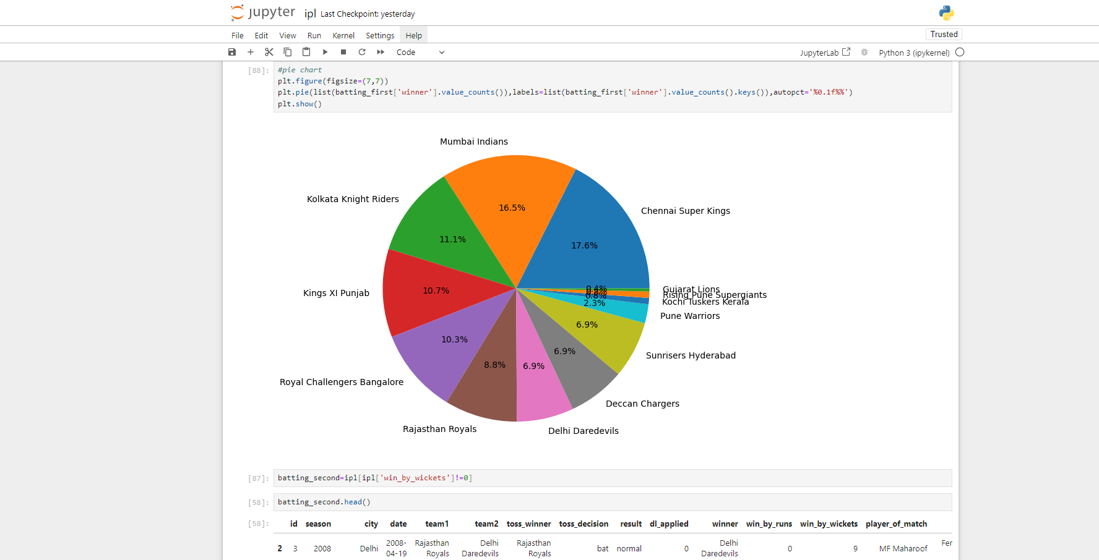
Source Code (screenshots)

Slide 11
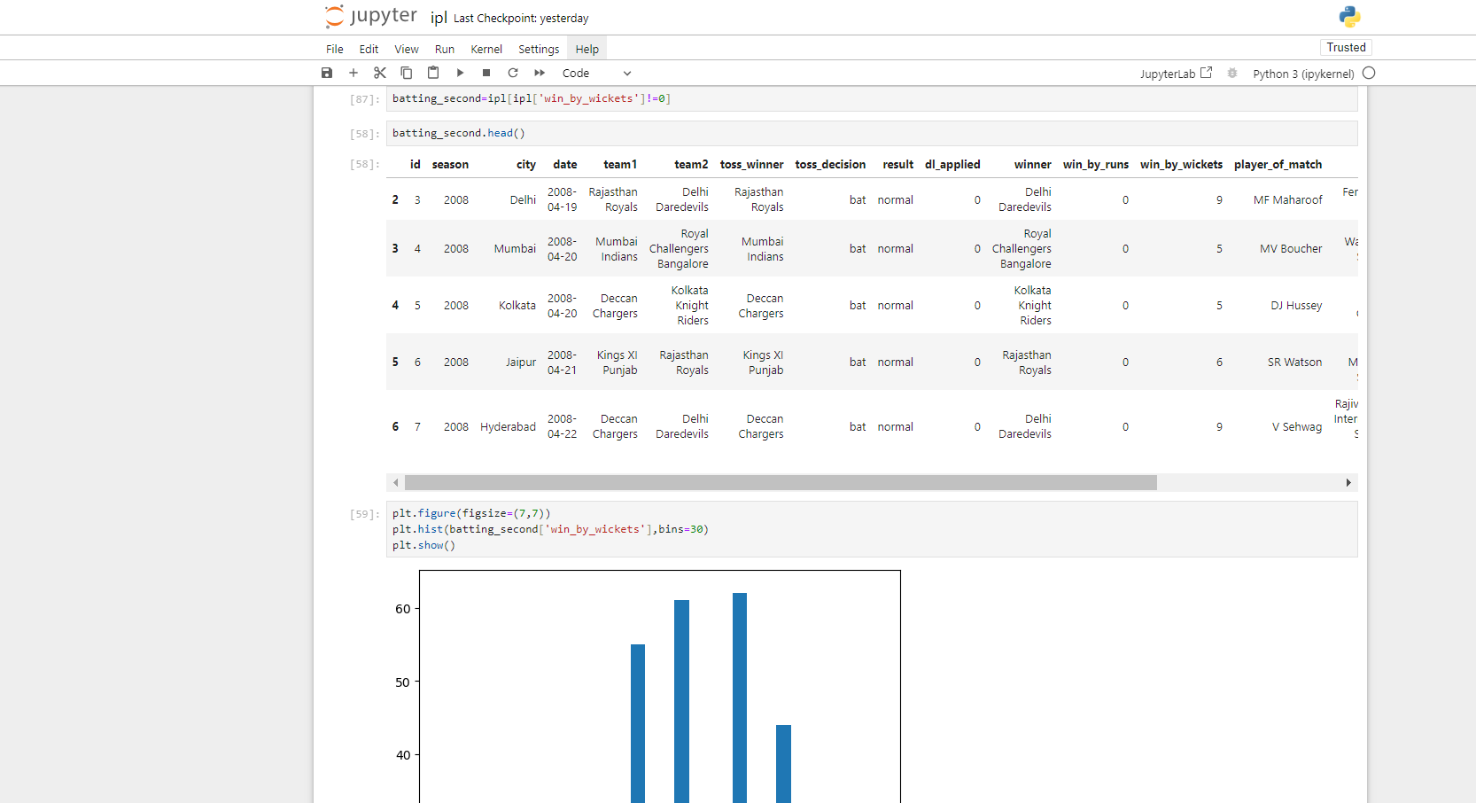
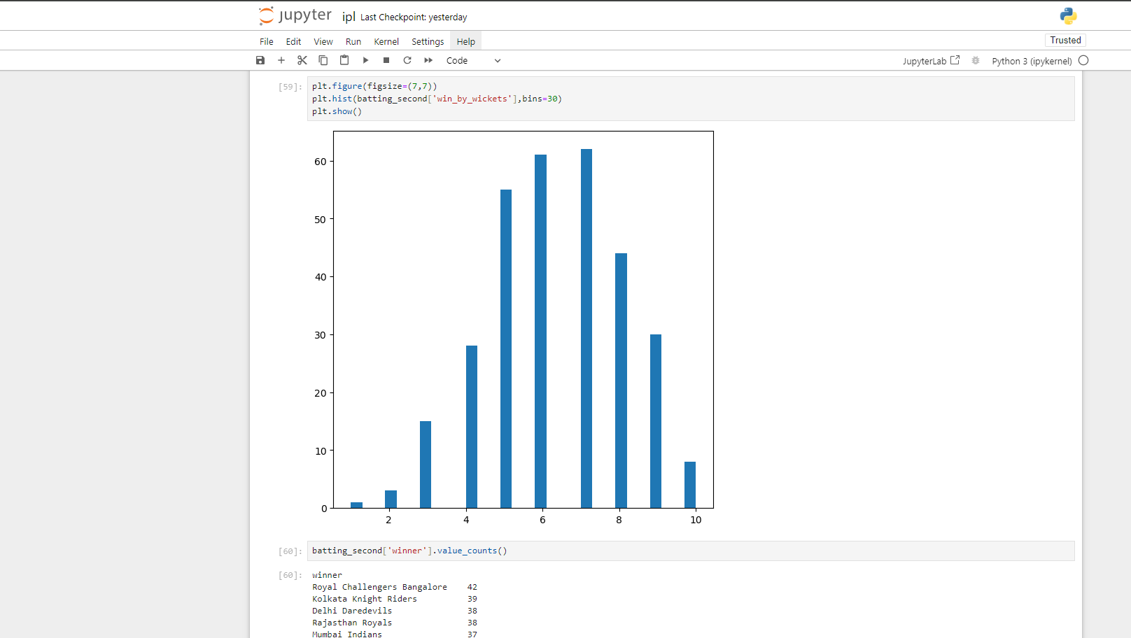
Source Code (screenshots)

Slide 12
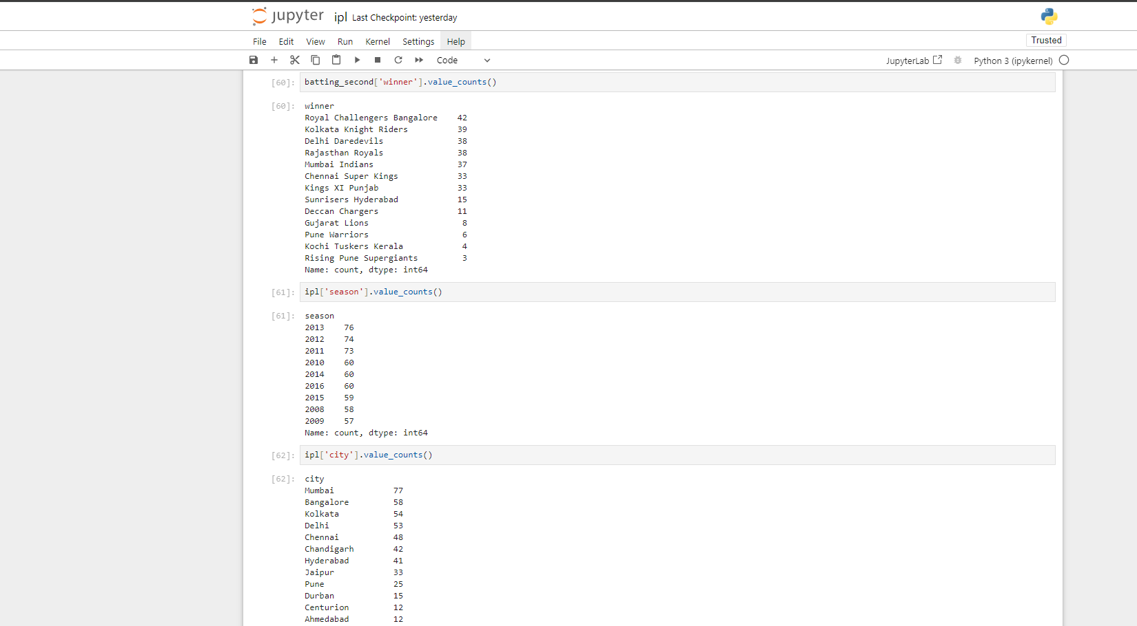
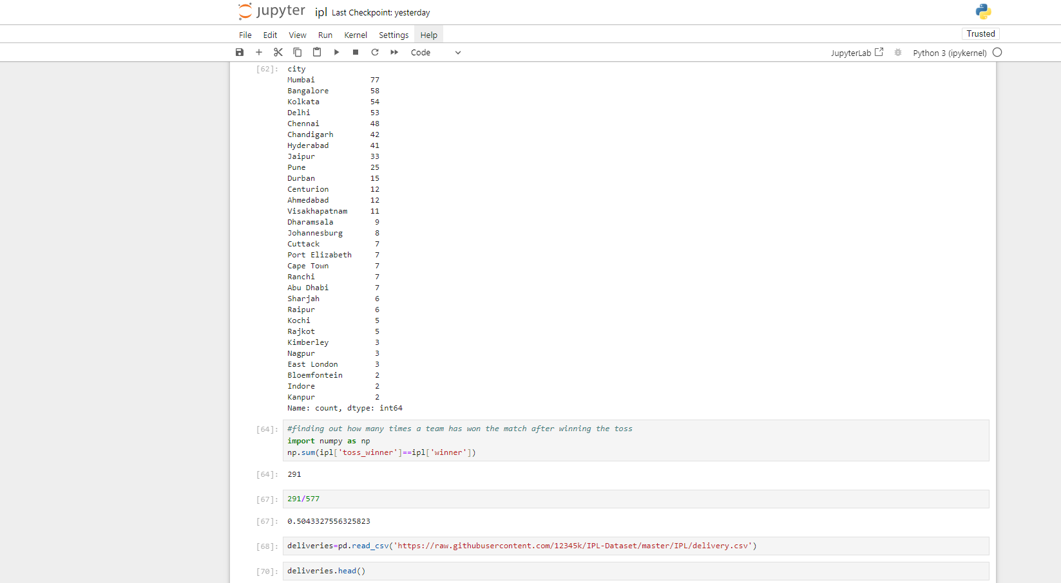
Source Code (screenshots)

Slide 13
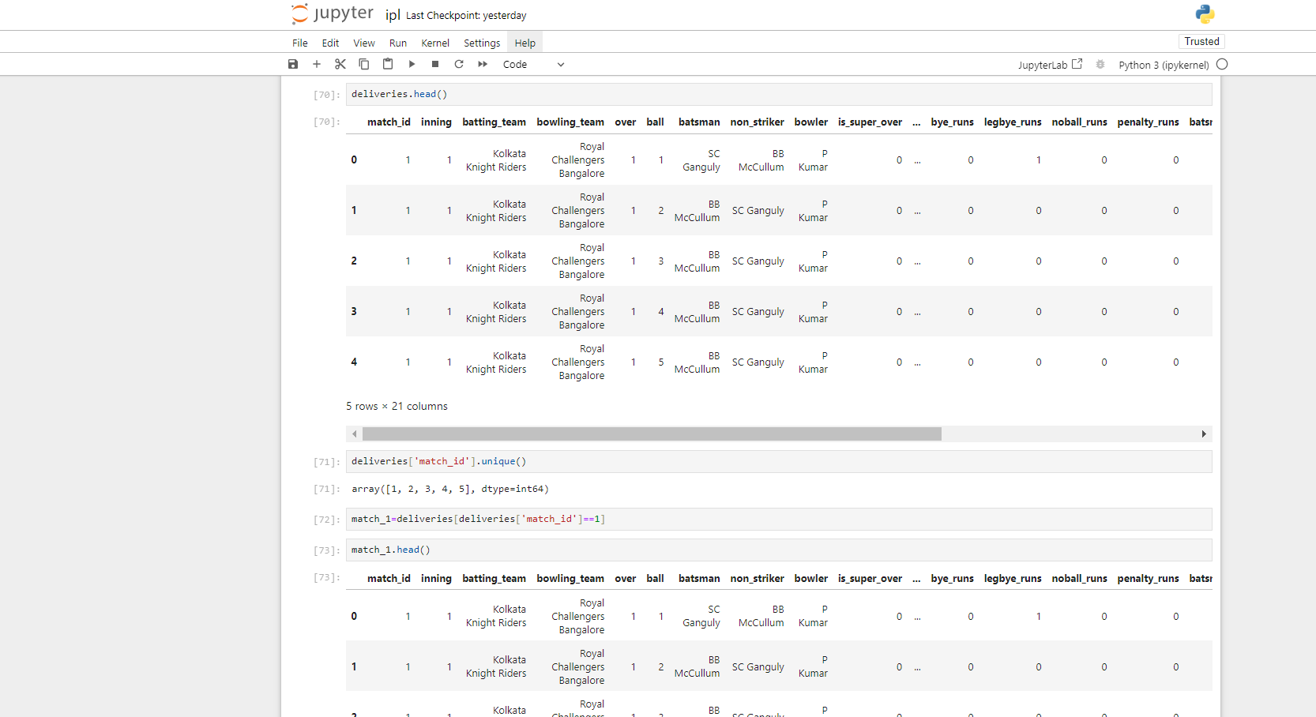
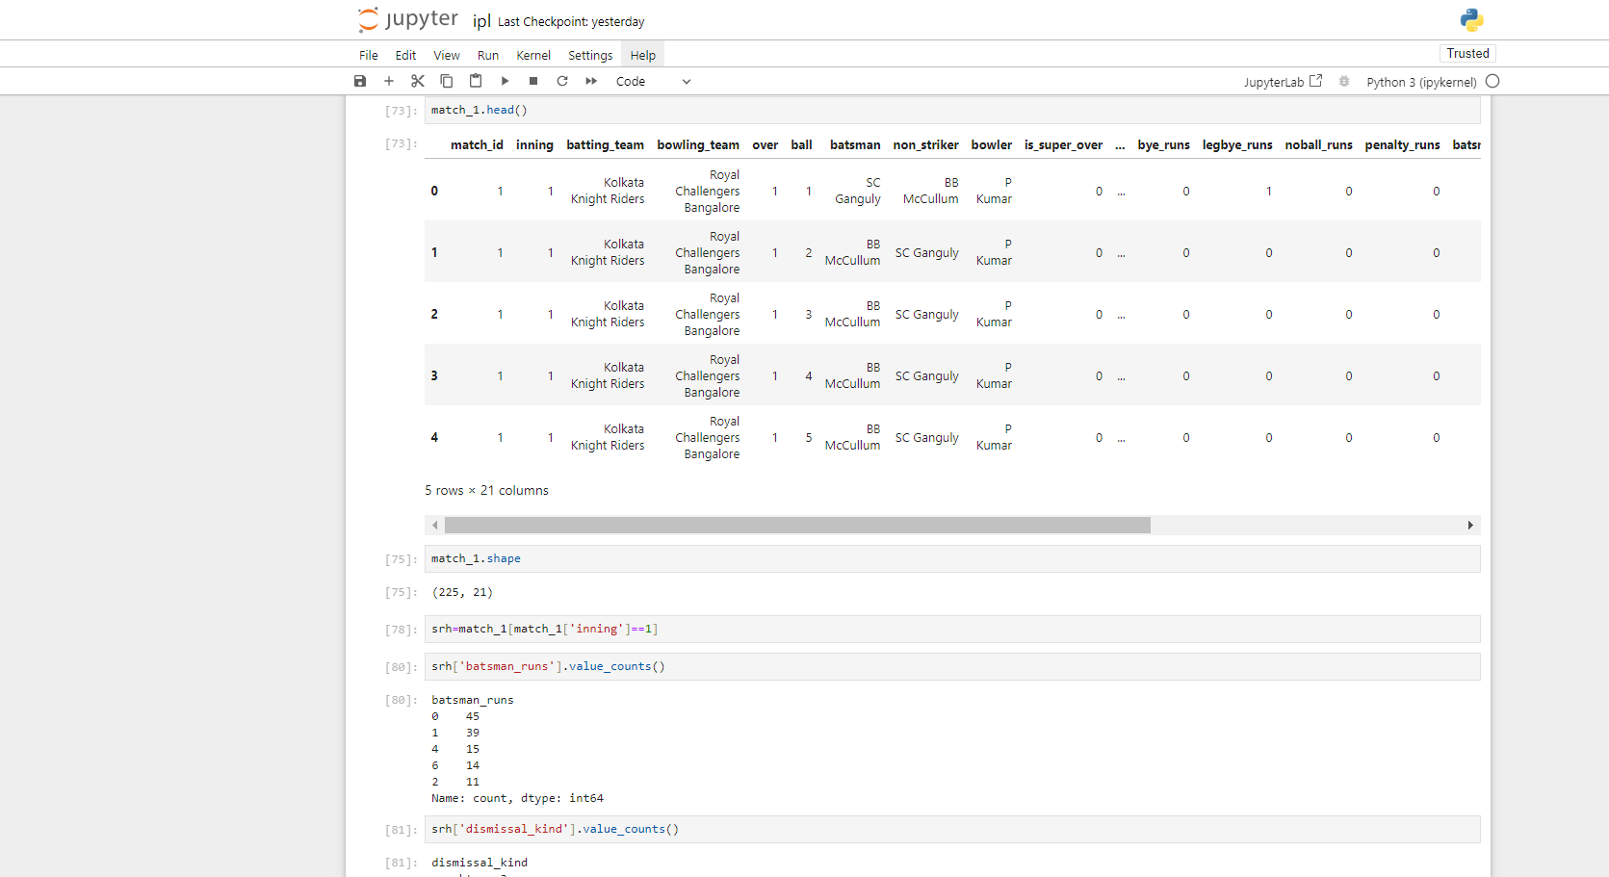
Source Code (screenshots)

Slide 14
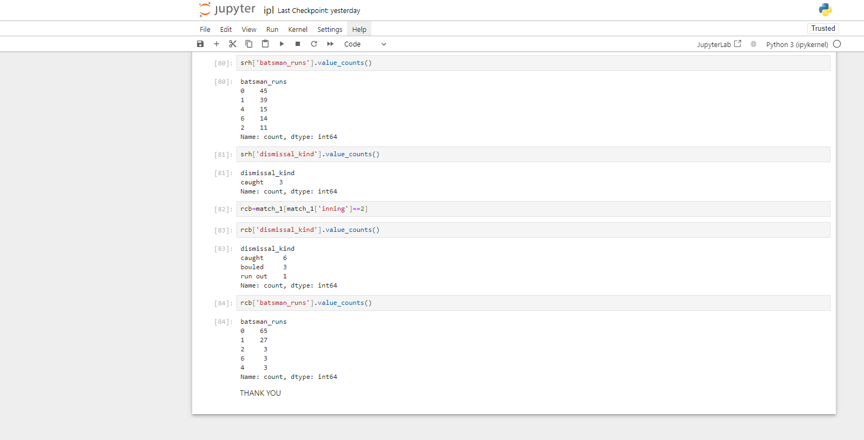
Source Code (screenshots)

Slide 15
Conclusion
The Python-based IPL data analysis project has successfully uncovered valuable insights through data preprocessing, exploratory analysis, predictive modeling, and visualization techniques.
Interactive visualizations and dashboards provide stakeholders with a user-friendly platform to explore data dynamically, enabling informed decision-making in cricket management, fantasy leagues, sponsorship, marketing, and sports analytics.
Continuous learning, collaboration with stakeholders, and staying updated with emerging trends will be pivotal in refining data analysis methodologies and delivering actionable insights for optimizing strategies and maximizing revenue in the IPL ecosystem

Slide 16
Reference
[1] https://www.youtube.com/watch?v=XHzQvq-ltAo&t=24888s
[2] https://www.geeksforgeeks.org/python-programming-language/

Slide 17
The End

