Slide 1
"Student Marks Management System"
Submitted by:
Bhavika Chopra-2210990221

Slide 2
Index
Objective
Introduction
Problem statement
Methodology, Approach & Techniques
Source Code (screenshots)
Result
Conclusion
Reference

Slide 3

Objective
To develop a user-friendly program that allows users to input and store marks for students in different subjects, calculate their average marks, and store this information in a file. This project aims to provide a convenient tool for educators or administrators to efficiently manage and track students' academic performance

Slide 4

Introduction
The "Student Marks Management System" automates the process of recording and managing students' academic performance.
Users can input marks for individual students in subjects
The system calculates the average score for each student, providing a comprehensive overview of their academic performance.
Data is stored in a file named "student_marks.txt", ensuring easy access and facilitating data management and analysis.
By streamlining the mark recording process, the system enhances educators' ability to monitor students' progress, identify trends, and make data-driven decisions to support student success.

Slide 5

Problem statement
How can educational institutions efficiently manage and track students' academic performance, considering the challenges associated with manual recording of marks and data management? Specifically, how can a system be developed to automate the process of recording marks for individual students across various subjects, calculate average scores, and maintain a centralized repository for easy access and analysis?

Slide 6

Methodology, Approach & Techniques
System Design: Develop a robust system architecture with intuitive interfaces for mark input, average score calculation, and data storage, ensuring scalability, reliability, and user-friendliness.
Algorithm Implementation: Implement efficient algorithms for calculating average scores and performing other necessary computations, optimizing for speed and accuracy to handle varying dataset sizes.
Data Management: Utilize suitable data structures and database technologies to manage student marks data securely, ensuring integrity, accessibility, and scalability for efficient data retrieval and storage.
Testing and Validation: Conduct thorough testing to identify and rectify software bugs and errors, validating against user requirements to ensure the system meets specified objectives and functions reliably.

Slide 7
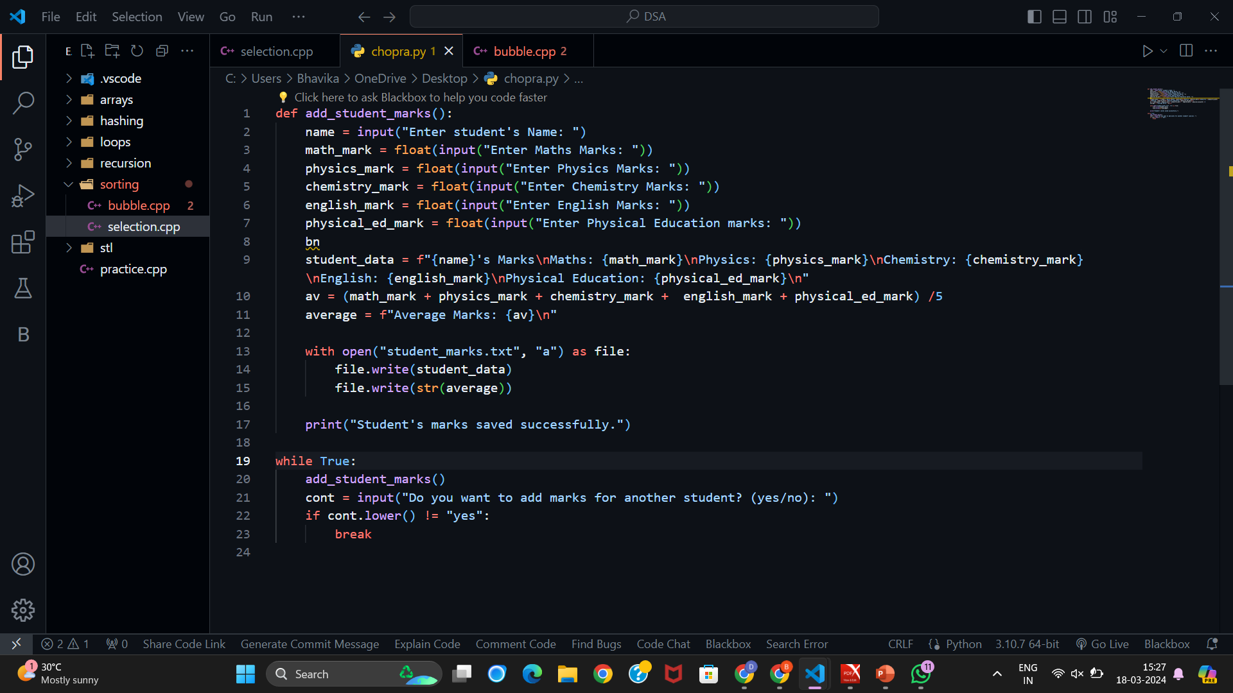
Source Code (screenshots)

Slide 8
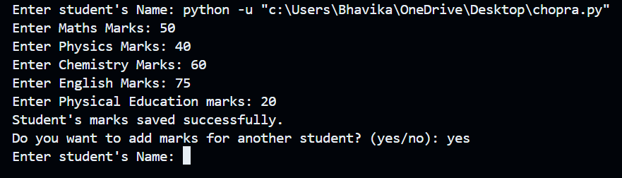
Result

Slide 9

Conclusion
In summary, the development of a "Student Marks Management System" addresses the challenges faced by educational institutions in efficiently managing and monitoring students' academic performance. Through thorough requirement analysis and systematic system design, the system offers intuitive interfaces for inputting marks, calculating averages, and storing data securely.
Overall, the implementation of the "Student Marks Management System" represents a significant step towards modernizing academic management practices, enabling educational institutions to leverage technology to optimize student performance tracking and support mechanisms.

Slide 10

Reference
[1] Stack Overflow, https://stackoverflow.com/, Accessed on March 4, 2024.
[2] Git hub: www.github.com
[3] geek for geek : www.geekforgeek.com
[4]W3schools

Slide 11
The End

