Slide 1

Smart Expense Tracker Automation
n8n + Google Forms + Google Sheets
Transforming Manual Finance into Smart Automation
Submitted by:-
Bhavika (2520982541)
Deeksha (2520982551)
Udita Bansal (2520982749)
Prachi ( 2520982677)
Notes:
N8n is a powerful automation toll which helps it’s users to connect apps, databases and ai models without using extensive coding. So any person who is not from coding background can also use it for their assistance . n8n connects the form to the sheet, adds smart rules in between, and turns expense tracking from a 5-day process into a 5-second one.”

Slide 2


Why Change Was Needed
The Old Way
❌ Approval Delays
Employees submitted expenses via scattered emails. Data lived in disconnected spreadsheets, and approvals wound through slow, manual chains — with no single source of truth.
Requests sat in inboxes for days
❌ Human Errors
Manual entry led to frequent mistakes
❌ Missing Records
No centralised audit trail
❌ Zero Visibility
No real-time status on any expense
Result: An inefficient, time-consuming system that cost businesses both money and trust.
Notes:
Have you ever noticed how submitting and approving expenses in companies can be slow and confusing?That’s exactly the problem we tried to solve through our project.” This slide explains why change was needed in the expense management system.Earlier, the process was completely manual. Employees used to submit their expenses through emails, and all the data was stored in different spreadsheets. Because of this, there was no single place where all the information was available.Due to this old system, several problems occurred.First, there were approval delays. Since requests were sent through emails, they often stayed in inboxes for days before getting approved.Second, there were human errors. Because everything was done manually, mistakes in data entry were very common.Third, there were missing records. As there was no centralized system, it was difficult to track or maintain proper records.And lastly, there was zero visibility. There was no real-time update, so employees and managers couldn’t track the status of expenses.Because of all these issues, the overall system became inefficient and time-consuming, which also affected business costs and trust.So, this clearly shows the need for a better, automated solution.”

Slide 3




Automation Is the Answer
A single, centralised pipeline replaces every manual step — from submission to approval notification.
Submit
Store
Employees fill a structured Google Form
Data lands instantly in Google Sheets
Trigger
Notify
n8n detects every new entry in real time
Automated email alerts sent immediately
FAST
ACCURATE
REAL-TIME
Notes:
This slide shows how automation solves all the problems we discussed earlier.Instead of using emails and scattered spreadsheets, we created a single, centralized system that handles everything automatically—from submission to approval.First step is Submit.Employees fill a structured Google Form to enter their expense details. This ensures that all data is collected in a proper and uniform format.Next is Store.As soon as the form is submitted, the data is automatically stored in Google Sheets. So, there is no need for manual entry, and all records are saved in one place.Then comes Trigger.Here, we use a tool called n8n, which detects every new entry in real time. This acts like a bridge between different steps and starts the automation process instantly.Finally, Notify.Once the entry is detected, automated email alerts are sent immediately to the concerned person for approval. This removes delays and keeps everyone updated.Because of this system, the process becomes fast, accurate, and real-time, eliminating human errors and saving a lot of time.So overall, automation makes the entire expense tracking system more efficient and reliable.”

Slide 4






Technology Behind the Automation
n8n Deeksha
Open n8n website
Register yourself with an email, verify your email
And now dashboard will be opened
Google Sheets
Live, centralised data storage with full audit history
Google Forms
Open google form, add title, add fields like employee name, department etc, then click link to google sheets, create new sheet as expense tracker data
Gmail Node
Dispatches formatted alert emails to relevant stakeholders
Set Node
If Node
Structures and formats raw form data before processing
Applies conditional logic to route expenses appropriately

Slide 5
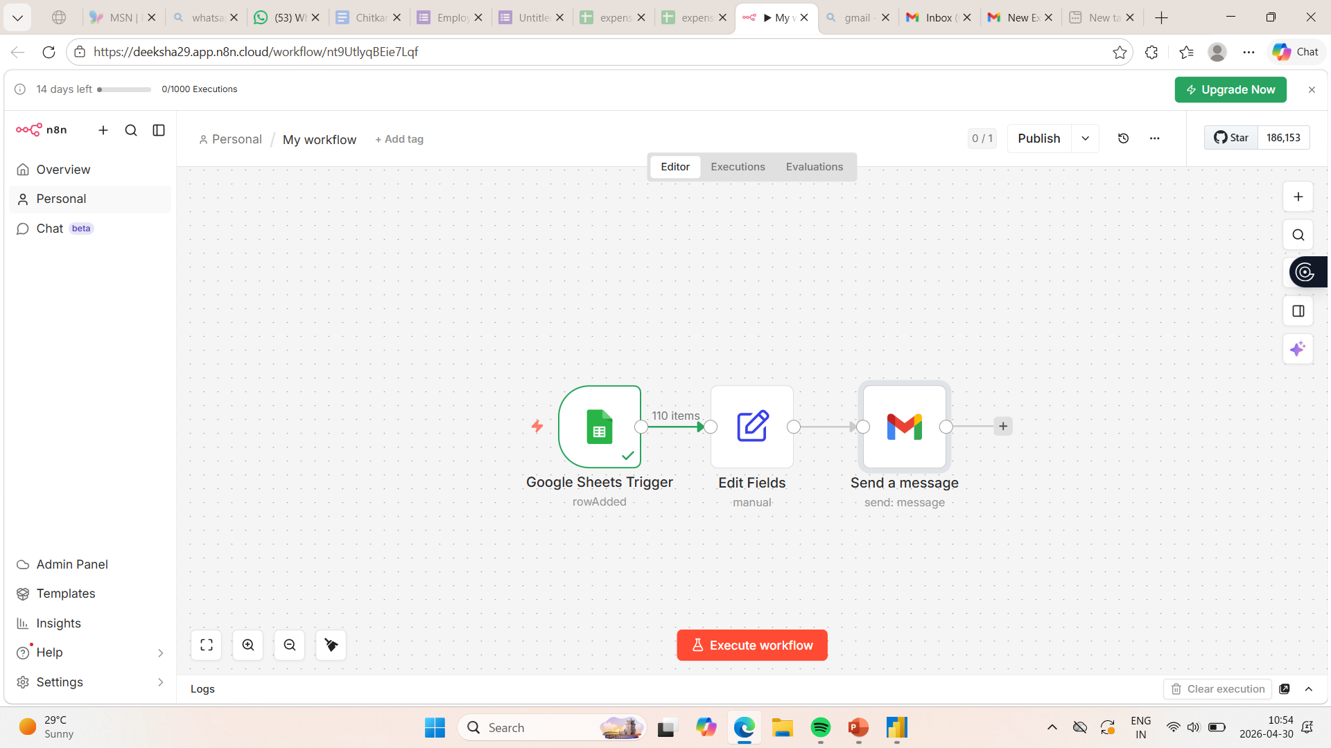
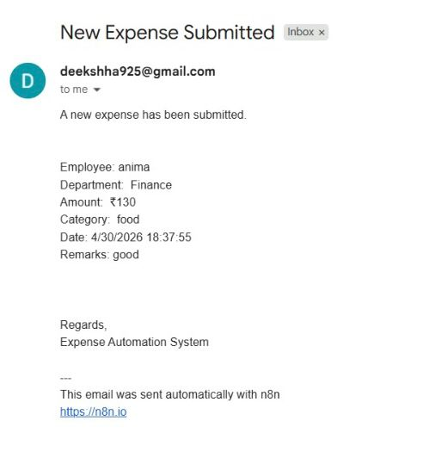
System Working

Slide 6
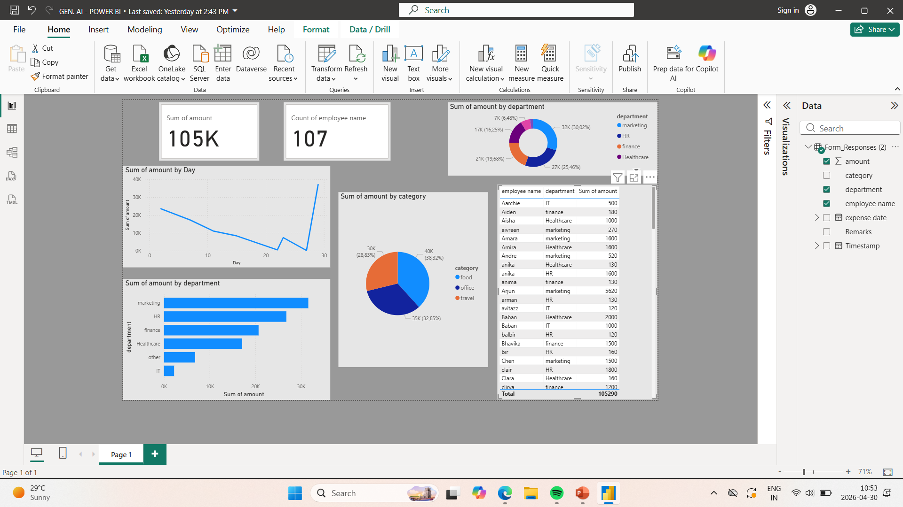

Slide 7

Results That Matter
The automated pipeline delivers measurable improvements across every stage of the expense management lifecycle.
100%
0
Auto-Logged
Manual Steps
Every submission captured without manual entry
Post-submission workflow is fully hands-free
Real-Time
↑
Visibility
Efficiency
Live tracking of all expense records
Faster processing, fewer errors, better decisions
From form submission to email alert — the entire workflow completes in seconds, not days.

Slide 8

Automation = The Future of Finance
This project demonstrates how low-code tools can solve real business problems — efficiently and at scale.
🕒 Saves Time
💡 Reduces Errors
Eliminates hours of manual data entry and follow-up
Automated logic ensures consistent, accurate processing
🔍 Improves Transparency
Every expense is tracked, timestamped, and auditable
Smart systems for smart businesses — built with n8n, Google Forms, and Google Sheets.
Notes:
Finance is moving from manual ,error prone work to a system that is fast, accurate and scalable.Benefits-Saves time by eliminating manual data entry and then waiting days for approval instead now an employee just submits a google form and n8n instantly picks it up and processes it and logs it into google sheets. Reduces error- the process has become accurate and there are no Chances of error and human bias as it is completely automated Improves transparency- as anybody who has the access can know who spent , how much he spent and on what things the person spent on .

