Slide 1
NoteNest:
Smart Docs

Slide 2
Introduction
NoteNest is a simple web application developed to store and manage notes and PDF documents in one place. It helps users upload, organize, and access their study materials easily. It is developed using React.js, Node.js, Express.js, and MongoDB Atlas.
01

Slide 3
Problem
  Students store notes and PDFs in different places.
  Finding required documents takes time.
  Managing multiple files is difficult.
  There is no single place to organize all study materials.
03

Slide 4
Purpose
  To reduce the time spent searching for documents.
  To provide an easy-to-use interface for managing files.
  To store all study materials in one place.
  To make file uploading and accessing simple.
04

Slide 5
System Architecture
Frontend
React.js
Backend
Node.js + Express.js
Database
MongoDB Atlas
05

Slide 6
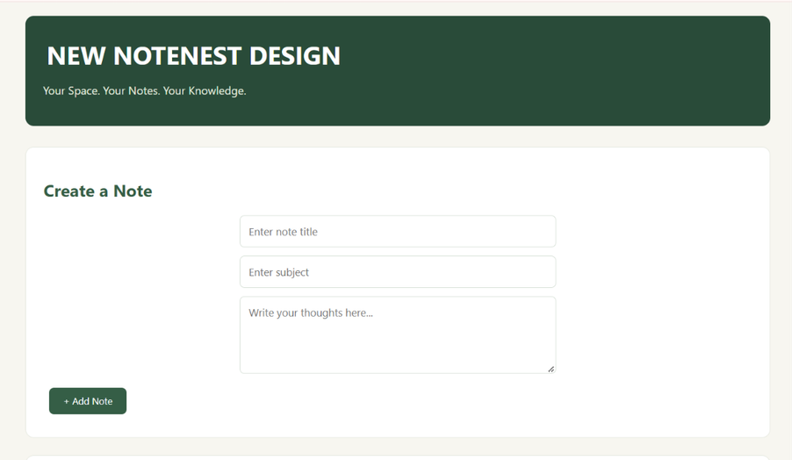
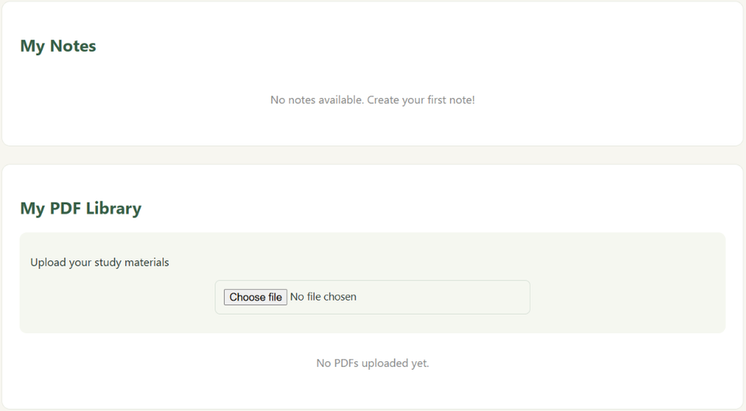
IMPLEMENTATION
08

Slide 7
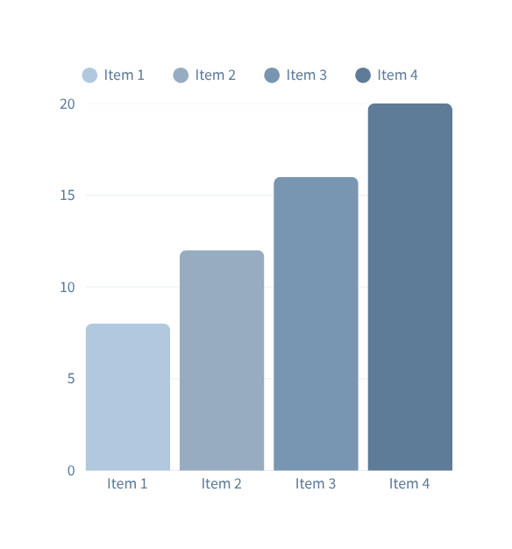
Result
  NoteNest web application was successfully developed.
  Users can upload PDF documents.
  Document details are stored in MongoDB Atlas.
  Stored documents can be retrieved through the application.
  The dashboard provides a simple way to manage documents.
07

Slide 8
Thank you

