Slide 1
🌤 Weather App — API Integration using React and OpenWeatherMap
Developed using React.js, HTML, CSS, and OpenWeatherMap API

Slide 2
Abstract
This project is a responsive Weather Application built using React.js, HTML, CSS, and the OpenWeatherMap API.
Users can search for any city and view real-time weather details such as temperature, humidity, wind speed, and conditions.
It also provides a 5-day forecast through API integration. The project showcases API handling, state management, and responsive design.

Slide 3
Existing System
Users depend on third-party applications for weather updates.
These systems are complex and lack transparency in data fetching and display.
They may not provide real-time updates or mobile responsiveness.

Slide 4
Proposed System
A React-based weather app integrated with the OpenWeatherMap API.
Users can input a city name to fetch live weather data.
The app follows component-based architecture and offers a responsive, user-friendly interface.

Slide 5
Advantages
• Simple and user-friendly interface
• Real-time weather updates using API
• 5-day forecast available
• Works on all devices
• Uses open-source API
• Easy maintenance and scalability

Slide 6
Disadvantages
• Requires an internet connection
• Depends on API data accuracy
• Limited free API requests per day

Slide 7
Hardware Requirements
Processor: Intel i3 or higher — used to handle smooth execution of React app and API data processing.
RAM: Minimum 4 GB — required for running Node.js server and React development environment efficiently.
Hard Disk: Minimum 100 MB free space — used to store project files, dependencies, and temporary build data.
Display: 1024×768 resolution or higher — ensures proper visualization of the app’s responsive user interface.
Internet connection — needed to fetch real-time weather data from the OpenWeatherMap API.

Slide 8
Software Requirements
• OS: Windows / macOS / Linux
• IDE: Visual Studio Code
• Browser: Chrome / Edge / Firefox
• Node.js installed
• React.js library
• OpenWeatherMap API key

Slide 9
Modules
Search Module — allows users to input a city name and trigger weather data requests.
API Integration Module — connects the app to the OpenWeatherMap API to fetch real-time weather data.
Weather Display Module — dynamically shows current weather details such as temperature, humidity, and wind speed.
Forecast Module — displays a 5-day weather forecast using API data.
Responsive UI Module — ensures the app layout adjusts smoothly on mobile, tablet, and desktop screens.

Slide 10
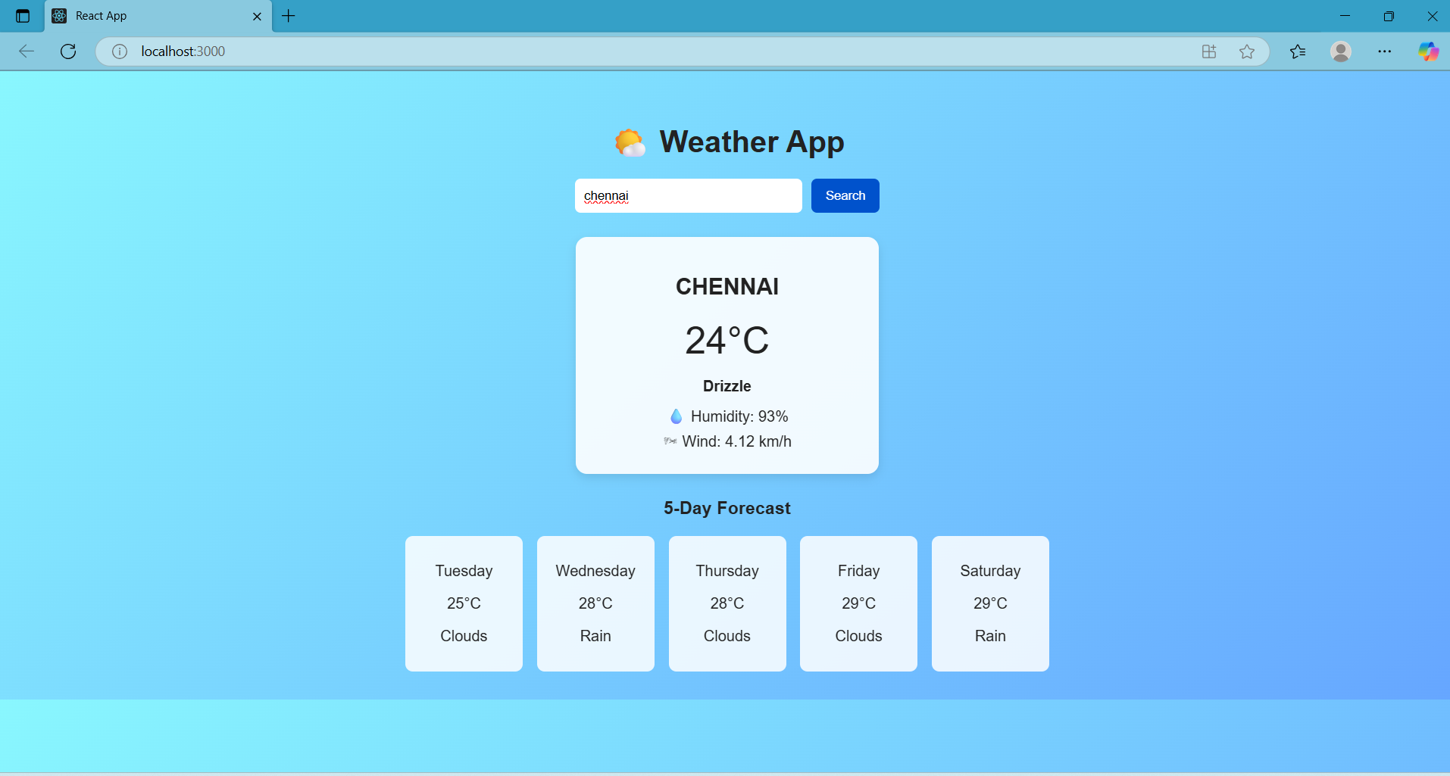
Sample Output (Screenshot)

Slide 11
Conclusion
The React Weather App effectively integrates APIs and demonstrates component-based design.
It provides accurate, real-time weather updates for any city worldwide.
This project highlights modern front-end development with React.js and responsive UI design.

