Slide 1

By Bhavika Sahu
Erp Id: RU-25-10387
B.Tech CSE(AI/ML)-IBM(A)

Slide 2
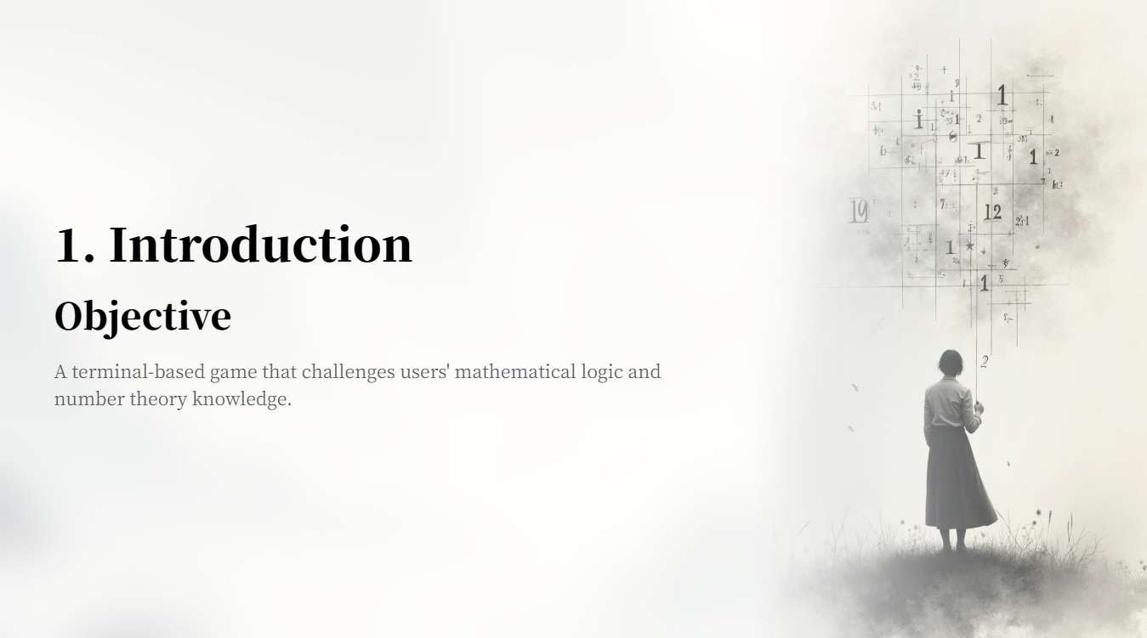

Slide 3
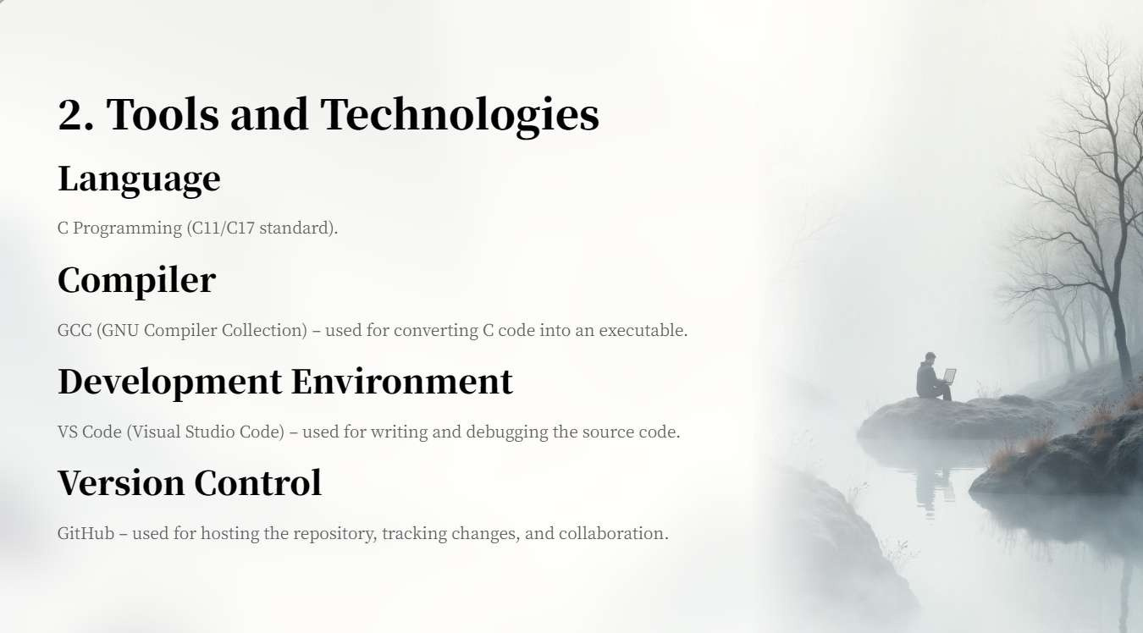

Slide 4
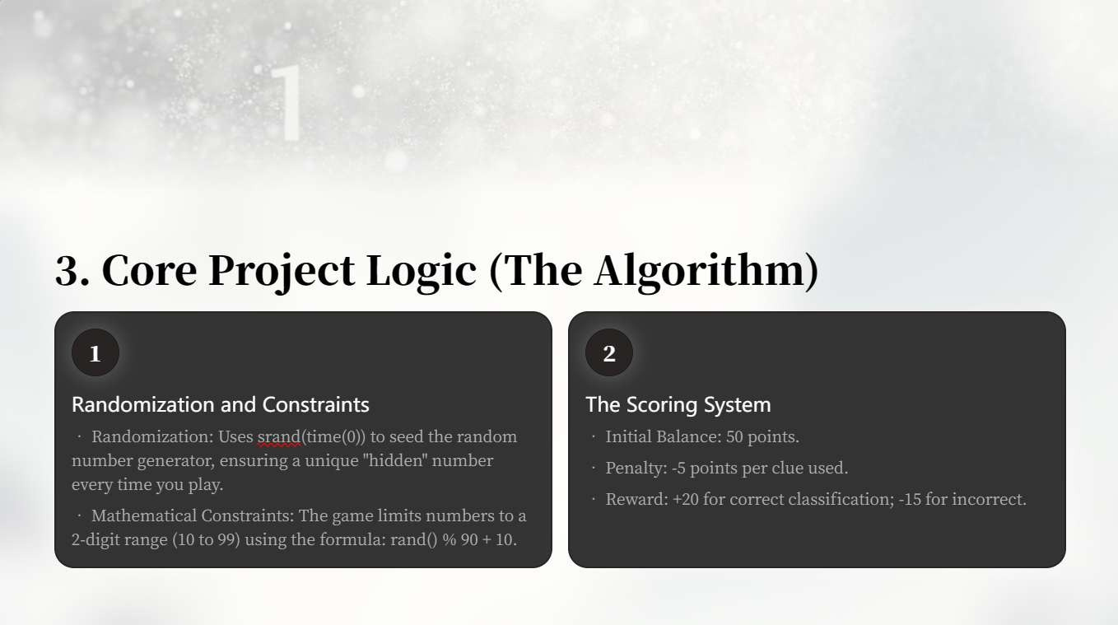

Slide 5
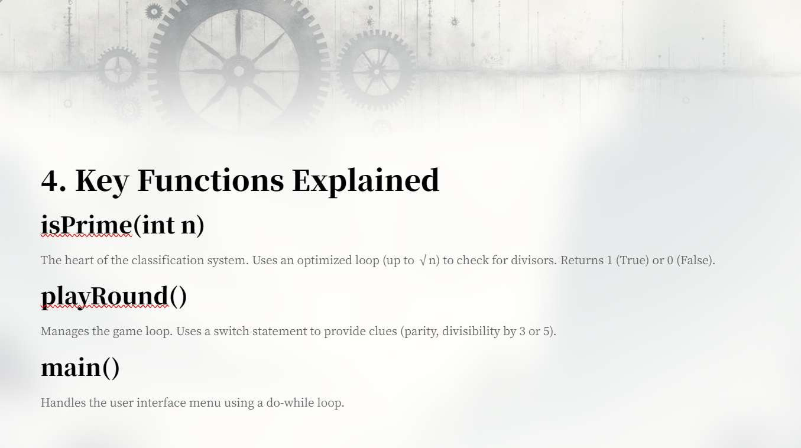

Slide 6
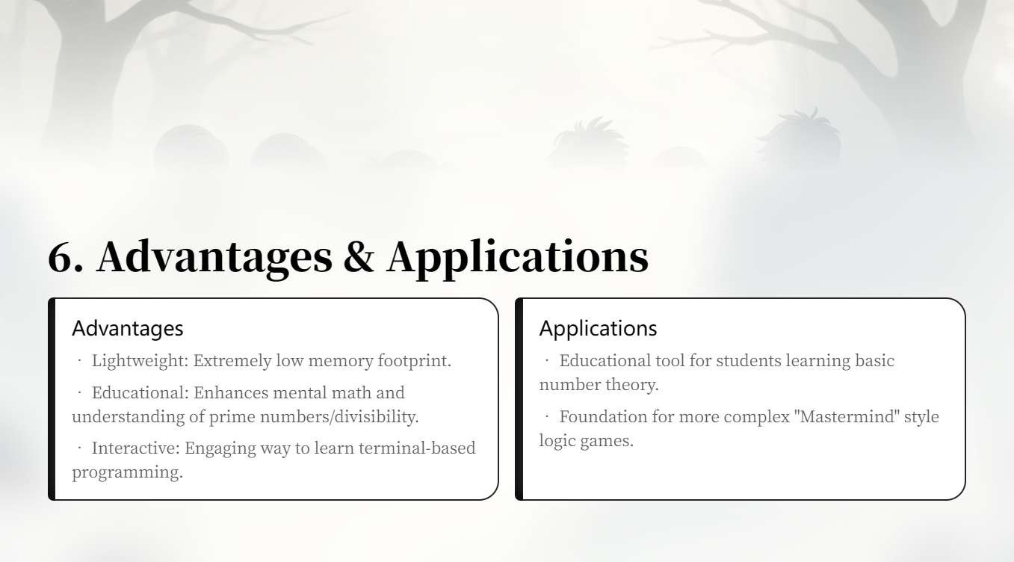

Slide 7
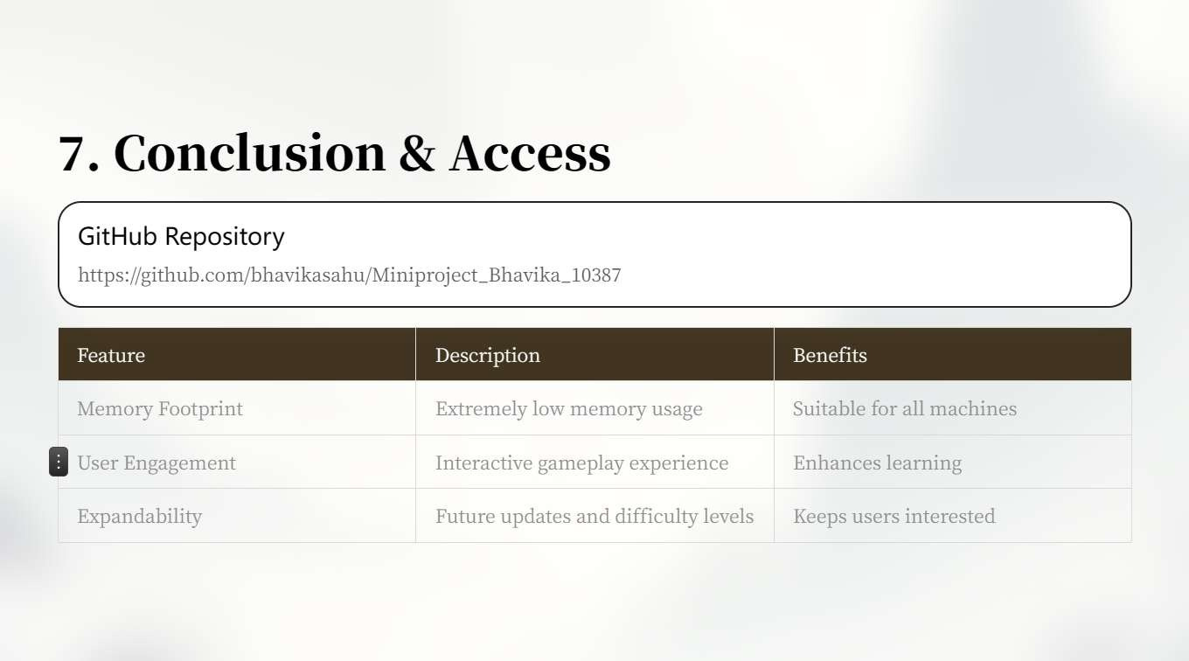

Slide 8


