Slide 1
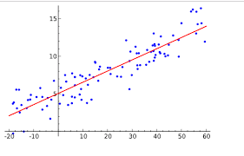
Sales Prediction using Regression Models in Big Data Analytics
Team Members
2320030005 - Vaishnavi Ponnuru
2320030029 - B Bhavika Sree
2320030143 - V Charita Sree
Guide Name:
Venkateswara E Katevarapu

Slide 2
Problem Statement
PROBLEM STATEMENT:
Businesses need to predict future sales to manage inventory and planning.
Traditional methods are not accurate for large and complex datasets.
Sales are affected by many factors like holidays, economy, and store differences.
Without proper prediction, companies may face losses or overstocking.
Hence, a data-driven solution is required for accurate sales forecasting.

Slide 3
Objective
OBJECTIVE:
To analyze historical sales data and identify patterns.
To build a prediction model using Multiple Linear Regression.
To study the impact of factors like holidays, fuel price, CPI, and unemployment on sales.
To evaluate model performance using R² and MSE.
To develop a simple system that predicts sales based on user input.

Slide 4
Dataset Description
Dataset Details
Dataset: Walmart Sales Dataset
Total Records: 421,570
Total Features: 8
Data Type: Structured (Tabular)
Time Period: Weekly
Variables
Store
Date
Weekly_Sales (Target)
Holiday_Flag
Temperature
Fuel_Price
CPI
Unemployment

Slide 5
Data Preprocessing & EDA
Preprocessing Steps
Converted data types (Date, Store, Holiday)
Removed missing values
Created new features (Month, Year)
EDA Insights
Higher sales during holidays
Economic factors influence sales
Variation across stores

Slide 6
Model Implementation
Model Used
Multiple Linear Regression
Regression Equation
Sales = f(Holiday, Temperature, Fuel Price, CPI, Unemployment, Store)
Steps
Data split: 80% Training, 20% Testing
Model trained using historical data
Predictions generated

Slide 7
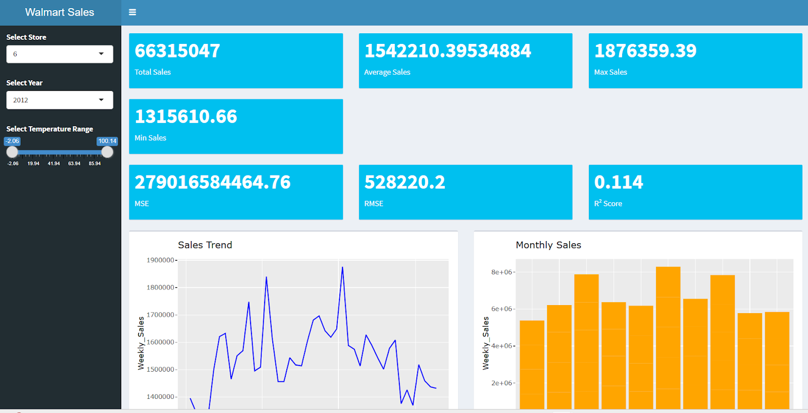
Results & Performance
Sales Prediction and Model Performance
A Linear Regression model is used to predict weekly sales based on factors like store number, temperature, fuel price, CPI, unemployment rate, and holiday indicators. The model generates predicted sales values that are compared with actual sales using prediction graphs. The model performance is evaluated using metrics such as Mean Squared Error (MSE), Root Mean Squared Error (RMSE), and R-squared (R²), which measure prediction accuracy.

Slide 8
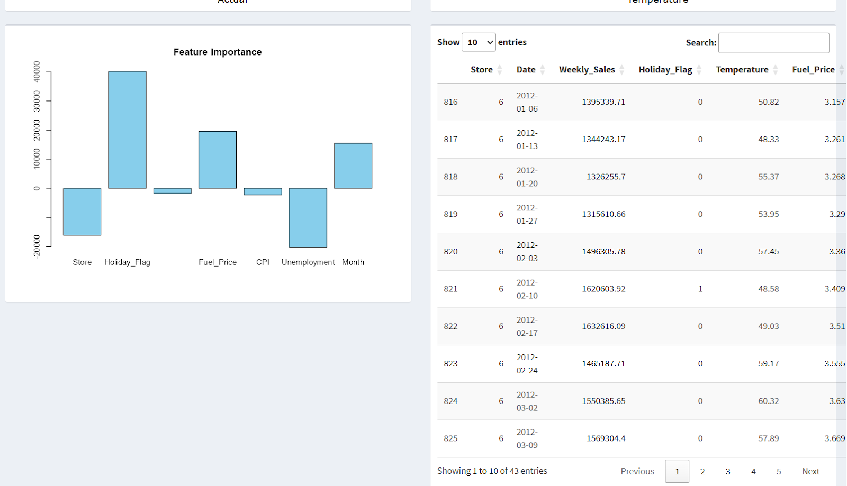
Results & Performance
Sales Dashboard Overview
The project output is presented through an interactive dashboard developed using R in RStudio with the help of Shiny.
The dashboard allows users to analyze Walmart sales data using filters such as Store, Year, and Temperature.
It displays key sales metrics including total sales, average sales, maximum sales, and minimum sales. These indicators provide a quick overview of store performance and help users understand overall revenue patterns.

Slide 9
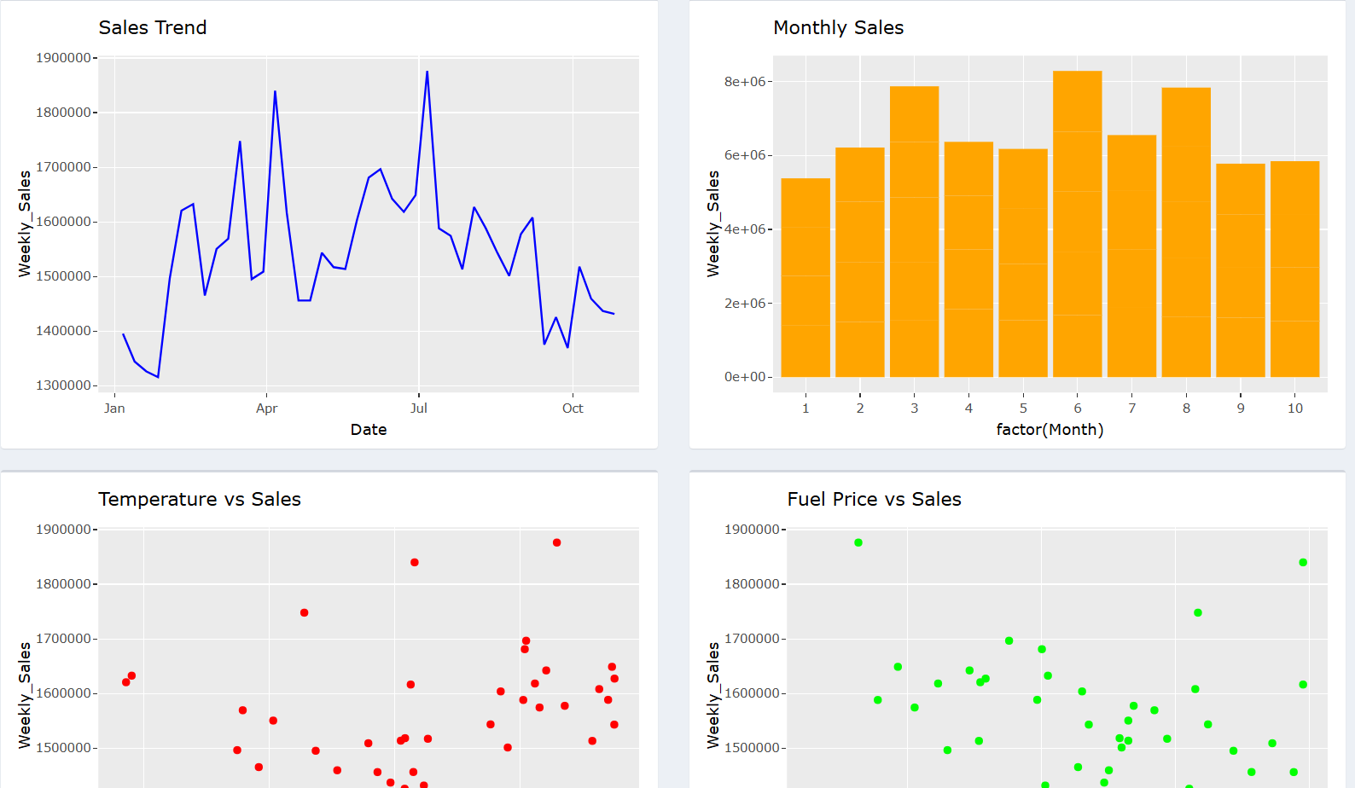
Results & Performance
Data Visualization and Analysis
The system includes multiple graphs to visualize sales trends and patterns. Visualizations such as sales trend graphs, monthly sales distribution, temperature vs sales plots, and holiday impact analysis help identify factors that influence sales performance. These graphs make it easier to interpret large datasets and reveal patterns such as seasonal sales increases and variations in customer buying behavior.

Slide 10
Frontend Implementation
Technology Used
R Shiny
Features
User input fields
Predict button
Displays predicted sales
Shows performance metrics
Graph visualization

Slide 11
Key Observations & Challenges
Observation:
Sales increase during holiday weeks
Promotions boost short-term sales
High unemployment reduces sales
CPI has moderate impact
Store-wise variations observed
Challenges:
Handling Large DataSet
Data Preprocessing Complexity
Model Tuning
Integrating Frontend with Backend

Slide 12
Conclusion
This project focused on developing a Big Data Analytics framework for sales prediction using regression models on Walmart-like datasets. The system follows a structured ETL (Extract, Transform, Load) process, ensuring large-scale retail data is efficiently processed for predictive analysis. Historical sales data, along with additional features like store locations, product categories, and holidays, were cleaned, normalized, and transformed to create high-quality inputs for regression models. The workflow from data extraction to visualization ensures accurate sales forecasts and actionable insights for business decision-making.

