Slide 1
ASSIGNMENT:MODULE-1 HTML
Prepared by: Bhavika Vasani

Slide 2
1) Are the HTML tags and elements the same thing?
Tags and elements are not the same.
HTML tags are used to hold the HTML element and
HTML element holds the content.
HTML tag just opening or closing entity. For example: <p>and</p> are called HTML tags.
HTML element encompasses opening tag, closing tag, content. For Example: <p> This is the first paragraph and this is also content</p>
This complete thing is called a HTML element

Slide 3
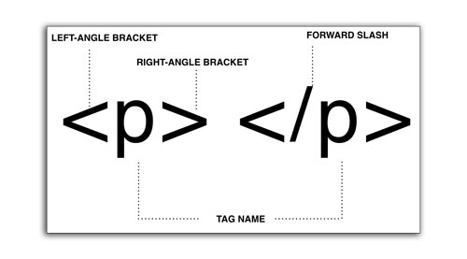
EXAMPLE OF HTML TAGS

Slide 4
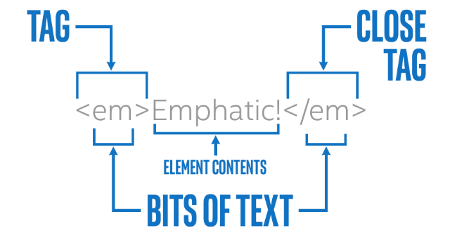
EXAMPLE OF HTML ELEMENTS
How tags are different from elements in HTML
That’s Why HTML tags and HTML elements both are different.

Slide 5
2) What are Tags and Attributes in HTML?
Tags and attributes are the basis of HTML.
They work together but perform different functions.
What are HTML Tags?
Tags are used to mark up the start of an HTML element and they are usually enclosed in angle brackets. An Example of the tags is :<h1>
Most tags must be opened <h1> and closed </h1> in order to function.
What are HTML Attributes?
Attributes contain additional pieces of information.
Attributes take the form of an opening tag and additional info is placed inside. For Example

Slide 6
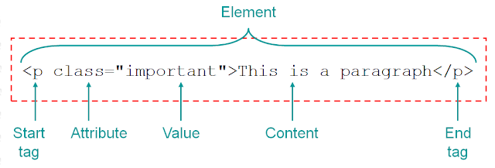
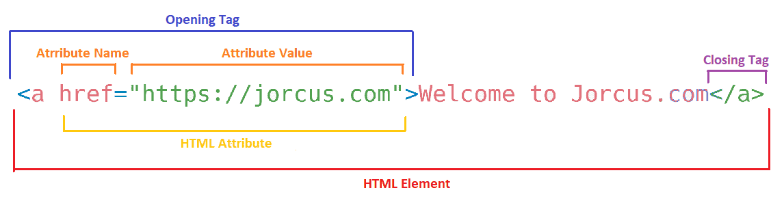
Example of HTML TAGS and ATTRIBUTES
TAGS : <h1></h1> and <p></p>
ATTRIBUTES : 1)
2)

Slide 7
3) What are void elements in HTML?
Most of the HTML elements are surrounded by start and end tags to specify the starting and end of the element.
There is a special group of elements that only have start tags and does not contain any content within it, these elements are called void elements.
Void elements does not have ending tags and can only have attributes but do not contain any kind of content.
Example of such elements are <br>, <hr>, <img>, <input>, <link>, <base>, <meta>, <param>, <area>, <embed>, <col>, <track>, <source> etc.

Slide 8
Characteristics of void elements
Void elements do not have end tags.
Void elements cannot have content inside it.
Void elements have attributes.
Void elements cannot be nested.

Slide 9
4) What are HTML Entities?
Some characters are reserved in HTML.
If you use the less than (<) or greater than (>) signs in your text, the browser might mix them with tags.
Character entities are used to display reserved characters in HTML.
A character entity looks like this:
Example: &entity_name; OR &#entity_number;
To display a less than sign (<) we must write: &lt; or &#60;

Slide 10
Pros And Cons
Advantage of using an entity name: An entity name is easy to remember.
Disadvantage of using an entity name: Browsers may not support all entity names, but the support for entity numbers is good.
Examples:

Slide 11
11) How to create a Hyperlink in HTML?
HTML links are hyperlinks. You can click on a link and jump to another document.
When you move the mouse over a link, the mouse arrow will turn into a little hand.
HTML Links – Syntax
The Html <a> tag defines a hyperlink. It has the following syntax:
<a href="url">link text</a>
The most important attribute of the <a> element is href attribute, which indicates the link’s destination.

Slide 12
Example of Hyperlink
This example shows how to create a link to:
<a href=“https://www.naukri.com”>Naukri Learning</a>
Anchor tag that creates
A hyperlink.
Link URL specifies the
Destination address of
The link.
Link text
(visible part of the link)

Slide 13
Example:
<!DOCTYPE html>
<html>
<head>
<title>Example of HTML Link</title>
</head>
<body>
<p>Click on the below link</p>
<a href = "https://www.naukri.com/learning">Naukri Learning</a>
</body>
</html>

Slide 14
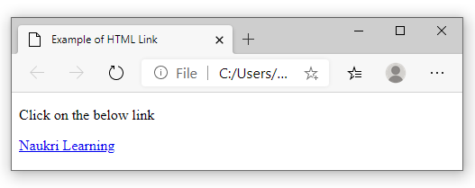
OUTPUT :

Slide 15
12) What is the use of an iframe tag?
HTML Iframe is used to display a nested webpage (a webpage within a webpage).
The HTML <iframe> tag defines an inline frame, hence it is also called as an Inline frame.
An inline frame is used to embed another document within the current HTML document.

Slide 16
SYNTAX OF IFRAME
<iframe src="url" title="description"></iframe>
NOTE: It is a good practice to always include a title attributes for the <iframe>.this is used by screen readers to read out what the content of the iframe is.

Slide 17
EXAMPLE OF iframe TAG
<iframe src="demo_iframe.htm" height="200" width="300" title="Iframe Example"></iframe>

Slide 18
SET height and weight in IFRAME
<iframe src="demo_iframe.htm" height="200" width="300" title="Iframe Example"></iframe>

Slide 19
Iframe - Remove the Border
To remove the border, add the style attribute and use the CSS border property:
EXAMPLE:
<iframe src="demo_iframe.html" style="border: none;" title="Iframe Example"></iframe>

Slide 20
Iframe Target for a link
You can set a target frame for a link by using iframe. Your specified target attribute of the link must refer to the name attribute of the iframe.
Example:
<!DOCTYPE html>
<html>
<body>
<h2>Iframe - Target for a Link</h2>
<iframe height="300px" width="100%" src=“demo_iframe.html" name="iframe_a"></iframe>
<p><a href="https://www.demoiframe.com" target="iframe_a">demoiframe.com</a></p>
<p>The name of iframe and link target must have same value else link will not open as frame. </p>
</body>
</html>

Slide 21
5) Different Types of lists in HTML?
HTML Lists are used to specify lists of information.
All list may contain one or more list elements.
<li> element in HTML is used to define list of item.
Every list can have one or more list element.
List items must be contained within a parent element. Such as, an ordered list<ol>, an unordered list<ul>.
Mainly three types of lists in HTML:
Ordered list
Unordered list
Nested list

Slide 22
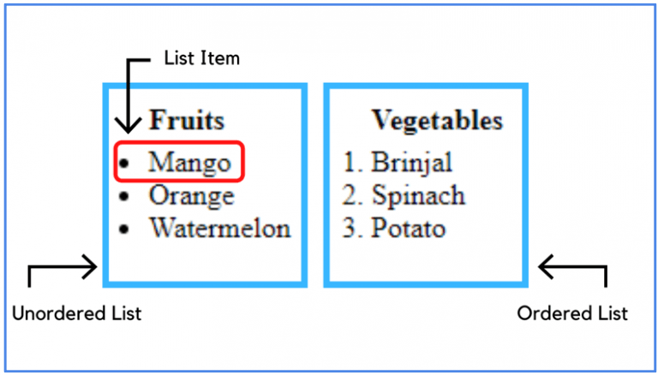
For a better understanding, look at the below image.

Slide 23
ORDER LIST
Order list is used to display list elements in numbered or alphabetical format.
We can display list elements in numerical numbers, alphabets and roman numbers.
Order list syntax:
<ol>
<li>Item 1</li>
<li>Item 2</li>
<li>Item 3</li>
</ol>

Slide 24
There are a total of five numbering types in an ordered list.
1. Numbers are defined by type=”1”
2. Uppercase Letters are defined by type=” A”
3. Lowercase letters are defined by type=” a”
4. Uppercase Roman Numbers are defined by type=” I”
5. Lowercase Roman Numbers are defined by type=” i”

Slide 25
<ol type="1">
<li>Item 1</li>
<li>Item 2</li>
<li>Item 3</li>
</ol>
<ol type="A">
<li>Item 1</li>
<li>Item 2</li>
<li>Item 3</li>
</ol>
<ol type="a">
<li>Item 1</li>
<li>Item 2</li>
<li>Item 3</li>
</ol>
<ol type="I">
<li>Item 1</li>
<li>Item 2</li>
<li>Item 3</li>
</ol>
<ol type="i">
<li>Item 1</li>
<li>Item 2</li>
<li>Item 3</li>
</ol>

Slide 26
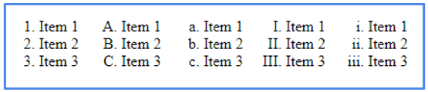
Output:

Slide 27
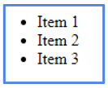
UNORDER LIST
Unordered lists are used to display list elements in bullet format.
When we don’t need to display things in a precise order, we can use an unordered list.
Unordered list syntax:
<ul>
<li>item 1</li>
<li>item 2</li>
<li>item 3</li>
</ul>
By default, unordered list items are marked with bullets (•)

Slide 28
Note: In HTML Unordered list, all the list items are marked with bullets. It is also known as a bulleted list also. The Unordered list starts with <ul> tag and list items start with the <li> tag.
There are four types of list bullets:
Disc
Circle
Square
None

Slide 29
<ul style="list-style-type:disc;">
<li>One</li>
<li>Two</li>
<li>Three</li>
</ul>
<ul style="list-style-type:square;">
<li>One</li>
<li>Two</li>
<li>Three</li>
</ul>
<ul style="list-style-type:circle;">
<li>One</li>
<li>Two</li>
<li>Three</li>
</ul>
<ul style="list-style-type:none;">
<li>One</li>
<li>Two</li>
<li>Three</li>
</ul>

Slide 30
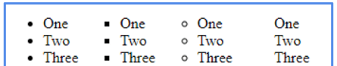
Output:

Slide 31
NESTED LIST
We can nest unordered lists, which means we can place one list inside another.
<body>
<ul>
<li>Fruits </li>
<ul>
<li>Mango</li>
<li>Orange</li>
</ul>
<li>Vegetables</li>
<ul>
<li>Cabbage</li>
<li>Capsicum</li>
<ul>
<li>Green Capsicum</li>
<li>Yellow Capsicum</li>
<li>Red Capsicum</li>
</ul>
</ul>
</ul>
</body>

Slide 32
Start Attribute in HTML Lists
A start attribute is used to define an initial value for the numbering of the list item.
if we specify the start value 10 then the list will start numbering from 10 onwards. start=” value” attribute is used to set start value.
Example:
<ol start="10">
<li>one </li>
<li>two</li>
<li>three</li>
<li>four</li>
<li>five</li>
<li>six</li>
<li>seven</li> </ol>

Slide 33
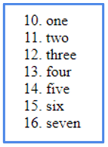
Output:

Slide 34
Reversed Attribute in HTML Lists
A reversed attribute is a Boolean attribute in Html with a reversed attribute we can number the list in descending format.
Example:
<ol reversed>
<li>Item 1</li>
<li>Item 2</li>
<li>Item 3</li>
</ol>

Slide 35
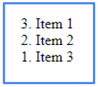
Output:

Slide 36
What is ‘Class’ Attribute?
The class attribute specifies one or more class names for an element.
The class Attribute mostly used to point to a class in a style sheet. And it also can be used with any HTML elements.

Slide 37
Example
<!DOCTYPE html>
<html>
<head>
<style>
h1.intro {
color: blue;
}
p.important {
color: green;
}
</style>
</head>
<body>
<h1 class="intro">Header 1</h1>
<p>A paragraph.</p>
<p class="important">Note that this is an important paragraph. :)</p>
</body>
</html>

Slide 38
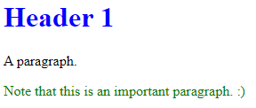
Output:

Slide 39
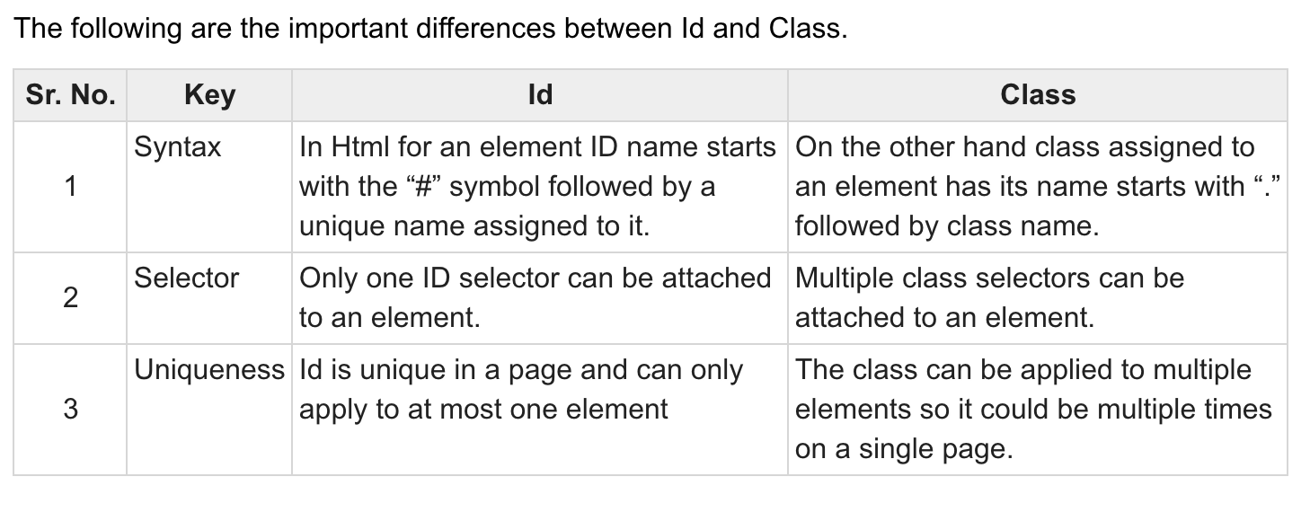
6) Difference between ‘id’ and ‘class’?

Slide 40
7)
Parameters | Cellpadding | Cellspacing
Purpose | Cell padding basically defines the space present between a table cell’s border and the content present in it. | Cell spacing basically defines the space present between individual adjacent cells.
Process of Creation | One can create it using the tag of HTML <table>, but it sets the type attribute to cellpadding. | One can create it using the tag of HTML <table>, but it sets the type attribute to cellspacing.
Number of Cells | It deals with a single cell. | It gets subjected to multiple cells (more than one) at a time.
Default Value | The default value for cellpadding is 1. | The default value for cellspacing is 2.
Effectiveness | It is very effective as compared to cellspacing. Thus, it is very widely used. | It is comparatively less effective than cellpadding.

Slide 41
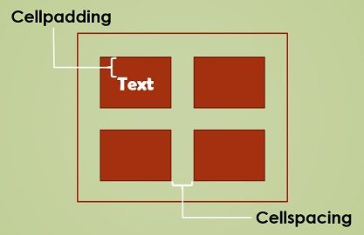
- The attribute which sets the space in a cell between the content and peripheral boundary is named as cellpadding.
- Cellspacing is different than cellpadding. It controls the distance between single cells in a table.

Slide 42
9) How can we club two or more rows or columns into a single row or column in an HTML table?
It can be done by using the rowspan and colspan attribute in HTML.
The rowspan is used to merge or combine the number of cells in a row.
The colspan is used to merge column cells in a table.

Slide 43
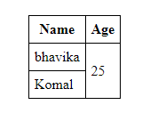
Example of rowspan
<table align="center">
<tr>
<th>Name</th>
<th>Age</th>
</tr>
<tr>
<td>bhavika</td>
<!-- This cell will take up
space on two rows -->
<td rowspan="2">25</td>
</tr>
<tr>
<td>Komal</td>
</tr>
</table>

Slide 44
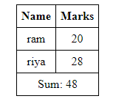
Example of colspan
<table align=“center”>
<tr>
<th>Name</th>
<th>Marks</th>
</tr>
<tr>
<td>ram</td>
<td>20</td>
</tr>
<tr>
<td>riya</td>
<td>28</td>
</tr>
<!-- The last row -->
<tr>
<!-- This td will span two
columns, that is a
single column will take
up the space of 2 -->
<td colspan="2">Sum: 48</td>
</tr>
</table>

Slide 45
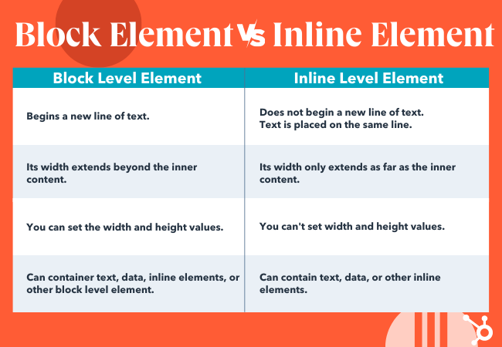
10) What is the difference between a block-level element and an inline element?

Slide 46
7) What are the various formatting tags in HTML?
Html formatting is process of formatting text for better look and feel.
Formatting Elements were designed to display special types of text.
<b> - bold text
<strong> - important text
<i> - italic text
<em> - emphasized text
<mark> - marked text
<small> - smaller text
<del> - deleted text
<ins> - inserted text
<sub> - subscript text
<sup> - superscript text

Slide 47

<b> tag:
<!DOCTYPE>
<html>
<body>
<p> <b>Write Your First Paragraph in bold text.</b></p>
</body>
</html>
Output:

Slide 48
<strong> Tag:
EXAMPLE:
<p><strong>This is an important content</strong>, and this is normal content</p>
OUTPUT:

Slide 49

<i> and <em> tag:
EXAMPLE:
<p><i>Write paragraph in italic text.</i></p>
<p><em>This is an important content</em>,which is displayed in italic text.</p>
Output :

Slide 50
<mark> Tag:
<!DOCTYPE>
<html>
<body>
<h2> I want to put a <mark> Mark</mark> on your face</h2>
</body>
</html>
Output:

Slide 51

<u> tag:
This text is used to underlined the text.
EXAMPLE:
<!DOCTYPE>
<html>
<body>
<p> <u>Write Your First Paragraph in underlined text.</u></p>
</body>
</html>
Output:
Output:

Slide 52

<small>Tag: This tag is used to reduce the font size to one to the previous one.
<!DOCTYPE>
<html>
<body>
<p>Hello <small>Write the paragraph in smaller font.</small></p>
</body>
</html>
Output:

Slide 53

<del> Tag:
Anything that puts within <del>..........</del> is displayed as deleted text.
Example:
<!DOCTYPE>
<html>
<body>
<p>Hello <del>Delete your first paragraph.</del></p>
</body>
</html>
Output:

Slide 54

<ins> Tag: This tag is defines text has been inserted into a document, browser will usually underline inserted text.
<!DOCTYPE html>
<html>
<body>
<h1>The ins element</h1>
<p>My favorite color is <del>blue</del> <ins>red</ins>!</p>
</body>
</html>
Output:

Slide 55
Subscript tag:
If you put the content within <sub>..............</sub> element, is shown in subscript ; means it is displayed half a character's height below the other characters.
Superscript tag:
If you put the content within <sup>..............</sup> element, is shown in superscript; means it is displayed half a character's height above the other characters.

Slide 56
<sub> & <sup> tag:
EXAMPLE:
<!DOCTYPE html>
<html>
<body>
<h1>The sub and sup elements</h1>
<p>This text contains <sub>subscript</sub> text.</p>
<p>This text contains <sup>superscript</sup> text.</p>
</body>
</html>

Slide 57
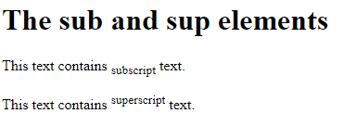
Output:

Slide 58
What is the use of a span tag? Explain with example?
→ The <span> tag is an inline container used to mark up a part of a text,
or a part of a document.
→ The <span> tag is easily styled by CSS or manipulated
with JavaScript using the class or id attribute.
→ The <span> tag is much like the <div> element,
but <div> is a block-level element and <span> is an inline element.

Slide 59
Example of Span Tag:
<!DOCTYPE html>
<html>
<body>
<h1>The span element</h1>
<p>My mother has <span style="color:blue;font-weight:bold">blue</span> eyes and my father has <span style="color:darkolivegreen;font-weight:bold">dark green</span> eyes.</p>
</body>
</html>

Slide 60

Output of the span tag:

Slide 61
What are the tags used to separate a section of texts?
<br> tag – Usually <br> tag is used to separate the line of text. It breaks the current line and conveys the flow to the next line
<p> tag – This contains the text in the form of a new paragraph.
<blockquote> tag – It is used to define a large quoted section. If you have a large quotation, then put the entire text within <blockquote>……….</blockquote> tag.

Slide 62
How to insert a picture into a background image of a web page?
To insert a picture into the background image, you need to place a tag code after the </head> tag in the following way:
<body background=“image.jpg”>
Now, replace image.jpg with the name of your image file. This will take the picture and make it the background image of your web page.

Slide 63
How are active links different from normal links?
The default color for normal and active links is blue.
Some browsers recognize an active link when the mouse cursor is placed over that link.
Whereas, others recognize active links when the link has the focus. Those that don’t have a mouse cursor over that link is considered a normal link.

Slide 64
What is SVG?
HTML SVG is used to describe the two-dimensional vector and vector or raster graphics.
SVG images and their behaviors are defined in XML text files. So as XML files, you can create and edit an SVG image with the text editor.
It is mostly used for vector type diagrams like pie charts, 2-Dimensional graphs in an X, Y coordinate system.

Slide 65
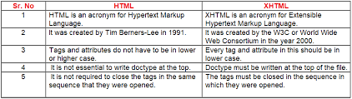
What is difference between HTML and XHTML?

Slide 66
What are logical and physical tags in HTML?
Logical tags are used to tell the meaning of the enclosed text.
The example of the logical tag is <strong> </strong> tag.
When we enclose the text in the strong tag, it tells the browser that enclosed text is more important than other texts.
Physical tags are used to tell the browser how to display the text enclosed in the physical tag.
Some of the examples of physical tags are <b>, <big>, <i>.

