Slide 1
NYC Property Sales Prediction
Presented By:
Rishi Takrani
Milind Chaudhari
Bhavik Lodha
Atharva Nandurdikar

Slide 2




Rishi Takrani
Milind Chaudhari
Bhavik Lodha
Atharva Nandurdikar

Slide 3

INTRODUCTION
This dataset is a record of every building or building unit (apartment, etc.) sold in the New York City property market over a 12-month period.
It contains the location, address, type, sale price, and sale date of building units sold.
The areas are subdivided into smaller locations called boroughs viz. Manhattan, Bronx, Brooklyn, Queens, and Staten Island.
Trading of every property in NYC built since 1900 has been documented in a rich dataset of around 70,000 rows.
From this grandiose property data, we identified a pattern that would help us determine the “sale price” of every property with respect to zip code.
This would help the owners to fetch the current value of their property. Similarly, our miniature will provide insights into the current trends in property sales in NYC for new buyers & real estate agencies.

Slide 4
DATASET
Sr No. | Variable | Type | Description
1 | Borough | Numeric | The name of the borough in which the property is located.
2 | Neighborhood | String | Finance Assessors determine ‘neighborhood name’ in course of valuing properties.
3 | Building class category | String | Identify the type of building class as per the type of apartment or property
4 | Tax class at present | Numeric | Every property in the city is assigned to one of four tax classes, based on the use of the property.
5 | Block | Numeric | Sub-division of Borough to locate real properties.
6 | Lot | Numeric | A Tax Lot is a subdivision of a Tax Block and represents the property unique location
7 | Easement | String | It is ‘right’, which allows user to make limited use of another’s real property.

Slide 5
Sr No. | Variable | Type | Description
8 | Building class at present | String | It provides property’s current constructive value.
9 | Address | String | It is street address which contains apartment number & other
10 | Zip Code | Numeric | The property’s postal code
11 | Residential Units | Numeric | The number of residential units at the listed property.
13 | Commercial Units | Numeric | The number of commercial units at the listed property.
14 | Total Units | Numeric | The total number of units at the listed property.
15 | Land Square Feet | Numeric | The land area of the property listed in square feet.

Slide 6
Sr No. | Variable | Type | Description
16 | Gross Square feet | Numeric | Total area of the floors including walls & total land area.
17 | Year Built | Numeric | Year the structure on the property was built.
18 | Building class at the time of sale | Numeric | The Building Classification is used to describe a property’s constructive use at the time of sale.
19 | Sale Price | Numeric | Price paid for the property.
20 | Date sale | Numeric | Date the property sold.

Slide 7

STEPS FOLLOWED
Data Cleaning
Data Classification with respect to Borough (1= Manhattan, 2=Bronx, 3=Brooklyn, 4=Queens, 5=Staten Island)
Univariate Analysis
Regression Modelling
Clustering approach
Observation and Conclusion

Slide 8

DATA CLEANING
Data Cleaning is a process of detecting and correcting incorrect, incomplete and inaccurate data from the database.
All records which have sale_price less than 999 are eliminated
All records which have zero total_units (residential and commercial) have been eliminated
All records which have a zero gross_square_feet have been eliminated
All records which have a zero land_square_feet have been eliminated

Slide 9
DATA CLASSIFICATION
NYC Property Price Prediction
Borough 1 - Manhattan
Borough 5 –
Staten Island
Borough 2- Bronx
Borough 3 - Broklyn
Borough 4 - Queens

Slide 10

PROBLEM STATEMENT
Determine which zip codes within a borough prove to be significant for determining sale price of a property
Determine whether total units (cumulative of residential and commercial units), gross square feet and land square feet are significant for determining the sale price of a property

Slide 11

UNIVARIATE ANALYSIS
To examine distribution of data
Includes an assessment of normality and discovery of outliers
We performed an univariate analysis on all the five boroughs
Given below is a snippet as to how we performed it:

Slide 12
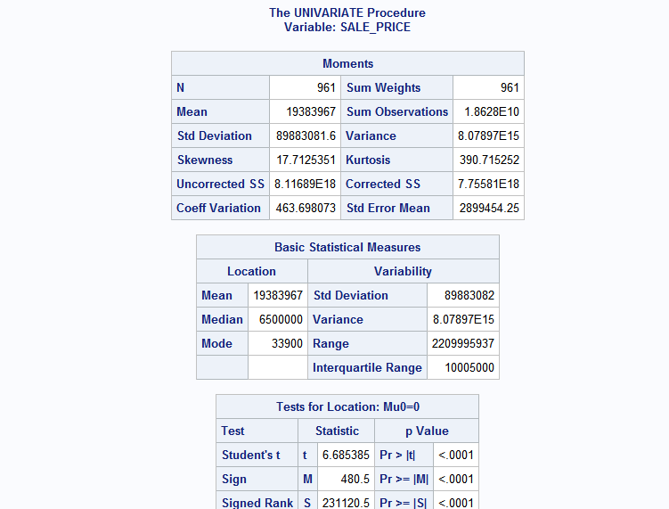
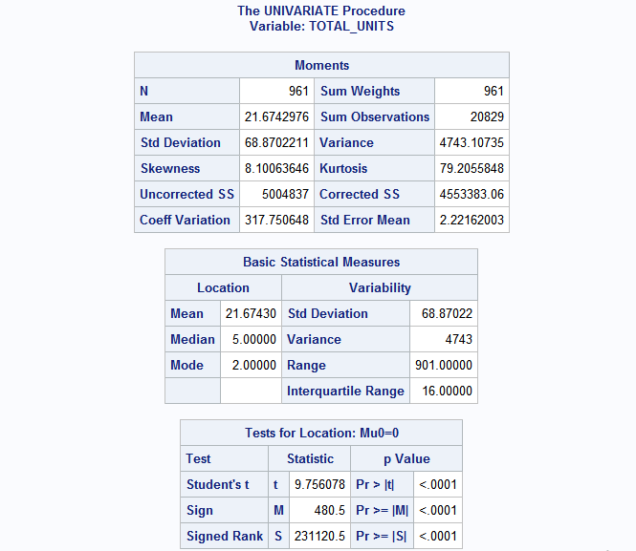
Univariate Analysis Output

Slide 13
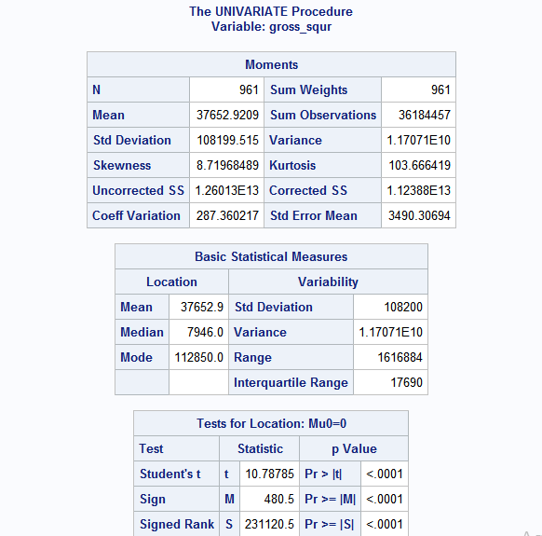
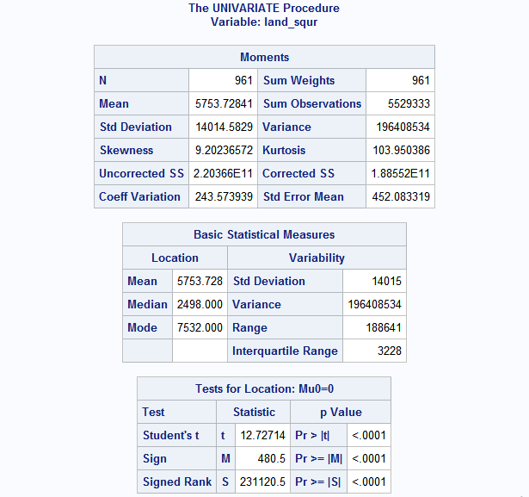

Slide 14
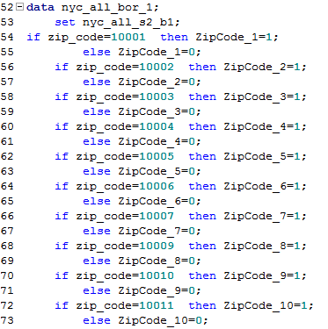
Logic Used for zip_code (Dummy Variables)
After removing outliers from univariate analysis, we segregated the data on the basis of zip_code
Our aim is to find the appropriate zip_codes within a specific borough using dummy variables which would depict a significant relation for our dependent variable which is sale_price
We created n-1 dummy variables, where n is the count distinct zip codes

Slide 15
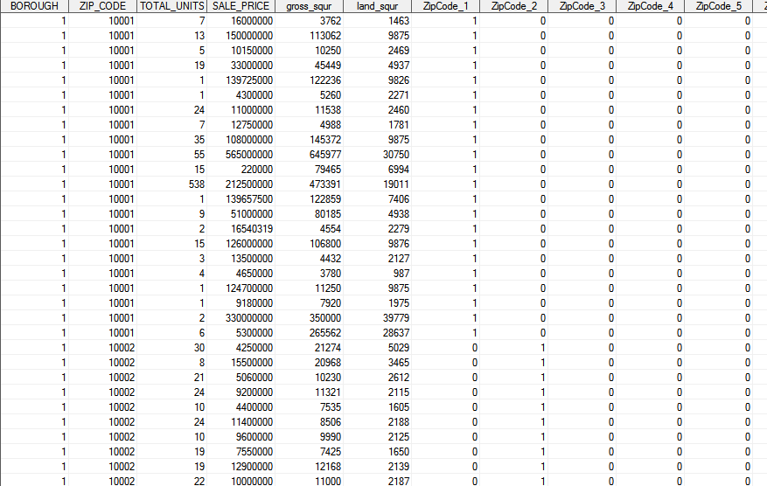
DATA AFTER ZIP_CODE SEGREGATION

Slide 16
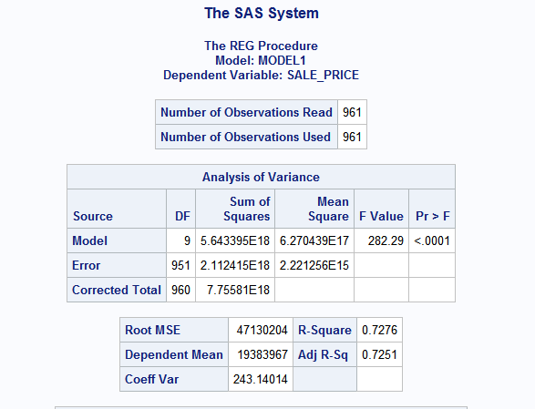
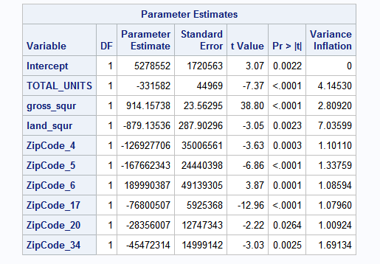
MULTIPLE REGRESSION

Slide 17

Cluster Analysis: Approach
Sorted the data by zip code
Calculate the average of Gross Square Feet, Land Square Feet and Sale Price grouping zip code. For Example: If 10001 has 5 rows with values of sales price and gross square feet, then we need to take average of sales price and gross square feet.
Performing Cluster Analysis taking average Sales price and Zip Code
Aim is to find the average sale price of particular zip codes significant in regression model.
To verify whether the significant zip codes fall in same cluster.

Slide 18
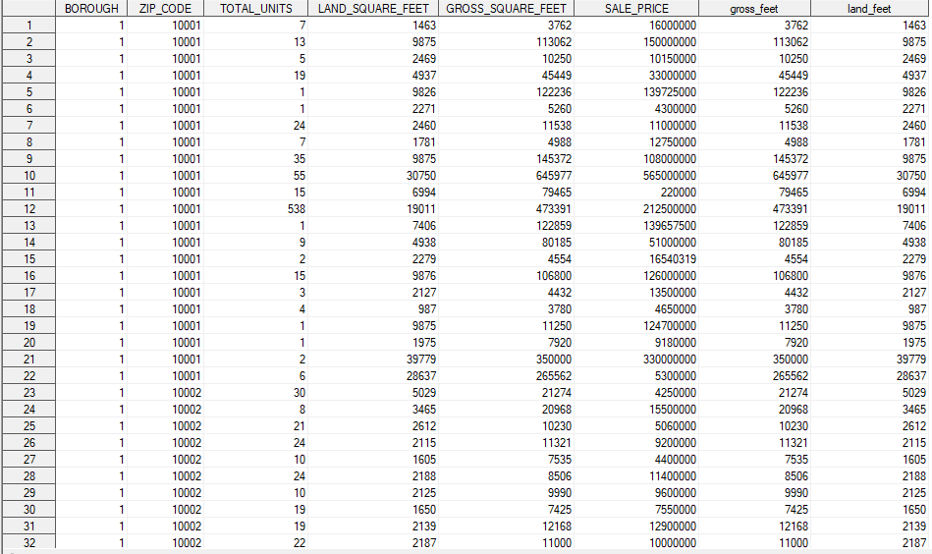
Total Observations: 961

Slide 19
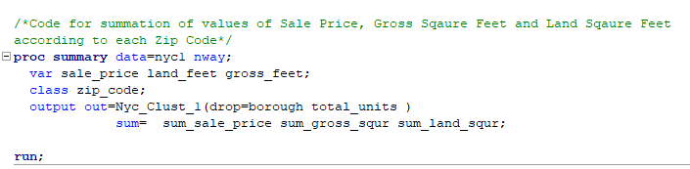
Analysis: Clustering the Data
We clustered the data according to each zip code
Code provides us the frequency of data occurred for a particular zip code, like if we have 22 different rows of “10001” then Frequency will be 22
Summation of Sale Price, Gross Square Feet and Land Square Feet according to Zip Code. We get sum of sale price of 22 rows having zip code as 10001

Slide 20
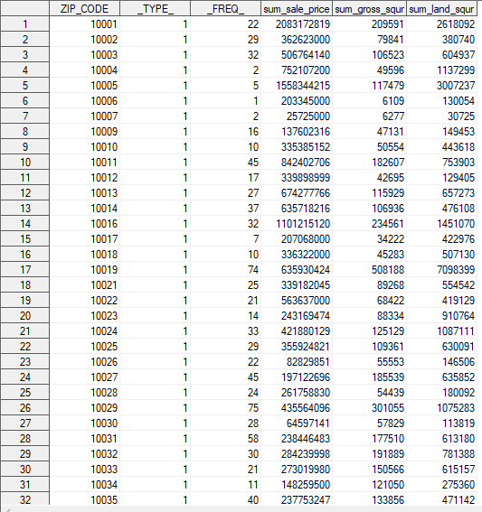
Total Observations: 43

Slide 21
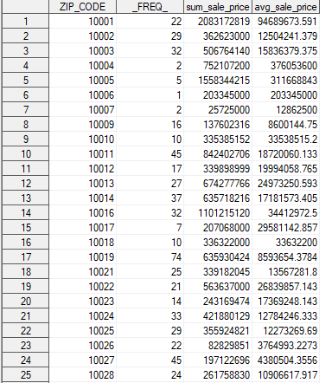
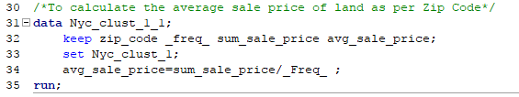

Slide 22
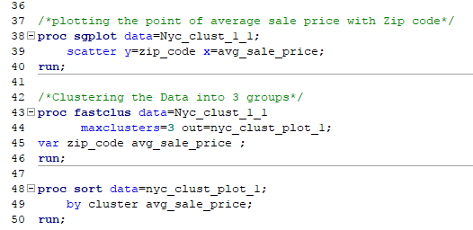
Clustering Logic

Slide 23
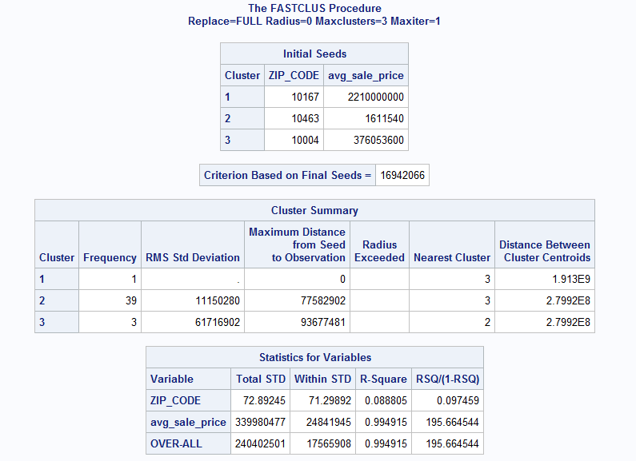
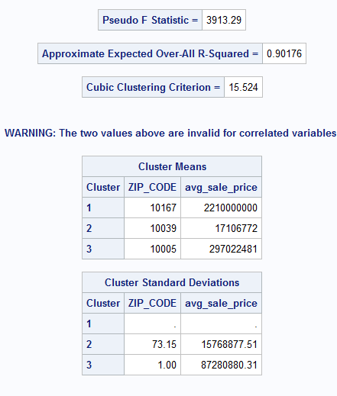

Slide 24
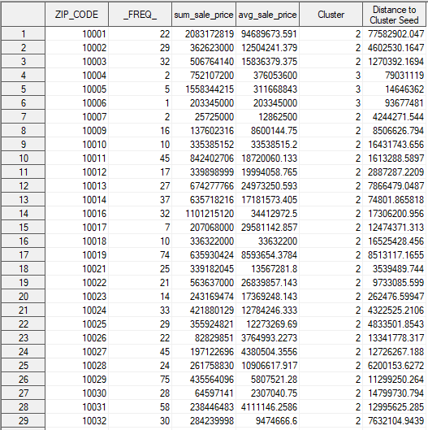
Observation
Analysis Result: Zip Code 10004 , 10005 and 10006 fall in Cluster 3
Analysis Result: Zip Code 10019, 10023 and 10037 fall in Cluster 2

Slide 25
OBSERVATIONS AND CONCLUSION
Multiple regression helped us in identifying the significant zip_codes which have a significant impact on the value of sale price in a specific borough
Clustering helped us in identifying whether the zip codes identified from the regression model fall in the same cluster i.e whether they are a part of the same cluster
For borough 1, below are the significant variables which provides significant impact on sale price:
Total_Units
Gross_Square_Feet
Land_Square_Feet
Zipcode_4 - 10004
ZipCode_5 - 10005
ZipCode_6 - 10006
ZipCode_17 - 10019
ZipCode_20 - 10023
ZipCode_34 - 10037

Slide 26
OBSERVATIONS AND CONCLUSION
For borough 2, below are the significant variables which provides significant impact on sale price:
Total_Units
Gross_Square_Feet
Land_Square_Feet
Zipcode_2 - 10458
ZipCode_3 - 10451
ZipCode_8 - 10468
ZipCode_18 - 10453
ZipCode_23 - 10463
For borough 3, below are the significant variables which provides significant impact on sale price:
Total_Units
Gross_Square_Feet
Land_Square_Feet
Zipcode_11 - 11205

Slide 27
OBSERVATIONS AND CONCLUSION
Zipcode_12 – 11238
Zipcode_15 – 11234
Zipcode_16 – 11217
Zipcode_17 – 11201
Zipcode_22 – 11212
Zipcode_24 – 11207
Zipcode_25 – 11236
Zipcode_27 – 11231
Zipcode_28 – 11249
Zipcode_29 – 11224
Zipcode_31 – 11208
Zipcode_33 – 11203
Zipcode_34 – 11229
Zipcode_35 – 11215
Zipcode_38 – 11211

Slide 28
OBSERVATIONS AND CONCLUSION
For borough 4, below are the significant variables which provides significant impact on sale price:
Total_Units
Gross_Square_Feet
Land_Square_Feet
Zipcode_3- 11005
Zipcode_5- 11101
Zipcode_6- 11102
Zipcode_7- 11103
Zipcode_9- 11105
Zipcode_10- 11106
Zipcode_12- 11354
Zipcode_13- 11355
Zipcode_15- 11357

Slide 29
OBSERVATIONS AND CONCLUSION
For borough 5, below are the significant variables which provides significant impact on sale price:
Total_Units
Gross_Square_Feet
Land_Square_Feet
Zipcode_2- 10302
Zipcode_3- 10303
Zipcode_7- 10307
Zipcode_9- 10309
Zipcode_12- 10314

Slide 30
THANK YOU

