Slide 1


SUMMER INTERNSHIP - PROJECT
Project name :- “File Sharing”

Slide 2
Guide :- Prof. PARESH M. CHAUHAN
Name : Magtarpara Bhavik Himmatbhai
Semester : 7
Enrollment No : 190430116067
Team ID : 239260

Slide 3
TABLE OF CONTENTS
INTRODUCTION
PROJECT SUMMARY
FLOW CHART
ACTIVITY DIAGRAM
USE CASE DIAGRAM
DATA FLOW DIAGRAM (LEVEL 0)
DATA FLOW DIAGRAM (LEVEL 1)
REFERANCE

Slide 4
-Introduction
Share Files Between two user
Features
Flexibility.
Working with high speed.
Fast loading screens.
Security..

Slide 5
PROJECT SUMMARY
Project Title | File Sharing
Aim | Our application aim is to user can share there file with other without ant interrupt.
Project Category | Web base application
Tools | IDE | Visual Studio Code
 | Language/Frameworks | HTNL, CSS, JavaScript, Nodejs, Express js
 | Database | MongoDB

Slide 6
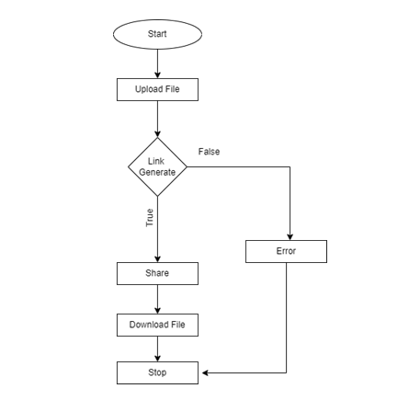
FLOW CHART

Slide 7
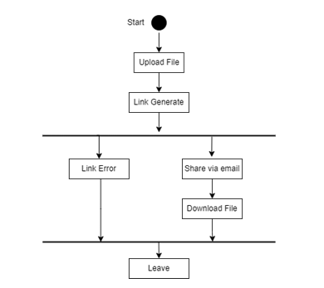
ACTIVITY DIAGRAM

Slide 8
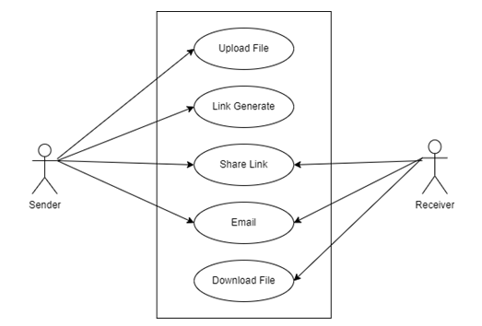
Use Case diagram

Slide 9
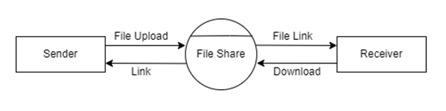
DATA FLOW DIAGRAM (LEVEL 0)

Slide 10
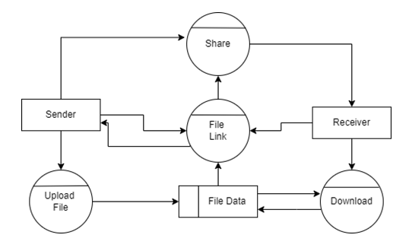
DATA FLOW DIAGRAM (LEVEL 1)

Slide 11
REFERENCE
PMMS Portal
http://www.pmms.gtu.ac.in/Upload/UserManual/UserManualforStudent.pdf
Nodejs documentation
https://nodejs.org/en/docs/
https://nodejs.dev/learn/the-nodejs
https://www.w3schools.com/nodejs/nodejs_uploadfiles.asp
https://www.w3schools.com/nodejs/nodejs_mongodb_find.asp
Nodejs npm package dependencies
https://www.npmjs.com/package/express
https://www.npmjs.com/search?q=nodemoon
Mongodb atlas
https://www.mongodb.com/atlas/database
https://www.mongodb.com/docs/guides/?_ga=2.247104260.18817763.1650801653-18221092.1649142470
https://www.mongodb.com/docs/manual/crud
https://www.mongodb.com/docs/manual/tutorial/query-embedded-documents

Slide 12
THANK YOU

