Slide 1
PYTHON TIC TAC TOE
Bhavik Sharma 2210990217

Slide 2
Index
Problem Statement
Objective
Code Snippets
Result
Source Code (screenshots)
Output
Conclusion

Slide 3
PROBLEM STATEMENT
Develop a function to display the Tic Tac Toe board, showing the current state of the game with the marks placed by the players on the grid.
Implement a function to check for a win condition after each move, verifying if any player has formed a horizontal, vertical, or diagonal line of three of their marks.

Slide 4
OBJECTIVE
Winning Condition: Achieve a line of three consecutive marks (either horizontally, vertically, or diagonally) before the opponent does.
Blocking Opponent: Prevent the opponent from achieving a winning line while strategically placing one's own marks.
Occupying Key Positions: Occupy strategic positions on the board to maximize winning opportunities while limiting the opponent's options.

Slide 5
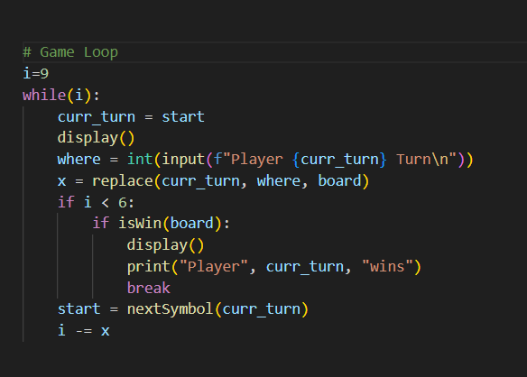
GAME LOOP

Slide 6
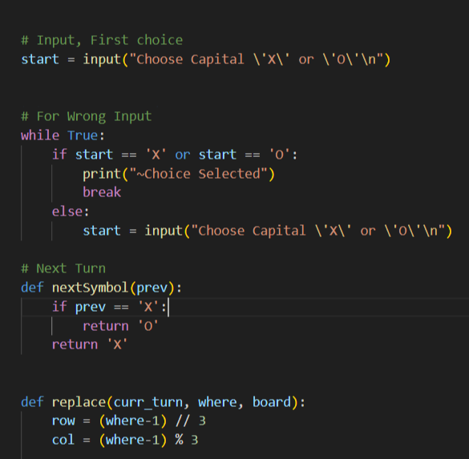
WRONG INPUT AND NEXT TURN

Slide 7
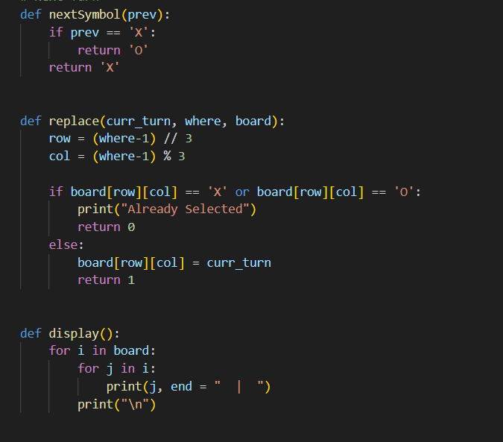
REPLACE MARK

Slide 8
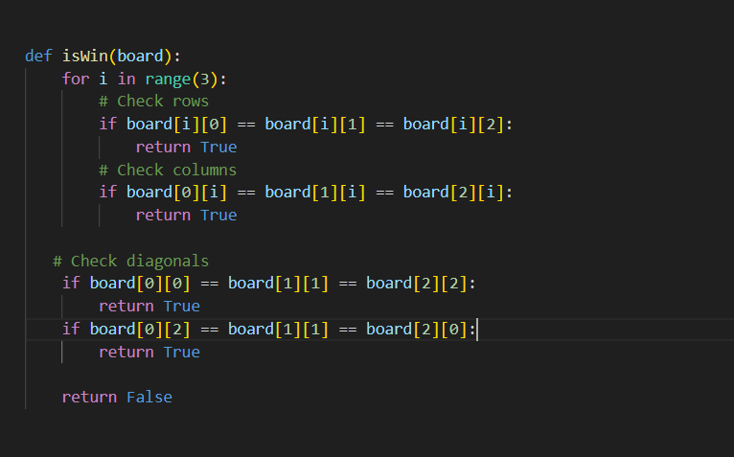
WIN LOGIC

Slide 9
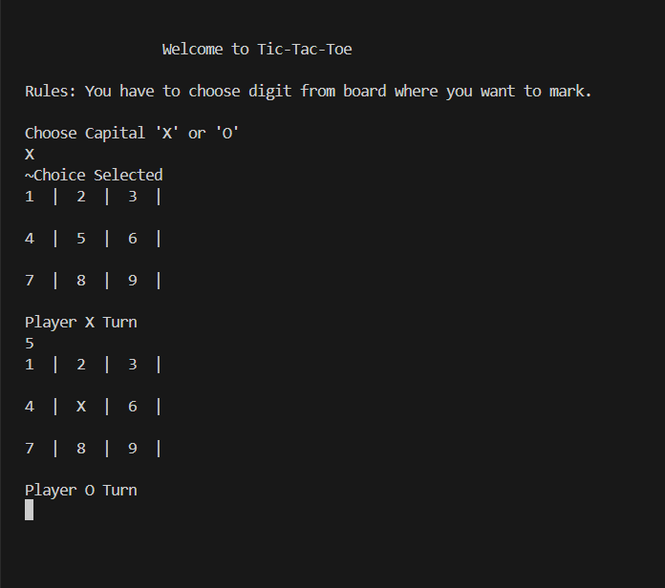
OUTPUT

Slide 10
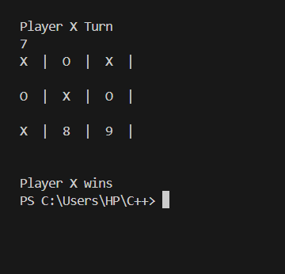
OUTPUT

Slide 11
CONCLUSION
One player successfully aligns three of their symbols horizontal, vertically or diagonally
It is a game of skill and strategic thinking.

Slide 12

THANK YOU

