Slide 1
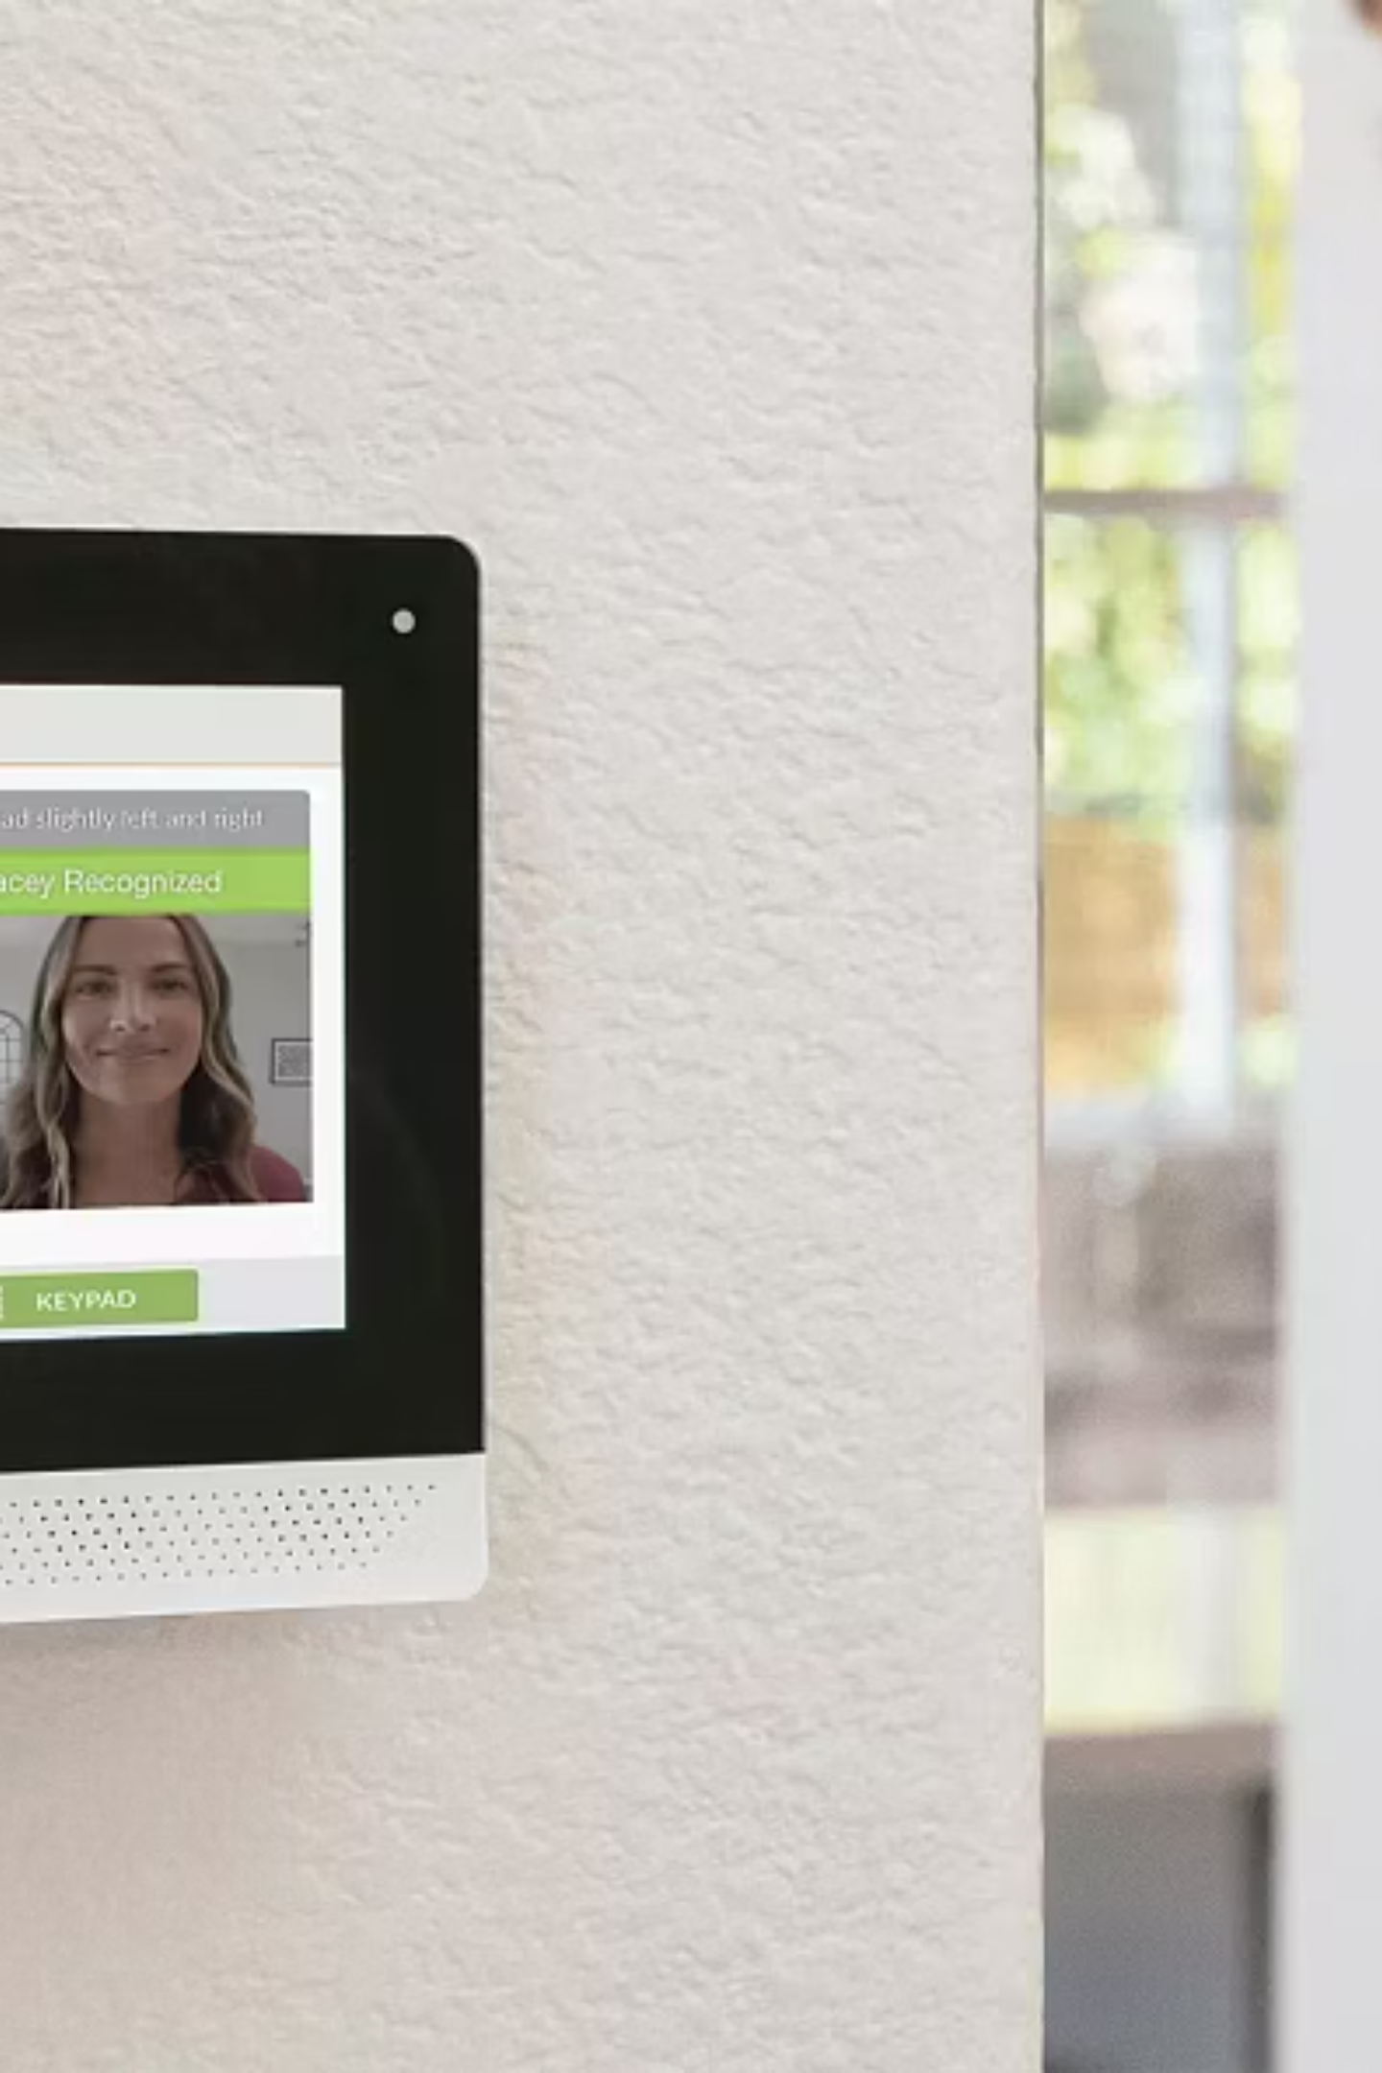
Smart Intruder Detection and Smart Lock Control System
Bhavik Talwar
2410994778
Project Artefact Presentation
SIT210 – Embedded Systems Development

Slide 2




Purpose of the System
This intelligent security system revolutionizes home and office door security through automation and real-time monitoring. It combines motion detection with facial recognition to identify visitors instantly, providing seamless access for authorized users while alerting owners to unknown persons.
Motion Detection
Instant Alerts
Automatically detects movement and activates facial recognition in real time
Sends immediate notifications for unknown persons via email and Telegram
Remote Control
Event Logging
Allows secure remote unlock via Telegram or MQTT from anywhere
Maintains comprehensive local logs for accountability and security audits

Slide 3
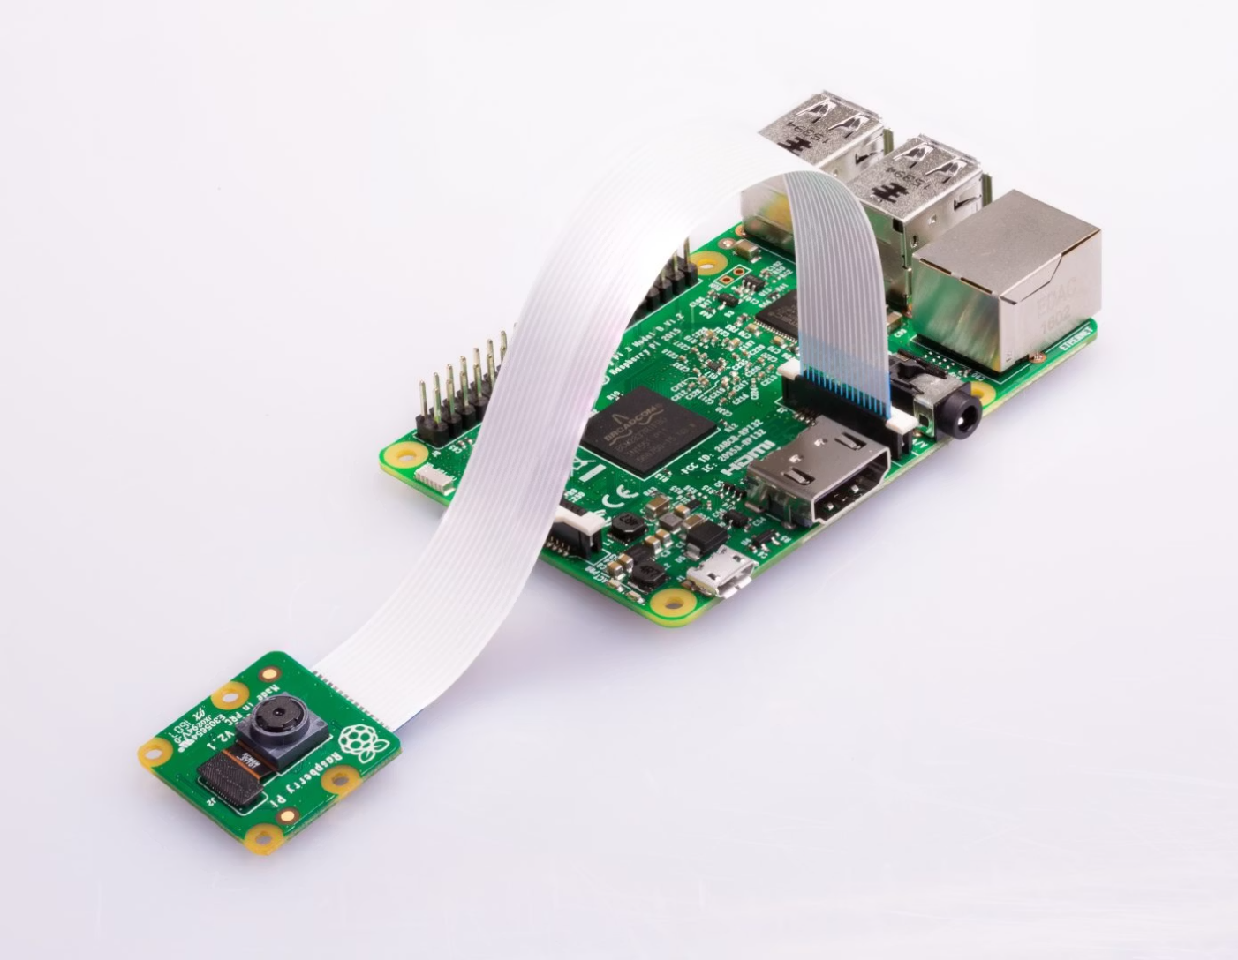





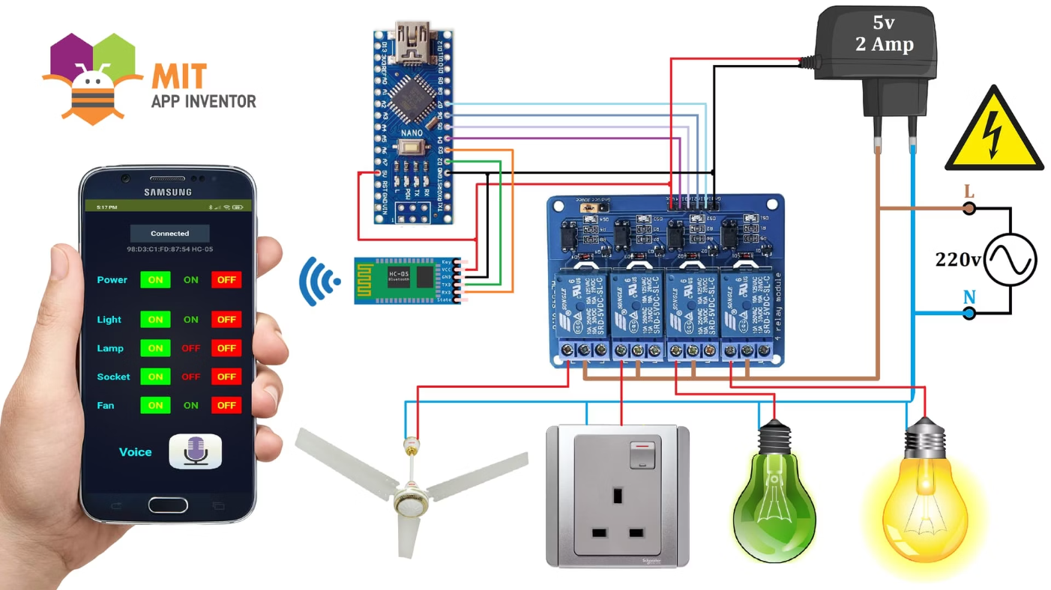

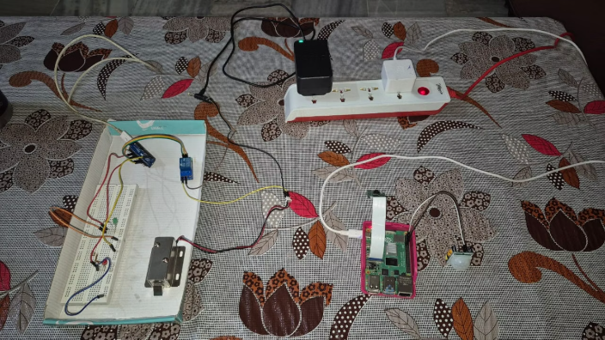
Hardware Components
The system integrates multiple hardware components working in harmony to deliver robust security functionality. Each component plays a critical role in the detection, recognition, and control pipeline.
Raspberry Pi
Main controller running facial recognition algorithms and cloud functions
PIR Sensor
Detects motion to trigger camera activation
Pi Camera
Captures high-quality images for facial recognition processing
Arduino Nano 33 IoT
Manages lock control via Bluetooth Low Energy communication
Relay + Solenoid Lock
Physical locking mechanism controlled electronically
Status LEDs
Visual indicators: green for unlock, red for intruder detection

Slide 4
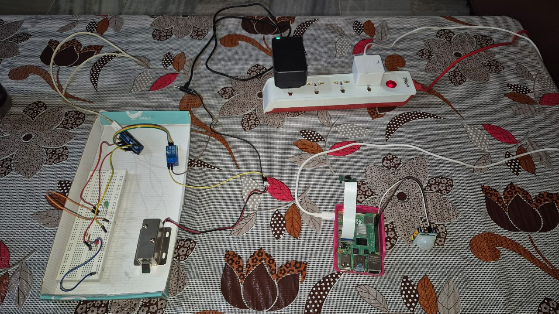

Slide 5





Network & Communication Architecture
The system employs a multi-layered communication strategy to ensure reliable operation across local and cloud environments. This architecture enables real-time control, remote monitoring, and persistent data storage.
BLE Communication
Bluetooth Low Energy enables efficient Pi to Arduino communication for lock/unlock commands with minimal power consumption
Cloud Integration
Dropbox API securely stores captured intruder images with automatic upload and link generation
Alert System
Notification channel via Email deliver instant alerts with image links to the owner
Manual Override
Owner can send "/unlock" command via Telegram bot or MQTT protocol for remote access control
Local Logging
CSV log file records timestamp, action type, confidence level, and image path for every event

Slide 6







Overall System Operation
The system follows a streamlined workflow from motion detection to door control, ensuring security while maintaining user convenience. Each step is optimized for speed and reliability.
Motion Detection
PIR sensor detects movement in the monitored area
Image Capture
Camera activates and captures a frame for analysis
Face Recognition
System checks captured face against known user database
Known User Path
If recognized, door unlocks automatically for seamless entry
Unknown User Path
If unrecognized, captures image, uploads to cloud, and sends alert
Remote Override
User can manually unlock remotely via Telegram or MQTT
Event Logging
All events logged locally with full details for audit trail

Slide 7

Fault Tolerance Mechanisms
Robust fault tolerance ensures the system remains operational even when individual components or network connections fail. Multiple redundancy layers protect against common failure modes.
Local Logging Resilience
Camera Protection
CSV logging continues even if cloud or network fails, ensuring no event data is lost
Auto-sleep mode when idle prevents camera overheating during extended operation
Background Processing
Network Recovery
Dropbox uploads run in background threads, preventing system freezes during network delays
Automatic reconnection handles network interruptions without manual intervention
Independent Override
BLE Retry Logic
Manual MQTT/Telegram unlock remains active independently of recognition system
Automatic retry mechanism handles temporary Bluetooth connection drops gracefully

Slide 8
Demonstration Summary
The system demonstration validates all core functionalities, from automated recognition to manual override capabilities. Each feature performed reliably under test conditions.
Motion to Camera
Auto Unlock
Intruder Alert
PIR sensor successfully triggers camera activation upon detecting movement
Known users are recognized and door unlocks automatically without delay
Unknown users trigger email and Telegram alerts with cloud-hosted image links
Remote Control
Data Logging
Manual unlock via Telegram "/unlock" command functions reliably from remote location
Local CSV logging confirmed with accurate timestamps and event details

Slide 9


Reflection & Future Work
Key Learnings
This project provided invaluable hands-on experience integrating sensors, computer vision, and IoT protocols into a cohesive embedded system. Key challenges included optimizing CPU performance for real-time facial recognition and establishing reliable BLE communication between the Raspberry Pi and Arduino.
Future Enhancements
Advanced Detection
Add mask detection and person counting capabilities for enhanced security

