Slide 1

Genesis Capital CRM
CLIENT DEMONSTRATION · OCTOBER 2026
One CRM for every desk — built around your rules, and changeable by your own team.
Lending
Wealth
Funds
Securities
Advisory
Forex
Compliance
Notes:
Welcome and introductions. One sentence: one CRM for every desk — lending, wealth, funds, trading, advisory, forex and compliance — that follows your rules and that your own team can change without developers. Everything on screen today is the Genesis Capital demo workspace; all people and documents are invented.

Slide 2





Five problems we set out to solve
WHAT WE HEARD
Client data is split by business line — nobody sees the whole relationship
OUR ANSWER
Lending runs on email and spreadsheets — status is hard to know
One CRM for every desk that follows your rules — KYC, suitability, Chinese walls, four-eyes approvals — and that your own team can change without developers.
KYC, suitability and conflict checks rely on memory
Advisory work must stay behind Chinese walls
Management reporting is rebuilt by hand every month
One view · Rules built in · Yours to change
Notes:
Say it back to them, then ask: "Is this still right? What would you add?" Let them talk and reuse their words in the demo.

Slide 3



Three ideas run through everything you will see
THE APPROACH
One client view
Rules built in
Yours to change
Every desk works on the same client record, with exactly the detail their role allows.
KYC, suitability, Chinese walls and four-eyes approvals run inside the process — not on a checklist.
Screens, fields, stages, workflows and dashboards are settings, not code.
In the demo: Client 360 · RM Workbench
In the demo: A refused fund order · a trader’s empty search
In the demo: A pipeline stage renamed live
Notes:
Keep coming back to these three ideas. Each scene of the demo proves one of them.

Slide 4
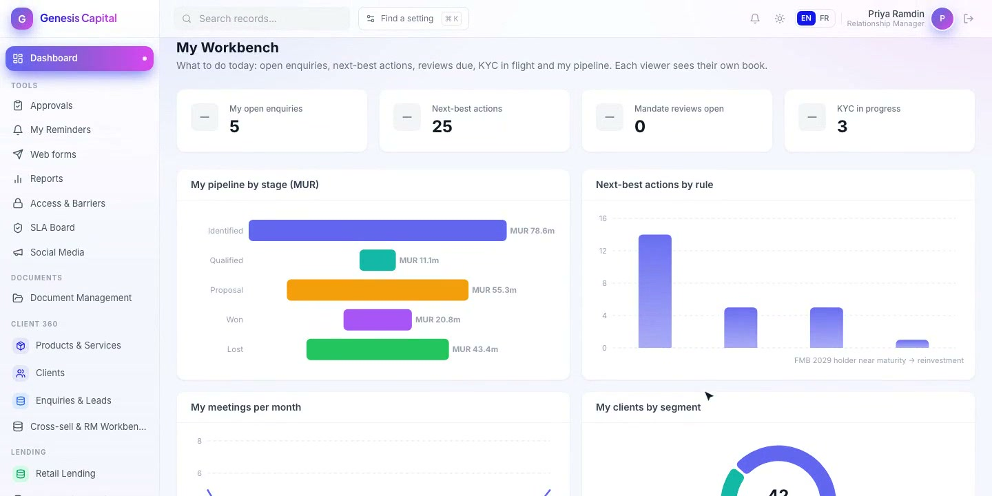
Configured for a six-entity financial group
AT A GLANCE
6
19
business units
modules
91
89
business objects
automated workflows
15
22
My Workbench — an RM’s day on one screen. Every figure is live and limited to their own book.
live dashboards
products & services
English and French throughout: business vocabulary, letters and client emails.
Notes:
The whole financial-services setup is one configuration pack on the Genesis platform: lending, wealth, funds, securities, corporate advisory and forex, plus compliance, marketing, introducers and revenue.

Slide 5






From website enquiry to client portal — no re-typing
ONE CLIENT, END TO END
Website enquiry
Client & KYC
Loan application
Four-eyes approval
Offer & e-sign
Client portal
routed, SLA clock on
created in one step
checklist, credit bureau
maker ≠ checker
letter generated
status, upload, message
TODAY’S LIVE DEMO · 8 SCENES · ABOUT 35 MINUTES
1 Website to enquiry
2 The whole client
3 Loan to approval
4 Compliance in the flow
5 Chinese walls
6 Client portal
7 French and forex
8 Management view
Notes:
The story follows one client, Karine Ruhee, wherever it can. Scene 1: website form to routed enquiry with SLA clock. 2: Client 360 and masked ID. 3: loan approval and offer letter. 4: refused fund order and audit chain. 5: Project Dodo invisible to the trader. 6: client portal. 7: French labels and an FX deal. 8: Group Executive dashboard and a live Builder change.

Slide 6
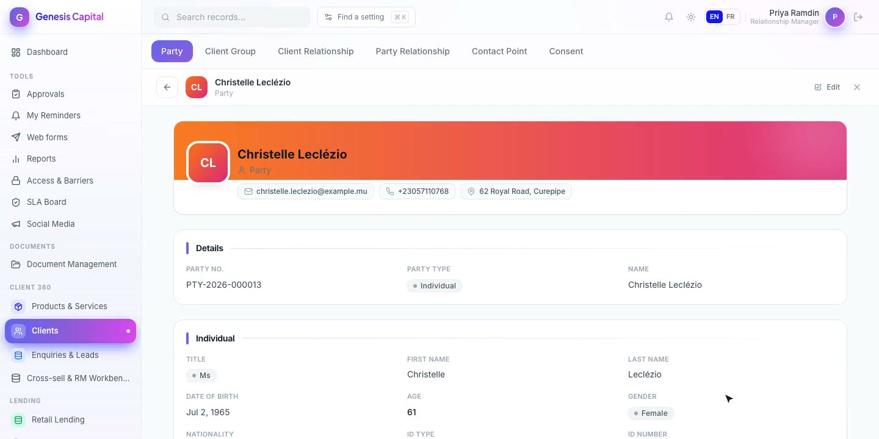



Every desk, one client record
ONE CLIENT VIEW
The whole relationship
Products, AUM, loans, documents and history across every entity.
Private by default
ID numbers are masked; each reveal is recorded with who and when.
Next-best actions
Rules suggest the right product at the right moment.
Notes:
Scene 2. Open Annabelle Ramful: relationship value about MUR 301 million across business lines. Click Reveal on the masked ID — Compliance will see that reveal in the audit chain in Scene 4. Open Mascarene Capital Partners: advisory work shows as restricted.

Slide 7






Compliance runs inside the work
RULES BUILT IN
KYC / CDD / AML
Suitability
Chinese walls
Cases, screening hits, risk scoring and periodic review.
Orders above the client’s risk profile are refused unless justified.
Barrier zones and insider lists hide confidential deals entirely.
Four-eyes approvals
Data protection
Audit chain
Whoever prepares a payment or order can never approve it.
Sensitive fields encrypted and masked; consent tracked.
Tamper-evident record of changes, approvals and reveals.
Notes:
Scenes 4 and 5. The fund order for a conservative client is refused. Compliance sees the ID in full and finds the RM’s reveal in the audit chain. The trader searches for Project Dodo and finds nothing — confidential work is not hidden behind a button, it is simply not there.

Slide 8




Fewer calls and emails, faster decisions
CLIENTS SERVED DIGITALLY
Client & introducer portal
Secure upload links
Web forms & calculators
Website feeds
Applications, loans, holdings with Redeem and Invest, documents, messages.
Signed, expiring links show only what is still needed. No email attachments.
Bilingual intake that lands routed, with the product preselected.
Live FX rates, fund NAVs and the prime lending rate for your website.
Clients sign in to the portal with a one-time code sent to the email on their record — no extra password to manage.
Notes:
Scene 6 and the Scene 3 upload step. Sign in to the portal as Karine Ruhee, show the approved loan and fund holdings, upload a document and message the RM; the message appears on her record in the CRM.

Slide 9



Built to change, safe to run, ready to connect
UNDER THE HOOD
Built to change
Secure by design
Ready to connect
No-code Builder: fields, forms, stages, workflows, approvals, dashboards, roles
Changes go live in minutes — no release, no developer
Whole setup ships as one installable pack
Two-factor sign-in that policy can enforce
AES-256-GCM encryption of sensitive fields
Sessions revoked instantly; workspaces kept apart
Screening, credit bureau, loan system, transfer agent, OMS, FX dealing, SMS
Running on a sandbox today; live with your credentials
Docker: your cloud or your data centre
Stack React · Node.js · MySQL · Redis · Docker Migration external reference on every record — safe, repeatable loads
Notes:
Scene 8 shows the live change. Technical summary: React front end, Node.js API, MySQL, Redis, in Docker. Every record has an external reference, so data can be migrated, checked and re-loaded safely. Going live with a provider means entering its connection details — the workflows do not change.

Slide 10
NEXT STEPS
From demo to go-live
1
Discovery workshop
ON THE ROADMAP
Half a day per business line: processes, roles, reports
Single sign-on (Entra ID / Google)
Live provider connections
Outlook / Google calendar sync
WhatsApp
Self-service reports on every object
French for menus and dashboards
2
Hosted sandbox
2–4 weeks for your own testers, demo data only
3
Integration list
Systems, providers and credential owners
4
Phased go-live
Lending & client view → wealth & funds → advisory & FX
Which part would make the biggest difference to your team first?
Notes:
Recap the three ideas in their words. Be open about the roadmap items — say: "This is configured and working against a sandbox; to go live we need your credentials, and nothing in the workflow changes." Agree a date for the follow-up and who attends. Follow-up email within 24 hours.

