Slide 1
VPN (Virtual Private Network)
PRESENTED BY:
BHAVIN PANCHAL

Slide 2
Content
Introduction
What’s VPN?
How’s VPN works?​
Characteristics
Devices
Types of VPN
Types of Tunneling
VPN in ​OSI model
Protocols
Reference

Slide 3
Introduction
What is VPN – definition?
VPN stands for virtual private network. It provides secure and encrypted connection between two devices over network to protect transmitted data which could be sensitive.
VPN helps to protect unauthorized access and eavesdropping, allowing user to securely access the data and resources from anywhere at remote location.

Slide 4
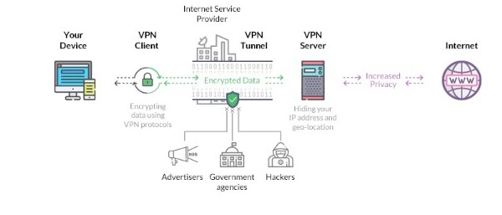
What’s VPN?

Slide 5
How’s VPN work?
When you connect to a VPN, your device initiates a connection to a VPN server.
Once the connection is established VPN server authenticate each other to ensure the legitimacy of the connection.
A VPN creates a secure tunnel between your device and the VPN server.
a new IP address by the VPN server.

Slide 6
Characteristics of VPN
Authentication:
only valid and legitimate user
Integrity:
Through hash make sure data is not altered while transporting
Access control:
Only authorized and registered user access network.
Confidentiality:
encrypted data to disclose sensitive information

Slide 7
Devices of VPN
DEVICES
1.Hardware
2.Firewall
3.Software

Slide 8
1. Hardware
Usually a VPN type of router.
Pros:
highest network throughput
Plug and play
Dual-purpose
Cons:
cost
Lack of flexibility

Slide 9
2.Firewall
More security.
Pros:
“Harden” Operating System
Tri-purpose
Cost-effective
Cons:
Still relatively costly

Slide 10
3. Software
Ideal for two end points not in same org.
Great when different firewalls implemented.
Pros:
Flexible
Low relative cost
Cons:
Lack of efficiency
More labor training required
Lower productivity;higher labor costs

Slide 11
Types of VPN
Type 1: Remote Access VPN
Type 2: Site to site VPN
1. Intranet Based
2. Extranet Based

Slide 12
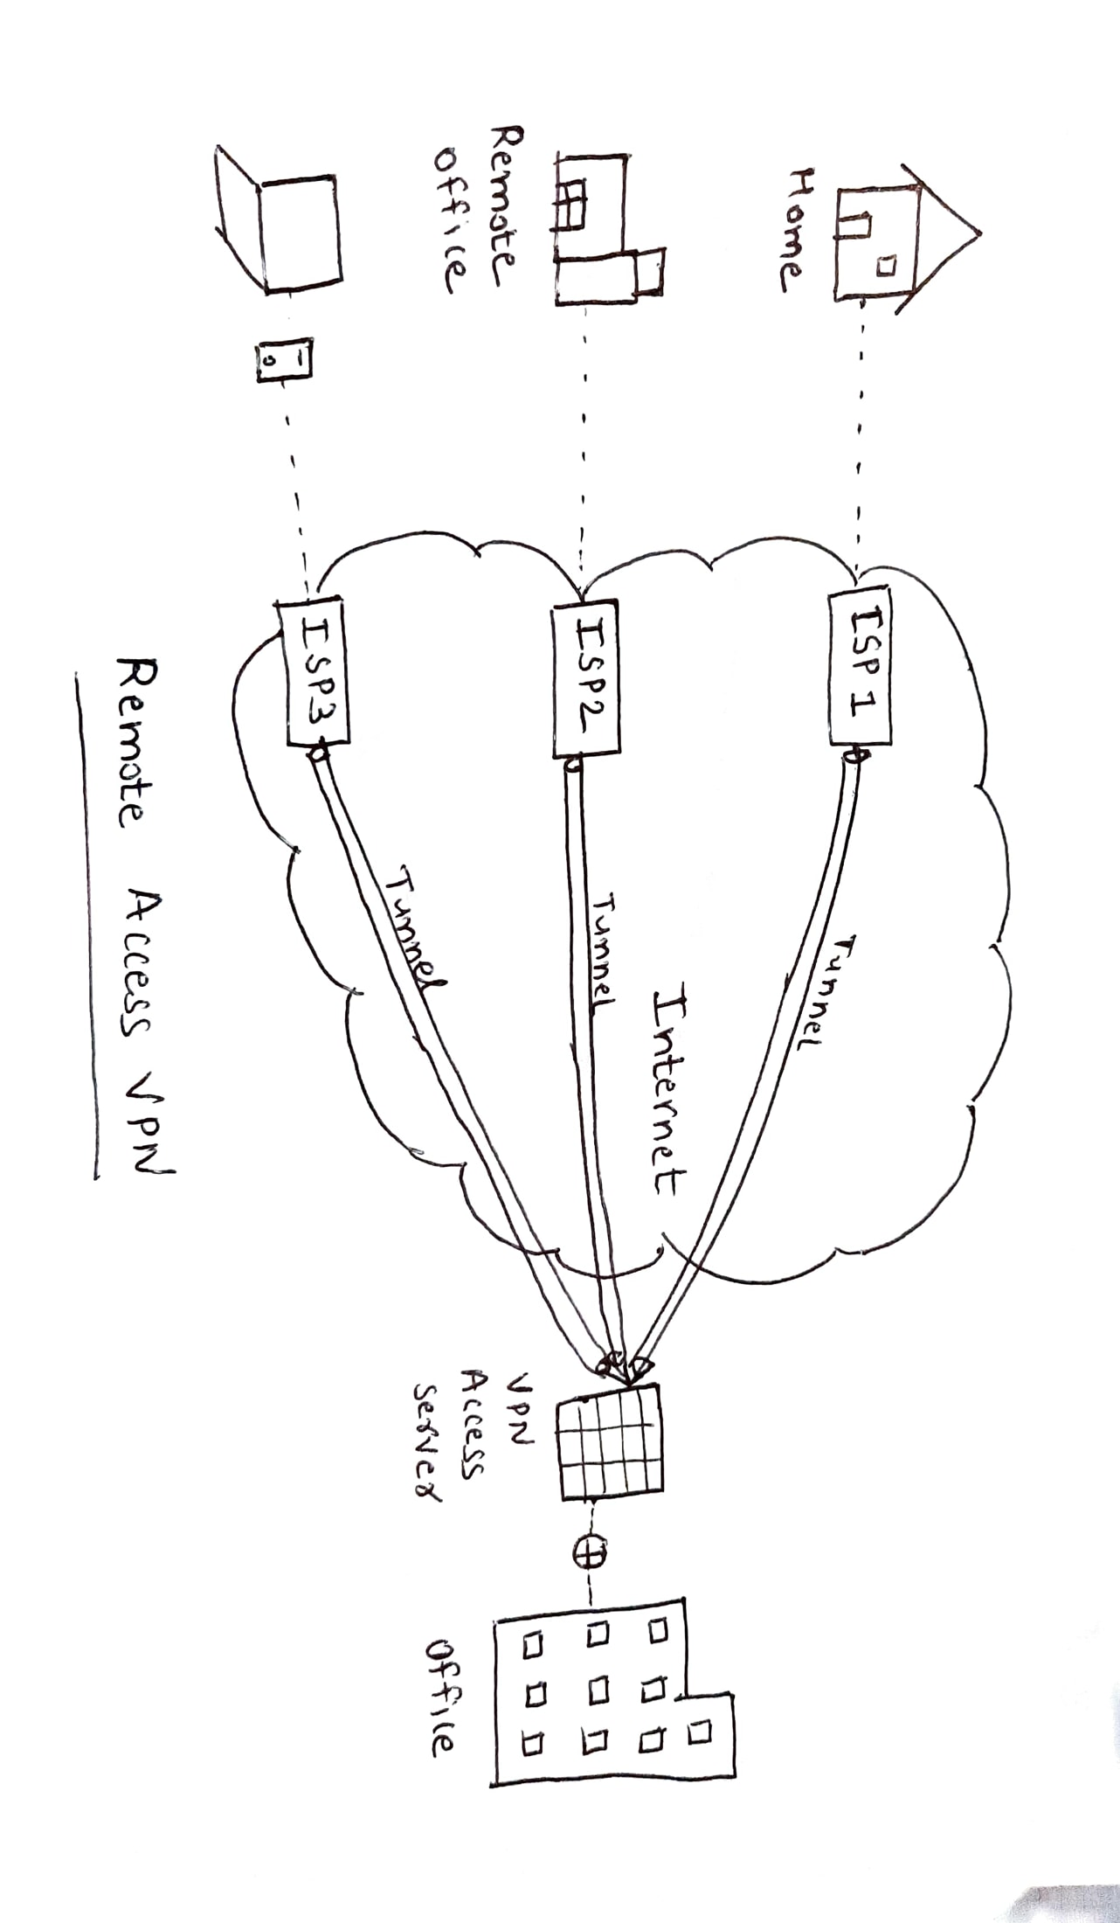
Type 1: Remote Access VPN
Enables users to connect to private network from remote location over the internet.
This type of VPN is commonly used by organizations employees to securely access resources and communications from any location.

Slide 13
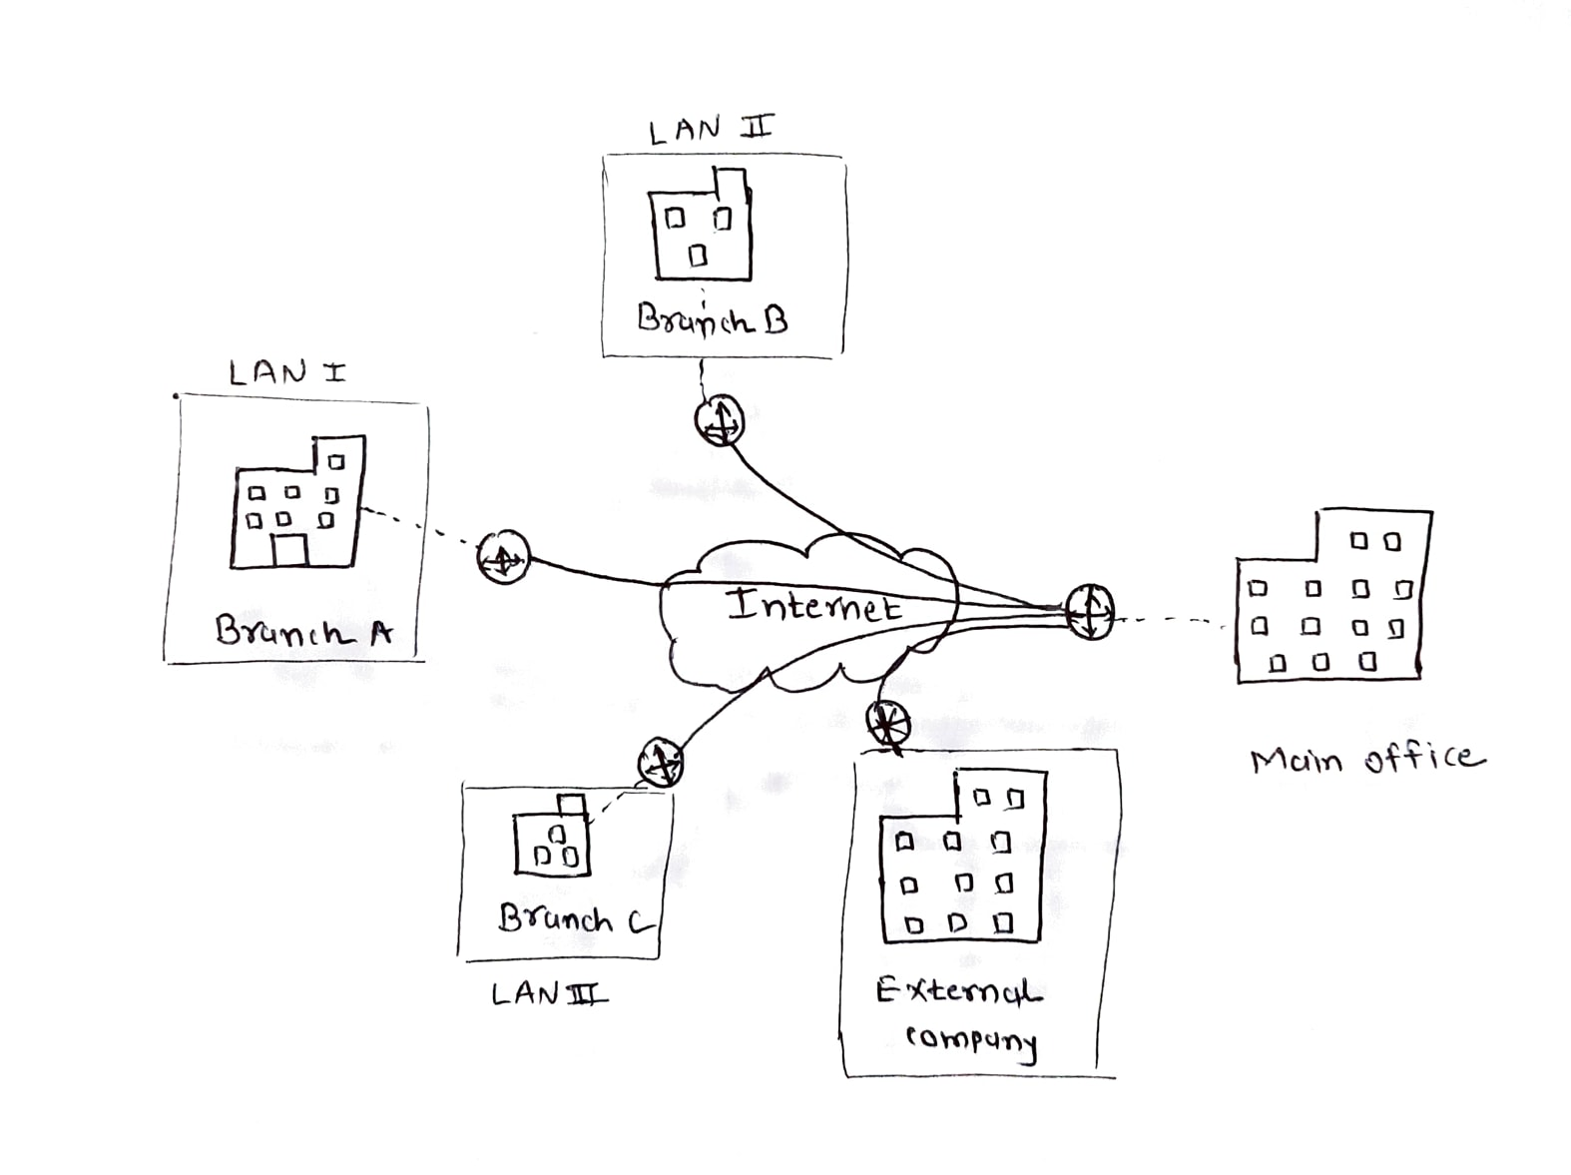
Type 2: Site to site VPN
Site to site VPN is connection of two or more networks at different locations are connected securely over the internet. It Also known as router to router
These types is mainly used by business organizations to setup communications between their geographically dispersed offices.
Intranet based : more than two branches of the same organization are connected to VPN network
Extranet based: Companies use site to site VPN to connect other company office .

Slide 14
Types of Tunneling
Split Tunneling
Full Tunneling
A full tunnel VPN connection is just another word for a standard VPN. This means that every data packet, whether browsing a website, accessing emails, or streaming media, is encrypted and passed through the VPN before reaching its final destination on the internet.
Split Tunneling is a VPN feature that allows users to direct a portion of their internet traffic through an encrypted virtual private network while leaving the rest to be routed through a separate tunnel on the open network. Split tunneling is a unique technology that gives you control over which data you encrypt through a VPN and other data remains open on the network. Simple terms split tunneling gives you complete control over which data is sent over the internet through your VPN and which data is kept on the faster, unencrypted open web.

Slide 15
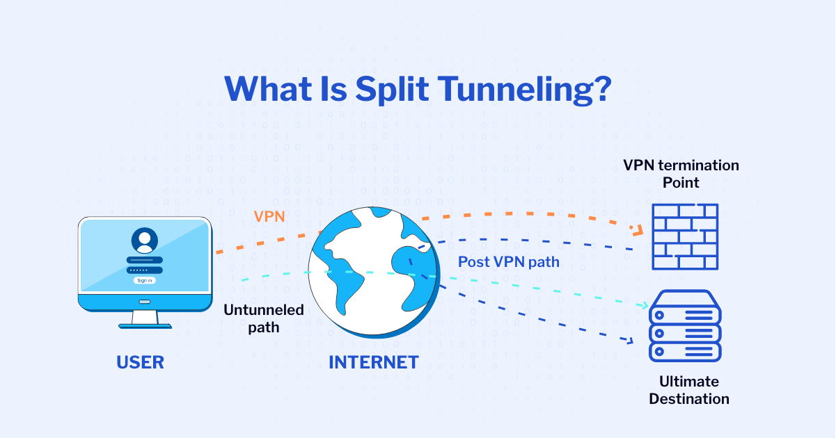

Slide 16
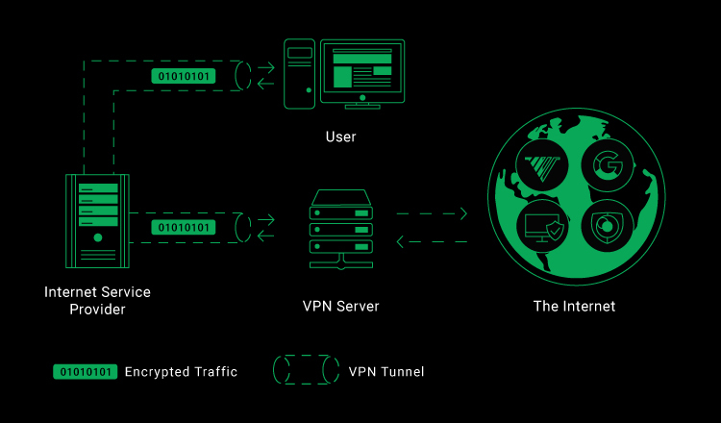

Slide 17
OSI MODEL of VPN
Datalink Layer:
VPNs create a direct connection between two or more network nodes, effectively extending a local area network (LAN) over a wider geographic area. Layer 2 VPNs are often used for connecting geographically dispersed offices or data centers.

Slide 18


PPTP-Point-to-point tunneling protocol
First widely used
Basic VPN protocol for transfer datagram between two computers with only one tunnel between two users.
It is extended version of PPTP protocol.
Multiple tunnels between 2 end points.
Packet switched network connection.
implemented with IPSec.
L2TP-Layers to Tunneling protocol

Slide 19
Network Layer:
Most commonly, VPNs operate at the Network Layer of the OSI model. This includes popular VPN protocols such as IPsec and SSL/TLS. VPNs create secure connections over public networks, such as the internet, by encapsulating and encrypting data packets. This allows for secure communication between remote users or networks.

Slide 20

IPSec Internet Security Protocol
Used for secure internet communications through ip Network.
Communicate by verifying session and encryption of data packets.
Two modes – Transport mode and tunneling mode

Slide 21
IPSec Modes
1. Tunnel Mode:
Tunnel mode is used in site-to-site VPNs or when connecting entire networks such as organization to communicate.
In tunnel mode a new IP packet is created in which header and payload is encapsulated and encrypted.
a new header is added for routing through the secure tunnel and packet is transmitted over the public network to the remote VPN gateway.
the outer IP header is removed, and the original packet is decrypted on remote gateway.
2. Transport Mode:
Transport mode is used in end-to-end communication between individual two users or hosts for communication.
In transport mode, only the payload (data) is encrypted and transmitted over the public internet.
Transport mode only encrypt the payload that cause original IP header visible over the public internet.

Slide 22
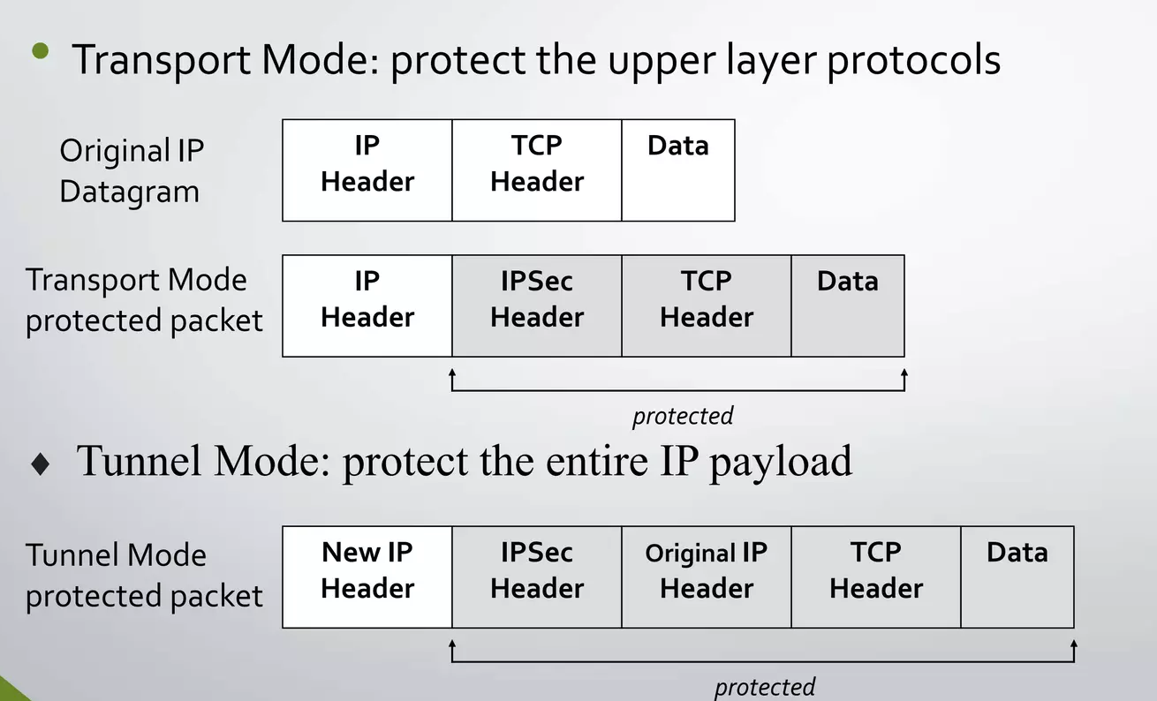
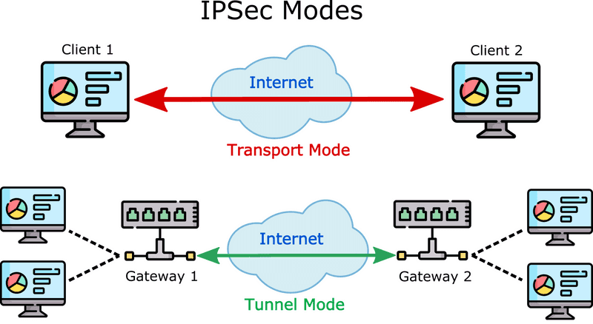
IPSec Modes
In summary, tunnel mode is often used for network-level security between entire networks, encapsulating and encrypting the entire IP packet. Transport mode, on the other hand, is used for host-level security, encrypting only the data payload while leaving the original IP header visible. The choice between tunnel mode and transport mode depends on the specific requirements of the VPN deployment.

Slide 23
OSI MODEL OF VPN
Transport Layer
Transport Layer Security (TLS) and Datagram Transport Layer Security (DTLS) protocols operate at the Transport Layer (Layer 4) of the OSI (Open Systems Interconnection) model. TLS and DTLS are commonly used to secure communication channels, and they can be employed for various VPN scenarios.

Slide 24

SSL/TLS Encryption
SSL (Secure Sockets Layer) and TLS (Transport Layer Security) are typical cryptographic protocols that provide secure communication over a computer network. Although, they can also be used for Virtual Private Network (VPN) implementations.
Users access a web portal through a standard web browser.
After authentication, they can access specific applications or resources.
A dedicated software client is used to establish a secure tunnel.
This type of VPN provides a more traditional VPN experience.

Slide 25
OSI MODEL of VPN
Application layer:
These applications produce the data, which has to be transferred over the network. This layer also serves as a window for the application services to access the network and for displaying the received information to the user.

Slide 26

Secure Socket Tunneling Protocol
SSTP is commonly used for remote access VPN scenarios.
It is providing a secure communication channel for individual users connecting to a corporate network.
Its use of HTTPS and compatibility with standard web traffic ports make it a perfect choice for environments where other VPN protocols might face restrictions.

Slide 27
Conclusion
VPN provides best possible combination of security and private network capabilities with adequate cost-saving to the companies who are presently working with leased lines.
As we have gone through all possible details we conclude that VPN is the best option for the corporate networking.

Slide 28
Reference
https://nordvpn.com/blog/protocols/
https://nordvpn.com/what-is-a-vpn/
https://crm.org/news/types-of-vpn
https://ipcisco.com/lesson/vpn-types-and-protocols-of-vpn-2/
https://www.geeksforgeeks.org/types-of-virtual-private-network-vpn-and-its-protocols/
https://usa.kaspersky.com/resource-center/definitions/what-is-a-vpn
https://nordlayer.com/learn/vpn/types-and-protocols/#most-common-vpn-protocols

Slide 29
Thank You

