Slide 1
JAX-RS API using Jersey Webservice
Bhavin Patel
CSC 570

Slide 2
Requirement
Use JAX-RS API using Jersey for this project
Create Doctor and Patients services
Use patients.db and drs.db as input files
Webservice can have many doctors where each doctor as mentioned earlier is associated with a List of patients and their insurance card
Perform four basic CURD operations like GET, POST, PUT and DELETE

Slide 3
Use of Technology
JAX-RS API using Jersey framework
Tomcat Server
Curl utility
prediction3 webservice source code is utilize from book

Slide 4
Classes and Method
Class Patient
This class has basic getter and setter methods for doctor, patient and insurance card
Class RestfulDrpatient
RestfulDrpatient interacts with the Jersey JAX-RS implementation under a Tomcat deployment.
RestfulDrpatient has a ApplicationPath annotation indicates that the URI part of the URL continues with /resourcesDr.

Slide 5
Classes and Method 2
Class DrpatientsList
DrpatientsList is a class that represents a collection of Patients instances, with the collection implemented.
It has two main methods
find method: finds doctor based on id.
add method: adds doctor and patient information

Slide 6
Classes and Method 3
Class DrpatientsRS
DrpatientsRS is a resource class of drpatients webservices. It uses two input files: patients.db and drs.db It is a POJO class which has four CURD operation methods, @GET, @POST. @PUT and @DELETE
It has one main method except four CURD operations
populate method: reads the doctor and patient data from a text file, patients.db and drs.db, encapsulated in the deployed WAR file.

Slide 7
Deploy Webservice
Deploy a webservice on Tomcat server using java build tool apache ant
Run this command in source code folder
ant -Dwar.name=drpatients deploy
It will create drpatients webservice under apache Tomcat webapp folder with a war file
Make sure Tomcat is running for following CURD operations

Slide 8
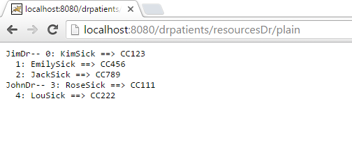
Get a list of all doctors along with their patients in plain text.
http://localhost:8080/drpatients/resourcesDr/plain

Slide 9
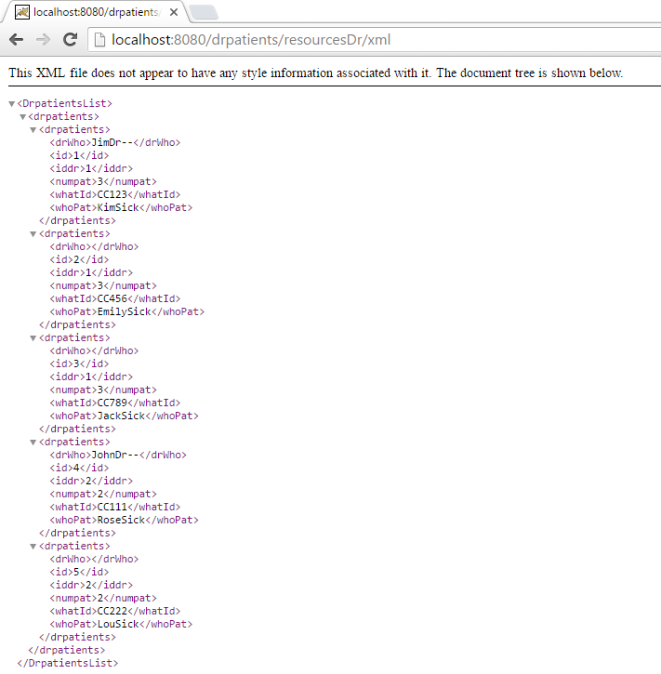
Get a list of all doctors along with their patients in xml.
http://localhost:8080/drpatients/resourcesDr/xml

Slide 10
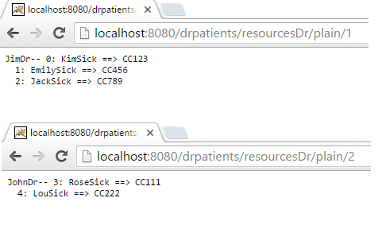
Get a list of doctor along with their patients in plain by his/her id.
http://localhost:8080/drpatients/resourcesDr/plain/1
http://localhost:8080/drpatients/resourcesDr/plain/2

Slide 11
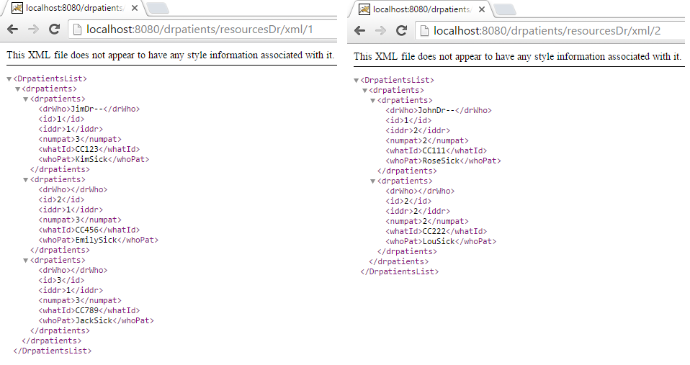
Get a list of doctor along with their patients in xml by his/her id.
http://localhost:8080/drpatients/resourcesDr/xml/1
http://localhost:8080/drpatients/resourcesDr/xml/2

Slide 12
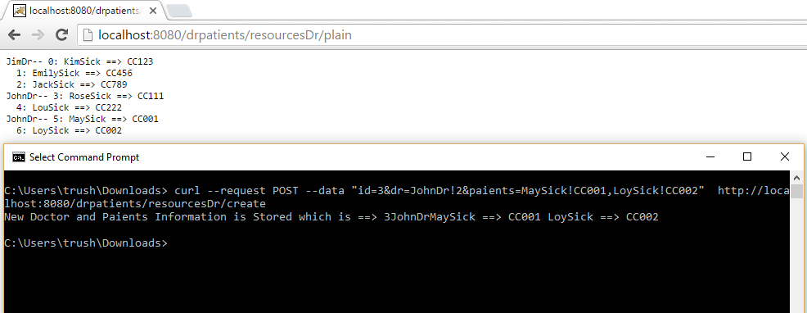
Add or create a new doctor along with his/her patients to the existing list.
Curl –-request POST –data "id=3&dr=JohnDr!2&paients=MaySick!CC001,LoySick!CC002" http://localhost:8080/drpatients/resourcesDr/create

Slide 13
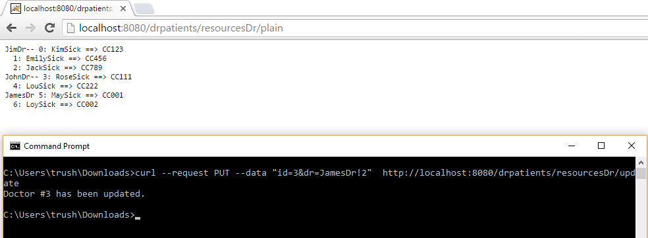
Update a doctor’s name only on an existing list of doctor-patients given an id for the doctor along with a new name.
curl –-request PUT -–data "id=3&dr=JamesDr!2" http://localhost:8080/drpatients/resourcesDr/update

Slide 14
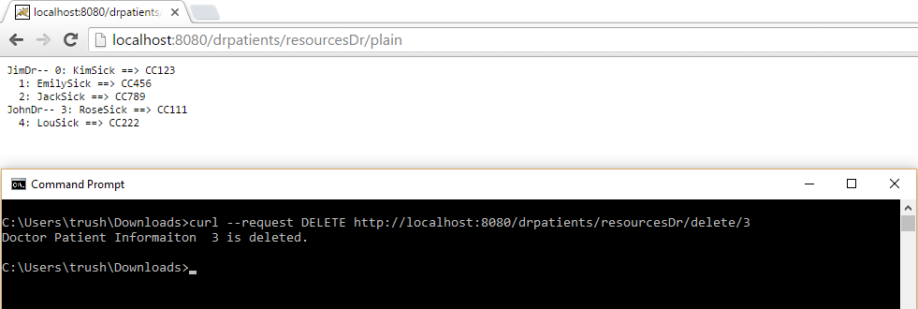
Delete an existing doctor along with his/her patients: (given an id for the doctor).
curl --request DELETE http://localhost:8080/drpatients/resourcesDr/delete/3

Slide 15
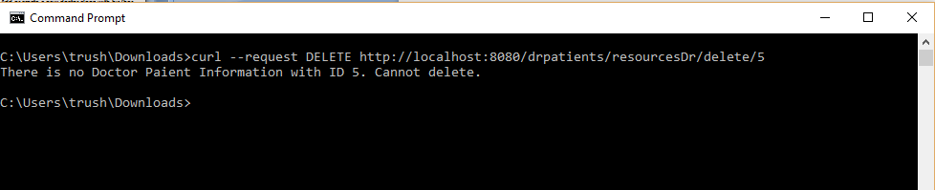
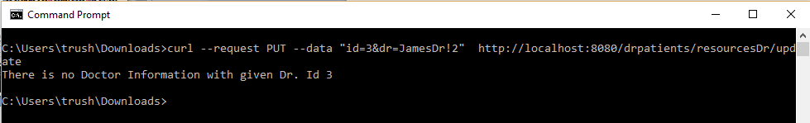
Handling bad request
In below screenshot, trying to delete a doctor who does not exists.
In below screenshot, trying to update a doctor who does not exists.

Slide 16
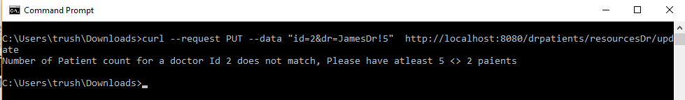
Handling bad request 2
In below screenshot, trying to update a doctor who does not have same patient count.

