Slide 1
Secure Data Hiding in Images using Steganography
CAPSTONE PROJECT
Presented By,
Student Name : Bhavinash Chennuri
College Name & Department : Prasad V. Potluri Siddhartha Institute of Technology, Computer Science and Engineering

Slide 2
OUTLINE
Problem Statement
Technology used
Wow factor
End users
Result
Conclusion
Git-hub Link
Future scope

Slide 3
Problem Statement
This project focuses on developing an advanced steganographic system to securely embed and extract secret information within digital images. Leveraging techniques such as least significant bit (LSB) manipulation, the system aims to provide a robust method for covert data transmission. The primary objectives include ensuring the imperceptibility of the hidden data, maintaining high security against steganalysis attacks, and achieving efficient data embedding and extraction processes. The successful implementation of this system has significant potential applications in digital forensics, confidential communication, and privacy protection.

Slide 4
Technology used
Opencv – python library
Os library
String library
Python language
Steganographic Algorithms
Image Formats
Testing and Validation Tools

Slide 5
Wow factors
What makes this project stand out from other project(Unique features)?
Advanced Steganographic Techniques
Robust Security Measures
Steganalysis Resistance
Multi-Platform Support
Performance Optimization

Slide 6
End users
Who are the end users ?
Government and Military Agencies
Law Enforcement and Intelligence Agencies
Journalists and Whistleblowers
Business and Corporations
Healthcare Professionals
Academia and Research Institutions
Legal Professionals

Slide 7
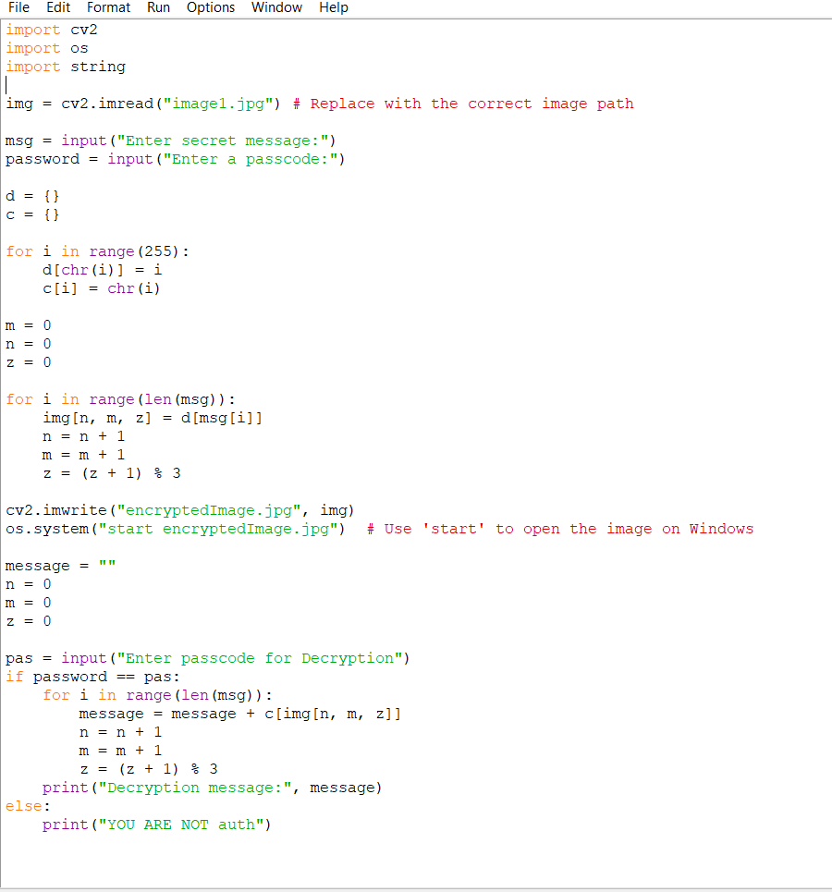
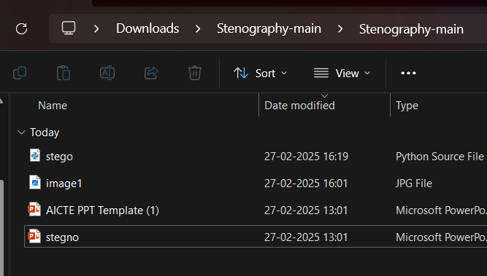
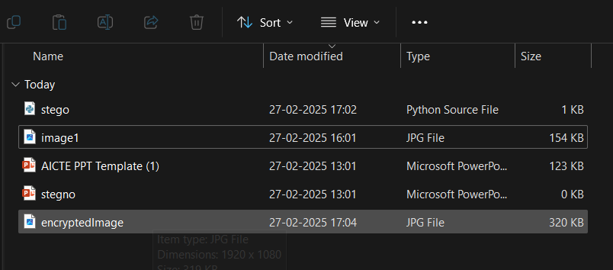
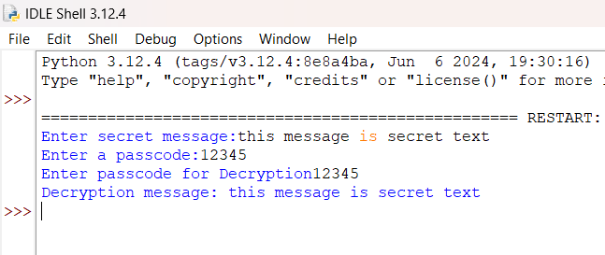
Results

Slide 8
Conclusion
This project successfully develops a robust and secure steganographic system for embedding and extracting secret information within digital images. Through the implementation of advanced techniques such as least significant bit (LSB) manipulation and additional encryption layers, the system ensures the imperceptibility and security of the hidden data. The project also incorporates measures to resist common steganalysis attacks, providing a reliable method for covert communication.
The steganographic system has significant potential applications across various domains, including government and military agencies, law enforcement, healthcare, legal professions, and general public usage. By safeguarding sensitive information and ensuring privacy, this project addresses the critical need for secure data transmission in today's digital landscape.

Slide 9
GitHub Link
Make sure that there should be readme file

Slide 10
Future scope(optional)
Advanced Steganographic Techniques
Enhanced Security Measures
Real-Time Steganography
Cross-Platform Compatibility
User-Friendly Interfaces
Integration with Messaging Platforms
Performance Optimization

Slide 11
THANK YOU

