Slide 1
Research Oriented Project on Automated Deployment
Team Members:
Bhavin G Chennur, PES2201800682
Nishanth S Shastry, PES2201800533
Monish S, PES2201800380

Slide 2

Our Project works on Distributed Computing
Many computers of different capacities are connected to a Master Node.

Slide 3
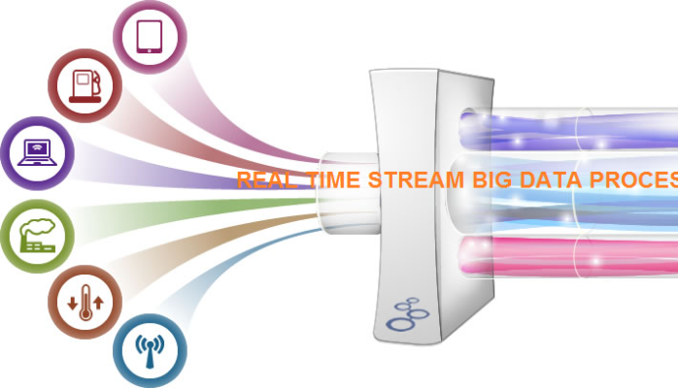
Inputs from the user
In a stream of inputs to the system, the stream is made up of:
Many users giving jobs.
Most of the users give jobs at short bursts with a time intervals in between.

Slide 4

A Machine Learning Approach to Perform Automated Deployment
We build a model to understand the capacities of every single computer in the cluster.

Slide 5
How Do We Do This?
Using a kNN Algorithm
We train the model with:
Node number and
the number of tasks it could perform in a given amount of time.
This way the model understands the processing power of every computer in the cluster.

Slide 6
How do we Rank a user?
He’ll submit various jobs after certain time intervals.
Each time he appears, he submits more than 1 tasks.
We’ll divide the total number of jobs he submits by the number of times he appears i.e., we find the average number of tasks the user gives every time he appears so that we can judge his requirements for every appearance.

Slide 7
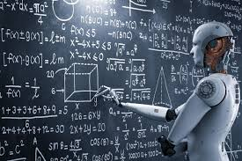
Prediction for Automated Deployment
Using an appropriate k value ( say k = 3 ) we’ll predict the right node for the user.
It is a combination of the user’s needs and the computer’s processing power.

Slide 8

How is this Automated Deployment?
The input is a stream of tasks, the user doesn’t have to configure / understand anything.
Every user is assigned to a node intelligently by the computer.

Slide 9

How can we use Big Data Technologies to apply this concept?

Slide 10

The Frontend
The user inputs:
His information and
Submits the number of tasks,

Slide 11

Spark
Finds the average computing requirements of every user.
Advantage: Same code can be used in Spark Streaming, if our project gets a real world application !!

Slide 12

K-NN Algorithm
Learns user requirements,
Learns capabilities of all computers in cluster
Maps a user to a computer.

Slide 13

Map-Reduce
Counts the number of users every node is assigned to.
A statistical view.

Slide 14

Hive
Backs up all the input and training datasets.
If our project gets a chance for real world application, Hive helps us scale it to distributed processing.

Slide 15
Technologies Used:
Spark
Map-Reduce
Hive
HTML
CSS
JAVA SCRIPT
MYSQL
PHP MYADMIN
kNN algorithm
Bash Script
Usage of each of them will be explained in the demonstration.

Slide 16


