Slide 1
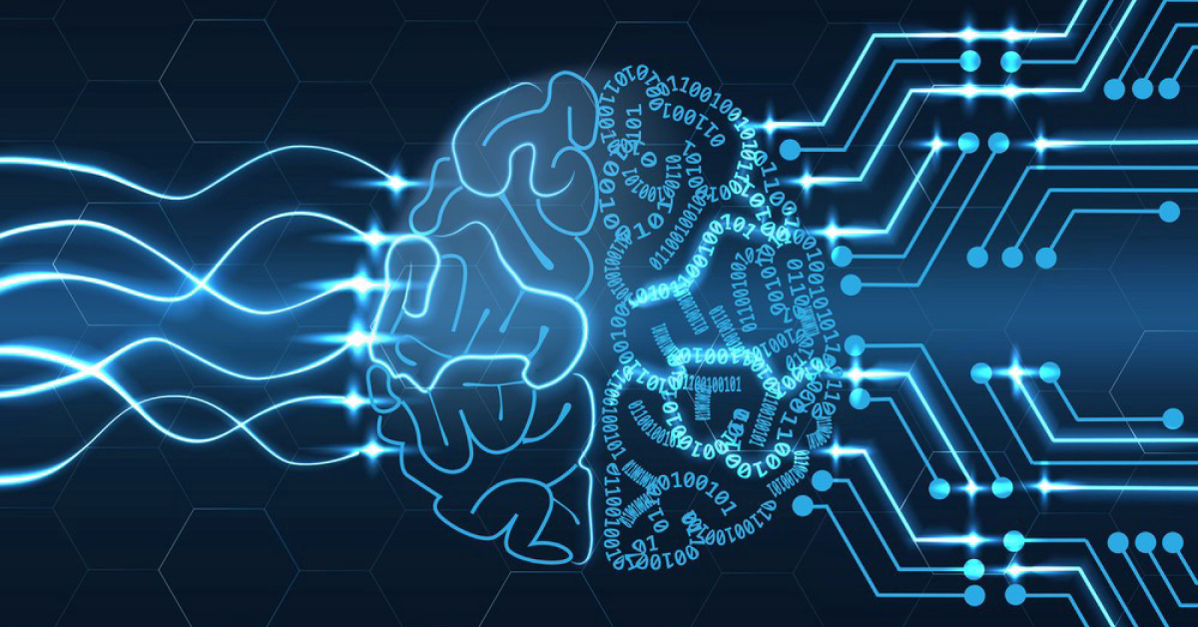
APPLICATION OF
LINEAR ALGEBRA
IN NEURAL NETWORKS

Slide 2
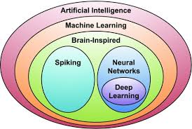
TERMS
NEURAL NETWORK
DEEP LEARNING
MACHINE LEARNING

Slide 3
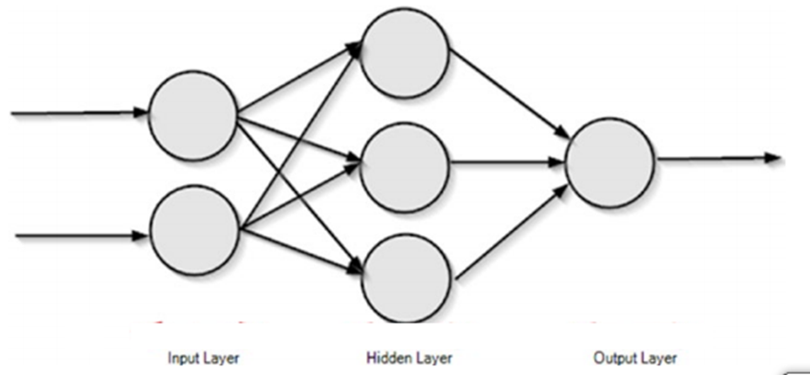
NEURAL NETWORKS USING LINEAR ALGEBRA
STEP 1:
FEED FORWARD NEURAL NETWORK
STEP 2:
VECTORIZATION

Slide 4
VECTORS AND VECTORIZATION
Vectorization is the process of converting an algorithm from operating on a single value at a time to operating on a set of values (vector) at one time
Vector: A vector is a quantity that has both magnitude and direction. It is an entity that exists in space
  LINEAR INDEPENDENT VECTORS
  LINEAR DEPENDENT VECTORS
  UNIT NORMAL VECTORS

Slide 5
MATRICES
MATRIX OPERATIONS
  Matrix-Scalar Operations
  Matrix-Vector Multiplication
  Matrix-Matrix Addition and Subtraction
  Matrix-Matrix Multiplication
PROPERTIES OF MATRICES
  INVERSE PROPERTIES
  TRANSPOSE PROPERTIES
  IDENTITY LAW, COMMUTATIVE LAW ,etc…

Slide 6
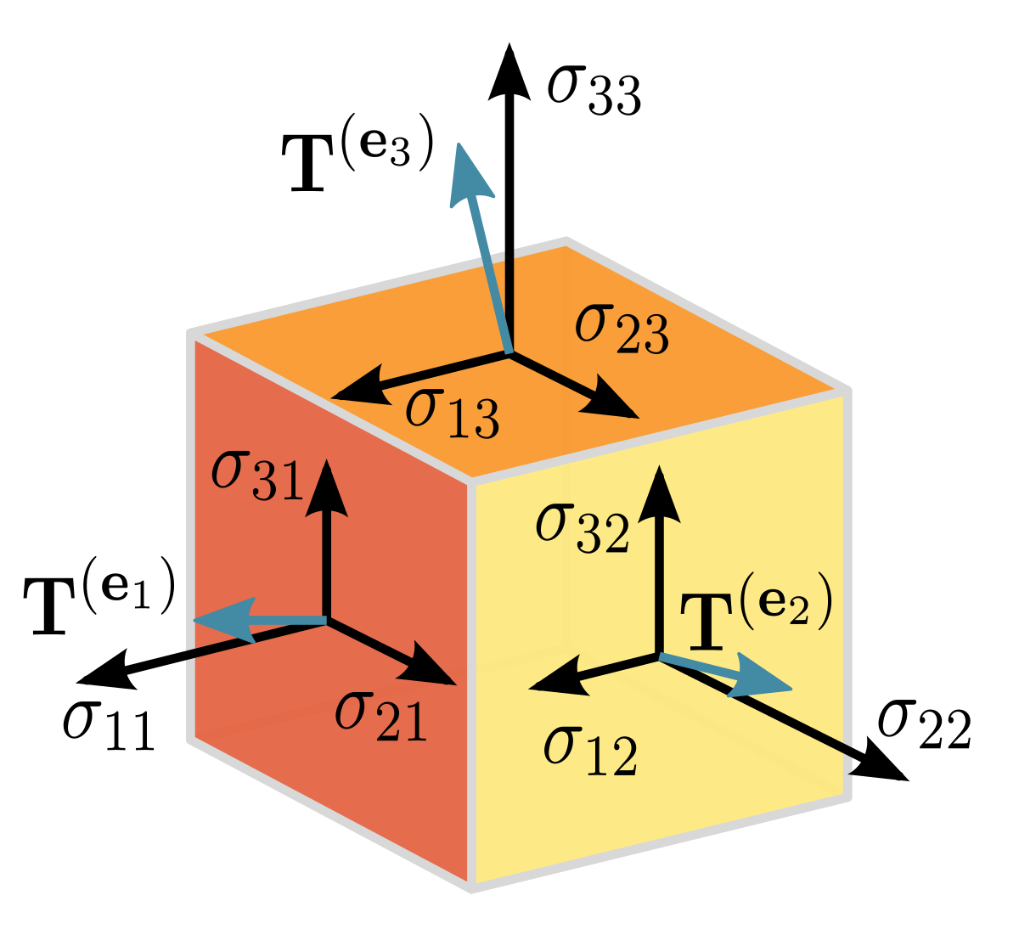
TENSORS
Tensor is an array of numbers, arranged on a regular grid, with a variable number of axes. A Tensor has three indices, where the first one points to the row, the second to the column and the third one to the axis.

Slide 7
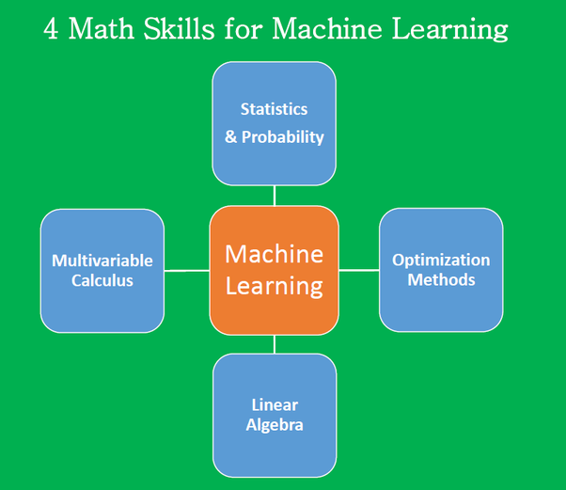
Linear Algebra – Neural Networks Relationship
Linear Algebra is one of the core
subjects for Machine Learning
because algorithm to be developed
for the machine learning has
to be written with the help of
Linear Algebra which makes
things much simpler.

Slide 8
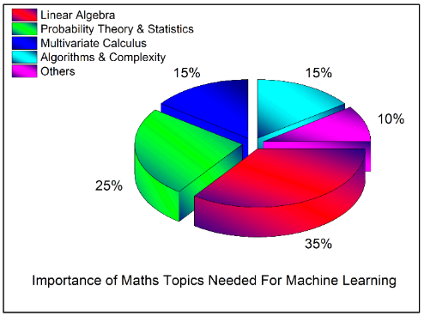
CONCLUSION
Thus, we can conclude that Linear Algebra with the help of others like probability ,calculus ,etc forms a major part of Machine Learning. Hence by the help of these core subjects, newer algorithms can be formed which is beneficial for tech industries worldwide.

