Slide 1

Object Oriented Programming Project
Topic : Self Diagnosis System
Submitted to : Gaurav Kumawat Sir BY:
Bhavini Jain
Harshit Chaubisa
2nd Year CS

Slide 2
What is Self-Diagnosis System?
Self-diagnosis is the process of diagnosing, or identifying, medical conditions in oneself. It may be assisted by medical dictionaries, books, resources on the Internet, past personal experiences, or recognizing symptoms or medical signs of a condition that a family member previously had.
Through this system one can test himself having sudden disorders in body.

Slide 3
Why Self-Diagnosis?
As in this pandemic period we can save ourselves from visting hospitals for test and can diagnose ourself at home.

Slide 4
Advantages:
Internet diagnosis are much quicker than setting up a doctor’s appointment and wait for them to attend you. Most of the time, the symptoms disappear by themselves before your appointment date comes up.
Most of the time it can calm you down as you might realise your symptoms are pretty common and will recover in no time, without necessarily consulting a doctor.
It saves our money and time if you have common symptoms and too can get alert for major disease.

Slide 5
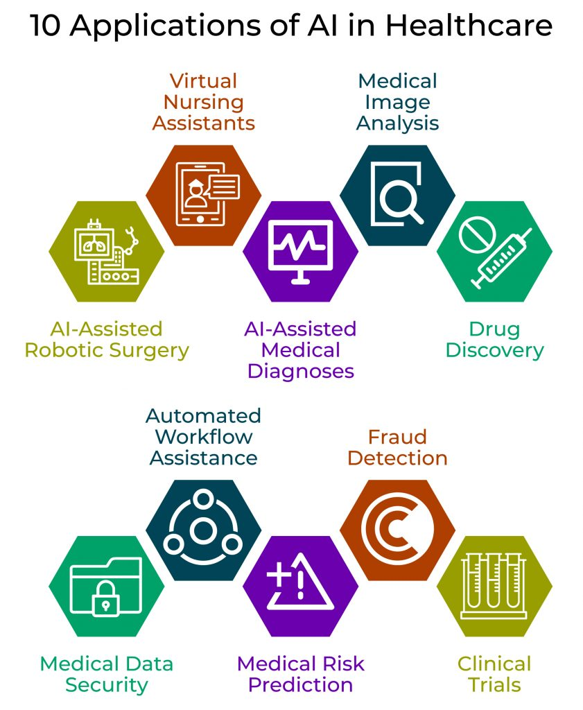
Future Enhancement
Self-diagnostics will be the growth area in over-the-counter health for the next five years,and that rising prescription charges were a factor encouraging people to treat themselves.
We can built an app or software for particular clinic or hospital in which proper prescription will be given by the doctors and too online appointment scheduling in serious cases.
We can schedule “Live Video Confernce” with doctors too.

Slide 6
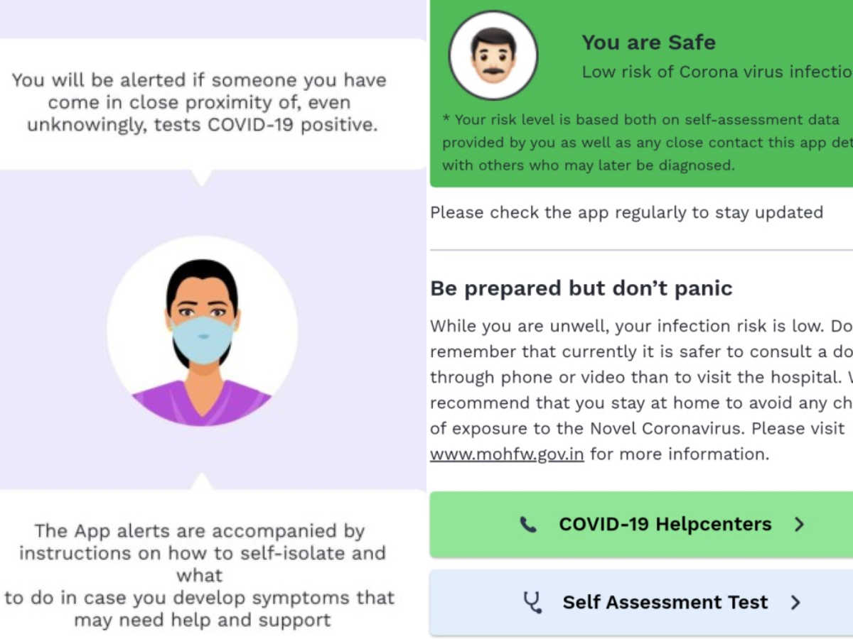
Inspired By Aarogya Setu App

Slide 7
Code flow:
Register
1.Login
2.Register
3.Forgot
4.Exit
Login
1.Previous Records
2.Covid Test
3.Personal info
4.Routine Checkup

Slide 8
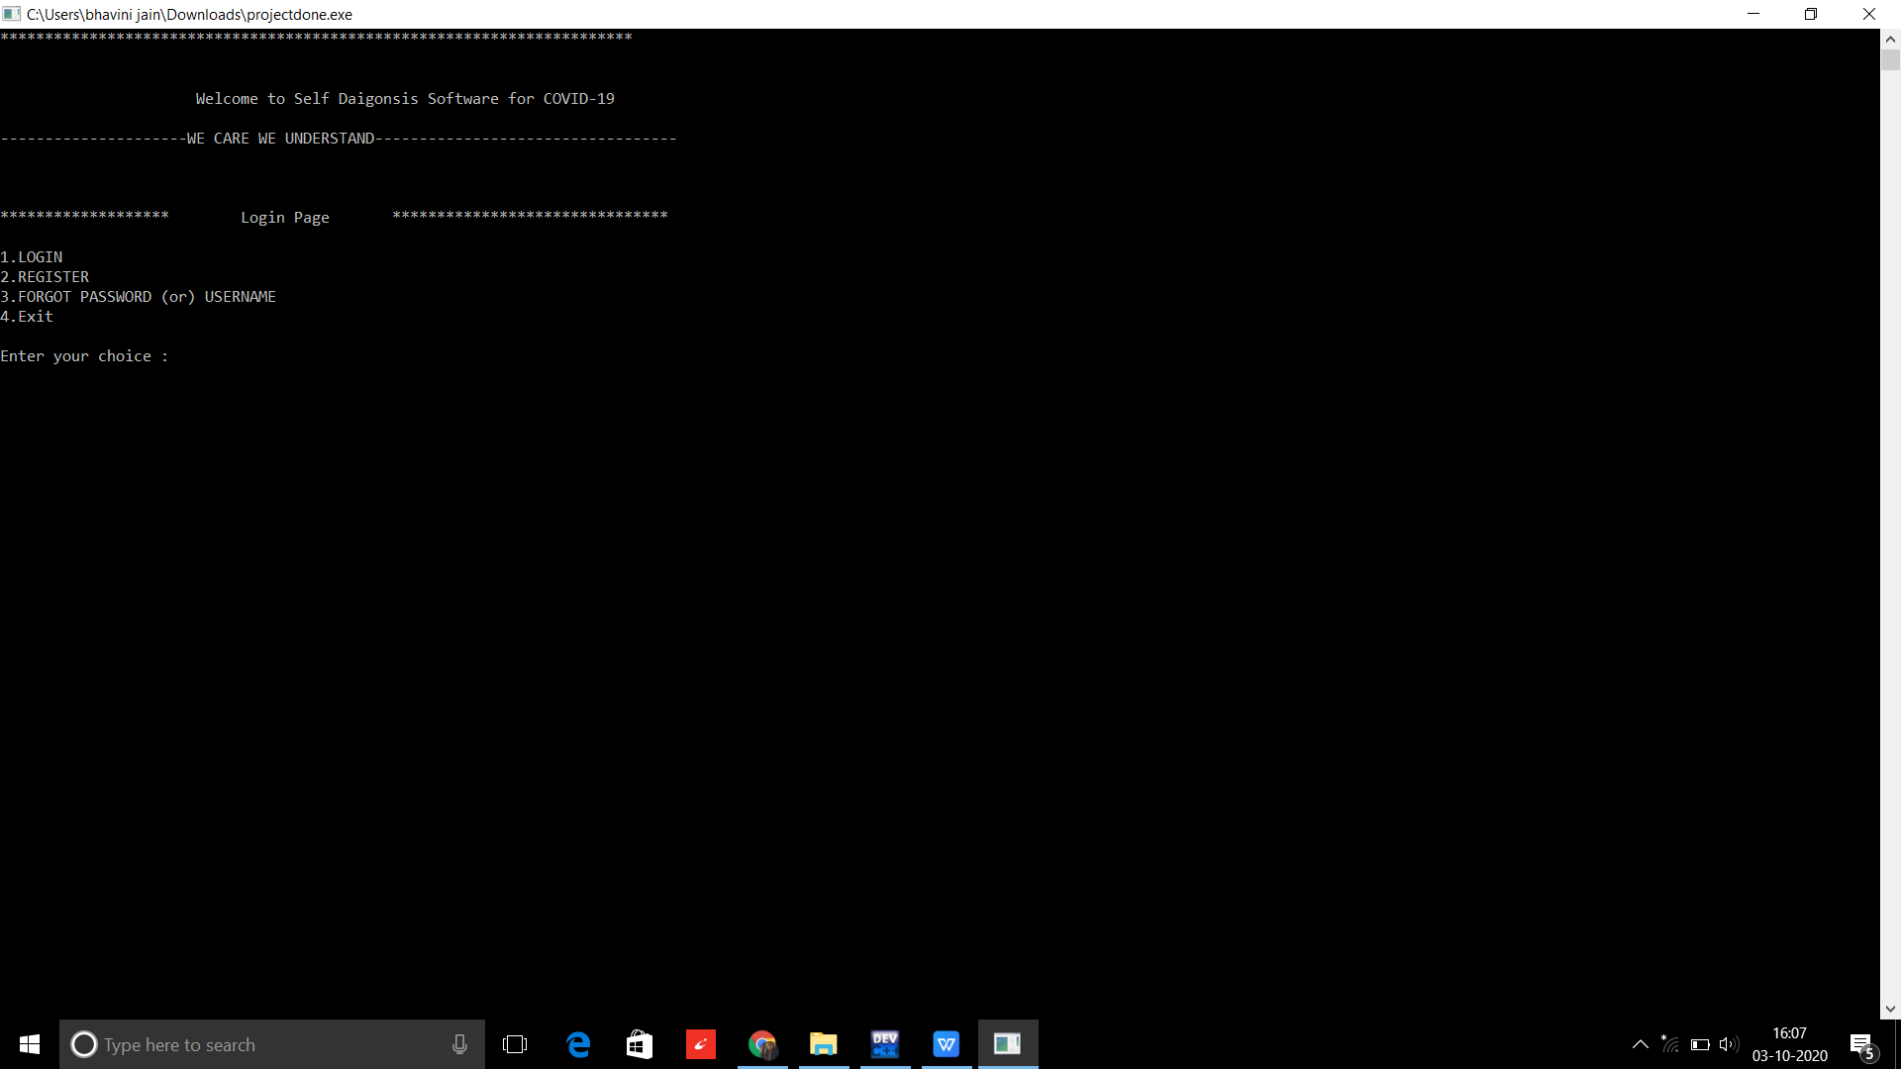
Login → If you are an existing user. Register→If you are a new user. Forgot→If you forgot your id password.

Slide 9
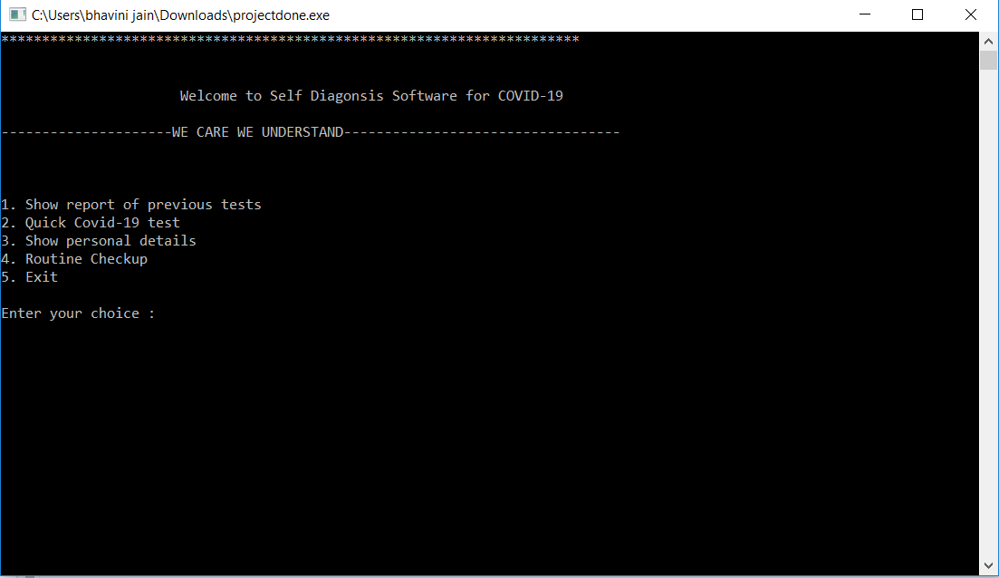
Diagnosis Options Window
Here, we can go for different tests and also for the records and tests perviously taken.

Slide 10
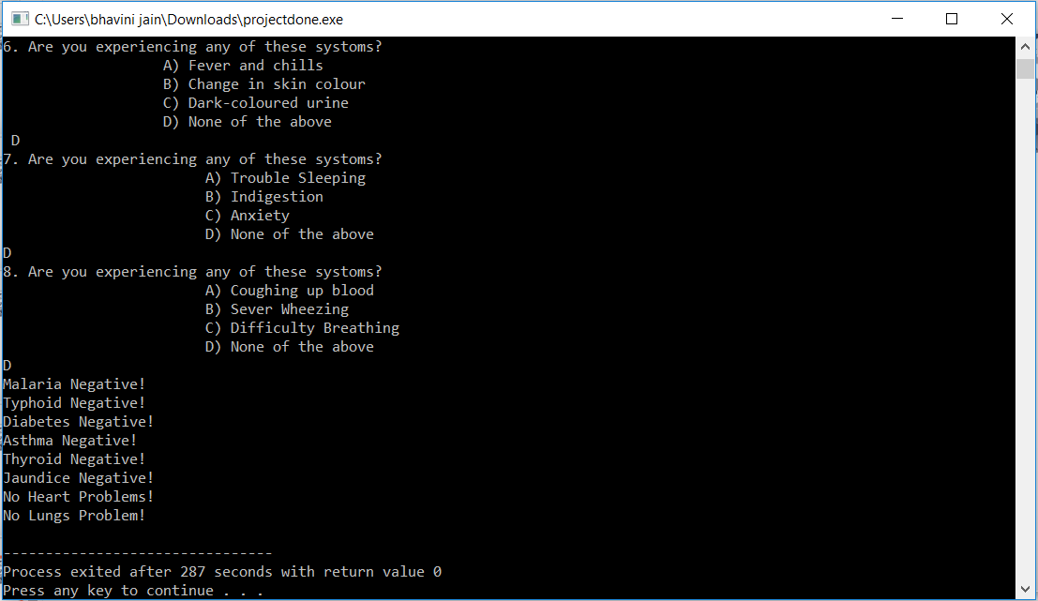
Routine Checkup
In this one have to enter if he/she is feeling any disorders from last few days .
It helps one to confirm about disease and can go for test if serious case found.

Slide 11


