Slide 1
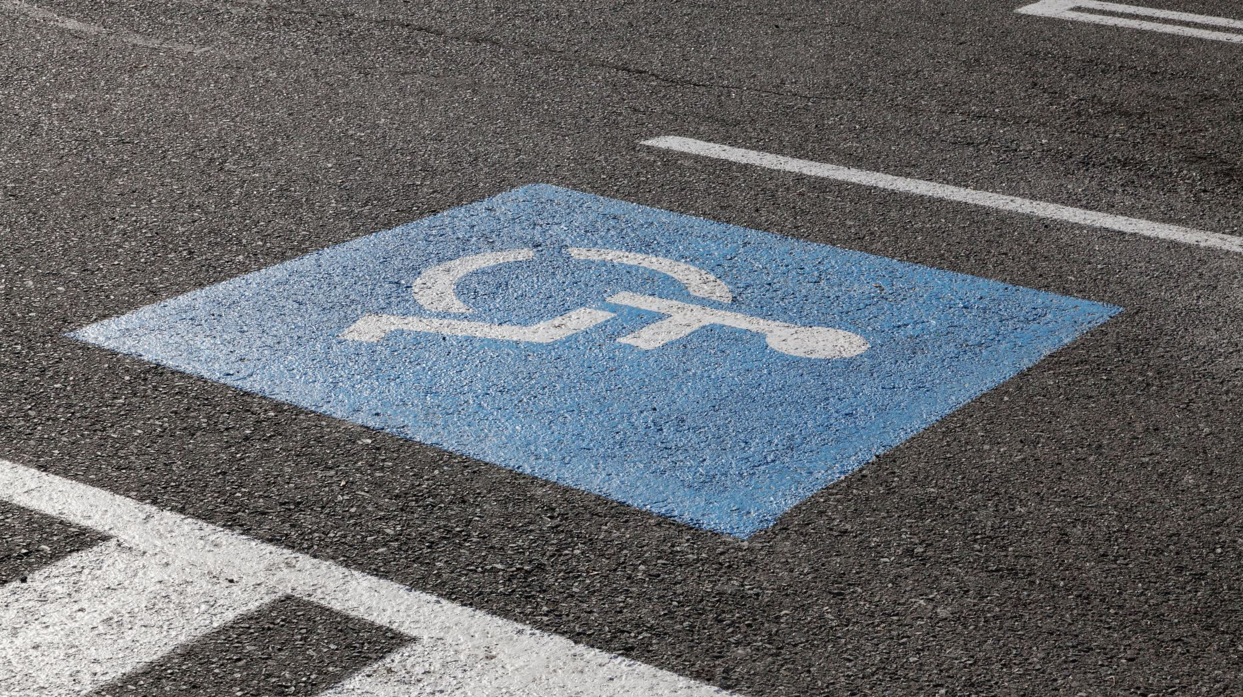
US Accidents Severity Prediction
Ahmar Jamal
Bhavini Vyas
Rutabah Khan

Slide 2
Data Source: Kaggle. Dataset contains US traffic data from Feb 2016 to March 2019 Description: This project is used to predict US traffic accidents severity based on weather conditions like visibility, temperature, and weather categories as well as based on US location and the day of the week. This project can be used for numerous applications such as real-time accident severity prediction based on environment factors. Studying accident hotspot locations and their severity.

Slide 3
Data
Rich data with almost 2 million rows
Needed pre-processing (Spark)
Severity contained in data is prone to errors
Weather condition categorization may not be accurate
Data is imbalanced

Slide 4
Technologies
Spark
AWS-Postgres
Pandas
Scikit-Learn
Tableau
Flask

Slide 5

Pre-processing
Categorized weather conditions
Eliminated rows that greatly contributed to the imbalance of the data and were not significant in volume
Replaced null values with fillers

Slide 6
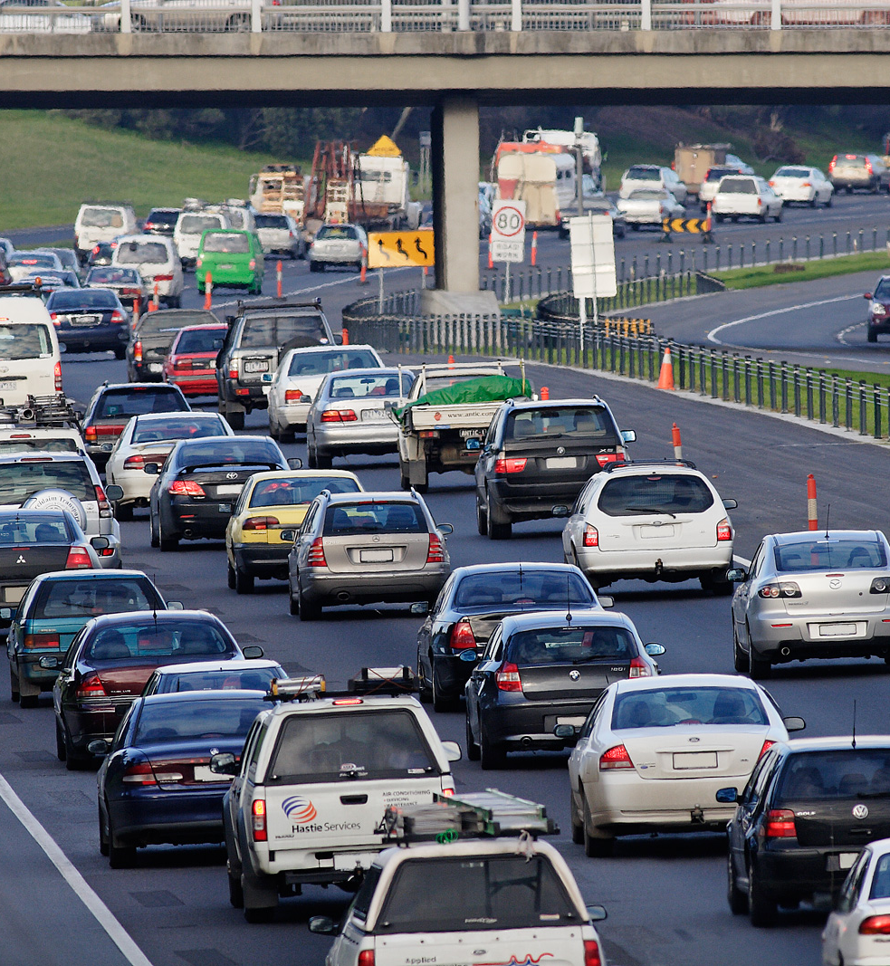
Machine Learning Models
Logistic Regression
Random Forest
SVM
+ Did Hyper Parameter Tuning using Grid Search
+ Trained the model with 75% of data
+ Tested Accuracy for all models using test data
+ Generated classification reports
+ Generated feature importance
+ Random Under Sampler to balance data (imb learn)
This Photo by Unknown Author is licensed under CC BY-SA

Slide 7
Model-1
Logistic Regression
Model-2
Support Vector Classifier
Training Accuracy: 35%
Testing Accuracy: 35%
Training Accuracy: 36.7%
Testing Accuracy: 35.4%
Because of low accuracy these models were not used.

Slide 8
Model -3 Random Forest with grid search (n_estimator: 10, max_depth: 75) and under sampling- RandomUnderSampler
Training Accuracy: 65%
Testing Accuracy: 61.91%
pre rec f1
2 0.83 0.63 0.72
3 0.54 0.58 0.56
4 0.14 0.71 0.23
avg / total 0.72 0.62 0.65

Slide 9
Model - 4 Random Forest with grid search (n_estimator: 10, max_depth: 75) and over sampling -SMOTE
Training Accuracy: 93%
Testing Accuracy: 73%
Due to overtraining the model, it has not been used even though it gives high accuracy.

Slide 10
Model - 5 Random Forest with grid search (n_estimator:10, max_depth: 20) and over sampling -SMOTE
Training Accuracy: 77.7%
Testing Accuracy: 69.9%
pre rec f1
2 0.85 0.71 0.77
3 0.58 0.69 0.63
4 0.21 0.52 0.30
avg / total 0.74 0.70 0.71

Slide 11
Finally Model-5 Random Forest with grid search (n_estimator:10, max_depth: 20) and over sampling -SMOTE has been used to predict the accident severity.
Model takes Latitude, Longitude, Temperature(F), Visibility(mi), Weather_Category(Rain, Cloudy, slippery etc..), Weekday as features and predicts Accident severity in terms of Less Severe, Moderate or Severe.
As an example, some of the inputs and predicted results are given below.
Model Testing
 | Latitude | Longitude | Temperature (F) | Visibility(Mi) | Weather Condition | Day |  | Predicted Severity
Austin | 30.26 | -97.74 | 92 | 15 | Slippery | Thursday |  | Moderate
 | 30.26 | -97.74 | 92 | 15 | Cloudy | Thursday |  | Less Severe
 | 30.26 | -97.74 | 92 | 15 | Rain | Thursday |  | Moderate
Pittsburgh | 40.44 | -79.99 | 92 | 15 | Rain | Thursday |  | Less Severe
 | 40.44 | -79.99 | 60 | 2.5 | Rain | Thursday |  | Moderate
 | 40.44 | -79.99 | 60 | 0.5 | Low Visibility | Thursday |  | Less Severe
 | 40.44 | -79.99 | 60 | 0.5 | Low Visibility | Saturday |  | Severe

Slide 12
Web app: https://us-acc-severity-prediction.herokuapp.com/ http://399beff0.ngrok.io/ Dashboard https://public.tableau.com/profile/rutabah8195#!/vizhome/USAccidents_15793603352260/Dashboard2 https://public.tableau.com/profile/rutabah8195#!/vizhome/USAccidentsMap/Dashboard1?publish=yes

