Slide 1
Azure Databricks
(Data Exfiltration Prevention)
Restrict inbound communication to Azure Databricks clusters (data plane)
Filter outbound communication using an egress appliance (Firewall)
Traffic to Azure hosted services stays on Azure backbone

Slide 2
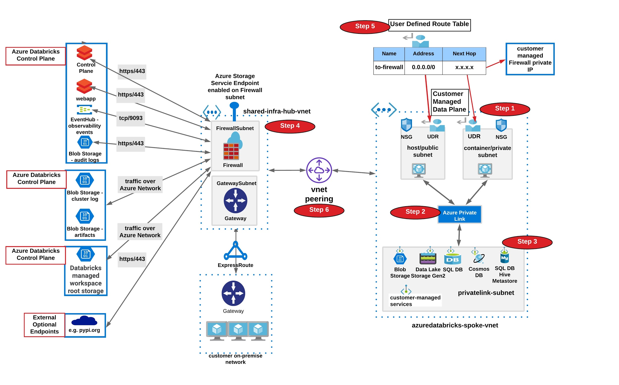
Deploy Azure Databricks to prevent data exfiltration

Slide 3
Prerequisites - Azure Databricks(ADB) Workspace
Bring your own Virtual Network (VNET) i.e. create a brand new or use an existing one.
CIDR range between /16 to /24
Network Security Group (dedicated to ADB subnets)
With default rules
A pair of subnets, used by Azure Databricks only, 1 workspace requires 2 subnets.
CIDR range between /18 to /26
Subnet delegation set to Azure Databricks
Azure Databricks NSG associated with these subnets
Multiple ADB workspaces could reside in the same VNET
Pair of subnet’s used by Azure Databricks can only be associated with 1 workspace

Slide 4
Prerequisites - Egress firewall configuration
Azure Firewall (you could also use any other Azure hosted egress appliance)
Deployed in a separate VNET or in the same VNET as ADB
Dedicated subnet called AzureFirewallSubnet with CIDR /26
Egress rules for Azure Databricks Control Plane services
Get your regional endpoints from here

Slide 5
Firewall Egress Rules - Checklist
Azure Databricks Control Plane Services | Type | Endpoint Address | Transport | Port
Relay (used by no public ip enabled workspaces) |  |  | https | 443
artifacts (runtime images) | blob storage |  | https | 443
logs (audit and cluster) | blob storage |  | https | 443
health-check (observability) | eventhub |  | tcp | 9093
webapp |  |  | https | 443
dbfs (customer owned) | blob storage |  | https | 443
managed-hive | mysql |  | tcp | 3306
External lib dependency provider services required by application code
python lib repo | public repo | *pypi.org, *pythonhosted.org | https | 443
r package repo | public repo | cran.r-project.org, cran.rstudio.com | https | 443
content delivery / required by Ganglia UI | cdn | cdnjs.cloudflare.com | https | 443
Optional Services
demo-datasets-mounts token service, to get temporary token from STS to access the databricks-datasets S3 bucket |  | sts.amazonaws.com | https | 443
demo-datasets-mounts storage bucket, to access the /databricks-datasets folder on DBFS in ADB |  | databricks-datasets-oregon.s3.us-west-2.amazonaws.com/ | https | 443

Slide 6
Follow Along Video
Video Link

Slide 7
Deployment Sequence
Make a list of Azure Databricks regional control plane service endpoints, we’ll need them to configure firewall egress rules. Please use this checklist template.
For Azure Databricks Workspace
Create VNET and a pair of Subnets if not exists (spoke-vnet)
Enable Azure Active Directory service endpoint on both subnets
Create NSG if not exists
Associate NSG to Subnets
Delegate Subnet to Azure Databricks
Create Azure Databricks Workspace using VNET and Subnets created earlier (ARM template)
Note down DBFS storage account address post workspace deployment
For Azure Firewall
Create Firewall VNET and Subnet (hub-vnet)
Deploy Azure Firewall
Configure Firewall egress rules (ARM Template)
Peer spoke and hub vnets
Create a user defined route table
Add a default (0.0.0.0/0) route which forwards all of the traffic originating from Azure Databricks subnets to Azure Firewall private ip address
Attach route table to Azure Databricks Subnets
Launch Workspace and create cluster (test deployment)

Slide 8
Further reading
Understand ADB security
Data exfiltration strategy and guide
ARM templates used in this video
github.com/bhavink/databricks → adb4u

