Slide 1
Formation of SQL from Natural Language Query using NLP
Authors:
Uma M
Sneha V
Sneha G
Bhuvana J
Bharathi B
1911100 Bhavin Patel
978-1-5386-9471-8/19/$31.00 2019 IEEE

Slide 2
Abstract
Today, everyone has their own personal devices that connects to the internet. Every user tries to get the information that they require through internet. Most of the information is in the form of a database.
A user who wants to access a database but having limited or no knowledge of database languages faces a challenging and difficult situation. Hence, there is a need for a system that enables the users to access the information in the database.
This paper aims to develop such a system using NLP by giving structured natural language question as input and receiving SQL query as the output, to access the related information from the railways reservation database with ease.

Slide 3
The steps involved in this process are tokenization, lemmatization, parts of speech tagging, parsing and mapping
The dataset used for the proposed system has a set of 2880 structured natural language queries on train fare and seats available.
They have achieved 98.89 per cent accuracy.
The paper would give an overall view of the usage of Natural Language Processing (NLP) and use of regular expressions to map the query in English language to SQL.

Slide 4
Objectives
The work focuses on Railway Reservation System, where a user can enquire about the trains that are available from a source to destination, the fare of a ticket in various classes.
Objective of this paper is to convert a natural language query into a SQL to simplify data extraction.

Slide 5
Overview of query formation
User submits an English query in the text form which is then sent into several natural language processing (NLP) modules.
This NLP phase is followed by a mapping phase in which the attributes are detected in the English query, mapped to form the final SQL query and may then be fed into the database to retrieve the required information and provide it to the user.

Slide 6
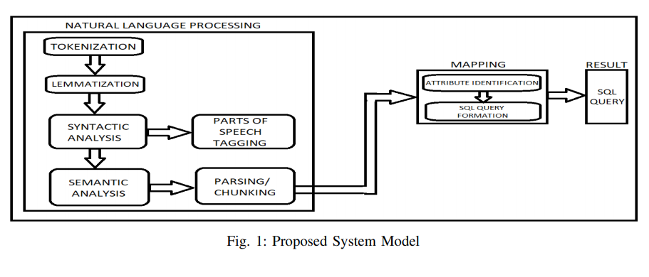
Proposed system

Slide 7
NLP phase
The NLP phase consists of processes such as tokenization, lemmatization, Parts Of Speech tagging (POS tagging) and parsing.

Slide 8
1) Tokenization:
It is the first step that is used to break a sentence into smaller meaningful tokens in most cases these are words.
In the proposed system, we applied tokenization as soon as the text input is received from the user and the tokens obtained are stored in the form of a list.
We have used word tokenize module of nltk.tokenize library in Python
2) Lemmatization:
This process is similar to stemming where the root words or lemma of each of these tokens are obtained from the output of the previous step and are stored in another list.

Slide 9
3) Syntactical Analysis:
In syntactic analysis, each of the lemmatized tokens are analyzed and according to their context of appearance, each token is tagged with a POS.
Here, each word and its tag are packed into a tuple and a list of all such tuples is obtained.
4) Semantic Analysis:
In semantic analysis, we try to make sense of the tokens so that the system could proceed with the SQL query formation. This is achieved by the process of parsing (or chunking).
In the proposed system, the RegExpParser() (regular expression parser) is used for parsing the POS tagged input data. This parser chunks the data based on a regular expression.
In our work, a regular expression is framed such that a phrase has the source and destination information is classified into a separate chunk and are extracted by means of a rule-based paradigm

Slide 10
SOURCE AND DESTINATION IDENTIFIER
The regular expression that is used in the project is:
CH : {(< Verb .? > | < Noun.? > | < Adjective.? >) < Noun > ∗ < Adverb.? > ∗ (< IN > | < T O >)? < ProperNoun > < Noun.? > ∗ < Noun > ∗ < Verb .? >? (< IN > | < T O > )? < ProperNoun >< Noun(Plural form) >? < Verb .? >?}
Regular expression syntax overview:
. any character;
? occurrence of 0 or 1 times of the preceding character;
* occurrence of 0 or more times of the preceding character ;
|| OR condition;
() Group;

Slide 11
According to this regular expression, we detect a pattern such that it contains the source and destination in an extractable form.
The pattern is such that the beginning of the chunk is either a verb or a noun.
Followed by this there may be a noun (optional denoted by *) or adverb (optional denoted by *).
This is followed by either a from (POS Tag IN) keyword or to keyword (POS tag TO).
When these keywords appear, it is predicted that the user would give the source information immediately after from and the destination information immediately after to keyword.

Slide 12
SOURCE AND DESTINATION IDENTIFIER
Hence the regular expression specifies a check for a proper noun following “from” or “to” (since all locations are proper nouns). The proper noun may be followed by a noun(optional) or verb (optional) to include information such as station or junction (which are nouns).
When the pattern is detected, it is classified as a separate chunk named CH which appears as a subtree in the tree diagram of the parsed data.

Slide 13
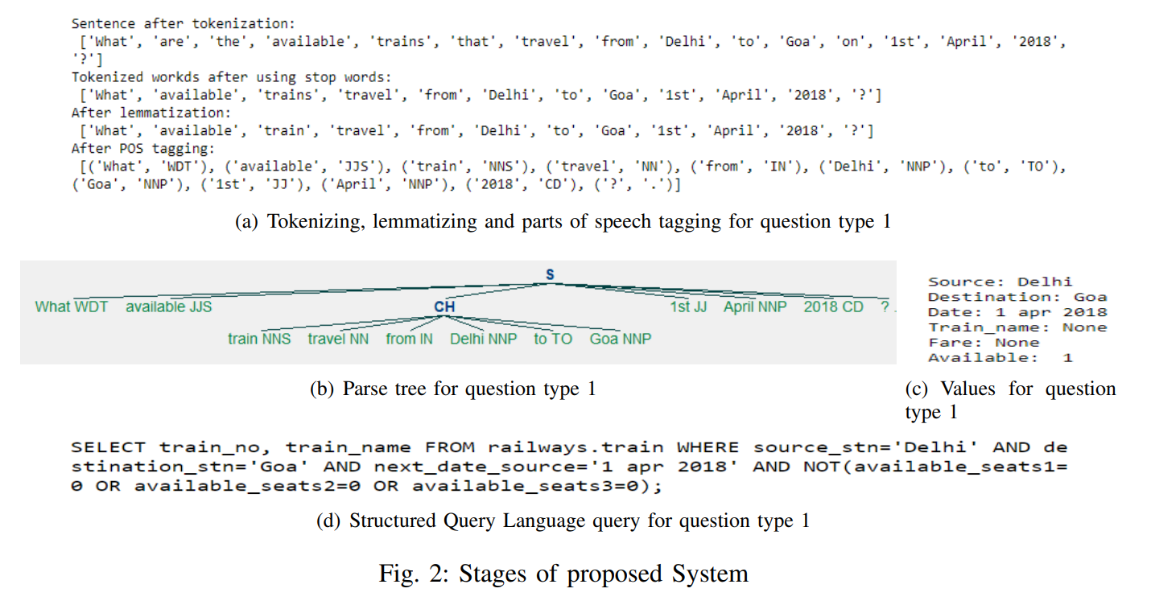

Slide 14
TRAIN NAME IDENTIFIER
To detect the train name(s) (if any) is present in the input data, we use the regular expression ’(express)|(mail)|(passenger)’.
According to this regular expression, the input data is searched for the words express, mail and passenger. If they are found, their preceding word along with the matched word is taken as the train name and it is returned.
If no such train name could be found, then the calling function had None value

Slide 15
Fare Identifier
The proposed system can handle two types of queries:
one in which the user wants to know the train number and train name and the other in which the user wants to know the fare.
To detect if the user wants to know about the fare, we search the set of lemmatized words for the keyword fare. If it is present, we search the succeeding and preceding words for the class name of which the fare is needed. The class names maybe class1, class2 or class3.
Regular expressions are used for this purpose. The regular expression class[.][123] is used to find out the class name. Once the class name is identified, its corresponding fare such as fare1, fare2 or fare3 is returned. If the user has not posed any fare regarding questions, then the variable at the left of fare identifier() will have None value

Slide 16
Algorithm: Formation of SQL Query from Natural Language Query
Input: Natural Language query in English text.
Output: SQL query
1) Tokenize the input into list of words
2) Lemmatize the list of words
3) Perform POS tagging
4) Parsed sentence = Parse using regular expressions
5) If table. attribute ∈ Parsed sentence
a) Extract them
b) Call SQLmap()

Slide 17
Algorithm for sqlmap function
SQLmap() Algorithm
query= ”SELECT”
if (value = Fare Identifier())
query = query + value
Else
query = query + train no + train name
query = query + ”FROM railways.train WHERE”
if (value= Train Name Identifier ())
query = query + ”train name=” + value
if (source, destination = Source Destination Identifier())
query = query + ”source stn=” + source + ”destination stn=” + destination
if (date= Date Identifier())
query = query + ”next date source” + date

Slide 18
Conclusion
Although several methodologies are employed to extract information from a database, Natural Language Processing has set a new standard in doing the same.
The work presents a clear picture on the steps that are involved in NLP. Various processes like tokenization, lemmatization, syntactic and semantic analysis are carried out to generate an equivalent SQL query from a natural language query.
The accuracy obtained is of 98.89 per cent.
Following are the future improvements that can be incorporated:
The input received can be of audio form, which can be converted into textual format;
The database could be larger in terms of attributes and tuples. Also, there could be multiple tables of related data which can be accessed using JOIN keyword;
It could be used to create chatbots for various sectors which handle large databases and can help users to access them with greater ease.
To conclude, NLP is a boon to any ordinary person having no knowledge on database management.

Slide 19
Implementation
In Python language
NLP Phase: NLTK library for preprocessing
Part of speech tagger: nltk or standford
Attribute extraction using regular expressions

Slide 20
REFERENCES
Woods, William, (1972) “The lunar sciences natural language information system,” BBN report, Bolt Beranek and Newman.
[2] Hendrix, Gary G, Sacerdoti, Earl D and Sagalowicz, Daniel and Slocum, Jonathan, (1978) “Developing a natural language interface to complex data,” ACM Transactions on Database Systems (TODS), vol. 3, Issue 2, pp. 105–147.
[3] Sathick, K Javubar and Jaya, A, (2015) “Natural language to SQL generation for semantic knowledge extraction in social web sources,” Indian Journal of Science and Technology, vol. 8, Issue 1, pp. 1–10.
[4] Singh, Garima and Solanki, Arun, (2016) “An algorithm to transform natural language into SQL queries for relational databases,” Selforganizology, Directory of Open Access Journals, vol. 3, Issue 3, pp. 100–116.
[5] Huang, Bei-Bei, Zhang, Guigang et al., (2008) “A natural language database interface based on a probabilistic context free grammar,” IEEE International workshop on Semantic Computing and Systems, pp. 155– 162.
[6] Rao, Gauri, Agarwal, Chanchal, Chaudhry, Snehal, et al., (2010) “Natural language query processing using semantic grammar,” International journal on computer science and engineering, vol. 2, Issue 2, pp. 219– 223.

Slide 21
THANK YOU

