Slide 1
Chapter 1
Introduction to Computers, Programs, and Python
Part - 1

Slide 2
What to be covered next
What is Python?
The history of python
Getting started with python
Notes:
Computer?
How to interact with a computer?
Write a program to let computer do something… shopping list, … OS… control computers
We know that a program runs on a computer. So Before we learn how to program, let us discuss the hardware components. Understanding the basics of computer hardware will help you learn how a program works on a computer.
After that, we will be interested in if there is only one programming language that understandable by the computer; if no, what are the others?
After this class, all of you should be able to write programs. But we should give a big thanks to an essential program on our computer, the operating system. Without it, we cannot control the computer, neither develop new programs/ software.
The goal of this course is to write programs in Python. So what is the history of Python? Are there any fun things about Python? You may want to share the stories with your family or friends.
At the end of the section, I will guide you to install a Python development environment on your computer and help you write and run your first Python program. I hope you will like the turtle example in Python as well.

Slide 3
What is Python?
General Purpose Interpreted Object-Oriented
Python is a general purpose programming language. That means you can use Python to write code for any programming tasks.
Python are now used in Google search engine, in mission critical projects in NASA, in processing financial transactions at New York Stock Exchange.
Notes:
COBOL

Slide 4
What is Python?
General Purpose Interpreted Object-Oriented
Python is interpreted, which means that python code is translated and executed by an interpreter one statement at a time.
>>> print("Hello, world“)
Hello, world
>>> print(2+3)
5
>>> print("2+3=", 2+3)
2+3= 5
>>>
Notes:
Java, C → complete code
No need for python

Slide 5
What is Python?
General Purpose Interpreted Object-Oriented
Python is an object-oriented programming language.
Object-oriented programming is a powerful tool for developing reusable software.

Slide 6

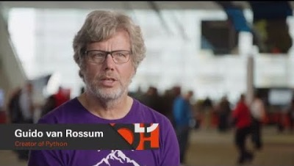
Created by Guido van Rossum in Netherlands in 1990
Open source
Python 2 vs. Python 3
Questions:
What is ABC?
How long did Guido spend to create Python?
Is Python programming language named after the snake python?
Notes:
What is ABC?
How long did Guido spend to create Python?
Is Python programming language named after the snake python?
Python 3 is a newer version, but it is not backward compatible with Python 2. That means if you write a program using Python 2, it may not work on Python 3.

Slide 7


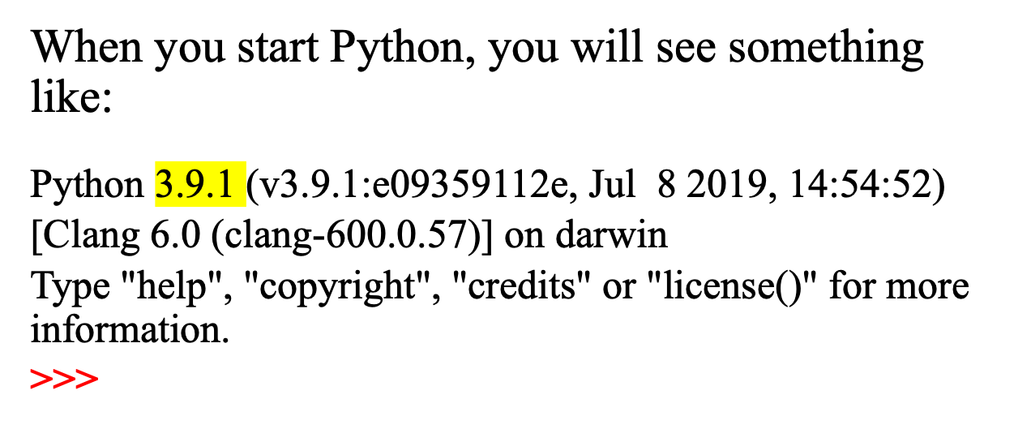
Step 1: Google Python → download → Python 3.9.1
install → using IDLE (Python GUI)

Slide 8
Step 2: Run the commands in red below one by one. Remember to press Enter key at the end of each command.
>>> print("Hello, world“)
Hello, world
>>> print("2+3=?")
2+3= ?
>>> 2+3
5
>>> type(2)
<class ‘int’>
>>> type(’Hello, world’)
<class ‘str’>

Slide 9
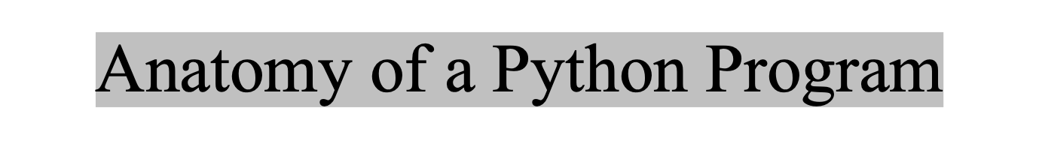
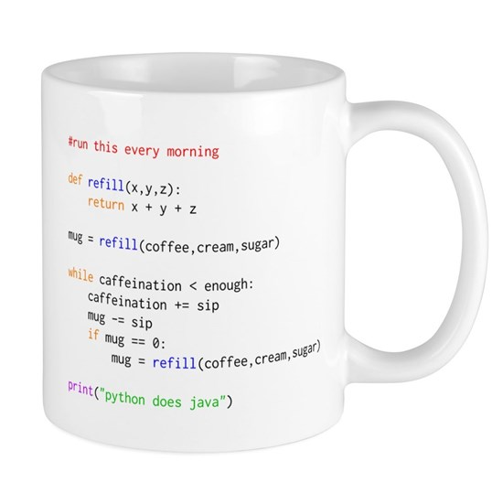
Statements
Comments
Indentation
Notes:
Generally, a python program may have three components -> statements, comments and indentation
A python program must have a statement for execution.
Do we use curly brace?

Slide 10
Comments
Anything after a # is ignored by Python
Why comment?
  Describe what is going to happen in a sequence of code
  Document who wrote the code or other ancillary information
  Turn off a line of code ( perhaps temporarily )
Comments
Notes:
When the program is executed, Python’s interpreter simply ignores the lines starting with a pond sign, and the text after a # sign.
Like the example in the last slide, the first line is a comment, not a command, so it is simply ignored by the python’s interpreter.
But why we need to make some lines as comments in program?
The comment can describe what does this piece of code do. So help someone to understand your program, you can write comment to describe the feature of some of your statements. You can even write comments for each statement in your code by simply adding the comment at the end of each statement.
Comments can also be used to document who is the programmer of the code, who owns it or some other useful information.
If there are multiple statements in your program and you do not want them to be executed, you can simply insert a pond sign at beginning of those statements so that they would be ignored when you run the program again.
Demo on command window:
Open python interpreter
$python
Enter the statement to print a message
>>>print(“Welcome to CIS 3260”)
Enter a second statement to print a message by accidently putting a space at beginning
>>> print(“Python is fun”)
Can you see the message printed out? Can you see an error there?
Let us fix the error by removing the leading space and try again.
>>>print(“Python is fun”)
Let me enter some descriptions for the above two statements
>>># finish displaying messages
Can I add leading spaces for this comment?
>>> # finish displaying messages
Does not matter….
Can I add some comment right after one statement on the same line?
>>> print(“Python is fun”) # print “python is fun”

Slide 11
Comments
Anything after a # is ignored by Python
Why comment?
  Describe what is going to happen in a sequence of code
  Document who wrote the code or other ancillary information
  Turn off a line of code ( perhaps temporarily )
Comments
Notes:
When the program is executed, Python’s interpreter simply ignores the lines starting with a pond sign, and the text after a # sign.
Like the example in the last slide, the first line is a comment, not a command, so it is simply ignored by the python’s interpreter.
But why we need to make some lines as comments in program?
The comment can describe what does this piece of code do. So help someone to understand your program, you can write comment to describe the feature of some of your statements. You can even write comments for each statement in your code by simply adding the comment at the end of each statement.
Comments can also be used to document who is the programmer of the code, who owns it or some other useful information.
If there are multiple statements in your program and you do not want them to be executed, you can simply insert a pond sign at beginning of those statements so that they would be ignored when you run the program again.
Demo on command window:
Open python interpreter
$python
Enter the statement to print a message
>>>print(“Welcome to CIS 3260”)
Enter a second statement to print a message by accidently putting a space at beginning
>>> print(“Python is fun”)
Can you see the message printed out? Can you see an error there?
Let us fix the error by removing the leading space and try again.
>>>print(“Python is fun”)
Let me enter some descriptions for the above two statements
>>># finish displaying messages
Can I add leading spaces for this comment?
>>> # finish displaying messages
Does not matter….
Can I add some comment right after one statement on the same line?
>>> print(“Python is fun”) # print “python is fun”

Slide 12
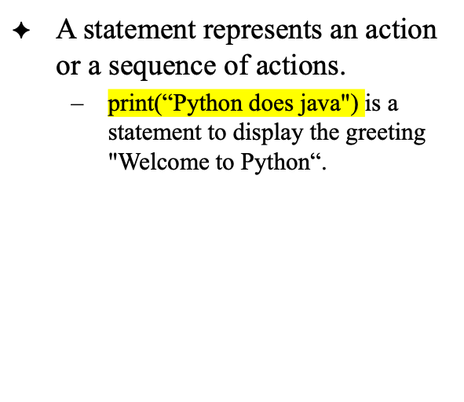
Statement
Statements
Notes:
When the program is executed, Python’s interpreter simply ignores the lines starting with a pond sign, and the text after a # sign.
Like the example in the last slide, the first line is a comment, not a command, so it is simply ignored by the python’s interpreter.
But why we need to make some lines as comments in program?
The comment can describe what does this piece of code do. So help someone to understand your program, you can write comment to describe the feature of some of your statements. You can even write comments for each statement in your code by simply adding the comment at the end of each statement.
Comments can also be used to document who is the programmer of the code, who owns it or some other useful information.
If there are multiple statements in your program and you do not want them to be executed, you can simply insert a pond sign at beginning of those statements so that they would be ignored when you run the program again.
Demo on command window:
Open python interpreter
$python
Enter the statement to print a message
>>>print(“Welcome to CIS 3260”)
Enter a second statement to print a message by accidently putting a space at beginning
>>> print(“Python is fun”)
Can you see the message printed out? Can you see an error there?
Let us fix the error by removing the leading space and try again.
>>>print(“Python is fun”)
Let me enter some descriptions for the above two statements
>>># finish displaying messages
Can I add leading spaces for this comment?
>>> # finish displaying messages
Does not matter….
Can I add some comment right after one statement on the same line?
>>> print(“Python is fun”) # print “python is fun”

Slide 13
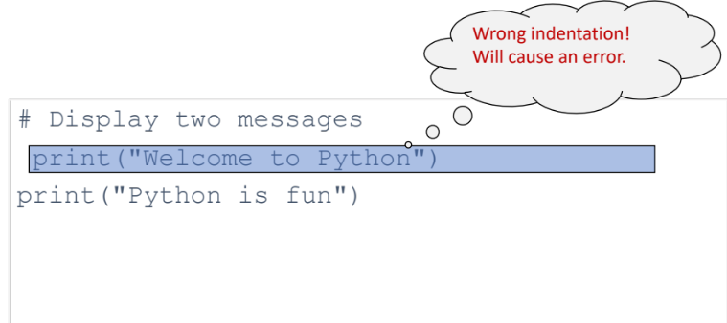
Indentation
The indentation matters in Python.
Commonly statements are entered from the first column in the new line.
Indentation
Indentation
Notes:
Indentation is a very important concept of Python because without proper indenting the Python code, you will end up seeing IndentationError and the code will not get compiled.
In simple terms indentation refers to adding white space before a statement. Currently there is no need for us to indent the statement. In later chapters, we will learn in which case the indentation is needed.
In this example, we put additional spaces as the indentation before the first statement, This is a wrong indentation, and it will cause the indentation Error

Slide 14
Run a Python Script
Step 3: File -> New File;
Step 4: Type the three lines below in the text editor;
Step 5: File -> Save as “test”
Step 6: Run -> run module
Please check what will be printed.
print("Hello, world“)
print(2+3)
print("2+3=", 2+3)

Slide 15
Two More Simple Examples
Step 7: Create a new Python program “ComputeExp” and enter the commands below.
Please check what will be printed.
# Display three messages
print("Welcome to Python")
print("Python is fun")
print("Problem Driven") # Display Problem Driven

Slide 16
Step 8: Create a new Python program “Welcome” and enter the commands below.
Please check what will be printed.
# Compute expression
print("(10.5 + 2 * 3) / (45 - 3.5) = ")
print((10.5 + 2 * 3) / (45 - 3.5)) # Display the result of the expression

Slide 17
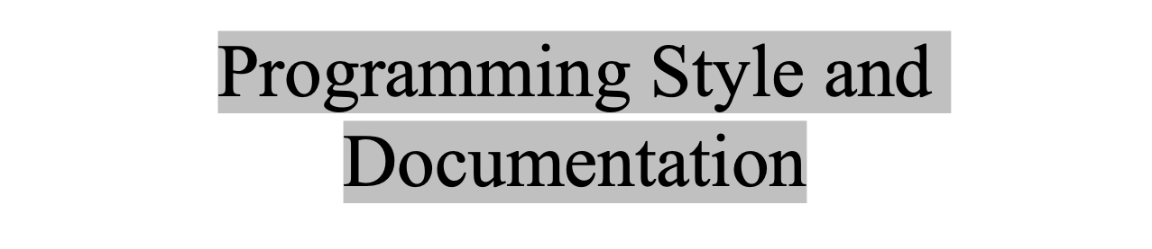
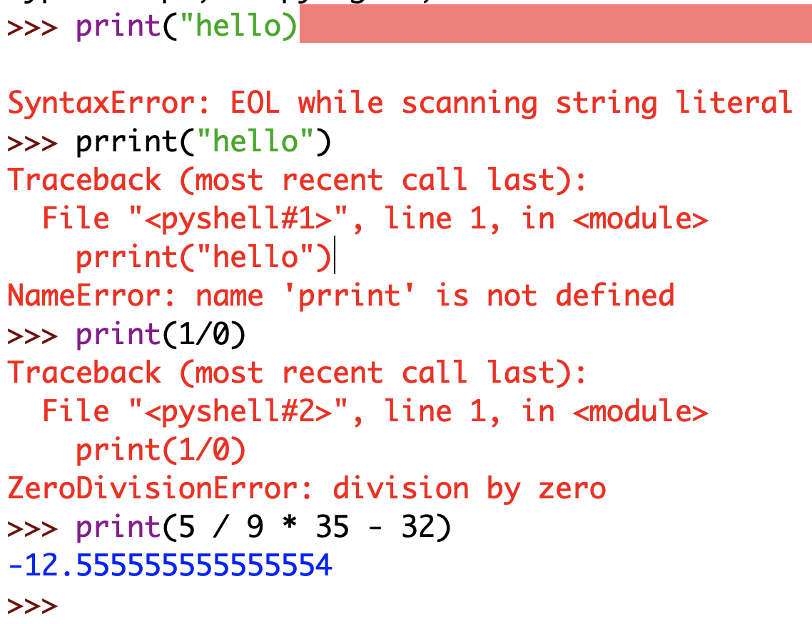
Syntax Errors
  Error in code construction
Runtime Errors
  Causes the program to abort
Logic Errors
  Produces incorrect result
Can not RUN / Not executable
Able to run, but quits while running
Able to run, but results not expected
Notes:
Programming errors are the errors we may make when write a program.
Programming errors can be categorized into three types: syntax errors, runtime errors, and logic errors.
Syntax rules come in two flavors, pertaining to tokens and how the tokens combined.
How to read a program? Top to bottom, left to right?
---------
The most common error you will encounter is syntax errors. We need to write a statement following the syntax rules created by the designer of programming language. For example, the designer asks us to surround a string with a pair of “”. If one double quotation marks is missing, that text will not be recognized as a string by the programming language. If it is recognized, it is considered as a syntax error. And this program cannot even be executed.
If you don’t know how to correct a syntax error, compare your program closely, character by character, with similar examples in the textbook. In the first few weeks of this course, you will probably spend a lot of time fixing syntax errors.
A runtime error is a program error that occurs while the program is running and cause a program to terminate abnormally. A program crash is the most noticeable type of runtime error, Common sources of runtime errors are missing file and division by zero. For example, the expression 1 / 0 in the statement would cause a runtime error.
Logic errors occur when a program does not perform the way it was intended to. For example, we are required to write a program to output the area of circle. But as a result, it prints out the value which doubles the area of the circle. Then we can conclude that even though this program is able to be executed, the results generated are not we expect. And the logic used to calculate the area of the circle has issues.
Let us open Python interpreter again.
Try this statement while missing the quotation mark
>>>print(“hello)
Again, we type another command by misspell print
>>>prrint(“hello”)
Notethat indentation error is a kind of syntax error.
How about runtime error?
>>>print(1/0)
convert a temperature (35 degrees) from Fahrenheit to Celsius:
>>>print(5 / 9 * 35 – 32)
You will get Celsius –12.55 degrees, which is wrong. It should be 1.66. To get the correct result, you need to use 5 / 9 * (35 – 32) rather than 5 / 9 * 35 – 32 in the expression. That is, you need to add parentheses around (35 – 32) so Python will calculate that expression first before doing the division.

