Slide 1

Chapter 2 Elementary Programming
Part - 1
Notes:
In chapter 1, we just learned hardware, software and general three components that we can put in a program.
In this chapter, we are going to learn the nuggets and bolts in the statement. Why called as elementary programming?

Slide 2
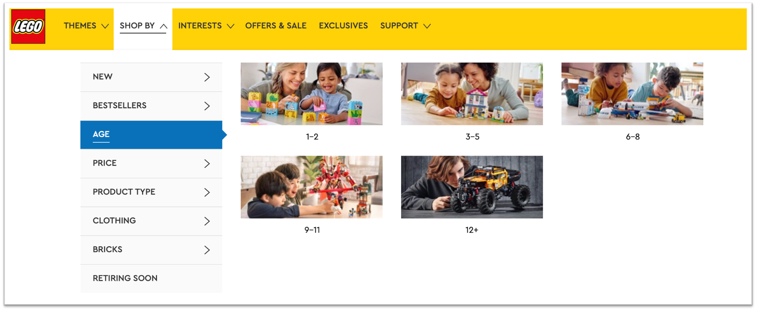
Notes:
Lego sets are designed for different ages.
Diversity and number of pieces.
For a toddler, basic parts avaible, there are only several different kinds of pieces and parts.
However, for a junior, a diverse of parts available, more pieces. you can find more pieces and parts available, like tires, mirrors so on for you to make a car. You can even do programming on a robot car.

Slide 3
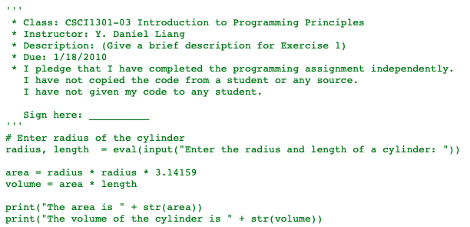
What to be covered next
Constants
Reserved Words
Variables
  Name Rules
Assignment Statement
Expressions
  Numeric Expressions
  Order of Evaluation
  Operator Precedence Rule
Input Statement
Notes:
Several basic features. Goal: write a program similar to this example.
Can someone help explain the program statement by statement?
Variable: radius, value can be changed because a different input when we run our program next time, or the value changes during the program execution.
Generally, we have learned how to write down a print statement, in this chapter we will learn how to write assignment statement and input statements,
In details, we are going cover, first, the most basic element we can use in an assignment statement, the constants, like integers and strings.
The purpose of using assignment statement is to assign a new value to a variable.
Variables are similar to the ones we use in our math class. But when naming a variable, please avoid using the words reserved by the programming language.
The value assigned to a variable can be the result evaluated based on an expression. In this chapter we learn only the numeric expression that resolves to a numeric value, either integer or floating point number. In later chapters, we will also learn how to write down a logic expression to be evaluated to a true or false.
The numeric expression is similar to an arithmetic expression. But remember that, in a program each statement is a single line. So an expression is also a single line expression. We cannot use superscript neither subscript. The division cannot be put on different lines.
An expression may have a lot of operators in it. Since all the operators are on the same line, then which operator should be evaluated first? For example, in the expression, 3+4/2. Should we calculate the division first or the plus first? This relates to the problem called as the order of evaluation. In Python, the order of evaluation depends on the operator precedence rule.
At last, we will discuss about how to use input statement to get input from user. So that we can ask user to enter the pay rate and hours, and then use our program to calculate and display the total pay.

Slide 4
What to be covered next
Constants
Reserved Words
Variables
  Name Rules
Assignment Statement
Expressions
  Numeric Expressions
  Order of Evaluation
  Operator Precedence Rule
Input Statement
Notes:
When doing calculations, we may need to use a fixed value, and this value is called as constant.

Slide 5
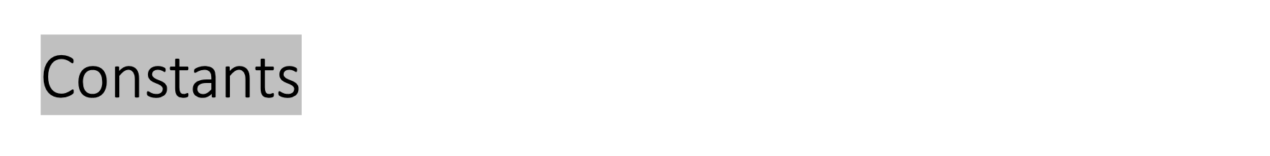
Fixed values such as numbers, letters, and strings, are called “constants” because their value does not change
Numeric constants are as you expect
String constants use single quotes (')
or double quotes (")
>>> print(123)
123
>>> print(98.6)
98.6
>>> print('Hello world')
Hello world
Notes:
Constant is the most basic element in a program.
The constants are the fixed values. We can directly write it down in a program. Numrica, and string.
In this example, the numbers 98.6 and 123 are both constants. But for the string constant, we need to use a pair of double quotes or single quotes. The string ‘hello world’ enclosed within the single quotes is a constant. A letter like ‘a’ can also be considered as a constant.

Slide 6
What to be covered next
Constants
Variables
  Name Rules
Reserved Words
Assignment Statement
Expressions
  Numeric Expressions
  Order of Evaluation
  Operator Precedence Rule
Input Statement
Notes:
Variables: value changes. Input at each run or during the execution of program

Slide 7
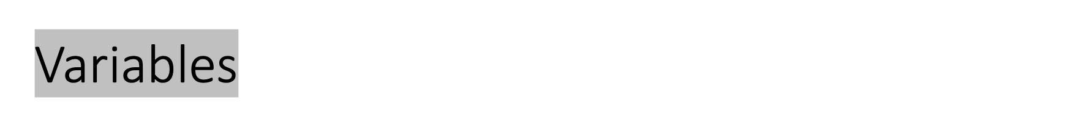
A variable is a named place in the memory where a programmer can store data and later retrieve the data using the variable “name”
Programmers get to choose the names of the variables
You can change the contents of a variable in a later statement
x = 12.2
y = 14
x
12.2
y
14
Notes:
A value can be assigned to a variable. Constant, input, result of an expression
Hardware…
1. Real location v.s. Nick name Question…
When a program runs, the value is stored in the memory. From chapter 1, we already known that each memory space is associated with an address. But as a programer, we do not want to memorize all the addresses. So instead, we can use a variable name to refer to memory place where we store data there. And later on fetch that data using the variable ”name”.
2. Math v.s. Programming ? Question…
As a programmer, we can choose the name of the variable.
For example, variable x associate to the memory place storing 12.2, and y associates to the memory place storing 14.
But be careful with this line. In your math class, this two lines tell us the solution of x and y. But in this class, the two lines here are assigning the values to the memory places these x and y associate to. And we call this statement assingment statement.
E1.
Print(x)
E2.
X=12.2
Print(x)
Print(y)
E3.
X=12.2
Print(x)
Y=14
Print(y)
X=12.2
Print(x)
Y=14
Print(y+1)
X=100
Print(x)

Slide 8
Variables
A variable is a named place in the memory where a programmer can store data and later retrieve the data using the variable “name”
Programmers get to choose the names of the variables
You can change the contents of a variable in a later statement
x = 12.2
y = 14
x = 100
100
x
12.2
y
14
Notes:
You can even change the contents of a variable in a later statement.
For instance, if I use x = 100, this will replace the data stored in memory space x.
If I write down another statement, print(x) . What will be printed out?
E3.
X=12.2
Print(x)
Y=14
Print(y)
X=100
Print(x)
E5.
X=“hello world”
Print(x)

Slide 9
Python Variable Name Rules
Must start with a letter or underscore _
Must consist of letters, numbers, and underscores
Case Sensitive
Cannot be reserved words
Good: spam eggs spam23 _speed
Bad: 23spam #sign var.12
Different: spam Spam SPAM
Notes:
How to name a variable?
First, we cannot pick a reserved word as the name.
Also, we should follow the naming rule.
A python variable name must start with a letter or underscore _. So 23spam, #sign are not good.
And we can only use letters, numbers and underscores in a variable name. So var.12 is illeagal.
Besides, python is case sensitive, so these three names can be used for three different variables.
Can you check if following names can be used for a variable?
1
X1
_1
_ONE
X?1
Python injection example: https://research.cs.wisc.edu/mist/SoftwareSecurityCourse/Chapters/3_8_3-Code-Injections.pdf

Slide 10
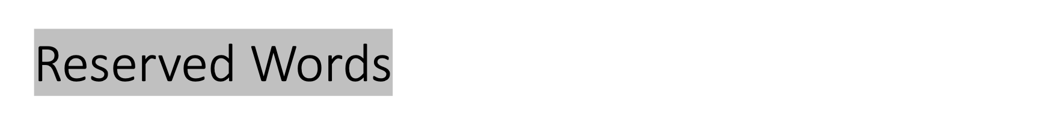
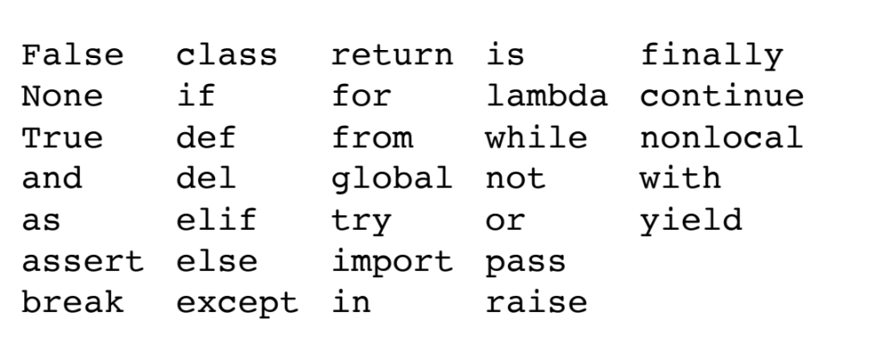
You cannot use reserved words as variable names / identifiers
Notes:
I am going to use a vairalbe, can I choose a name from this table.
E.g. class for class name.
Diffrence between programming and natural language. Reserved word for translation. High level language uses englihs words for understading…
===========
Survey: which programming language is not using reserved word.
When using a name for a variable, we should avoid the words reserved by the Python.
Python reserved about 30 words for special use. Each reserved word has its own significance.
Reserved words makes the programming language a high level langaige , easy to understand.
For example, ‘for’ is used to start a for loop statement in Python; ‘return ’ is used for return statement for returning a value.
Besides the variable names, the reserved word cannot be used as other identifiers. Idenfiter is the name used for variable, function and other constructs in Python.

Slide 11
Statements ( Sentences or Lines )
x = 2
x = x + 2
print(x)
Assignment statement
Assignment with expression
Print statement
Variable
Operator
Constant
Function
Notes:
And now we should be ready to write down more statements.
A statement is a command. Now let me talk about two kinds of statements: print statement and assignment statement.
Both of them can be a combination of variable, operaor, constant and function. Print is a function,. Later on we need to learn another function input().
When you type a statement in interactive mode, the interpreter executes it and displays the result, if there is one.

Slide 12
What to be covered next
Constants
Reserved Words
Variables
  Name Rules
Assignment Statement
Expressions
  Numeric Expressions
  Order of Evaluation
  Operator Precedence Rule
Input Statement
Notes:
Variables: value changes.

Slide 13
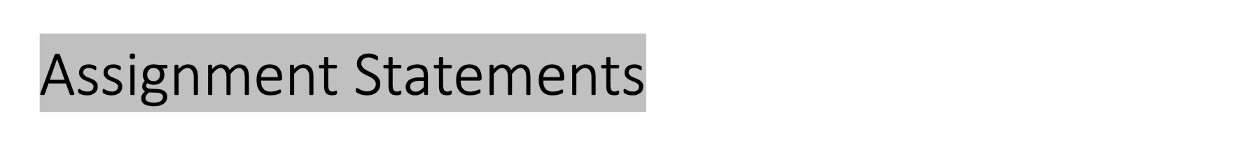
We assign a value to a variable using the assignment statement (=)
An assignment statement consists of an expression on the right-hand side and a variable to store the result
x = 3.9 * x * ( 1 - x )
Notes:
Assigment statement basically assign a value to a variable using the equal sign. Other programming langue may use arrow or : to assign the value to a variable.
In an assignment statement, the left hand side usually is a single variable. The right hand side can be a constant, or an expression.
Like in this example, the right hand side is a complicated expression and the variable itself x also appear on the right hand side.
In mathematics, x = 2 * x + 1 denotes an equation. And you will be asked solve this equation by a value of x.
But in Python, this is an assignment statement. Before this assignment staeemnt, x should already been assigned a value, otherwise, the Python interpreter will give us an error message.
Why x appears at both side?
X = x
X = x +1
X = x + y
X = y
X = 1
X = x + 1
Print(x)
X=x+y
X=2
Y=x+1
Print(x)
Print(y)

Slide 14
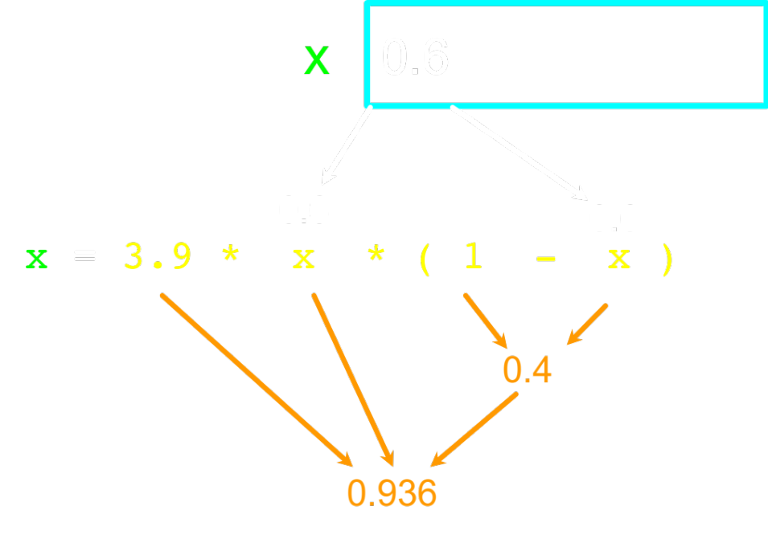
A variable is a memory location used to store a value (0.6)
The right side is an expression.
Once the expression is evaluated, the result is placed in (assigned to) x.
Notes:
For example, the content of variable x stores a value 0.6. Then We evalueate the expression on the right hand size. The result is placed into the variable on the left hand side, which is x again. Finnaly, the value of x is changed to 0.936.
Print(x)

Slide 15

An expression is a combination of values, variables, and operators.
A value all by itself is considered an expression, and so is a variable
If you type an expression in interactive mode, the interpreter evaluates it and displays the result.
But in a program, an expression all by itself doesn't do anything! This is a common source of confusion for beginners.
Notes:
Then what is an expression exactly in Python?
An expression is a combination of values, variables, and operators.
Note that A value all by itself is considered an expression, and so is a variable
For example,
17 ,x , x + 17
>>> 1 + 1 2
Exercise 1: Type the following statements in the Python interpreter to see what they do:
5 x = 5 x + 1

Slide 16
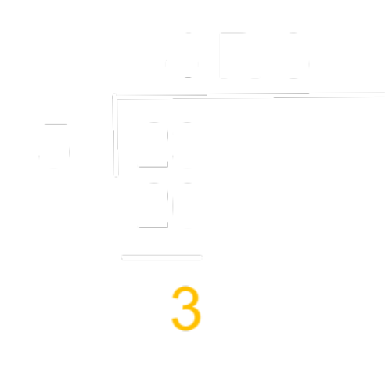
Numeric Expressions
>>> xx = 2
>>> xx = xx + 2
>>> print(xx)
4
>>> yy = 440 * 12
>>> print(yy)
5280
>>> zz = yy / 1000
>>> print(zz)
5.28
>>> jj = 23
>>> kk = jj % 5
>>> print(kk)
3
>>> print(4 ** 3)
64
Operator | Operation
+ | Addition
- | Subtraction
* | Multiplication
/ | Division
** | Power
% | Remainder
Notes:
In this chapter, we learn only the numeric experrsion which resolves to a numeric value.
In numerica expression, we can use the operators listed in the table on the right hand side.
Note that, in order to type these operators into a program, we must use the keys available in your keyboard.
So for muliptlication, we use *.
Division, we use forward slash, 4/2, precise value. // integer division, integer value as the result.
for power, we use double astristk, 2**3.
For remainder, we use percentage sign.
The % operator, known as remainder or modulo operator, yields the remainder after division. 23/5, quotient vs remainder
The remainder operator is very useful in programming. For example, an even number % 2 is always 0 and an odd number % 2 is always 1. Thus, you can use this property to determine whether a number is even or odd.
If you have an amount time in sections, you can obtains minutes using division, and remaining using modulo operator. For example, 500 seconds contains 8 minutes and 20 seconds.

Slide 17
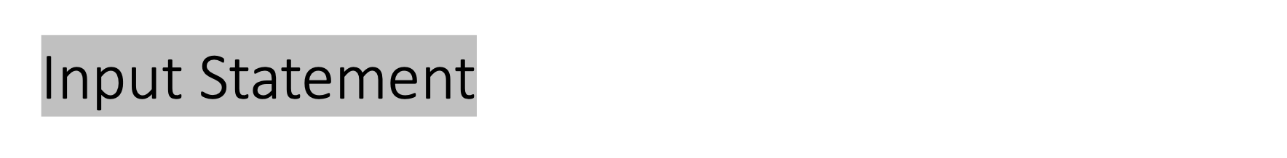
We can instruct Python to pause and read data from the user using the input() function
The input() function returns a string
nam = input('Who are you? ')
print('Welcome', nam)
Who are you? Yuan
Welcome Yuan
Notes:
In previous example, we calculate the total pay using the hours and rate assigned in a program. Can we ask user to enter number of hours and rate by themselves?
In order to get information or read data from the user, we can use input() function. Inside the parehtnsei of input function, we can put a string constant there, so that the string will be prompted before user enters a string. Once user enter a string, the string will be returned. Then we use a variable to store that string.
For example,
In print, if you want to print multilple objects on the same line, you can use separator , .
Onlinegdb
Demo:
Input()

Slide 18
Converting User Input
If we want to read a number from the user, we must convert it from a string to a number using a type conversion function.
Later we will deal with bad input data.
inp = input('Europe floor?’)
usf = int(inp) + 1
print(‘US floor’, usf)
Europe floor? 0
US floor 1
Notes:
String v.s. number
Change usf = int(inp) + 1 to usf=inp + 1

Slide 19
Order of Evaluation
When we string operators together - Python must know which one to do first
This is called “operator precedence”
Which operator “takes precedence” over the others?
x = 1 + 2 * 3 - 4 / 5 ** 6

Slide 20
Operator Precedence Rules
Highest precedence rule to lowest precedence rule:
  Parentheses are always respected
  Exponentiation (raise to a power)
  Multiplication, Division, and Remainder
  Addition and Subtraction
  Left to right
Parenthesis
Power
Multiplication
Addition
Left to Right

Slide 21
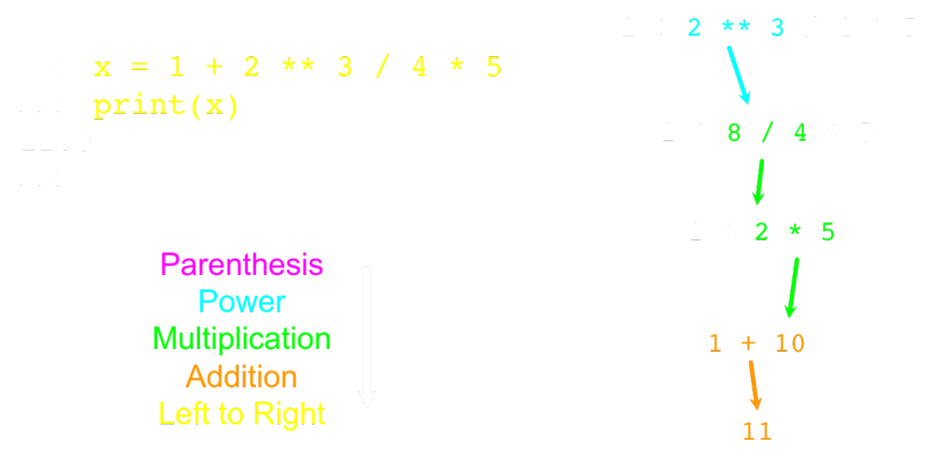

Slide 22
Summary
Constants
Reserved Words
Variables
  Name Rules
Assignment Statement
Expressions
  Numeric Expressions
  Order of Evaluation
  Operator Precedence Rule
Input Statement

