Slide 1
Chapter 3 Selection
Notes:
In chapter 1, we just learned the general three components that we can put in a program.
In this chapter, we are going to learn the nuggets and bolts in the statement.

Slide 2
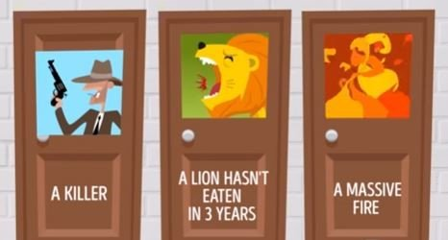
Which door is safe?

Slide 3
Selection in a program
Ask a user to enter something and response with different actions
  Account authentication
  Control the movement of a player
Do calculations and then make decisions
  Compute and interpret BMI
Notes:
Body mass index (BMI) is a measure of health based on weight. The interpretation of BMI for people 16 years and older is as follows:

Slide 4
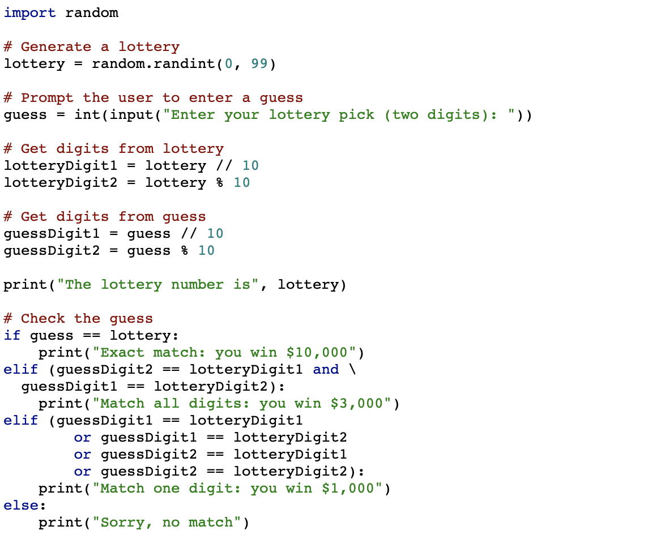
A simulation of lottery system
A player selects a number (0-99) and notifies the lottery system
The lottery system generates a winning number (0-99).
The lottery system determines whether the user wins according to the following rule:
  If player’s number matches the lottery in exact order, the award is $10,000.
  If player’s number matches the lottery, the award is $3,000.
  If one digit in player’s number matches a digit in the lottery, the award is $1,000.

Slide 5
What to be covered next
Boolean Expressions
  Boolean Type
  Relational Operator
Conditional Execution
  One-way Decisions
  Two-way Decisions
  Multi-way
  Nested decision
Logic operators
Short-circuit Evaluation of Logical Expressions

Slide 6
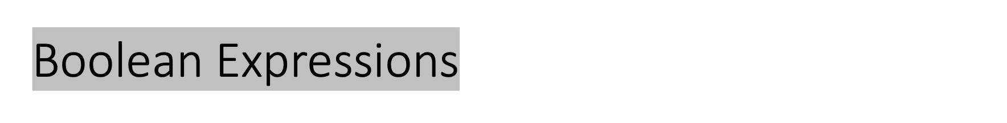
Boolean expressions ask a question and produce a Yes or No result which we use to control program flow
Boolean expressions using relational operators evaluate to True / False or Yes / No

Slide 7
Relational Operator
Boolean expressions using relational operators evaluate to True / False or Yes / No
Relational operators look at variables but do not change the variables
Python | Meaning
< | Less than
<= | Less than or Equal to
== | Equal to
>= | Greater than or Equal to
> | Greater than
!= | Not equal
Remember: “=” is used for assignment.
Notes:
How to produce a YES or NO?

Slide 8
Relational Operator
>>> 42 == 42
True
>>> 42 == 99
False
>>> 2 != 3
True
>>> 2 != 2
False
>>> 42 < 100
True
>>> 42 > 100
False
>>> 42 < 42
False
>>> eggCount = 42
>>> eggCount <= 42
True
>>> myAge = 29
>>> myAge >= 10
True
>>> 'hello' == 'hello'
True
>>> 'hello' == 'Hello'
False
>>> 'dog' != 'cat’
True
>>> True == True
True
>>> True != False
True
>>> 42 == 42.0
True
>>> 42 == '42'
False
Notes:
The ==and != operators can actually work with values of any data type.
The <, >, <=, and >= operators, on the other hand, work properly only with integer and floating-point values.
X=5
X!=5
Print(X<=5)
Y=6
Print(X==y)
Z=‘5’
Print(x==z)
Print(x>z)
Print(6!=‘6’)

Slide 9
Boolean Type
Boolean data type has only two values: True and False
No quotes around True and False
Start with a capital T or F, with the rest of the word in lowercase
>>> spam = True
>>> spam
True
>>> true
Traceback (most recent call last):
File "<pyshell#2>", line 1, in <module>
true
NameError: name 'true' is not defined
>>> True = 2 + 2
SyntaxError: can't assign to keyword
Notes:
YES or NO? Spcieal value, neither numerical, string.
How to store or represent a value of YES or NO?
\Like any other value, Boolean values are used in expressions and can be stored in variables ➊. If you don’t use the proper case ➋ or you try to use True and False for variable names ➌, Python will give you an error message.
Boolean is capitalized because the data type is named after mathematician George Boole.

Slide 10
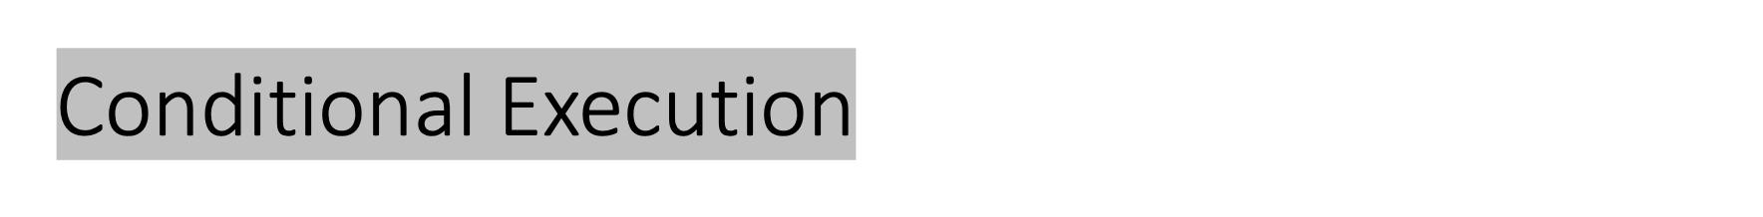
One-Way Decisions
Two-Way Decisions
Multiple-Way Decisions
Notes:
Now, let’s explore the most important piece of flow control: The statements represent the diamonds you saw in the flowchart, and they are the actual decisions your programs will make.

Slide 11
One-Way Decisions
if Statements
An if statement’s clause will execute if the statement’s condition is True.
The clause is skipped if the condition is False.
if name == 'Alice':
print('Hi, Alice.')
The if keyword
A condition
A colon
Starting on the next line, an indented block of code (if clause)
Notes:
The most common type of flow control statement is the if statement.
An if statement’s clause (that is, the block following the if statement)
A condition (that is, an expression that evaluates to True or False)

Slide 12
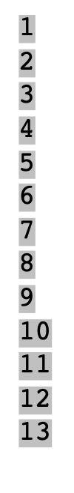
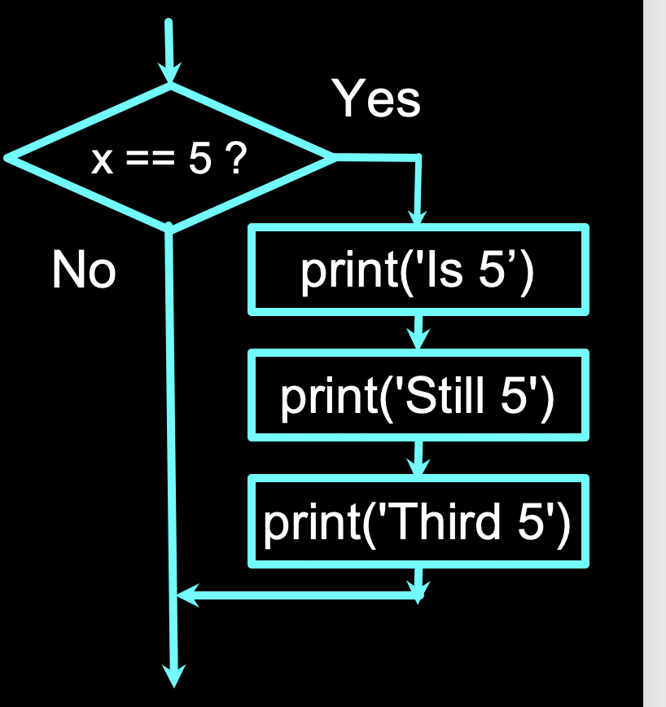
x = 5
print('Before 5')
if x == 5 :
print('Is 5')
print('Is Still 5')
print('Third 5')
print('Afterwards 5')
print('Before 6')
if x == 6 :
print('Is 6')
print('Is Still 6')
print('Third 6')
print('Afterwards 6')
Before 5
Is 5
Is Still 5
Third 5
Afterwards 5
Before 6
Afterwards 6

Slide 13
Indentation
Increase indent after an if statement or for statement (after : )
Maintain indent to indicate the scope of the block (which lines are affected by the if/for)
Reduce indent back to the level of the if statement or for statement to indicate the end of the block
Blank lines are ignored - they do not affect indentation
Comments on a line by themselves are ignored with regard to indentation
increase / maintain after if or for
decrease to indicate end of block
x = 5
if x > 2 :
print('Bigger than 2')
print('Still bigger')
print('Done with 2')
for i in range(5) :
print(i)
if i > 2 :
print('Bigger than 2')
print('Done with i', i)
print('All Done')

Slide 14
Two-way decisions
Sometimes we want to do one thing if a logical expression is true and something else if the expression is false
It is like a fork in the road - we must choose one or the other path but not both
An if clause can be followed by an else statement. The else clause is executed only when the if statement’s condition is False.
if name == 'Alice':
print('Hi, Alice.')
else:
print('Hello, stranger.')
The if keyword
A condition
A colon
Starting on the next line, an indented block of code (if clause)
The else keyword
A colon
Starting on the next line, an indented block of code (called the else clause)

Slide 15
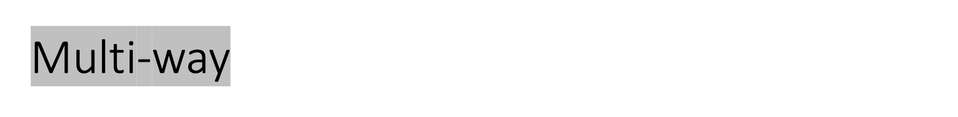
yes
x < 2
print('small')
if x < 2 :
print('small')
elif x < 10 :
print('Medium')
else :
print('LARGE')
print('All done')
no
yes
x < 10
print('Medium')
no
print('LARGE')
print('All Done')

Slide 16
Multi-way
x = 0
yes
x < 2
print('small')
x = 0
if x < 2 :
print('small')
elif x < 10 :
print('Medium')
else :
print('LARGE')
print('All done')
no
yes
x < 10
print('Medium')
no
print('LARGE')
print('All Done')

Slide 17
Multi-way
x = 5
yes
x < 2
print('small')
x = 5
if x < 2 :
print('small')
elif x < 10 :
print('Medium')
else :
print('LARGE')
print('All done')
no
yes
x < 10
print('Medium')
no
print('LARGE')
print('All Done')

Slide 18
Multi-way
x = 20
yes
x < 2
print('small')
x = 20
if x < 2 :
print('small')
elif x < 10 :
print('Medium')
else :
print('LARGE')
print('All done')
no
yes
x < 10
print('Medium')
no
print('LARGE')
print('All Done')

Slide 19
Multi-way Puzzles
Which will never print regardless of the value for x?
if x < 2 :
print('Below 2')
elif x >= 2 :
print('Two or more')
else :
print('Something else')
if x < 2 :
print('Below 2')
elif x < 20 :
print('Below 20')
elif x < 10 :
print('Below 10')
else :
print('Something else')

Slide 20
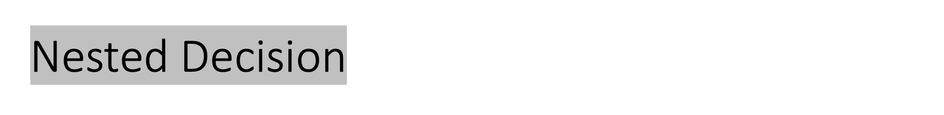
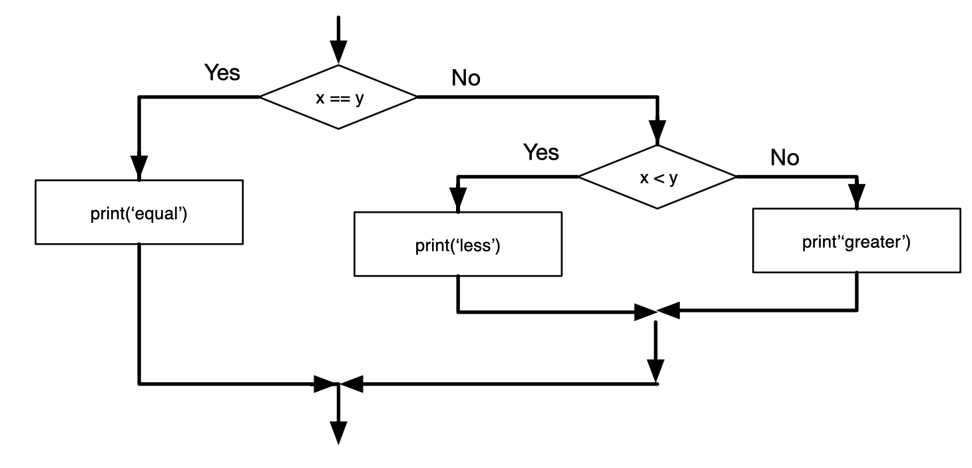
One conditional can also be nested with another.
if x == y:
print('x and y are equal’)
else:
if x < y:
print('x is less than y’)
else:
print('x is greater than y')
Notes:
The outer conditional contains two branches. The first branch contains a simple statement. The second branch contains another if statement, which has two branches of its own. Those two branches are both simple statements, although they could have been conditional statements as well.
Although the indentation of the statements makes the structure apparent, nested conditionals become difficult to read very quickly. In general, it is a good idea to avoid them when you can.
Inception, create a dream within a dream.

Slide 21
Nested Decision
Nested conditionals become difficult to read very quickly.
It is a good idea to avoid them when you can.
if 0 < x:
if x < 10:
print('x is a positive single-digit number.')
if 0 < x and x < 10:
print('x is a positive single-digit number.')
Notes:
Although the indentation of the statements makes the structure apparent, nested conditionals become difficult to read very quickly. In general, it is a good idea to avoid them when you can.
Logical operators often provide a way to simplify nested conditional statements. For example, we can rewrite the following code using a single conditional:
The print statement is executed only if we make it past both conditionals, so we can get the same effect with the and operator:

Slide 22
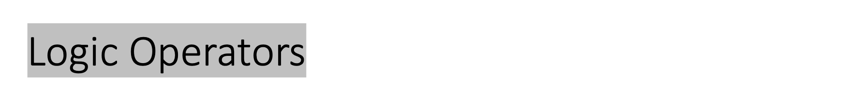
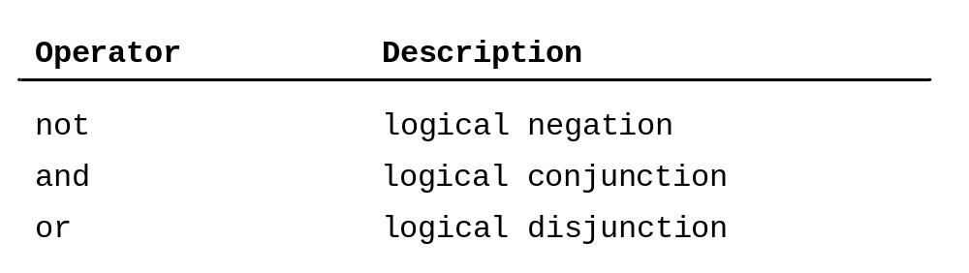
Three logic operators
Meaning of them like their meaning in English
  x > 0 and x < 10
  n%2 == 0 or n%3 == 0
  not (x > y)
is true only if x is greater than 0 and less than 10.
is true if either of the conditions is true, that is, if the number is divisible by 2 or 3.
is true if x > y is false; that is, if x is less than or equal to y.
Notes:
Not negates a boolean expression.
Strictly speaking, the operands of the logical operators should be boolean expressions, but Python is not very strict. Any nonzero number is interpreted as "true."

Slide 23
Logic Operators
The operand of the logical operators can also be any nonzero number.
  Any nonzero number is interpreted as "true."
>>> 17 and True
True

Slide 24
Operator Precedence and Associativity
Operator Precedence Chart | PrecedenceOperator
 | +, − (Unary plus and minus) ** (Exponentiation) not *, /, //, % (Multiplication, division, integer division, and remainder) +, − (Binary addition and subtraction) <, <=, >, >= (Relational) ==, != (Equality) and or =, +=, -=, *=, /=, //=, %= (Assignment operators)
If operators with the same precedence are next to each other, we evaluate them from left to right.
Notes:
The precedence rule defines precedence for operators. Table 3.7 contains the operators you have learned so far, with the operators listed in decreasing order of precedence from top to bottom.
The logical operators have lower precedence than the relational operators and the relational operators have lower precedence than the arithmetic operators.
Operators with the same precedence appear in the same group.

Slide 25
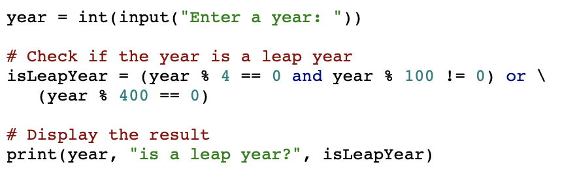
Problem: Determining Leap Year?
This program first prompts the user to enter a year as an int value and checks if it is a leap year.
A year is a leap year if it is divisible by 4 but not by 100, or it is divisible by 400.
(year % 4 == 0 and year % 100 != 0) or (year % 400 == 0)

Slide 26
A simulation of lottery system
A player selects a number (0-99) and notifies the lottery system
The lottery system generates a winning number (0-99).
The lottery system determines whether the user wins according to the following rule:
  If player’s number matches the lottery in exact order, the award is $10,000.
  If player’s number matches the lottery, the award is $3,000.
  If one digit in player’s number matches a digit in the lottery, the award is $1,000.

