Slide 1
Chapter 4
Mathematical Functions, Strings, and Objects

Slide 2
What to be covered next
Python Built-in Functions
Strings and Characters
Unicode and ASCII Code
Escape Sequences for Special Characters
Printing without the Newline
The str Function
Reading Strings from the Console

Slide 3
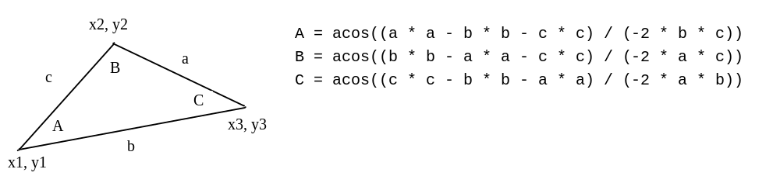
Problem: Compute Angles
Given three points of a triangle, you can compute the angles using the following formula:
ComputeAngles
https://liangcpp.pearsoncmg.com/pyhtml/ComputeAngles.html
Notes:
import math
x1 = float(input("Enter x-coordinate for Point 1: "))
y1 = float(input("Enter y-coordinate for Point 1: "))
x2 = float(input("Enter x-coordinate for Point 2: "))
y2 = float(input("Enter y-coordinate for Point 2: "))
x3 = float(input("Enter x-coordinate for Point 3: "))
y3 = float(input("Enter y-coordinate for Point 3: "))
a = math.sqrt((x2 - x3) * (x2 - x3) + (y2 - y3) * (y2 - y3))
b = math.sqrt((x1 - x3) * (x1 - x3) + (y1 - y3) * (y1 - y3))
c = math.sqrt((x1 - x2) * (x1 - x2) + (y1 - y2) * (y1 - y2))
A = math.degrees(math.acos((a * a - b * b - c * c) / (-2 * b * c)))
B = math.degrees(math.acos((b * b - a * a - c * c) / (-2 * a * c)))
C = math.degrees(math.acos((c * c - b * b - a * a) / (-2 * a * b)))
print("The three angles are ", round(A * 100) / 100.0,
round(B * 100) / 100.0, round(C * 100) / 100.0)

Slide 4

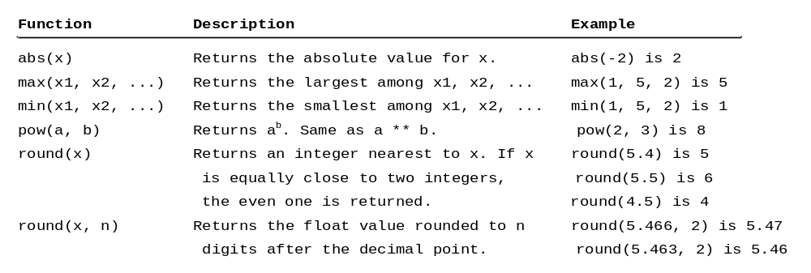
Notes:
What is function?
Return value meaning?
each x1, can be an expression
1
X
X+1
Max(1,2.3)
Max(1,2,3) + 1
Max(1,2+2,x+1)
Max(1,2,max(3,4))
Max(1,2, if else?)
Max(print())
Print(max(1,2,3))

Slide 5
Built-in Functions
>>> max(2, 3, 4) # Returns a maximum number
4
>>> min(2, 3, 4) # Returns a minimu number
2
>>> round(4.51) # Rounds to its nearest integer
4
>>> round(4.4) # Rounds to its nearest integer
3
>>> abs(-3) # Returns the absolute value
3
>>> pow(2, 3) # Same as 2 ** 3
8
Notes:
print(max(-1,10,9,0))
print(pow(3,2))
x=100
print(max(1,10,x,99))
print(max(1,10,x,99+2))
print(max(1,10,x,max(200,100))
x=100
y=200
z=300

Slide 6
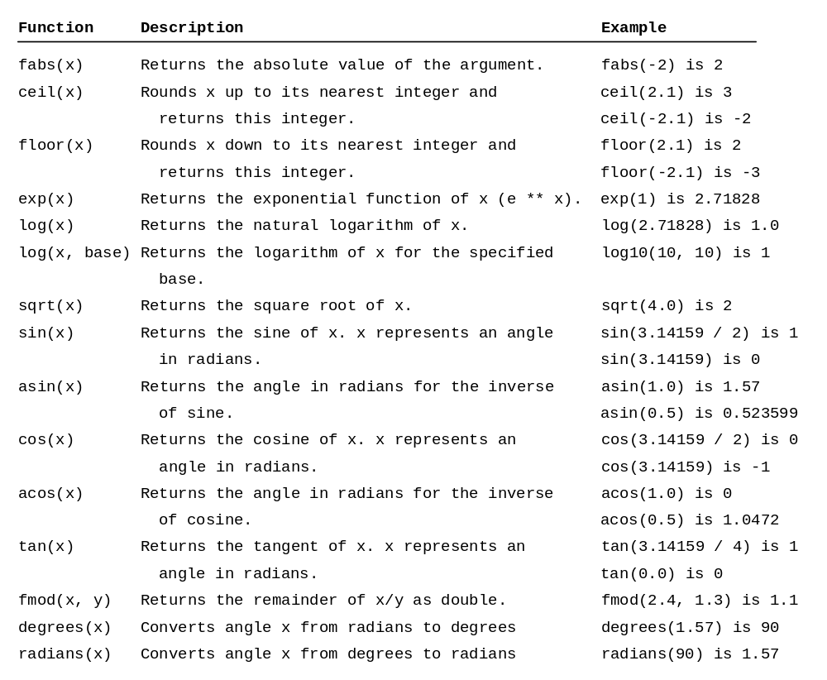
The math Functions

Slide 7
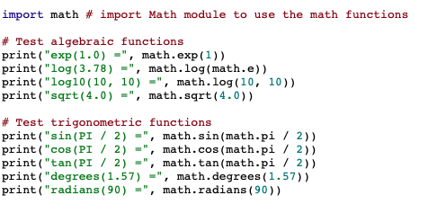

Slide 8

A string is a sequence of characters. String literals can be enclosed in matching single quotes (') or double quotes ("). Python does not have a data type for characters. A single-character string represents a character.
letter = 'A' # Same as letter = "A"
numChar = '4' # Same as numChar = "4"
message = "Good morning"
# Same as message = 'Good morning'

Slide 9
Unicode and ASCII Code
Python characters use Unicode, a 16-bit encoding scheme. Unicode is an encoding scheme for representing international characters. ASCII is a small subset of Unicode.
Notes:
Understanding ASCII and Unicode (GCSE)

Slide 10

ASCII Table and Description
Notes:
Numbers
Lowercase letters
Uppercase letters

Slide 11
Functions ord and chr
>>> ch = 'a'
>>> ord(ch)
97
>>> chr(98)
'b'
Notes:
Ord – original decode
Chr – character represented by the code

Slide 12
Escape Sequences for Special Characters
Description Escape Sequence Unicode
Backspace \b \u0008
Tab \t \u0009
Linefeed \n \u000A
Carriage return \r \u000D
Backslash \\ \u005C
Single Quote \' \u0027
Double Quote \" \u0022
Notes:
Print(ord(‘a’))
Print(ord(‘ ’))
Print(ord(‘\n’))

Slide 13
Printing without the Newline
print(item, end = 'anyendingstring')
print("AAA", end = ' ')
print("BBB", end = '')
print("CCC", end = '***')
print("DDD", end = '***')

Slide 14
The str Function
The str function can be used to convert a number into a string. For example,
>>> s = str(4.4) # Convert a float to string
>>> s
'4.4'
>>> s = str(3) # Convert an integer to string
>>> s
'3'
>>>

Slide 15
The String Concatenation Operator
You can use the + operator add two numbers. The + operator can also be used to concatenate (combine) two strings. Here are some examples:
>>> message = "Welcome " + "to " + "Python"
>>> message
'Weclome to Python'
>>> chapterNo = 2
>>> s = "Chapter " + str(chapterNo)
>>> s
'Chapter 2'
>>>

Slide 16
Problem: Process a string
Write a program that prompts the user to enter a string and displays its length and its first character.
Enter a string: Programming is fun
The length of string Programming is fun is 18
The first character of string Programming is fun is P
Notes:
s = input("Enter a string: ")
print("The length of string", s, "is", len(s))
print("The first character of string" , s, "is", s[0])

Slide 17
What to be covered next
Introduction to Objects and Methods
Str Object Methods
Formatting Numbers and Strings

Slide 18
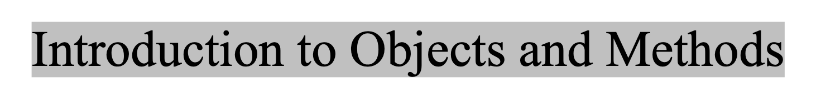
In Python, all data—including numbers and strings—are actually objects.
An object is an entity. Each object has an id and a type. Objects of the same kind have the same type. You can use the id function and type function to get these information for an object.

Slide 19
Object Types and Ids
The id and type functions are rarely used in programming, but they are good pedagogical tools for understanding objects.
>>> n = 3 # n is an integer
>>> id(n)
505408904
>>> type(n)
<class ’int’>
>>> f = 4.0 # f is a float
>>> id(f)
26647120
>>> type(f)
<class ’float’>
>>> s = "Welcome" # s is a string
>>> id(s)
36201472
>>> type(s)
<class ’str’>

Slide 20
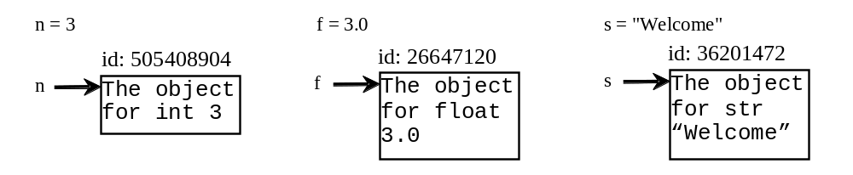
OOP and str Objects
The id and type functions are rarely used in programming, but they are good pedagogical tools for understanding objects.

Slide 21
Object vs. Object reference Variable
For n = 3, we say n is an integer variable that holds value 3. Strictly speaking, n is a variable that references an int object for value 3. For simplicity, it is fine to say n is an int variable with value 3.

Slide 22
Methods
You can perform operations on an object. The operations are defined using functions. The functions for the objects are called methods in Python. Methods can only be invoked from a specific object. For example, the string type has the methods such as lower() and upper(), which returns a new string in lowercase and uppercase. Here are the examples to invoke these methods:

Slide 23

>>> s = "Welcome"
>>> s1 = s.lower() # Invoke the lower method
>>> s1
'welcome'
>>> s2 = s.upper() # Invoke the upper method
>>> s2
'WELCOME'

Slide 24
Striping beginning and ending Whitespace Characters
Another useful string method is strip(), which can be used to strip the whitespace characters from the both ends of a string.
>>> s = "\t Welcome \n"
>>> s1 = s.strip() # Invoke the strip method
>>> s1
'Welcome'

Slide 25
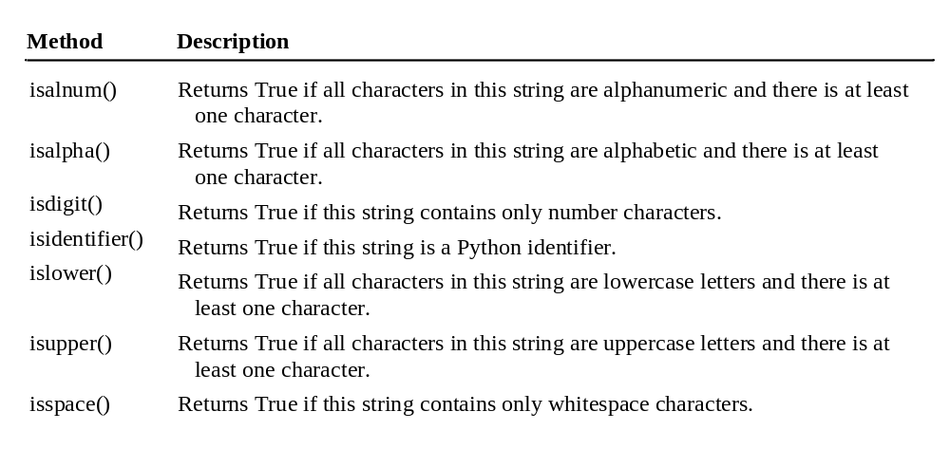
Testing Strings

Slide 26
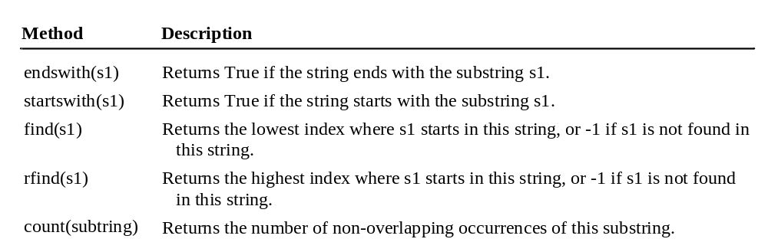
Searching for Substrings

Slide 27
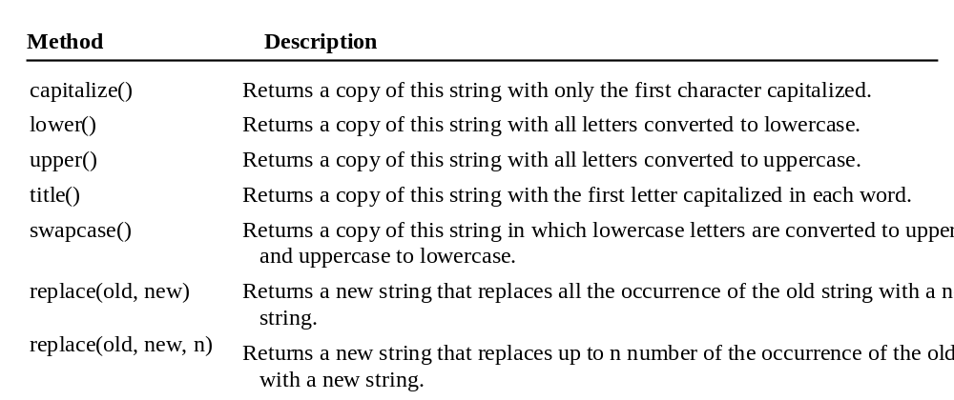
Converting Strings

Slide 28
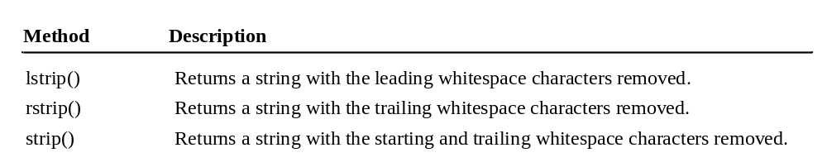
Striping Whitespace Characters

