Slide 1
Chapter 5 Loops
© Copyright 2018 by Pearson Education, Inc. All Rights Reserved.

Slide 2
Motivations
Suppose that you need to print a string (e.g., "Programming is fun!") a hundred times. It would be tedious to have to write the following statement a hundred times:
print("Programming is fun!");
So, how do you solve this problem?

Slide 3
Opening Problem
Problem:
print("Programming is fun!");
print("Programming is fun!");
print("Programming is fun!");
print("Programming is fun!");
print("Programming is fun!");
print("Programming is fun!");
…
…
…
print("Programming is fun!");
print("Programming is fun!");
print("Programming is fun!");
100 times

Slide 4
Introducing while Loops
count = 0
while count < 100:
print("Programming is fun!")
count = count + 1

Slide 5
What to be covered
Loop Design Strategy
while Loop Flow Chart
Trace while loop
Ending a Loop With A Sentinel Value
Numerical Errors In Loop
© Copyright 2018 by Pearson Education, Inc. All Rights Reserved.

Slide 6

Step 1: Identify the statements that need to be repeated.
Step 2:Wrap these statements in a loop.
Step 3: Code the loop-continuation-condition and add appropriate statements for controlling the loop.
Statements
while True:
Statements
while loop-continuation-condition:
Statements
Additional statements for controlling the loop

Slide 7

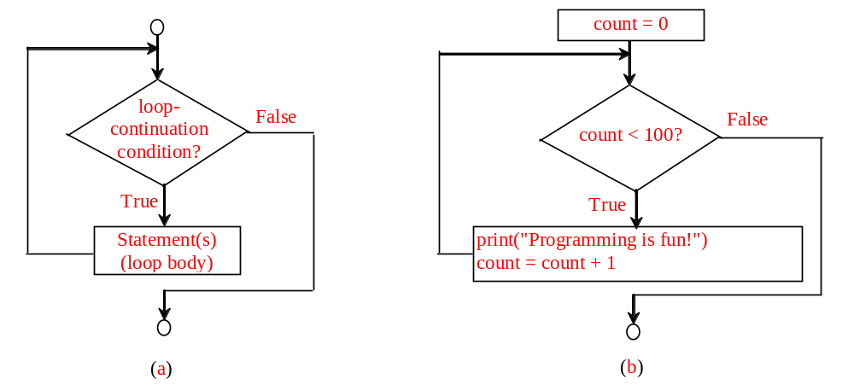
count = 0
while count < 100:
print("Programming is fun!")
count = count + 1
while loop-continuation-condition:
# Loop body
Statement(s)

Slide 8

animation
Initialize count
count = 0
while count < 2:
print("Programming is fun!")
count = count + 1

Slide 9
Trace while Loop, cont.
animation
(count < 2) is true
count = 0
while count < 2:
print("Programming is fun!")
count = count + 1

Slide 10
Trace while Loop, cont.
animation
Print Programming is fun
count = 0
while count < 2:
print("Programming is fun!")
count = count + 1

Slide 11
Trace while Loop, cont.
animation
Increase count by 1
count is 1 now
count = 0
while count < 2:
print("Programming is fun!")
count = count + 1

Slide 12
Trace while Loop, cont.
animation
(count < 2) is still true since count is 1
count = 0
while count < 2:
print("Programming is fun!")
count = count + 1

Slide 13
Trace while Loop, cont.
animation
Print Programming is fun
count = 0
while count < 2:
print("Programming is fun!")
count = count + 1

Slide 14
Trace while Loop, cont.
animation
Increase count by 1
count is 2 now
count = 0
while count < 2:
print("Programming is fun!")
count = count + 1

Slide 15
Trace while Loop, cont.
animation
(count < 2) is false since count is 2 now
count = 0
while count < 2:
print("Programming is fun!")
count = count + 1

Slide 16
Trace while Loop
animation
The loop exits. Execute the next statement after the loop.
count = 0
while count < 2:
print("Programming is fun!")
count = count + 1
Notes:
Game:
Name: statement
Varible : count
Count=0, count<=5
Count=1, count<5
Count=1, count<=5

Slide 17
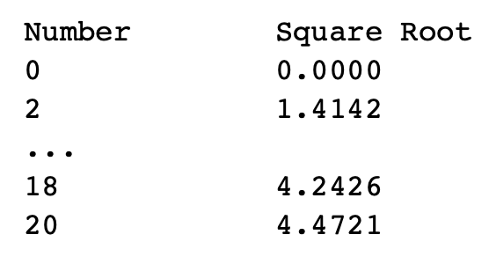
Discussion
Write a program that prints the following table using the sqrt function in the math module.
Statements
while True:
Statements
while loop-continuation-condition:
Statements
Additional statements for controlling the loop
Notes:
num=0
print(num,’\t’,math.sqrt(num))
num=num+2
print(num,’\t’,math.sqrt(num))
num=num+2
print(num,’\t’,math.sqrt(num))
…..
print(num,’\t’,math.sqrt(num))
# 11 times

Slide 18
Discussion
Guess what does following program do?
data = int(input("Enter an integer (the input exits " +
"if the input is 0): "))
# Keep reading data until the input is 0
sum = 0
while data != 0:
sum += data
data = int(input("Enter an integer (the input exits " +
"if the input is 0): "))
print("The sum is", sum)

Slide 19
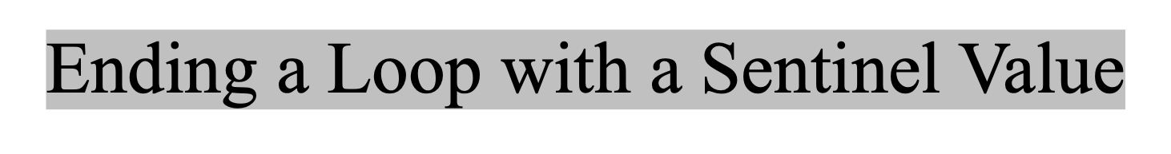
Often the number of times a loop is executed is not predetermined. You may use an input value to signify the end of the loop. Such a value is known as a sentinel value.
E.g., In order to read and calculate the sum of an unspecified number of integers, we can ask an input 0 to signify the end of the input.
Notes:
data = int(input("Enter an integer (the input exits " +
"if the input is 0): "))
# Keep reading data until the input is 0
sum = 0
while data != 0:
sum += data
data = int(input("Enter an integer (the input exits " +
"if the input is 0): "))
print("The sum is", sum)

Slide 20
Practice
Write a program that reads an unspecified number of integers, computes the total and average of the input values (not counting zeros). Your program ends with the input 0. Display the total as an integer and average as a floating-point number.
Statements
while True:
Statements
while loop-continuation-condition:
Statements
Additional statements for controlling the loop
Notes:
Bonus:
count = 0
total = 0
num = int(input("Enter an integer, the input ends if it is 0: "))
while num != 0:
total += num
count += 1
# Read the next number
num = int(input(
"Enter an integer, the input ends if it is 0: "))
if count == 0:
print("No numbers are entered except 0")
else:
print("The total is", total)
print("The average is", total / count)

Slide 21
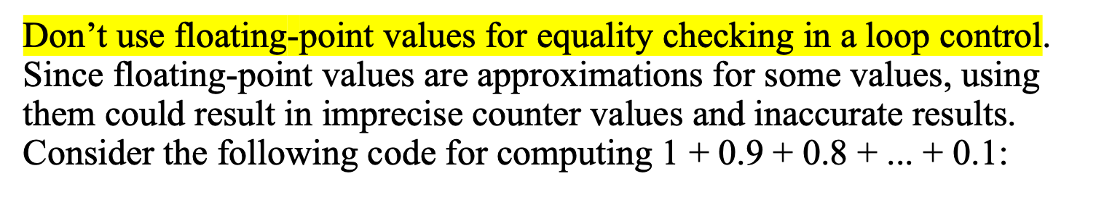
Caution
item = 1
sum = 0
while item != 0: # No guarantee item will be 0
sum += item
item -= 0.1
print(sum)
Variable item starts with 1 and is reduced by 0.1 every time the loop body is executed. The loop should terminate when item becomes 0. However, there is no guarantee that item will be exactly 0, because the floating-point arithmetic is approximated. This loop seems OK on the surface, but it is actually an infinite loop.

Slide 22
for Loops
i = initialValue # Initialize loop-control variable
while i < endValue:
# Loop body
...
i++ # Adjust loop-control variable
for i in range(initialValue, endValue):
# Loop body

Slide 23
range(a, b)
>>> for v in range(4, 8):
... print(v)
...
4
5
6
7
>>>

Slide 24
range(b)
>>> for i in range(4):
... print(i)
...
0
1
2
3
>>>

Slide 25
range(a, b, step)
>>> for v in range(3, 9, 2):
... print(v)
...
3
5
7
>>>

Slide 26
range(a, b, step)
>>> for v in range(5, 1, -1):
... print(v)
...
5
4
3
2
>>>

Slide 27
Problem: Predicting the Future Tuition
Problem: Suppose that the tuition for a university is $10,000 this year and tuition increases 7% every year. In how many years will the tuition be doubled?
while loop or for loop?

Slide 28
Problem: Predicating the Future Tuition
year = 0 # Year 0
tuition = 10000
year += 1 # Year 1
tuition = tuition * 1.07
year += 1 # Year 2
tuition = tuition * 1.07
year += 1 # Year 3
tuition = tuition * 1.07
tuition = 10000
year = 0 # Year 0
while tuition < 20000:
tuition = tuition * 1.07
year += 1
print("Tuition will be doubled in", year, "years")
print("Tuition will be $" + format(tuition, ".2f"),
"in", year, "years")

Slide 29
Problem: Predicating the Future Tuition
year = 0 # Year 0
tuition = 10000
year += 1 # Year 1
tuition = tuition * 1.07
year += 1 # Year 2
tuition = tuition * 1.07
year += 1 # Year 3
tuition = tuition * 1.07
tuition = 10000
year = 0 # Year 0
while True:
tuition = tuition * 1.07
year += 1
if tuition >= 20000:
break;
print("Tuition will be doubled in", year, "years")
print("Tuition will be $" + format(tuition, ".2f"),
"in", year, "years")

Slide 30
Using break and continue
Examples for using the break and continue keywords:
TestBreak.py
TestBreak
TestContinue.py
TestContinue

Slide 31
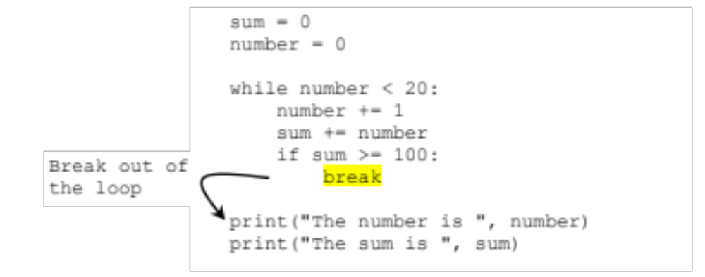
break
Notes:
Count-0
While count<20:
print(count)
if count%5==0:
break
count=count+1

Slide 32
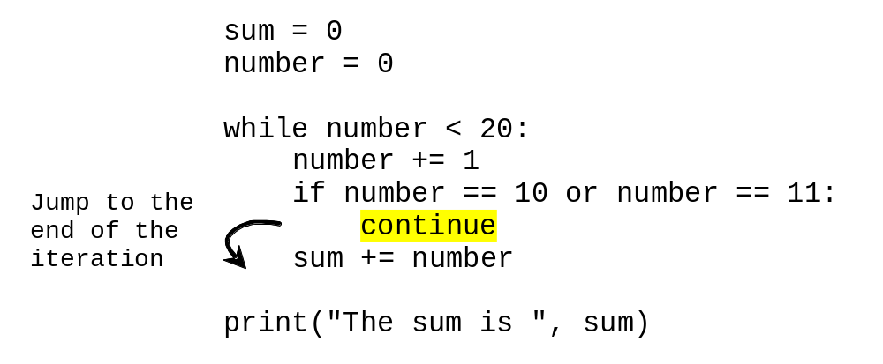
continue

Slide 33
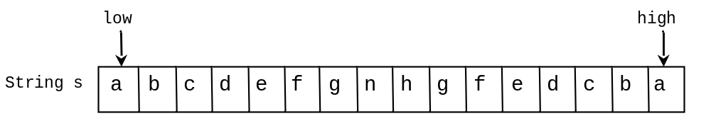
Problem: Checking Palindrome
A string is a palindrome if it reads the same forward and backward. The words “mom,” “dad,” and “noon,” for instance, are all palindromes.
The problem is to write a program that prompts the user to enter a string and reports whether the string is a palindrome. One solution is to check whether the first character in the string is the same as the last character. If so, check whether the second character is the same as the second-to-last character. This process continues until a mismatch is found or all the characters in the string are checked, except for the middle character if the string has an odd number of characters.
TestPalindrome

Slide 34
# Prompt the user to enter a string
s = input("Enter a string: ")
# The index of the first character in the string
low = 0
# The index of the last character in the string
high = len(s) - 1
isPalindrome = True
while low < high:
if s[low] != s[high]:
isPalindrome = False # Not a palindrome
break
low += 1
high -= 1
if isPalindrome:
print(s, "is a palindrome")
else:
print(s, "is not a palindrome")

