Slide 1
Chapter 6 Functions

Slide 2
Function Abstraction
You can think of the function body as a black box that contains the detailed implementation for the function.

Slide 3
Benefits of Functions
Write a function once and reuse it anywhere.
Information hiding. Hide the implementation from the user.
Reduce complexity.

Slide 4
Opening Problem
Find the sum of integers from 1 to 10, from 20 to 37, and from 35 to 49, respectively.

Slide 5
Problem
sum = 0
for i in range(1, 11):
sum += i
print("Sum from 1 to 10 is", sum)
sum = 0
for i in range(20, 38):
sum += i
print("Sum from 20 to 37 is", sum)
sum = 0
for i in range(35, 50):
sum += i
print("Sum from 35 to 49 is", sum)
Notes:
You may have observed that the code for computing these sums is very similar, except that the starting and ending integers are different. Wouldn’t it be nice to be able to write commonly used code once and then reuse it? You can do this by defining a function, which enables you to create reusable code. For example, the preceding code can be simplified by using functions, as follows:
A function is a collection of statements grouped together that performs an operation. In earlier chapters, you learned about such functions as input("Enter a value") and random.randint(a, b). When you call the random.randint(a, b) function, for example, the system actually executes the statements in the function and returns the result. In this chapter, you will learn how to define and use functions and apply function abstraction to solve complex problems.

Slide 6
Problem
sum = 0
for i in range(1, 11):
sum += i
print("Sum from 1 to 10 is", sum)
sum = 0
for i in range(20, 38):
sum += i
print("Sum from 20 to 37 is", sum)
sum = 0
for i in range(35, 50):
sum += i
print("Sum from 35 to 49 is", sum)

Slide 7
Solution
def sum(i1, i2):
result = 0
for i in range(i1, i2 + 1):
result += i
return result
def main():
print("Sum from 1 to 10 is", sum(1, 10))
print("Sum from 20 to 37 is", sum(20, 37))
print("Sum from 35 to 49 is", sum(35, 49))
main() # Call the main function

Slide 8
Defining Functions
A function is a collection of statements that are grouped together to perform an operation.
Notes:
Let’s look at a function created to find which of two integers is bigger. This function, named max, has two parameters, num1 and num2, the larger of which is returned by the function.
A function has two parts: header and body.
The header begins with the keyword def, followed by the function’s name and parameters, and ends with a colon.
The function body contains a collection of statements that define what the function does.

Slide 9
Practice
Write the definition of a function twice, that receives an integer parameter and returns an integer that is twice the value of the parameter.

Slide 10
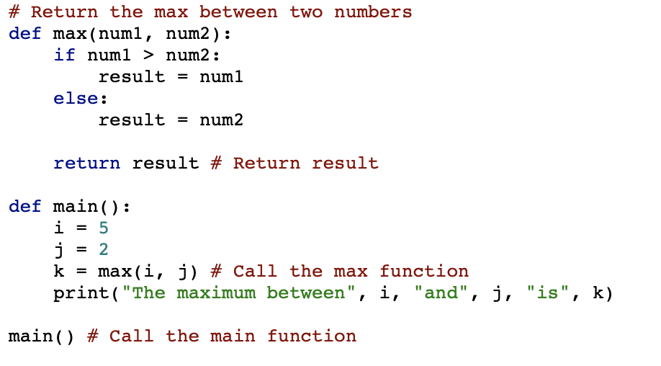
Calling Functions
Testing the max function
This program demonstrates calling a function max to return the largest of the int values
TestMax
Notes:
In a function’s definition, you define what it is to do. To use a function, you have to call or invoke it. The program that calls the function is called a caller.
This program contains the max and main functions. The program script invokes the main function. By convention, programs often define a function named main that contains the main functionality for a program.
How is this program executed? The interpreter reads the script in the file line by line starting from line 1. Since line 1 is a comment, it is ignored.
When it reads the function header in line 2, it stores the function with its body (lines 2–8) in the memory. Remember that a function’s definition defines the function, but it does not cause the function to execute. The interpreter then reads the definition of the main function (lines 10–14) to the memory. Finally, the interpreter reads the statement at the last line, which invokes the main function and causes the main function to be executed. The control is now transferred to the main function, as shown in Figure 6.2.

Slide 11

Calling Functions, cont.
animation

Slide 12
Trace Function Invocation
animation
Invoke the main function
Notes:
When a function is invoked, the control is transferred to the function.
Now main function is invoked, the control is transferred to the main function.
The execution of the main function begins with the initialization of I and j

Slide 13
Trace Function Invocation
animation
i is now 5

Slide 14

Trace Function Invocation
animation
j is now 2

Slide 15
Trace Function Invocation
animation
invoke max(i, j)
Notes:
And then invokes max(i, j) .

Slide 16
Trace Function Invocation
animation
invoke max(i, j)
Pass the value of i to num1
Pass the value of j to num2
Notes:
When the max function is invoked, i is passed to num1 and j is passed to num2. The control is transferred to the max function, and the max function is executed.

Slide 17
Trace Function Invocation
animation
(num1 > num2) is true since num1 is 5 and num2 is 2
Notes:
When the return statement in the max function is executed, the max function returns the control to its caller (in this case the caller is the main function).

Slide 18
Trace Function Invocation
animation
result is now 5

Slide 19
Trace Function Invocation
animation
return result, which is 5
Notes:
After the max function is finished, the returned value from the max function is assigned to k

Slide 20
Trace Function Invocation
animation
return max(i, j) and assign the return value to k
Notes:
The main function prints the result (line 14).

Slide 21
Trace Function Invocation
animation
Execute the print statement
Notes:
The main function is now finished. It returns the control to its caller (line 16). The program is now finished.

Slide 22
Trace Function Invocation
animation
Return to the caller
Notes:
Here main is defined after max. In Python, functions can be defined in any order in a script file as long as the function is loaded into the memory when it is called. You can also define main before max.

Slide 23
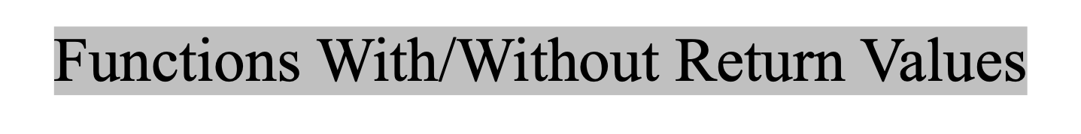
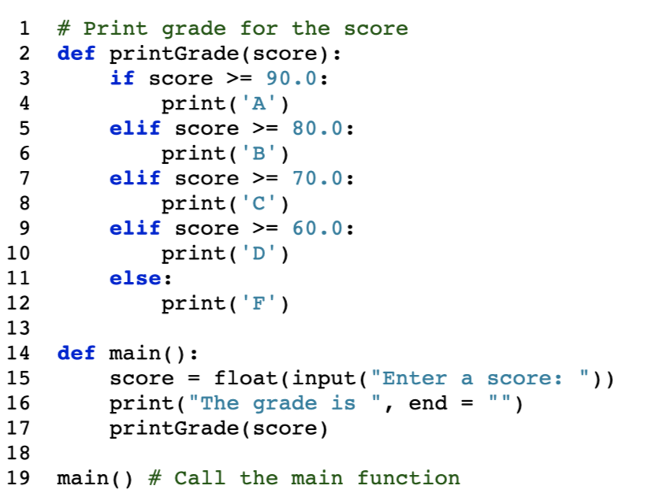
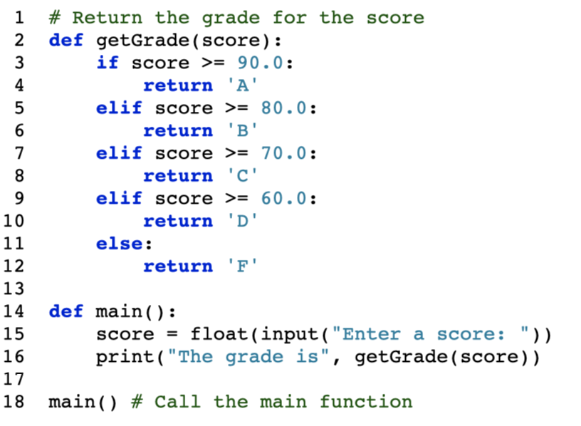
This type of function does not return a value. The function performs some actions.
PrintGradeFunction
ReturnGradeFunction
Notes:
A function does not have to return a value.
The preceding section gives an example of a value-returning function. This section shows how to define and invoke a function that does not return a value. Such a function is commonly known as a void function.
The printGrade function does not return any value.
To see the differences between a function that does not return a value and a function that returns a value, let’s redesign the printGrade function to return a value.
We call the new function that returns the grade, getGrade.
The getGrade function defined in lines 2–12 returns a character grade based on the numeric score value. It is invoked in line 16.
The getGrade function returns a character, and it can be invoked and used just like a character. The printGrade function does not return a value, and it must be invoked as a statement.
A return statement is not needed for a void function, but it can be used for terminating the function and returning control to the function’s caller. The syntax is simply

Slide 24
The None Value
A function that does not return a value is known as a void function in other programming languages such as Python, C++, and C#. In Python, such function returns a special value None.
def sum(number1, number2):
total = number1 + number2
print(sum(1, 2))
Notes:
Demo:
def sum(number1, number2):
total = number1 + number2
print(sum(1, 2))
you will see the output is None, because the sum function does not have a return statement. By default, it returns None.
Technically, every function in Python returns a value whether you use return or not. If a function does not return a value, by default, it returns a special value None\\
The None value can be assigned to a variable to indicate that the variable does not reference any object.

Slide 25
Passing Arguments by Positions
def nPrintln(message, n):
for i in range(0, n):
print(message)
Suppose you invoke the function using
nPrintln(“Welcome to Python”, 5)
What is the output?
Suppose you invoke the function using
nPrintln(“Computer Science”, 15)
What is the output?
What is wrong
nPrintln(4, “Computer Science”)
Notes:
DEMO:
def nPrintln(message, n):
for i in range(0, n):
print(message)
nPrintln(“Welcome to Python”, 5)
nPrintln(“Computer Science”, 15)
nPrintln(4, “Computer Science”)
nPrintln(4, “Computer Science”)
nPrintln(n = 4, message = “Computer Science”)
For example, the following function prints a message n times:
When calling a function, you need to pass arguments to parameters. There are two kinds of arguments: positional arguments and keyword arguments.
When we call a function like this, it is said to use positional arguments. The arguments must match the parameters in order, number, and compatible type, as defined in the function header.

Slide 26
Keyword Arguments
def nPrintln(message, n):
for i in range(0, n):
print(message)
What is wrong
nPrintln(4, “Computer Science”)
Is this OK?
nPrintln(n = 4, message = “Computer Science”)
Notes:
You can also call a function using keyword arguments, passing each argument in the form name=value. For example, nPrintln(n = 5, message = "good") passes 5 to n and "good" to message. The arguments can appear in any order using keyword arguments.

Slide 27
Scope of Variables
Scope: the part of the program where the variable can be referenced.
A variable created inside a function is referred to as a local variable. Local variables can only be accessed inside a function. The scope of a local variable starts from its creation and continues to the end of the function that contains the variable.
In Python, you can also use global variables. They are created outside all functions and are accessible to all functions in their scope.
Notes:
Why we need different variables? Reuse the names of variables.
The scope of a variable is the part of the program where the variable can be referenced.

Slide 28
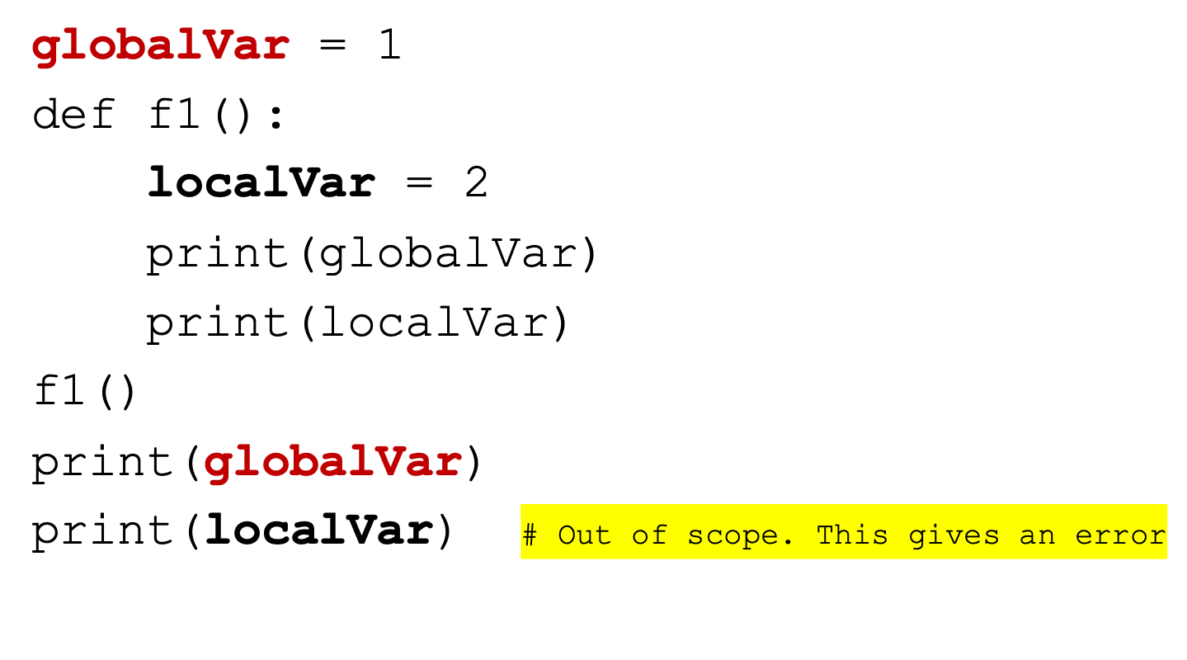
Example 1
Notes:
A global variable is created in line 1 in Example 1. It is accessed within the function in line 4 and outside the function in line 8. A local variable is created in line 3. It is accessed within the function in line 5. Attempting to access the variable from outside of the function causes an error in line 9.

Slide 29
Example 2
x = 1
def f1():
x = 2
print(x) # Displays 2
f1()
print(x) # Displays 1
Notes:
Two xs, but they are different.
Here a global variable x is created in line 1 in Example 2 and a local variable with the same name (x) is created in line 3. From this point on, the global variable x is not accessible in the function. Outside the function, the global variable x is still accessible. So, it prints 1 in line 7.

Slide 30
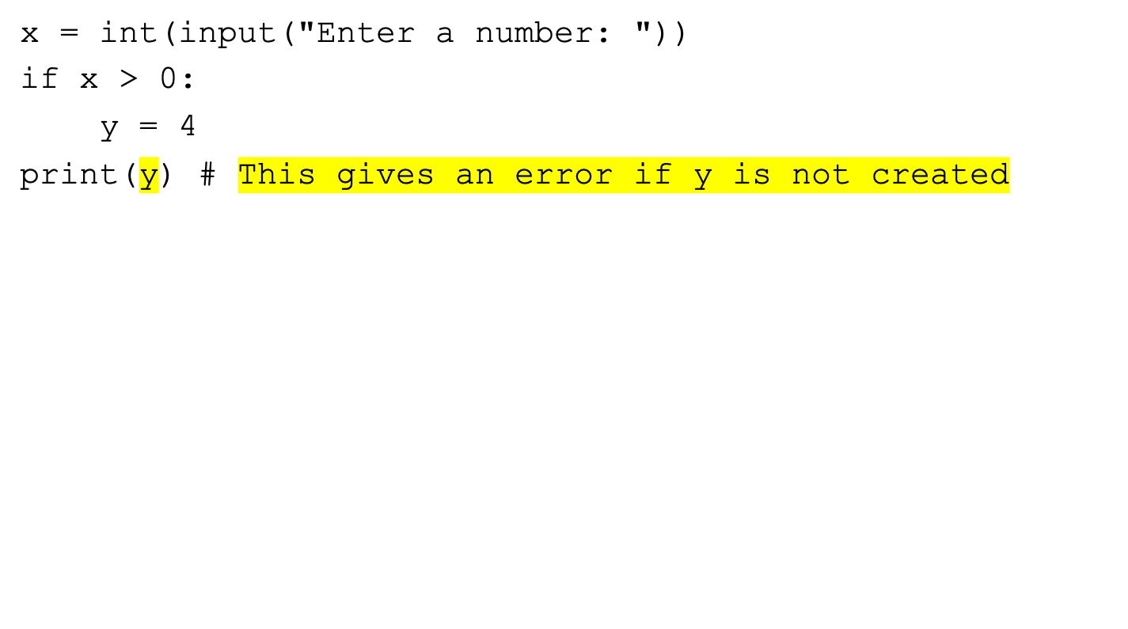
Example 3
Notes:
Eval>
Here the variable y is created if x > 0 in Example 3. If you enter a positive value for x (line 1), the program runs fine. But if you enter a nonpositive value, line 5 produces an error because y is not created.

Slide 31
Example 4
sum = 0
for i in range(5):
sum += i
print(i)
Notes:
Here the variable i is created in the loop in Example 4. After the loop is finished, i is 4, so line 5 displays 4.

Slide 32
Example 5
x = 1
def increase():
global x
x = x + 1
print(x) # Displays 2
increase()
print(x) # Displays 2
Notes:
How to use a global variable in a function?
You can bind a local variable in the global scope. You can also create a variable in a function and use it outside the function. To do either, use a global statement, as shown in the following two examples.
\
Here a global variable x is created in line 1 in Example 6 and x is bound in the function in line 3, which means that x in the function is the same as x outside of the function, so the program prints 2 in line 5 and in line 8.

Slide 33
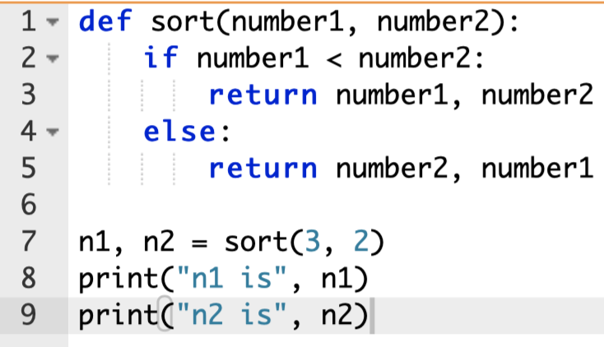
Returning Multiple Values
Python allows a function to return multiple values. Listing 6.9 defines a function that takes two numbers and returns them in non-descending order.
MultipleReturnValueDemo
Notes:
The sort function returns two values. When it is invoked, you need to pass the returned values in a simultaneous assignment.

Slide 34
Stepwise Refinement
The concept of function abstraction can be applied to the process of developing programs. When writing a large program, you can use the “divide and conquer” strategy, also known as stepwise refinement, to decompose it into subproblems. The subproblems can be further decomposed into smaller, more manageable problems.

Slide 35
PrintCalender Case Study
Let us use the PrintCalendar example to demonstrate the stepwise refinement approach.
PrintCalender

Slide 36
Design Diagram

Slide 37
Implementation: Top-Down
Top-down approach is to implement one function in the structure chart at a time from the top to the bottom. Stubs can be used for the functions waiting to be implemented. A stub is a simple but incomplete version of a function. The use of stubs enables you to test invoking the function from a caller. Implement the main function first and then use a stub for the printMonth function. For example, let printMonth display the year and the month in the stub. Thus, your program may begin like this:
A Skeleton for PrintCalendar
Notes:
How would you get started writing such a program? Would you immediately start coding? Beginning programmers often start by trying to work out the solution to every detail. Although details are important in the final program, concern for detail in the early stages may block the problem-solving process. To make problem solving flow as smoothly as possible, this example begins by using function abstraction to isolate details from design and only later implements the details.
For this example, the problem is first broken into two subproblems: (1) get input from the user and (2) print the calendar for the month. At this stage, you should be concerned with what the subproblems will achieve, not with how to get input and print the calendar for the month. You can draw a structure chart to help visualize the decomposition of the problem

Slide 38
