Slide 1
Chapter 7 Lists
Notes:
Program for calculations
Do not forget about data
E.g.

Slide 2
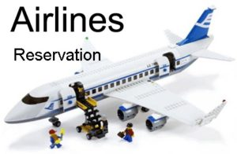

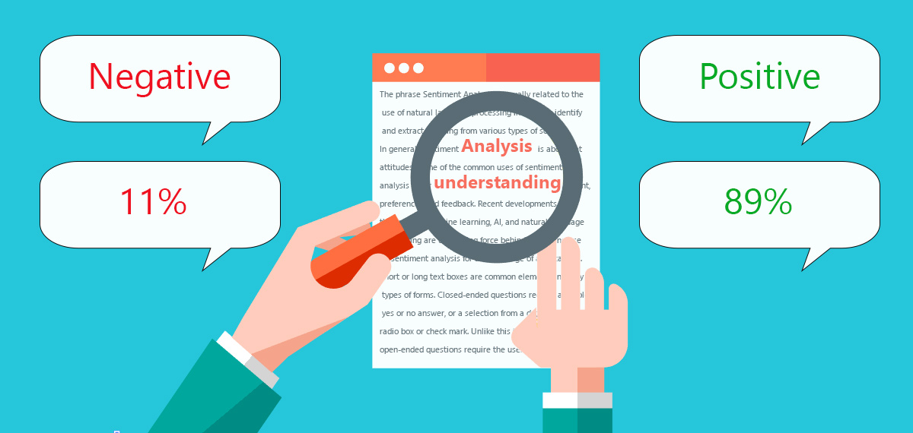

Slide 3
Opening Problem
Read one hundred numbers, compute their average, and find out how many numbers are above the average.
Notes:
One hundred grades, average
One hundred ratings, average
One hundred temperaturs, avafege…
Read one number, one variable
Two numbers, two variables
N1+n2…+n100
Loop with n[i]

Slide 4
What to be covered
Creating lists
Functions for lists
List comprehension
Traversing elements
Comparing lists
Copying lists
Lists in function

Slide 5

Creating list using the list class
list1 = list() # An empty list
list2 = list([2, 3, 4]) # list with integers
list3 = list(["red", "green", "blue"]) # list with strings
list4 = list(range(3, 6)) # list with elements 3, 4, 5
list5 = list("abcd") # list with characters a, b, c
For convenience, you may create a list using the following syntax:
list1 = [] # Same as list()
list2 = [2, 3, 4] # Same as list([2, 3, 4])
list3 = ["red", "green"] # Same as list(["red", "green"])
Notes:
List4
List5

Slide 6
Practice
__________ creates a list.
A. list1 = list()
B. list1 = []
C. list1 = list([12, 4, 4])
D. list1 = [12, 4, 4]
E. list1 = [1, "3", "red"]
Notes:
ABCDE

Slide 7

>>> list1 = [2, 3, 4, 1, 32]
>>> len(list1)
5
>>> max(list1)
32
>>> min(list1)
1
>>> sum(list1)
42
>>> import random
>>> random.shuffle(list1) # Shuffle the items in the list
>>> list1
[4, 1, 2, 32, 3]

Slide 8
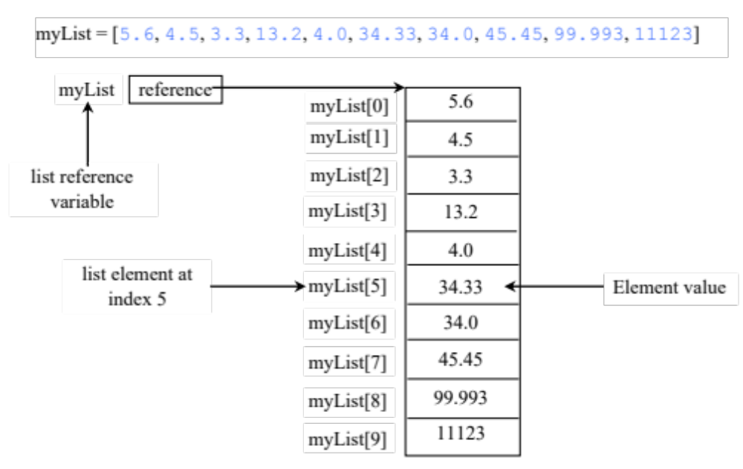
Use Indexer Operator [] to access one element of list
Notes:
House → sunglasses → shelf organizaer
Name + floor number
An element in a list can be accessed through the index operator, using the following syntax:myList[index]
List indexes are 0 based, that is, they range from 0 to len(myList)−1, as illustrated in Figure 7.1.
myList[index] can be used just like a variable, so it is also known as an indexed variable. myList[2] = myList[0] + myList[1]
Indicate true or false for the following statements:
a. Every element in a list must have the same type.
b. A list's size is fixed after it is created.
c. A list can have duplicate elements.
d. The elements in a list can be accessed via an index operator.

Slide 9
Wrong index causes off-by-one Error
lst=[1,2,3,4]
i = 0
while i <= len(lst):
print(lst[i])
i += 1
Index of list lst starts from 0 to len-1
Notes:
Make sure my list is created correctly.
Accessing a list out of bounds is a common programming error that results in a runtime IndexError. To avoid this error, make sure that you do not use an index beyond len(myList) – 1.

Slide 10
The +, *, [ : ], and in Operators
>>> list1 = [2, 3]
>>> list2 = [1, 9]
>>> list3 = list1 + list2
>>> list3
[2, 3, 1, 9]
>>> list3 = 2 * list1
>>> list3
[2, 3, 2, 3]
>>> list4 = list3[2 : 4]
>>> list4
[2, 3]
Notes:
One list has rating for air pod 1, another list has ratings for air pod 2. → store both ratings
Ratings for air pod 1 only?
You can use the concatenation operator (+) to join two lists and the repetition operator (*) to replicate elements in a list.
[ : ], List slicing operator
The index operator allows you to select an element at the specified index. The slicing operator returns a slice of the list using the syntax list[start : end : step]. The slice is a sublist from index start to index end – 1 with the specified step. By default, step is 1. End is exclusive
The starting index or ending index may be omitted. In this case, the starting index is 0 and the ending index is the last index.

Slide 11
The +, *, [ : ], and in Operators
>>> list1 = [2, 3, 5, 2, 33, 21]
>>> list1[-1]
21
>>> list1[-3]
2
>>> list1 = [2, 3, 5, 2, 33, 21]
>>> 2 in list1
True
>>> list1 = [2, 3, 5, 2, 33, 21]
>>> 2.5 in list1
False
Notes:
You can determine whether an element is in a list by using the in or not in operator.

Slide 12

Creates a list of items from sequence.
Consists of brackets containing an expression followed by a for clause, then zero or more for or if clauses.
Generate list items by evaluating the expression.
>>> list1 = [x for x in range(0, 5)] # Returns a list of 0, 1, 2, 4
>>> list1
[0, 1, 2, 3, 4]
>>> list2 = [0.5 * x for x in list1]
>>> list2
[0.0, 0.5, 1.0, 1.5, 2.0]
>>> list3 = [x for x in list2 if x < 1.5]
>>> list3
[0.0, 0.5, 1.0]
Notes:
[x for y in range(1,3)]
[x for x range(0, 5)]

Slide 13
Traversing Elements in a For Loop
Suppose list1 = [1, 2, 3], what is the output of the following code?
for i in list1:
print(i * 2, end = '')
A. 2 4 6
B. 246
C. [2, 4, 6]
D. 2, 4, 6
Notes:
The elements in a Python list are iterable. Python supports a convenient for loop, which enables you to traverse the list sequentially without using an index variable.

Slide 14

>>>list1 = ["green", "red", "blue"]
>>>list2 = ["red", "blue", "green"]
>>>list2 == list1
False
>>>list2 != list1
True
>>>list2 >= list1
True
>>>list2 > list1
True
>>>list2 < list1
False
>>>list2 <= list1
False
>>> list1=[1,2,3]
>>> list2=[2,3,4]
>>> list1>list2
False
Notes:
Which one has better ratings?

Slide 15
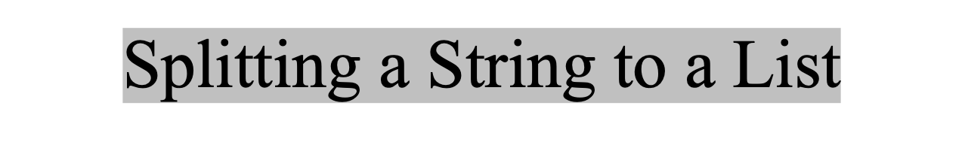
items = "Welcome to the US".split()
print(items)
['Welcome', 'to', 'the', 'US']
items = "34#13#78#45".split("")
print(items) #
['34', '13', '78', '45']

Slide 16
Practice
Write a program to read a text file, and count number of words in this file.
# Hint:How to read a file
f = open("D:\\myfiles\\welcome.txt", "r")
text = f.read()
print(text)
Notes:
print(len(text.split()))

Slide 17

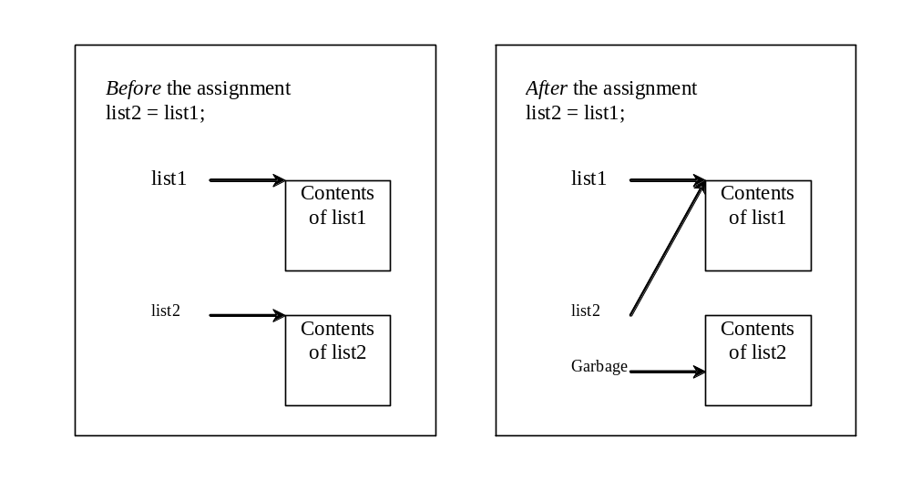
Often, in a program, you need to duplicate a list or a part of a list. Can we use the assignment statement (=), as follows:
list2 = list1;
Discussion:
What is the output and why?
old_list = [1, 2, 3]
new_list = old_list
# add an element to list new_list.append('a’)
print('New List:', new_list)
print('Old List:', old_list)
Notes:
list2 = list1[ : ]
Ratings until year 2020, ratings until year 2021

Slide 18
Copying Lists
To copy elements from the old list to a new list, we should use
Discussion:
What is the output and why?
new_list = list.copy()
old_list = [1, 2, 3]
new_list = old_list.copy()
# add an element to list new_list.append('a’)
print('New List:', new_list)
print('Old List:', old_list)
Notes:
list2 = list1[ : ]

Slide 19

Passing lists to functions
Returning a lists from a function
Notes:
Can we use list as input?
Can we use list as output?

Slide 20
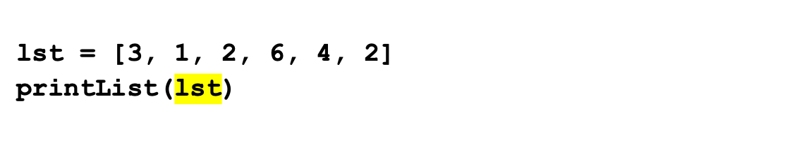
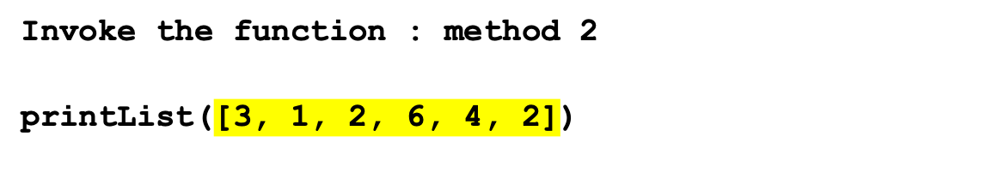
Passing Lists to Functios
def printList(lst):
for element in lst:
print(element)
Invoke the function : method 1
Invoke the function : method 2
Anonymous list
Notes:
Argument must be an expression
1
2
[1,2]
Var
Var+1

Slide 21
Pass By Value for strings and numbers (immutable)
Argument of a number or a string
A copy of number or string passed
The original value outside the function is not changed.

Slide 22
Pass By Sharing for list (changeable)
Argument of list
A reference to a list passed
The original value outside the function is changed.
Notes:
For an argument of a list, the value of the argument is a reference to a list; this reference value is passed to the function. Semantically, it can be best described as pass-by-sharing, i.e., the list in the function is the same as the list being passed. So if you change the list in the function, you will see the change outside the function.

Slide 23
An example of pass by value vs. pass by sharing
def main():
x = 1 # x represents an int value
y = [1, 2, 3] # y represents a list
m(x, y) # Invoke f with arguments x and y
print("x is " + str(x)) # print1
print("y[0] is " + str(y[0]))#5555
def m(number, numbers):
number = 1001 # Assign a new value to number
numbers[0] = 5555 # Assign a new value to numbers[0]
main()
Discussion:
What is the output and why?

Slide 24
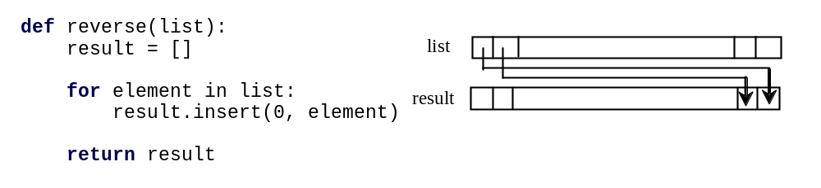
Returning a List from a Function
list1 = [1, 2, 3, 4, 5, 6]
list2 = reverse(list1)
Note that list already has the reverse method
list.reverse()

Slide 25
Problem: Analyze Numbers
Read one hundred numbers, compute their average, and find out how many numbers are above the average.
AnalyzeNumbers
https://liangcpp.pearsoncmg.com/pyhtml/AnalyzeNumbers.html

Slide 26
NUMBER_OF_ELEMENTS = 3 # For simplicity, use 3 instead of 100
numbers = [] # Create an empty list
sum = 0
for i in range(NUMBER_OF_ELEMENTS):
value = float(input("Enter a new number: "))
numbers.append(value) # Append value to numbers list
average = sum(numbers) / NUMBER_OF_ELEMENTS
count = 0 # The number of elements above average
for i in range(NUMBER_OF_ELEMENTS):
if numbers[i] > average:
count += 1
print("Average is", average)
print("Number of elements above the average is", count)
Notes:
Can we write a function for each?

Slide 27
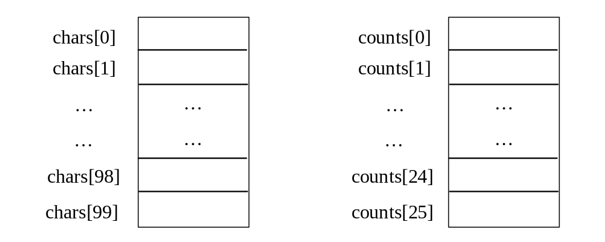
Problem: Counting Occurrence of Each Letter
Generate 100 lowercase letters randomly and assign to a list of characters.
Count the occurrence of each letter in the list.
CountLettersInList
https://liangcpp.pearsoncmg.com/pyhtml/CountLettersInList.html

