Slide 1
Chapter 8
Lists for Multi-dimensional Data
Notes:
matrix=[
[1,2,3],
[2,3,4],
]
print(matrix)
print(matrix[0])
print(matrix[1])
print(matrix[0][1])
print(matrix[1][1])

Slide 2
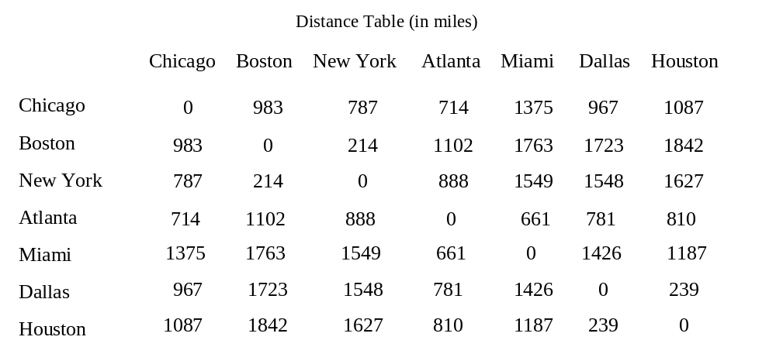
Motivations
distances = [
[0, 983, 787, 714, 1375, 967, 1087],
[983, 0, 214, 1102, 1763, 1723, 1842],
[787, 214, 0, 888, 1549, 1548, 1627],
[714, 1102, 888, 0, 661, 781, 810],
[1375, 1763, 1549, 661, 0, 1426, 1187],
[967, 1723, 1548, 781, 1426, 0, 239],
[1087, 1842, 1627, 810, 1187, 239, 0]
]

Slide 3
What to be covered
Create and process two-dimensional lists
Two-dimensional lists in functions

Slide 4

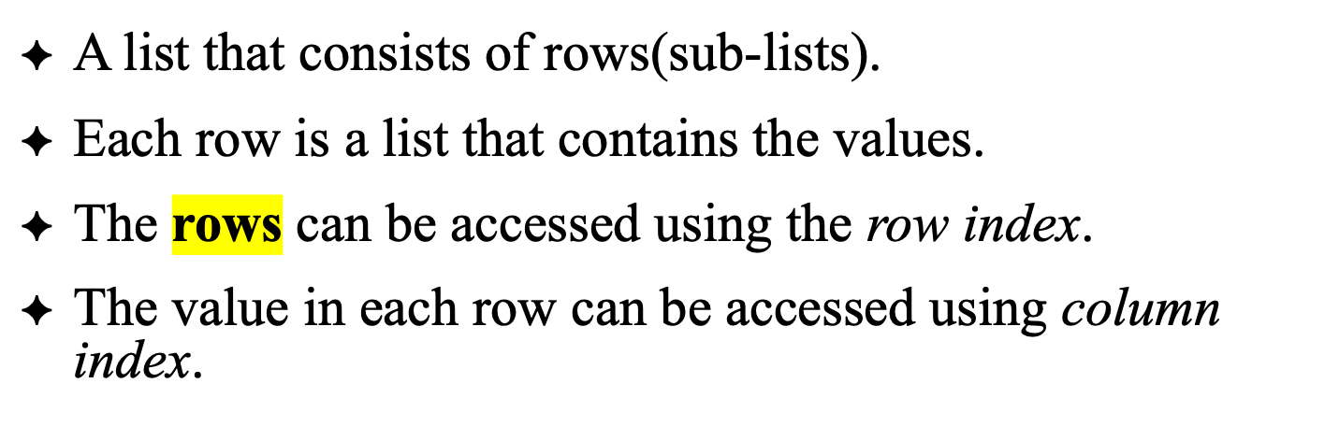
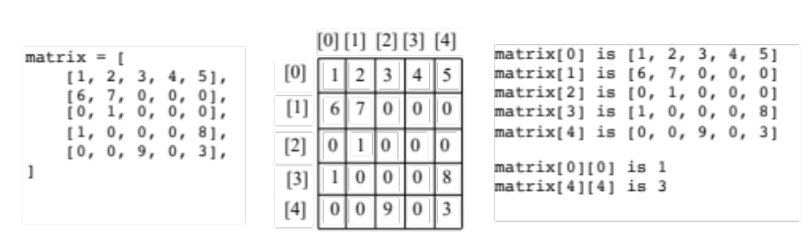
row index
row index
column index
Notes:
You can view a two-dimensional list as a list that consists of rows. Each row is a list that contains the values. The rows can be accessed using the index, conveniently called a row index. The values in each row can be accessed through another index, conveniently called a column index.

Slide 5
Processing Two-Dimensional lists
See the examples in the text.
(Initializing lists with input values)
(Initializing lists with random values)
(Printing lists)
(Summing all elements)
(Summing all elements by column)

Slide 6
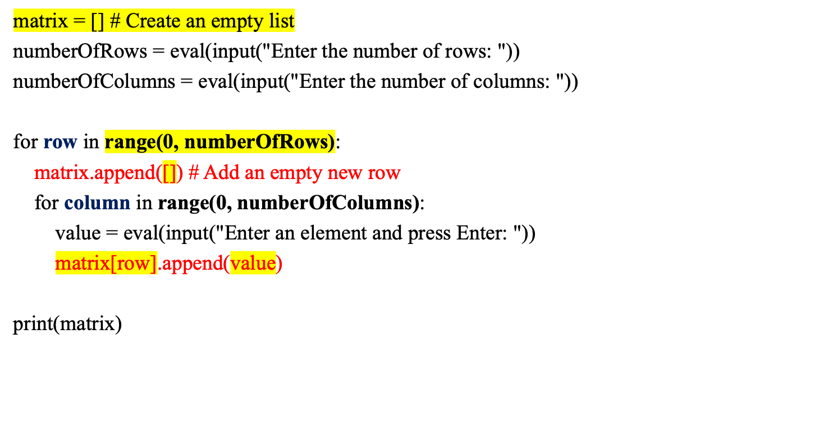
Initializing lists with input values

Slide 7
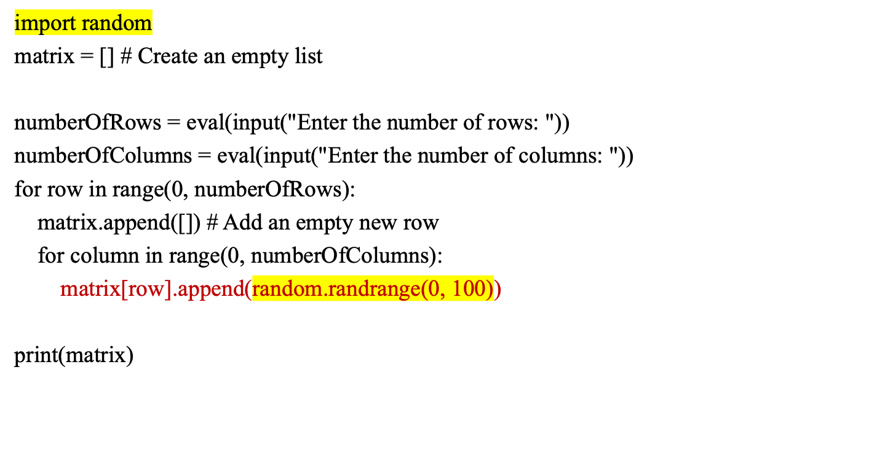
Initializing lists with random values

Slide 8
Printing lists
matrix = [[1, 2, 3], [4, 5, 6], [7, 8, 9]] # Assume a list is given
for row in range(0, len(matrix)):
for column in range(0, len(matrix[row])):
print(matrix[row][column], end = " ")
print() # Print a newline

Slide 9
Summing all elements
matrix = [[1, 2, 3], [4, 5, 6], [7, 8, 9]] # Assume a list is given
total = 0
for row in range(0, len(matrix)):
for column in range(0, len(matrix[row])):
total += matrix[row][column]
print("Total is " + str(total)) # Print the total

Slide 10
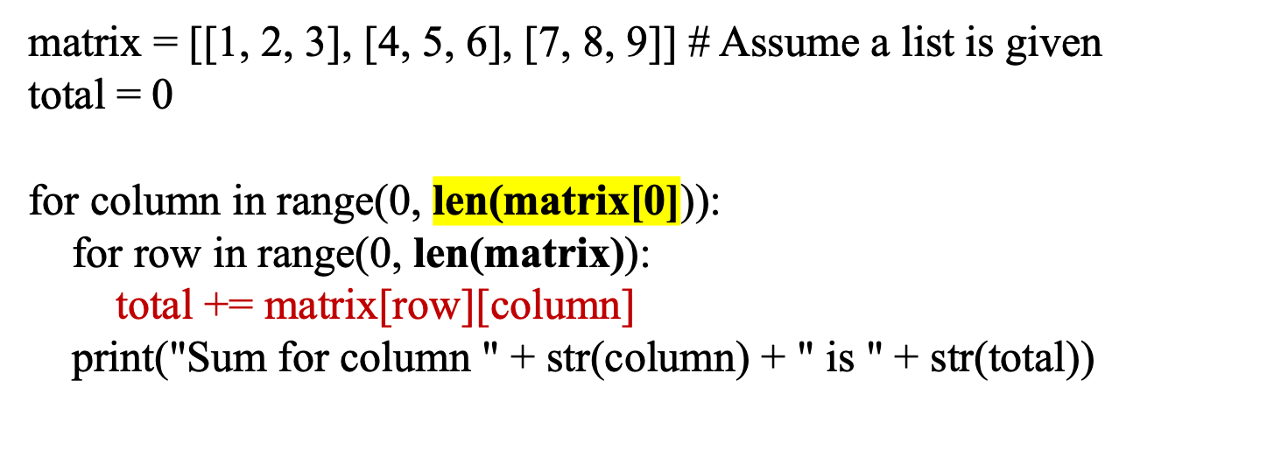
Summing elements by column

Slide 11
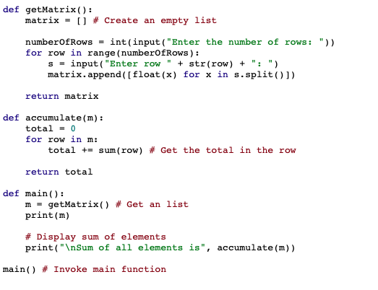
Passing Tow-Dimensional Lists to Functions
PassTwoDimensionalList
Notes:
def getMatrix():
matrix = [] # Create an empty list
numberOfRows = int(input("Enter the number of rows: "))
for row in range(numberOfRows):
s = input("Enter row " + str(row) + ": ")
matrix.append([float(x) for x in s.split()])
return matrix
def accumulate(m):
total = 0
for row in m:
total += sum(row) # Get the total in the row
return total
def main():
m = getMatrix() # Get an list
print(m)
# Display sum of elements
print("\nSum of all elements is", accumulate(m))
main() # Invoke main function

Slide 12
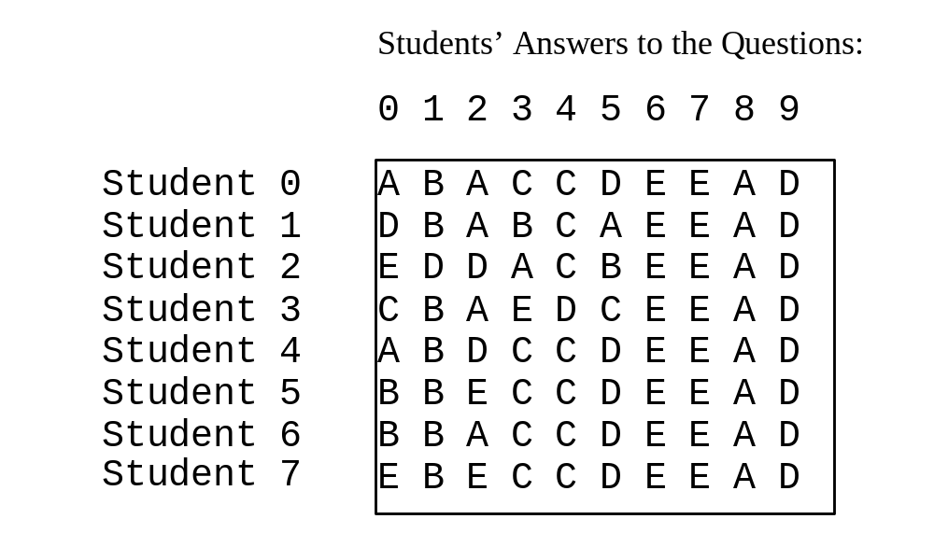
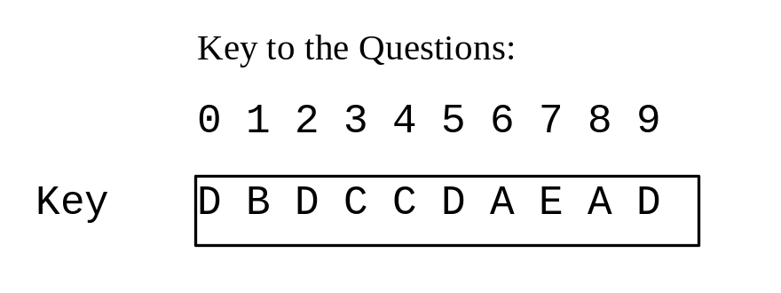
Problem: Grading Multiple-Choice Test
Objective: write a program that grades multiple-choice test.
GradeExam
Discussion:
How to store the key?
How to store the answers?
How to grade all the answers from all students?
Notes:
def main():
# Students' answers to the questions
answers = [
['A', 'B', 'A', 'C', 'C', 'D', 'E', 'E', 'A', 'D'],
['D', 'B', 'A', 'B', 'C', 'A', 'E', 'E', 'A', 'D'],
['E', 'D', 'D', 'A', 'C', 'B', 'E', 'E', 'A', 'D'],
['C', 'B', 'A', 'E', 'D', 'C', 'E', 'E', 'A', 'D'],
['A', 'B', 'D', 'C', 'C', 'D', 'E', 'E', 'A', 'D'],
['B', 'B', 'E', 'C', 'C', 'D', 'E', 'E', 'A', 'D'],
['B', 'B', 'A', 'C', 'C', 'D', 'E', 'E', 'A', 'D'],
['E', 'B', 'E', 'C', 'C', 'D', 'E', 'E', 'A', 'D']]
# Key to the questions
keys = ['D', 'B', 'D', 'C', 'C', 'D', 'A', 'E', 'A', 'D']
# Grade all answers
for i in range(len(answers)):
# Grade one student
correctCount = 0
for j in range(len(answers[i])):
if answers[i][j] == keys[j]:
correctCount += 1
print("Student", i, "'s correct count is", correctCount)
main() # Call the main function

