Slide 1
Chapter 9 Object-Oriented Programming

Slide 2

Motivations
After learning the preceding chapters, you are capable of solving many programming problems using selections, loops, and functions. However, these Python features are not sufficient for developing graphical user interfaces and large scale software systems. Suppose you want to develop a graphical user interface as shown below. How do you program it?

Slide 3
OO Programming Concepts
Object-oriented programming (OOP) involves programming using objects.
An object is an entity in the real world
  E.g., a student, a circle, a button, and even a loan
  Has unique identity, state, and behaviors.
    State: defines the object
    Behavior : defines what the object does

Slide 4

Python Class Defines an Object
A Python class uses variables to store data fields (state) and defines methods to perform actions (behavior).

Slide 5
initializer method : creating data fields
__init__()
Perform initializing actions, such as creating the data fields of objects.
class ClassName:
initializer
methods

Slide 6
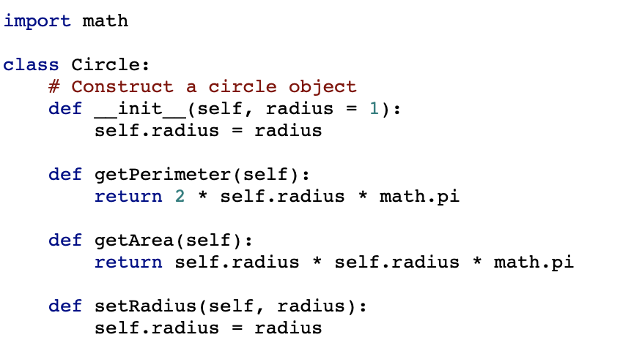
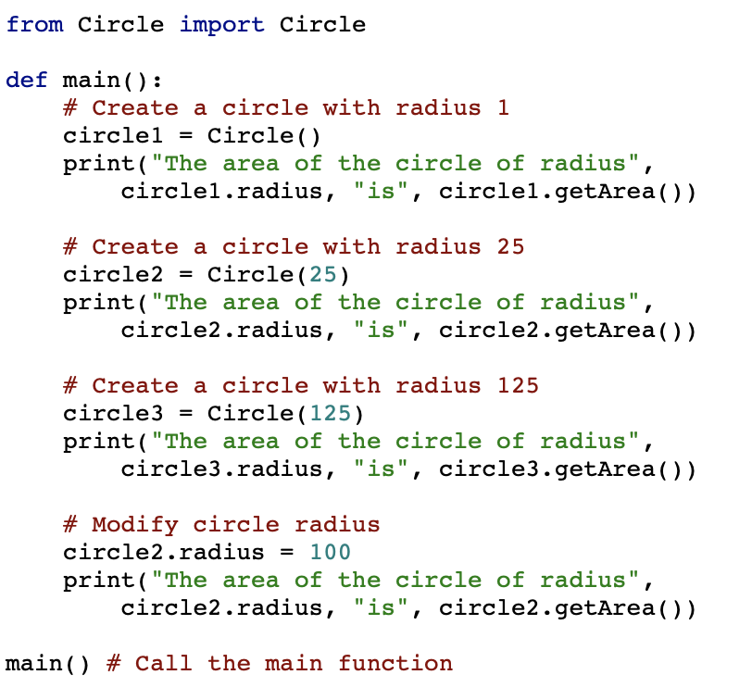
An example of initializer method
Circle
TestCircle

Slide 7
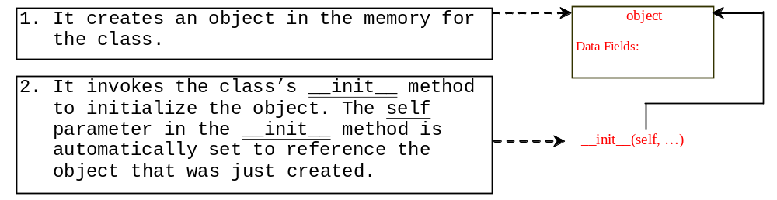
constructor: create an object
Create objects from a defined class by using the following syntax, called a constructor:
ClassName(arguments)

Slide 8
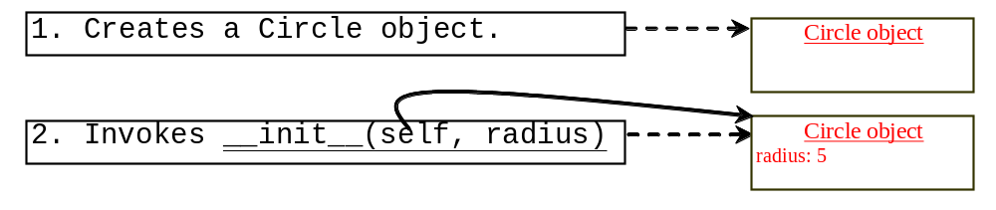
constructor: create an object
The effect of constructing a Circle object using Circle(5) is shown below:

Slide 9
Instance Methods : defining behavior
Functions defined inside a class.
Invoked by objects to perform actions on the objects.
Both __init__ and instance methods use self as a first parameter to refer to a specific object. self ignored when methods are called.

Slide 10
Accessing Objects
After an object is created, you can access its data fields and invoke its methods using the dot operator (.), also known as the object member access operator. For example, the following code accesses the radius data field and invokes the getPerimeter and getArea methods.
>>> from Circle import Circle
>>> c = Circle(5)
>>> c.getPerimeter()
31.41592653589793
>>> c.radius = 10
>>> c.getArea()
314.1592653589793

Slide 11
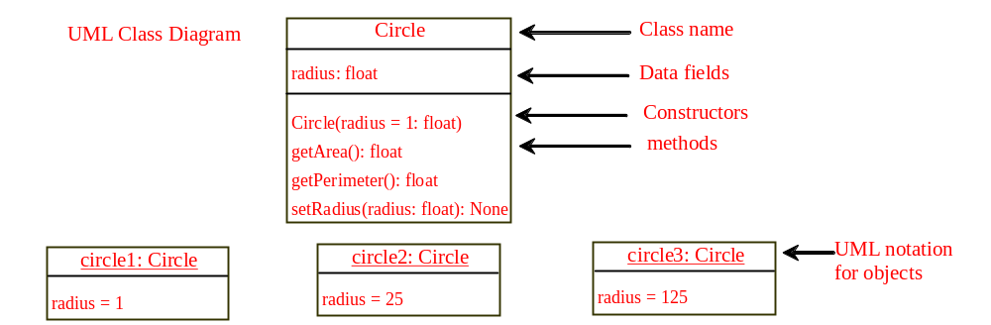
UML Class Diagram

Slide 12
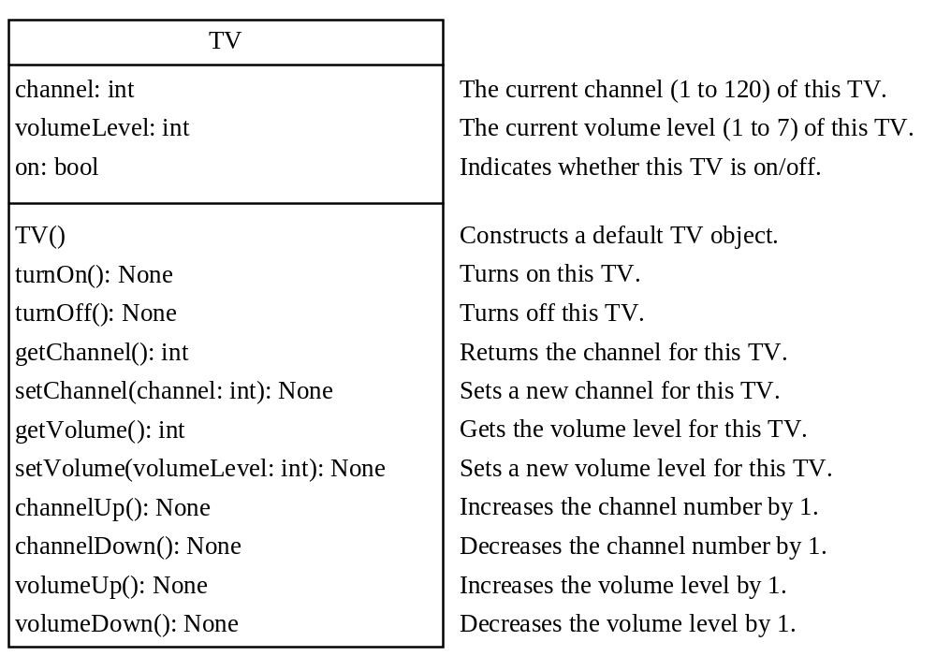
Example: Defining Classes and Creating Objects
TV
TestTV

Slide 13

Trace Code
animation
Assign object reference to myCircle
myCircle = Circle(5.0)
yourCircle = Circle()
yourCircle.radius = 100
myCircle
reference value

Slide 14
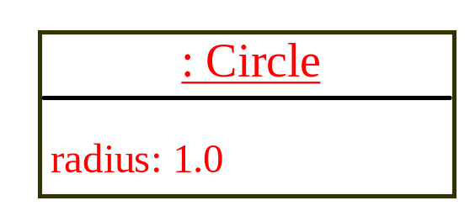
Trace Code
animation
myCircle = Circle(5.0)
yourCircle = Circle()
yourCircle.radius = 100
myCircle
reference value
Assign object reference to yourCircle
yourCircle
reference value

Slide 15
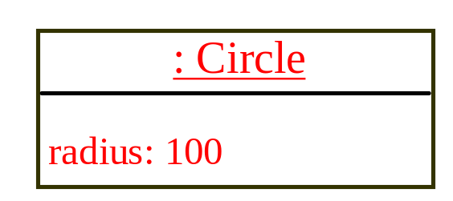
Trace Code
animation
myCircle = Circle(5.0)
yourCircle = Circle()
yourCircle.radius = 100
myCircle
reference value
Modify radius in yourCircle
yourCircle
reference value

Slide 16
The datetime Class
from datetime import datetime
d = datetime.now()
print("Current year is " + str(d.year))
print("Current month is " + str(d.month))
print("Current day of month is " + str(d.day))
print("Current hour is " + str(d.hour))
print("Current minute is " + str(d.minute))
print("Current second is " + str(d.second))

Slide 17
Data Field Encapsulation
To protect data.
  Don’t let the client directly access data fields.
To make class easy to maintain.
private data fields are named with two leading underscores.
private methods are named with two leading underscores.
CircleWithPrivateRadius

Slide 18
Data Field Encapsulation
CircleWithPrivateRadius
>>> from CircleWithPrivateRadius import Circle
>>> c = Circle(5)
>>> c.__radius
AttributeError: 'Circle' object has no attribute '__radius'
>>> c.getRadius()
5

Slide 19
When to define private data fields?
If a class is designed for other programs to use, to prevent data from being tampered with and to make the class easy to maintain, define data fields private.
If a class is only used internally by your own program, there is no need to encapsulate the data fields.

Slide 20

Class Abstraction and Encapsulation
Class abstraction means to separate class implementation from the use of the class. The creator of the class provides a description of the class and let the user know how the class can be used. The user of the class does not need to know how the class is implemented. The detail of implementation is encapsulated and hidden from the user.

Slide 21
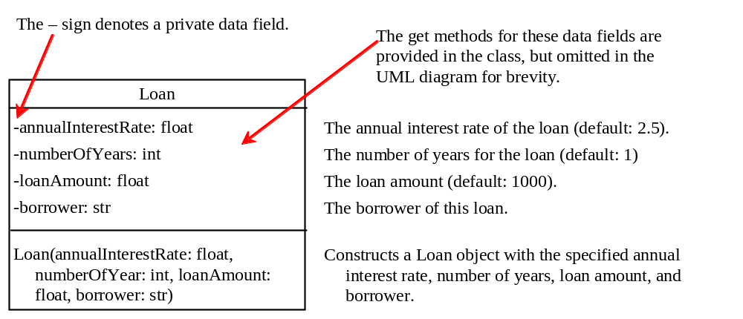
Designing the Loan Class
Loan
TestLoanClass

Slide 22
Object-Oriented Thinking
This book’s approach is to teach problem solving and fundamental programming techniques before object-oriented programming. This section will show how procedural and object-oriented programming differ. You will see the benefits of object-oriented programming and learn to use it effectively. We will use several examples in the rest of the chapter to illustrate the advantages of the object-oriented approach. The examples involve designing new classes and using them in applications.

Slide 23
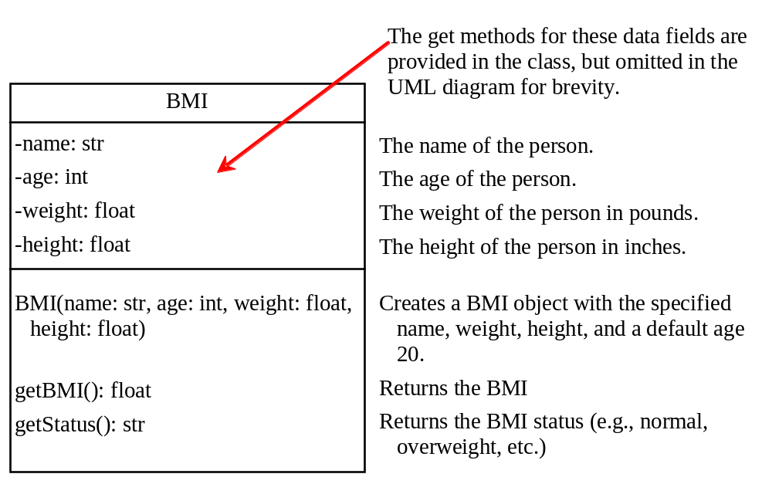
The BMI Class
BMI
UseBMIClass

Slide 24
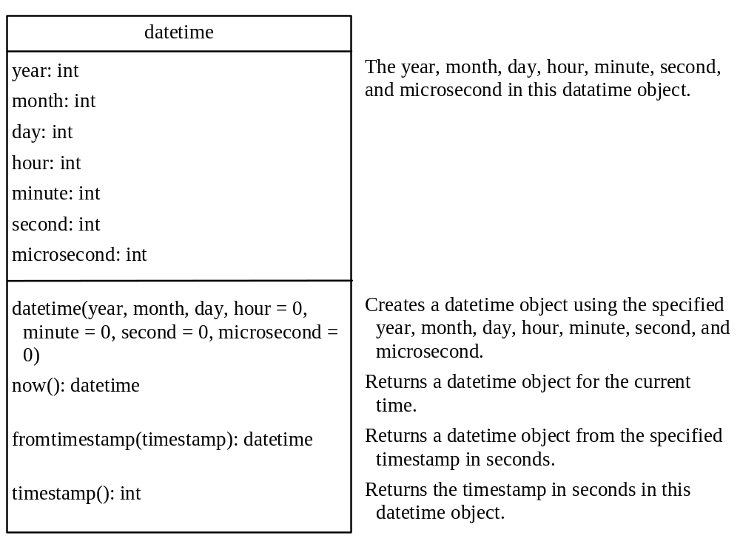
The datetime Class
DatetimeDemo

Slide 25
Procedural vs. Object-Oriented
In procedural programming, data and operations on the data are separate, and this methodology requires sending data to methods. Object-oriented programming places data and the operations that pertain to them in an object. This approach solves many of the problems inherent in procedural programming.

Slide 26
Procedural vs. Object-Oriented
The object-oriented programming approach organizes programs in a way that mirrors the real world, in which all objects are associated with both attributes and activities. Using objects improves software reusability and makes programs easier to develop and easier to maintain. Programming in Python involves thinking in terms of objects; a Python program can be viewed as a collection of cooperating objects.

