Slide 1
Chapter 14
Tuples, Sets, and Dictionaries

Slide 2
Motivations
The No Fly List is a list, created and maintained by the United States government's Terrorist Screening Center, of people who are not permitted to board a commercial aircraft for travel in or out of the United States. Suppose we need to write a program that checks whether a person is in the No Fly List. You can use a Python list to store the persons in the No Fly List. However, a more efficient data structure for this application is a set.

Slide 3
What to be covered
To use tuples as immutable lists
To use sets for storing and fast accessing non-duplicate elements
To understand the performance differences between sets and lists
To store key/value pairs in a dictionary and access value using the key
To use dictionaries to develop applications

Slide 4
Use Tuples as immutable lists
Tuples are like lists except they are immutable.
Once they are created, their contents cannot be changed.
Advantages
  Prevent data from being modified accidentally.
  More efficient than lists.

Slide 5
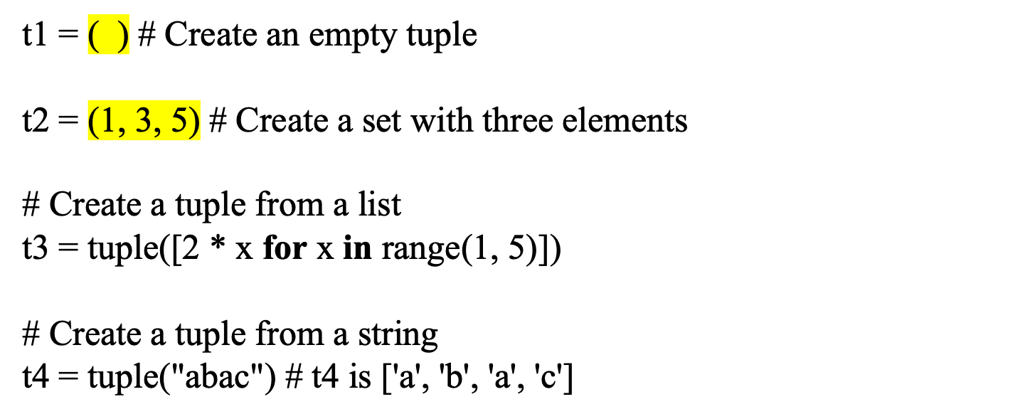
Creating Tuples
Creating tuples is like creating lists except using parenthesis ( )

Slide 6
Tuples
Tuples can be used like lists except they are immutable.
TupleDemo

Slide 7
Sets
Sets are like lists except elements in a set are unique and unordered.
Advantages
  Store unique data.
  More efficient than lists.

Slide 8
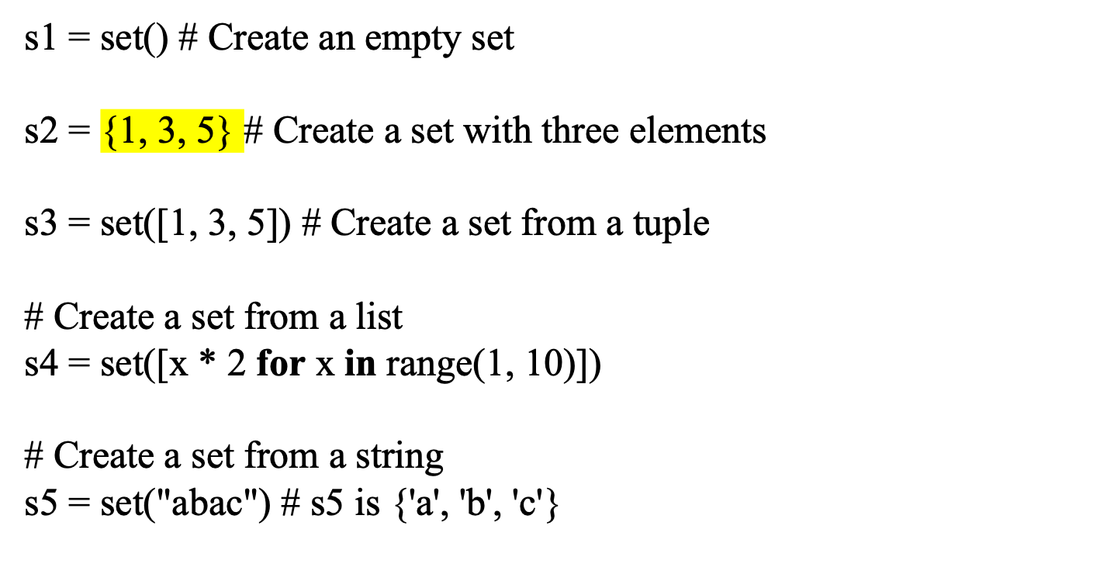
Creating Sets
Creating sets is like creating lists except using curly brace {}
Notes:
Can we use s1={}

Slide 9
Manipulating and Accessing Sets
>>> s1 = {1, 2, 4}
>>> s1.add(4)
>>> s1
{1, 2, 4}
>>> len(s1)
4
>>> max(s1)
6
>>> min(s1)
1
>>> sum(s1)
13
>>> 3 in s1
False
>>> s1.remove(2)
>>> s1
{1, 6}
>>>

Slide 10
Subset and Superset
>>> s1 = {1, 2, 4}
>>> s2 = {1, 4, 5, 2, 6}
>>> s1.issubset(s2) # s1 is a subset of s2
True
>>>
>>> s1 = {1, 2, 4}
>>> s2 = {1, 4, 5, 2, 6}
>>> s2.issuperset(s1) # s2 is a superset of s1
True
>>>

Slide 11
Equality Test on Sets
>>> s1 = {1, 2, 4}
>>> s2 = {1, 4, 2}
>>> s1 == s2
True
>>> s1 != s2
False
>>>

Slide 12
Comparison Operators for sets
s1 > s2 returns true is s1 is a proper superset of s2.
s1 >= s2 returns true is s1 is a superset of s2.
s1 < s2 returns true is s1 is a proper subset of s2.
s1 <= s2 returns true is s1 is a subset of s2.

Slide 13
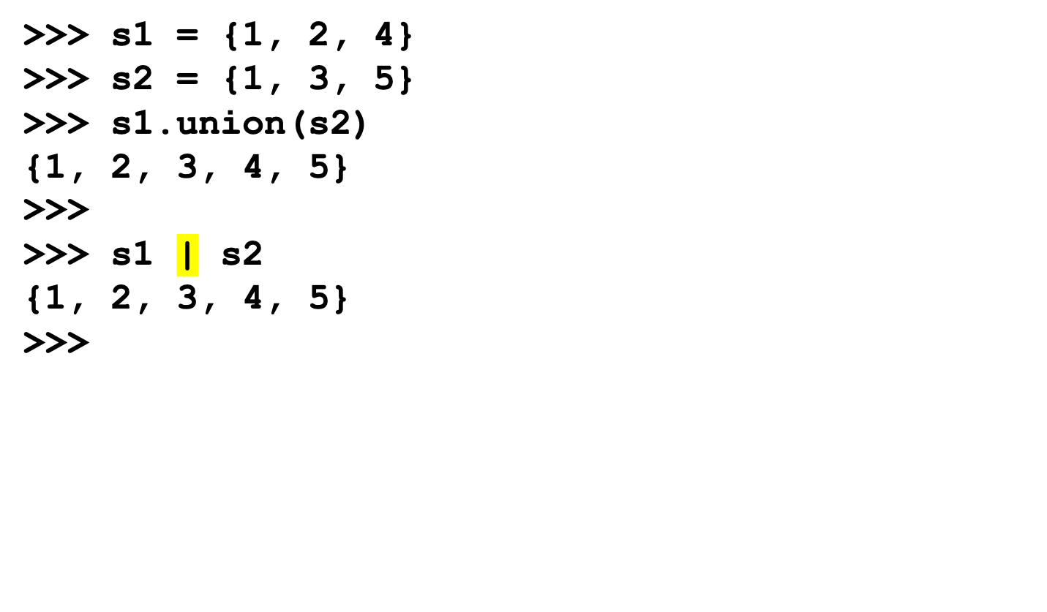
Set Operations (union, |)

Slide 14
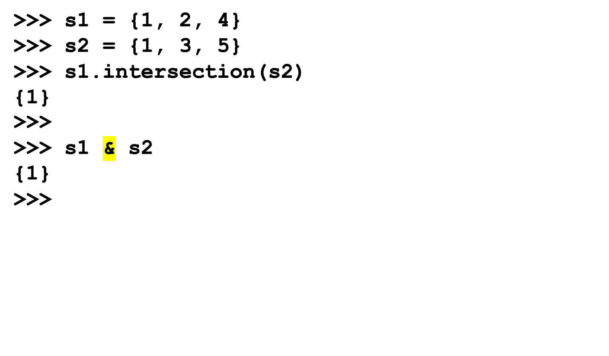
Set Operations (intersection, &)

Slide 15

Set Operations (difference, -)

Slide 16
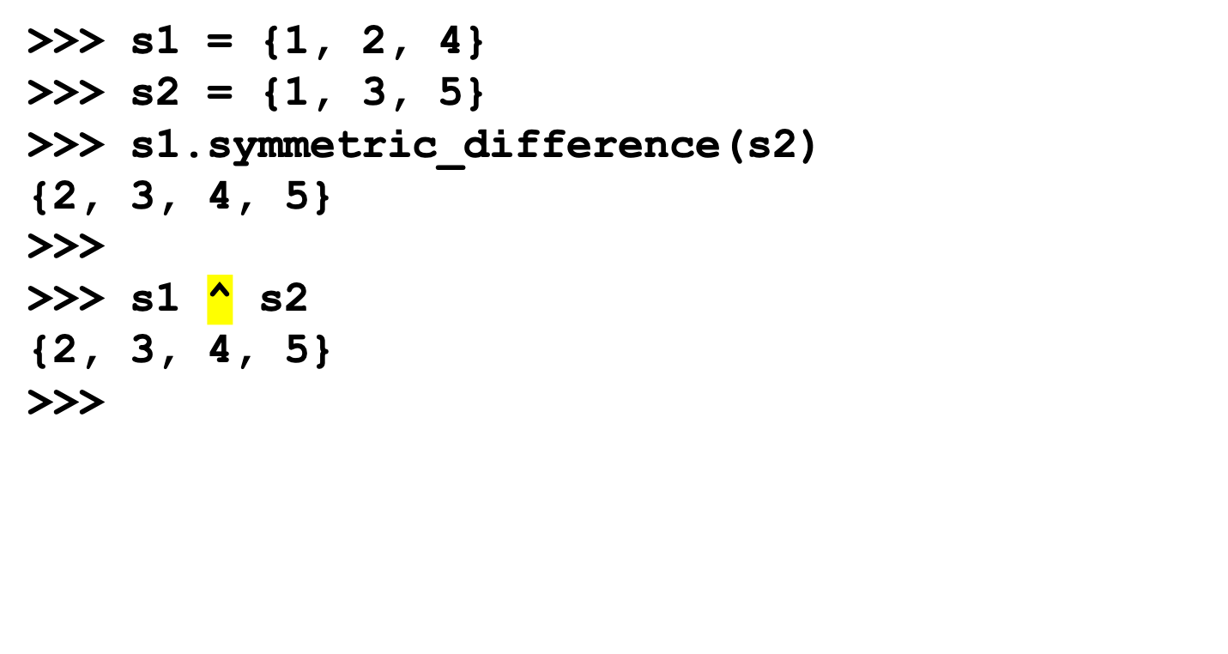
Set Operations (symetric_difference, ^)

Slide 17
Examples of Operations on Sets
SetDemo

Slide 18
Why Dictionary
Suppose your program stores a million students and frequently searches for a student using the social security number.
An efficient data structure is the dictionary.
  A collection that stores the elements along with the keys. The keys are like an indexer.

Slide 19
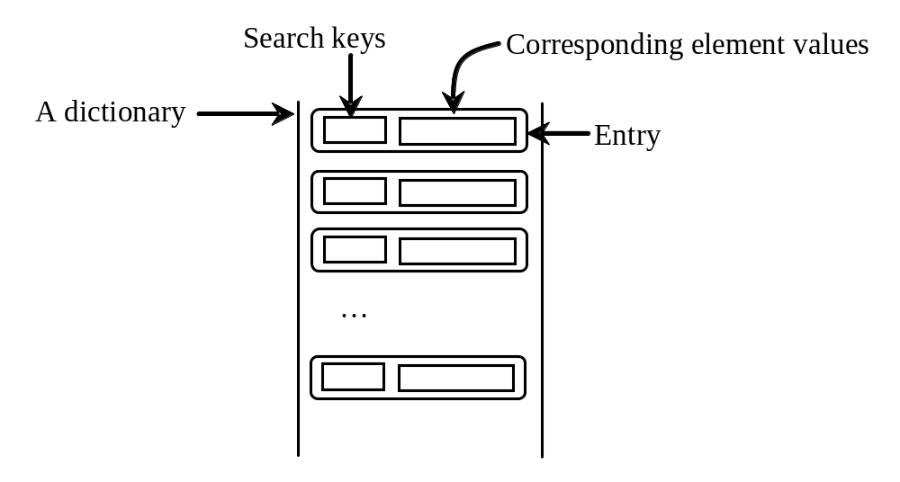
Key/value pairs

Slide 20
Creating a Dictionary
dictionary = {} # Create an empty dictionary
dictionary = {"john":40, "peter":45} # Create a dictionary
key
value
key
value

Slide 21
Adding/Modifying Entries
To add an entry to a dictionary, use
dictionary[key] = value
For example,
dictionary["susan"] = 50

Slide 22
Deleting Entries
To delete an entry from a dictionary, use
del dictionary[key]
For example,
del dictionary["susan"]

Slide 23
Looping Entries
for key in dictionary:
print(key + ":" + str(dictionary[key]))

Slide 24
The len and in operators
>>> dictionary = {"john":40, "peter":45}
>>> len(dictionary)
2
>>> "john" in dictionary
True
>>> "johnson" in dictionary
False
>>> 40 in dictionary
False

Slide 25
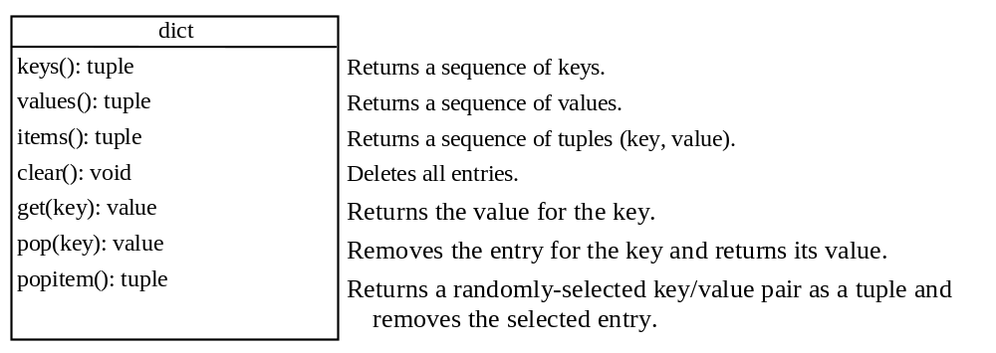
The Dictionary Methods

Slide 26
Case Studies: Occurrences of Words
Counts the occurrences of words in a text file and displays the words and their occurrences in alphabetical order of words.
  Uses a dictionary to store an entry consisting of a word and its count.
  For each word, check whether it is already a key in the dictionary.
    If not, add to the dictionary an entry with the word as the key and value 1. Otherwise, increase the value for the word (key) by 1 in the dictionary.
CountOccurrenceOfWords

