Slide 1

Data Visualization with Matplotlib
Yuan Long

Slide 2
Topics to be covered
What is Python Matplotlib?
Types of Plots
Bar Graph
Histogram
Scatter Plot
Area Plot
Pie Chart

Slide 3
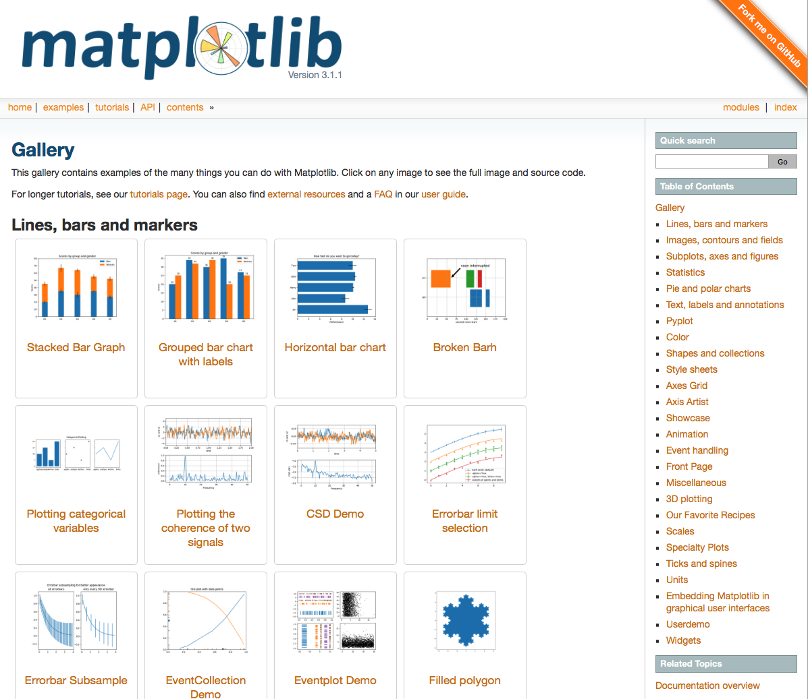
What is Python Matplotlib
matplotlib.pyplot is a plotting library used for 2D graphics
It can be used in python scripts, shell, web application servers and other graphical user interface toolkits.
https://matplotlib.org/
Gallery has large number
of examples.

Slide 4
Python Matplotlib : Types of Plots

Slide 5
Start with a simple graph
General steps
Import matplotlib
Plot to our canvas
Show what we plotted

Slide 6
Start with a simple graph (2)
Add the style
E.g. adjust the width or color of a line, add grid line
Import the style package from python matplotlib
Use styling functions style.use()

Slide 7
Python Matplotlib: Bar Graph
Purpose: compare data among different categories
Can be represented horizontally or vertically.
E.g. measure the changes over a period of time.

Slide 8
Python Matplotlib – Histogram
Purpose: show a distribution.
E.g. age of population with respect to bin.
Notes:
Now, bin refers to the range of values that are divided into series of intervals. Bins are usually created of the same size.

Slide 9
Python Matplotlib : Scatter Plot
Purpose: Compare variables.
E.g. how much one variable is affected by another variable.
Notes:
The data is displayed as a collection of points, each having the value of one variable which determines the position on the horizontal axis and the value of other variable determines the position on the vertical axis.

Slide 10
Python Matplotlib : Area Plot
Purpose: track changes over time for two or more related groups
Similar to line plot
E.g. compile the work done during a day into categories, say sleeping, eating, working and playing

Slide 11
Python Matplotlib : Pie Chart
Purpose: show the percentage or proportional data where each slice of pie represents a category.
A circular graph which is broken down into segments
E.g. compile the work done during a day into categories, say sleeping, eating, working and playing

Slide 12
Python Matplotlib : Working With Multiple Plots
Put multiple plots into a single figure
The subplot() command specifies numrow, numcol, fignum
Then plot the graph.
Notes:
Int

