Slide 1
Chapter 3 Selections
© Copyright 2018 by Pearson Education, Inc. All Rights Reserved.

Slide 2
Motivations
If you input a negative value for radius in Listing 2.2, ComputeAreaWithConsoleInput.py, the program would print an invalid result. If the radius is negative, you don't want the program to compute the area. How can you deal with this situation?

Slide 3
Objectives
To write Boolean expressions using relational operators (§3.2).
To generate random numbers using the random.randint(a, b), random.randrange(a, b), or random.random() functions (§3.3).
To program with Boolean expressions (AdditionQuiz) (§3.3).
To implement selection control using one-way if statements (§3.4).
To implement selection control using two-way if-else statements (§3.5).
To implement selection control with nested if and multi-way if-elif-else statements (§3.6).
To avoid common errors in if statements (§3.7).
To program with selection statements (§§3.8–3.9).
To combine conditions using logical operators (and, or, and not) (§3.10).
To use selection statements with combined conditions (LeapYear, Lottery) (§§3.11–3.12).
To write expressions that use the conditional expressions (§3.13).
To understand the rules governing operator precedence and associativity (§3.14).
To detect the location of an object (§3.15).
© Copyright 2018 by Pearson Education, Inc. All Rights Reserved.

Slide 4
Boolean Data Types
Often in a program you need to compare two values, such as whether i is greater than j. There are six comparison operators (also known as relational operators) that can be used to compare two values. The result of the comparison is a Boolean value: true or false.
b = (1 > 2)

Slide 5
Relational Operators
Operator Name
< less than
<= less than or equal to
> greater than
>= greater than or equal to
== equal to
!= not equal to

Slide 6
Problem: A Simple Math Learning Tool
This example creates a program to let a first grader practice additions. The program randomly generates two single-digit integers number1 and number2 and displays a question such as “What is 7 + 9?” to the student. After the student types the answer, the program displays a message to indicate whether the answer is true or false.
AdditionQuiz

Slide 7
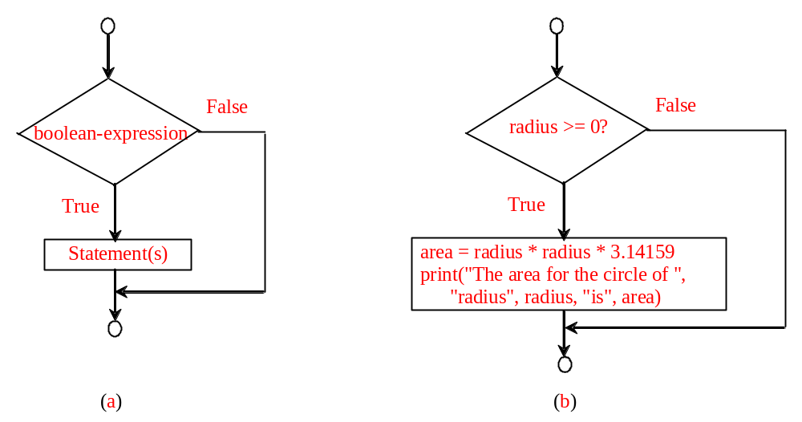
One-way if Statements
if radius >= 0:
area = radius * radius * 3.14159
print("The area for the circle of radius“,
radius, "is“, area)
if boolean-expression:
statement(s)

Slide 8
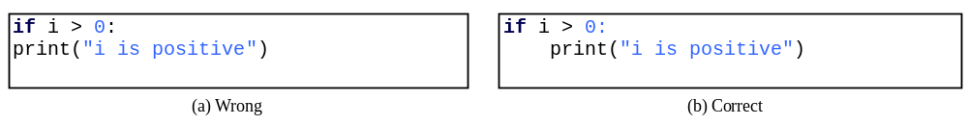
Note

Slide 9
Simple if Demo
Write a program that prompts the user to enter an integer. If the number is a multiple of 5, print HiFive. If the number is divisible by 2, print HiEven.
SimpleIfDemo

Slide 10
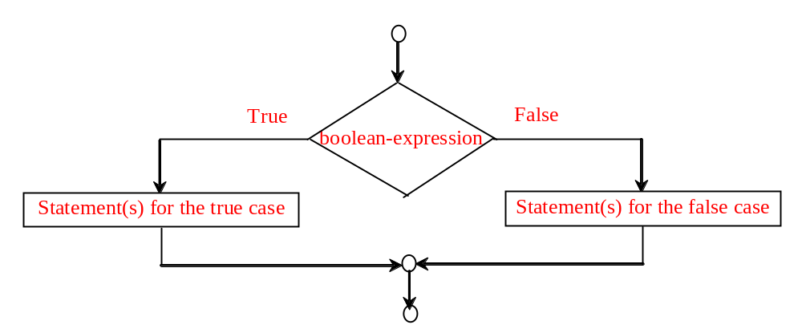
The Two-way if Statement
if boolean-expression:
statement(s)-for-the-true-case
else:
statement(s)-for-the-false-case

Slide 11
if...else Example
if radius >= 0:
area = radius * radius * math.pi
print("The area for the circle of radius", radius, "is", area)
else:
print("Negative input")

Slide 12
Problem: An Improved Math Learning Tool
This example creates a program to teach a first grade child how to learn subtractions. The program randomly generates two single-digit integers number1 and number2 with number1 >= number2 and displays a question such as “What is 9 – 2?” to the student. After the student types the answer, the program displays a message to indicate whether the answer is correct.
SubtractionQuiz

Slide 13
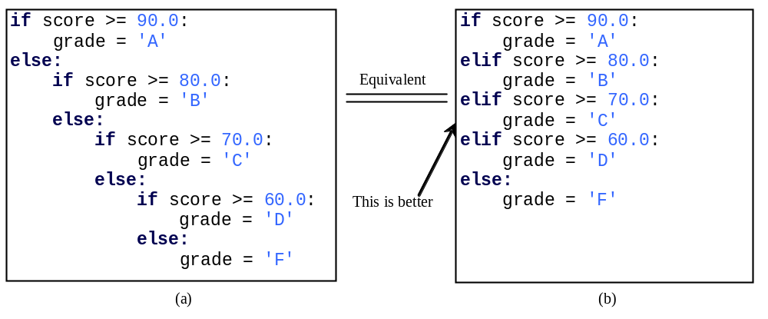
Multiple Alternative if Statements

Slide 14
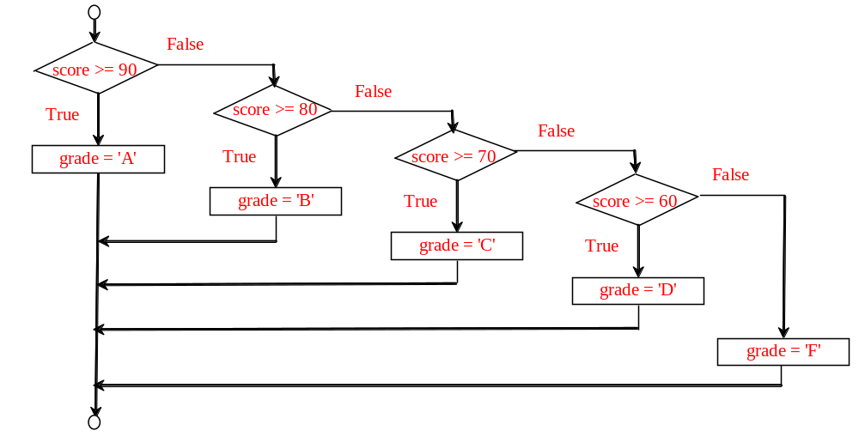
Flowchart

Slide 15
Trace if-else statement
animation
Suppose score is 70.0
The condition is false
if score >= 90.0:
grade = 'A'
elif score >= 80.0:
grade = 'B'
elif score >= 70.0:
grade = 'C'
elif score >= 60.0:
grade = 'D'
else:
grade = 'F'

Slide 16
Trace if-else statement
animation
Suppose score is 70.0
The condition is false
if score >= 90.0:
grade = 'A'
elif score >= 80.0:
grade = 'B'
elif score >= 70.0:
grade = 'C'
elif score >= 60.0:
grade = 'D'
else:
grade = 'F'

Slide 17
Trace if-else statement
animation
Suppose score is 70.0
The condition is true
if score >= 90.0:
grade = 'A'
elif score >= 80.0:
grade = 'B'
elif score >= 70.0:
grade = 'C'
elif score >= 60.0:
grade = 'D'
else:
grade = 'F'

Slide 18
Trace if-else statement
animation
Suppose score is 70.0
grade is C
if score >= 90.0:
grade = 'A'
elif score >= 80.0:
grade = 'B'
elif score >= 70.0:
grade = 'C'
elif score >= 60.0:
grade = 'D'
else:
grade = 'F'

Slide 19
Trace if-else statement
animation
Suppose score is 70.0
Exit the if statement
if score >= 90.0:
grade = 'A'
elif score >= 80.0:
grade = 'B'
elif score >= 70.0:
grade = 'C'
elif score >= 60.0:
grade = 'D'
else:
grade = 'F'

Slide 20
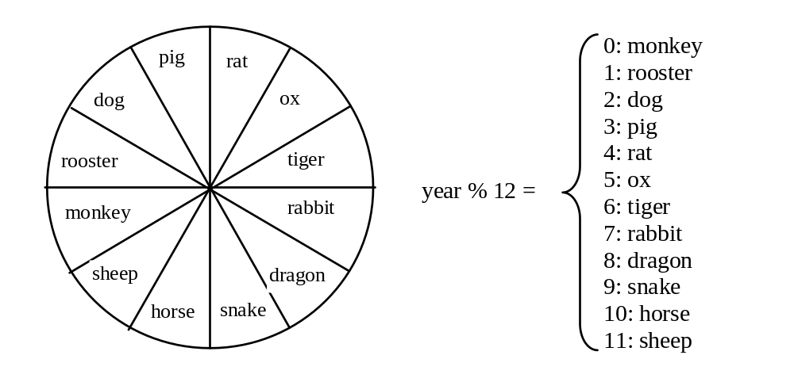
Example
Now let us write a program to find out the Chinese Zodiac sign for a given year. The Chinese Zodiac sign is based on a 12-year cycle, each year being represented by an animal: rat, ox, tiger, rabbit, dragon, snake, horse, sheep, monkey, rooster, dog, and pig, in this cycle.
ChineseZodiac

Slide 21
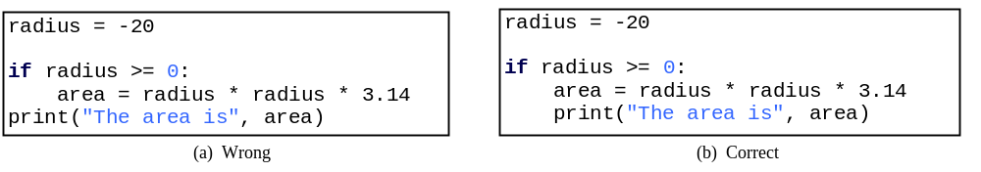
Common Errors
Most common errors in selection statements are caused by incorrect indentation. Consider the following code in (a) and (b).

Slide 22
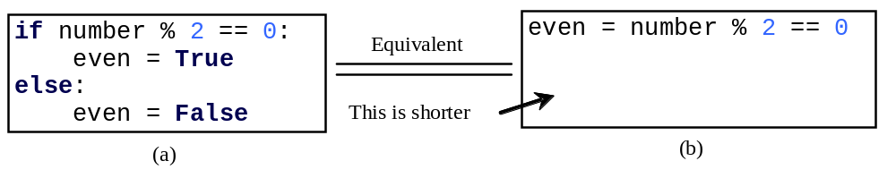
TIP

Slide 23
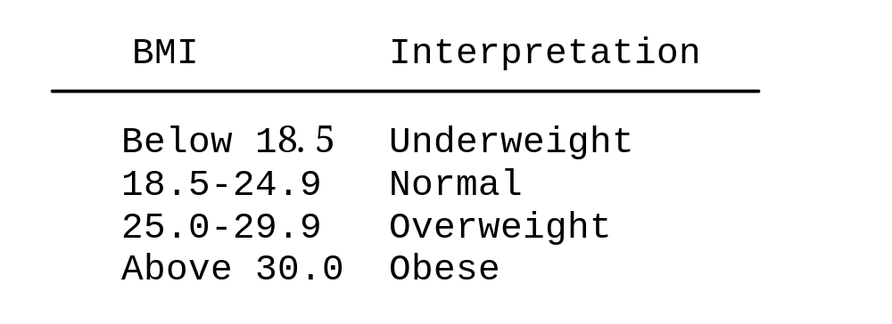
Problem: Body Mass Index
Body Mass Index (BMI) is a measure of health on weight. It can be calculated by taking your weight in kilograms and dividing by the square of your height in meters. The interpretation of BMI for people 16 years or older is as follows:
ComputeAndInterpretBMI

Slide 24
Problem: Computing Taxes
The US federal personal income tax is calculated based on the filing status and taxable income. There are four filing statuses: single filers, married filing jointly, married filing separately, and head of household. The tax rates for 2009 are shown below.
Marginal Tax Rate | Single | Married Filing Jointly or Qualified Widow(er) | Married Filing Separately | Head of Household
10% | $0 – $8,350 | $0 – $16,700 | $0 – $8,350 | $0 – $11,950
15% | $8,351– $33,950 | $16,701 – $67,900 | $8,351 – $33,950 | $11,951 – $45,500
25% | $33,951 – $82,250 | $67,901 – $137,050 | $33,951 – $68,525 | $45,501 – $117,450
28% | $82,251 – $171,550 | $137,051 – $208,850 | $68,525 – $104,425 | $117,451 – $190,200
33% | $171,551 – $372,950 | $208,851 – $372,950 | $104,426 – $186,475 | $190,201 - $372,950
35% | $372,951+ | $372,951+ | $186,476+ | $372,951+

Slide 25
Problem: Computing Taxes, cont.
if status == 0:
# Compute tax for single filers
elif status == 1:
# Compute tax for married filing jointly
elif status == 2:
# Compute tax for married filing separately
elif status == 3:
# Compute tax for head of household
else:
# Display wrong status
ComputeTax

Slide 26
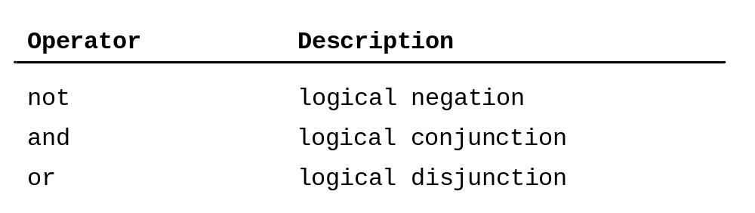
Logical Operators

Slide 27
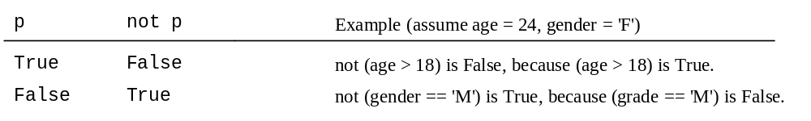
Truth Table for Operator not

Slide 28
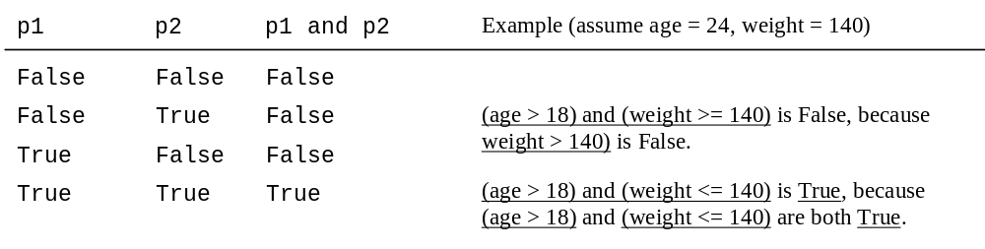
Truth Table for Operator and

Slide 29
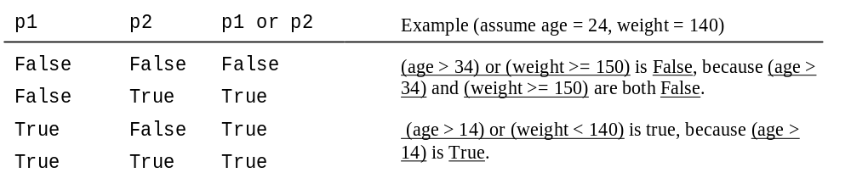
Truth Table for Operator or

Slide 30
Examples
Here is a program that checks whether a number is divisible by 2 and 3, whether a number is divisible by 2 or 3, and whether a number is divisible by 2 or 3 but not both:
TestBooleanOperators

Slide 31
Problem: Determining Leap Year?
This program first prompts the user to enter a year as an int value and checks if it is a leap year.
A year is a leap year if it is divisible by 4 but not by 100, or it is divisible by 400.
(year % 4 == 0 and year % 100 != 0) or (year % 400 == 0)
LeapYear

Slide 32
Problem: Lottery
Write a program that randomly generates a lottery between 0 and 99, prompts the user to enter a number in the same range, and determines whether the user wins according to the following rule:
If the user input matches the lottery in exact order, the award is $10,000.
If the user input matches the lottery, the award is $3,000.
If one digit in the user input matches a digit in the lottery, the award is $1,000.
Lottery

Slide 33
Conditional Expressions
if x > 0:
y = 1
else:
y = -1
is equivalent to
y = 1 if x > 0 else -1
expression1 if boolean-expression else expression2

Slide 34
Conditional Operator
if number % 2 == 0:
print(number, "is even")
else:
print(number, "is odd")
print(number, "is even" if (number % 2 == 0) else "is odd")

Slide 35
Operator Precedence
+, -
**
not
*, /, //, %
+, -
<, <=, >, >=
==, !=
and
or
=, +=, -=, *=, /=, //=, %= (Assignment operator)

Slide 36
Operator Precedence and Associativity
The expression in the parentheses is evaluated first. (Parentheses can be nested, in which case the expression in the inner parentheses is executed first.) When evaluating an expression without parentheses, the operators are applied according to the precedence rule and the associativity rule.
If operators with the same precedence are next to each other, their associativity determines the order of evaluation. All binary operators except assignment operators are left-associative.

Slide 37
Operator Associativity
When two operators with the same precedence are evaluated, the associativity of the operators determines the order of evaluation. All binary operators except assignment operators are left-associative.
a – b + c – d is equivalent to ((a – b) + c) – d
Assignment operators are right-associative. Therefore, the expression
a = b = c = 5 is equivalent to a = (b = (c = 5))

Slide 38
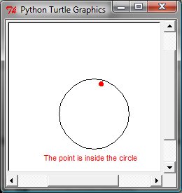
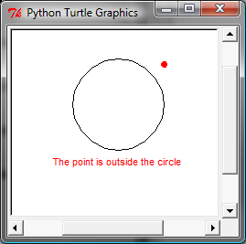
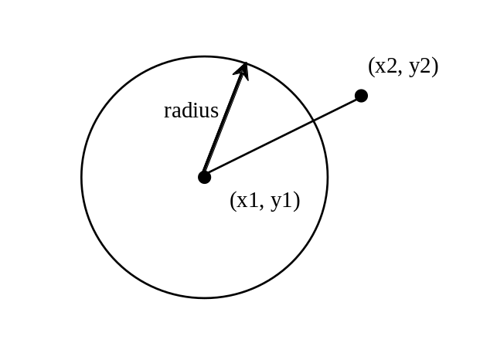
Turtle: Location of an Object
Test whether a point is inside a circle. The program prompts the user to enter the center of a circle, the radius, and a point.
PointInCircle

