Slide 1
Chapter 6 Functions

Slide 2
Opening Problem
Find the sum of integers from 1 to 10, from 20 to 37, and from 35 to 49, respectively.

Slide 3
Problem
sum = 0
for i in range(1, 11):
sum += i
print("Sum from 1 to 10 is", sum)
sum = 0
for i in range(20, 38):
sum += i
print("Sum from 20 to 37 is", sum)
sum = 0
for i in range(35, 50):
sum += i
print("Sum from 35 to 49 is", sum)

Slide 4
Problem
sum = 0
for i in range(1, 11):
sum += i
print("Sum from 1 to 10 is", sum)
sum = 0
for i in range(20, 38):
sum += i
print("Sum from 20 to 37 is", sum)
sum = 0
for i in range(35, 50):
sum += i
print("Sum from 35 to 49 is", sum)

Slide 5
Solution
def sum(i1, i2):
result = 0
for i in range(i1, i2 + 1):
result += i
return result
def main():
print("Sum from 1 to 10 is", sum(1, 10))
print("Sum from 20 to 37 is", sum(20, 37))
print("Sum from 35 to 49 is", sum(35, 49))
main() # Call the main function

Slide 6
Objectives
To define functions (§6.2).
To invoke value-returning functions (§6.3).
To invoke functions that does not return a value (§6.4).
To pass arguments by values (§6.5).
To pass arguments by values (§6.6).
To develop reusable code that is modular, easy to read, easy to debug, and easy to maintain (§6.7).
To create modules for reusing functions (§§6.7-6.8).
To determine the scope of variables (§6.9).
To define functions with default arguments (§6.10).
To return multiple values from a function (§6.11).
To apply the concept of function abstraction in software development (§6.12).
To design and implement functions using stepwise refinement (§6.13).
To simplify drawing programs using functions (§6.14).

Slide 7
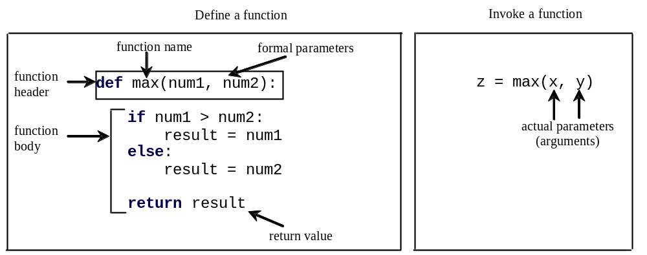
Defining Functions
A function is a collection of statements that are grouped together to perform an operation.

Slide 8
Function Header
A function contains a header and body. The header begins with the def keyword, followed by function’s name and parameters, followed by a colon.

Slide 9
Formal Parameters
The variables defined in the function header are known as formal parameters.

Slide 10
Actual Parameters
When a function is invoked, you pass a value to the parameter. This value is referred to as actual parameter or argument.

Slide 11
Return Value
A function may return a value using the return keyword.

Slide 12
Calling Functions
Testing the max function
This program demonstrates calling a function max to return the largest of the int values
TestMax

Slide 13
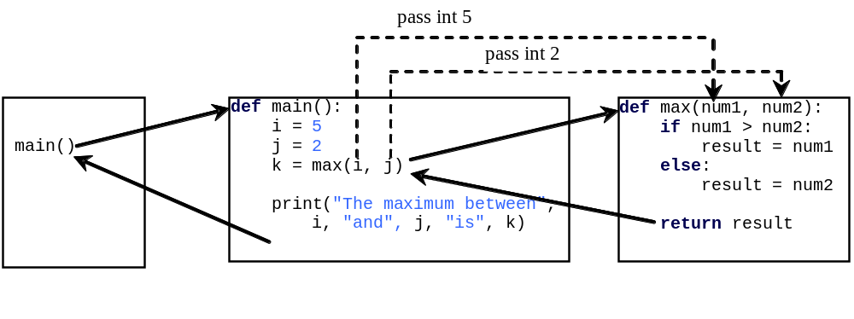
Calling Functions, cont.
animation

Slide 14
Trace Function Invocation
animation
Invoke the main function

Slide 15
Trace Function Invocation
animation
i is now 5

Slide 16
Trace Function Invocation
animation
j is now 2

Slide 17
Trace Function Invocation
animation
invoke max(i, j)

Slide 18
Trace Function Invocation
animation
invoke max(i, j)
Pass the value of i to num1
Pass the value of j to num2

Slide 19
Trace Function Invocation
animation
(num1 > num2) is true since num1 is 5 and num2 is 2

Slide 20
Trace Function Invocation
animation
result is now 5

Slide 21
Trace Function Invocation
animation
return result, which is 5

Slide 22
Trace Function Invocation
animation
return max(i, j) and assign the return value to k

Slide 23
Trace Function Invocation
animation
Execute the print statement

Slide 24
Trace Function Invocation
animation
Return to the caller

Slide 25
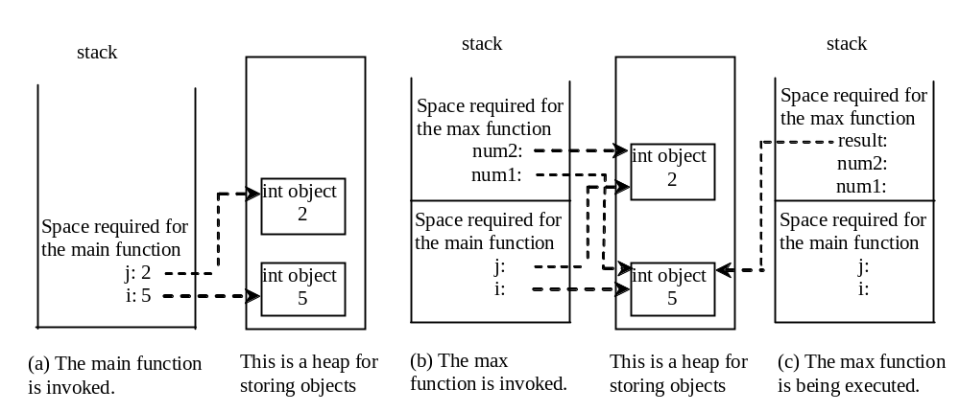
Call Stacks

Slide 26
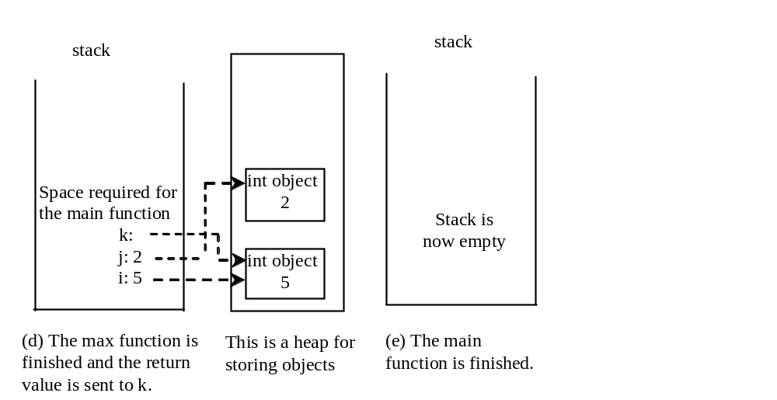
Call Stacks

Slide 27
Functions With/Without Return Values
This type of function does not return a value. The function performs some actions.
PrintGradeFunction
ReturnGradeFunction

Slide 28
The None Value
A function that does not return a value is known as a void function in other programming languages such as Python, C++, and C#. In Python, such function returns a special value None.
def sum(number1, number2):
total = number1 + number2
print(sum(1, 2))

Slide 29
Passing Arguments by Positions
def nPrintln(message, n):
for i in range(0, n):
print(message)
Suppose you invoke the function using
  nPrintln(“Welcome to Python”, 5)
What is the output?
Suppose you invoke the function using
  nPrintln(“Computer Science”, 15)
What is the output?
What is wrong
  nPrintln(4, “Computer Science”)

Slide 30
Keyword Arguments
def nPrintln(message, n):
for i in range(0, n):
print(message)
What is wrong
  nPrintln(4, “Computer Science”)
Is this OK?
  nPrintln(n = 4, message = “Computer Science”)

Slide 31
Pass by Value
In Python, all data are objects. A variable for an object is actually a reference to the object. When you invoke a function with a parameter, the reference value of the argument is passed to the parameter. This is referred to as pass-by-value. For simplicity, we say that the value of an argument is passed to a parameter when invoking a function. Precisely, the value is actually a reference value to the object.
If the argument is a number or a string, the argument is not affected, regardless of the changes made to the parameter inside the function.
Increment

Slide 32
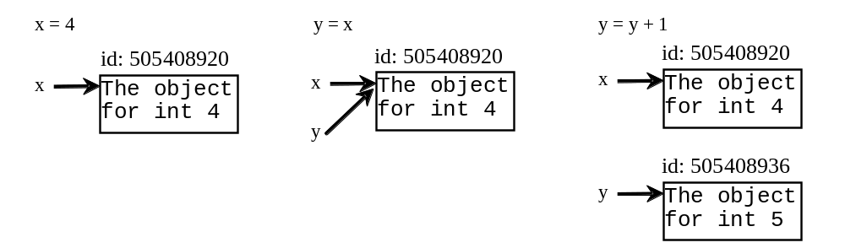
Pass by Value

Slide 33
Modularizing Code
Functions can be used to reduce redundant coding and enable code reuse. Functions can also be used to modularize code and improve the quality of the program.
GCDFunction
TestGCDFunction
PrimeNumberFunction

Slide 34
Problem: Converting Decimals to Hexadecimals
Write a function that converts a decimal integer to a hexadecimal.
Dec2Hex

Slide 35
Scope of Variables
Scope: the part of the program where the variable can be referenced.
A variable created inside a function is referred to as a local variable. Local variables can only be accessed inside a function. The scope of a local variable starts from its creation and continues to the end of the function that contains the variable.
In Python, you can also use global variables. They are created outside all functions and are accessible to all functions in their scope.

Slide 36
Example 1
globalVar = 1
def f1():
localVar = 2
print(globalVar)
print(localVar)
f1()
print(globalVar)
print(localVar) # Out of scope. This gives an error

Slide 37
Example 2
x = 1
def f1():
x = 2
print(x) # Displays 2
f1()
print(x) # Displays 1

Slide 38
Example 3
x = eval(input("Enter a number: "))
if x > 0:
y = 4
print(y) # This gives an error if y is not created

Slide 39
Example 4
sum = 0
for i in range(5):
sum += i
print(i)

Slide 40
Example 5
x = 1
def increase():
global x
x = x + 1
print(x) # Displays 2
increase()
print(x) # Displays 2

Slide 41
Default Arguments
Python allows you to define functions with default argument values. The default values are passed to the parameters when a function is invoked without the arguments.
DefaultArgumentDemo

Slide 42
Returning Multiple Values
Python allows a function to return multiple values. Listing 6.9 defines a function that takes two numbers and returns them in non-descending order.
MultipleReturnValueDemo

Slide 43
Generating Random Characters
RandomCharacter
TestRandomCharacter

Slide 44
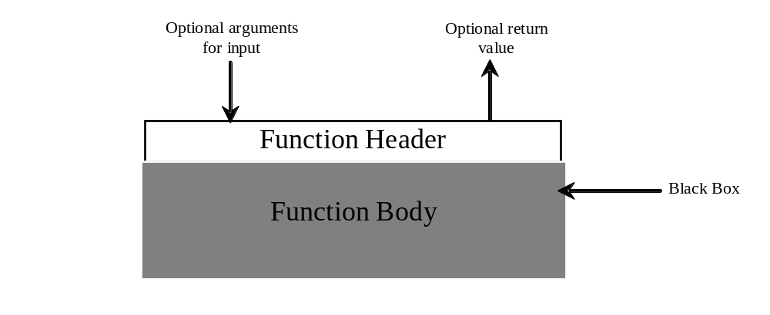
Function Abstraction
You can think of the function body as a black box that contains the detailed implementation for the function.

Slide 45
Benefits of Functions
Write a function once and reuse it anywhere.
Information hiding. Hide the implementation from the user.
Reduce complexity.

Slide 46
Stepwise Refinement
The concept of function abstraction can be applied to the process of developing programs. When writing a large program, you can use the “divide and conquer” strategy, also known as stepwise refinement, to decompose it into subproblems. The subproblems can be further decomposed into smaller, more manageable problems.

Slide 47
PrintCalender Case Study
Let us use the PrintCalendar example to demonstrate the stepwise refinement approach.
PrintCalender

Slide 48

Design Diagram

Slide 49
Design Diagram

Slide 50
Design Diagram

Slide 51
Design Diagram

Slide 52
Design Diagram

Slide 53
Design Diagram

Slide 54
Implementation: Top-Down
Top-down approach is to implement one function in the structure chart at a time from the top to the bottom. Stubs can be used for the functions waiting to be implemented. A stub is a simple but incomplete version of a function. The use of stubs enables you to test invoking the function from a caller. Implement the main function first and then use a stub for the printMonth function. For example, let printMonth display the year and the month in the stub. Thus, your program may begin like this:
A Skeleton for PrintCalendar

Slide 55
Implementation: Bottom-Up
Bottom-up approach is to implement one function in the structure chart at a time from the bottom to the top. For each function implemented, write a test program to test it. Both top-down and bottom-up functions are fine. Both approaches implement the functions incrementally and help to isolate programming errors and makes debugging easy. Sometimes, they can be used together.

Slide 56
Turtle:
Developing Reusable Graphics Functions
def drawLine(x1, y1, x2, y2):
def writeString(s, x, y):
def drawPoint(x, y):
def drawCircle(x = 0, y = 0, radius = 10):
def drawRectangle(x = 0, y = 0, width = 10, height = 10):
UsefulTurtleFunctions
UseCustomTurtleFunctions

