Slide 1
Chapter 8
Lists for Multi-dimensional Data

Slide 2
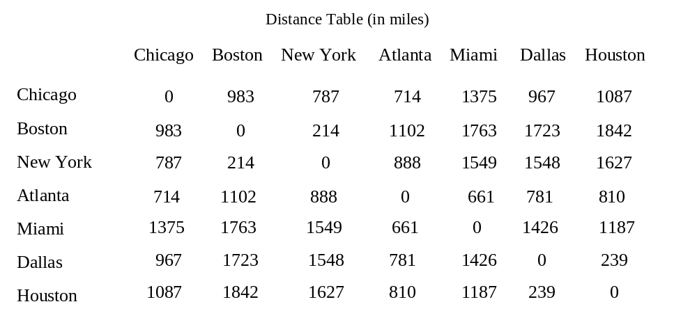
Motivations
distances = [
[0, 983, 787, 714, 1375, 967, 1087],
[983, 0, 214, 1102, 1763, 1723, 1842],
[787, 214, 0, 888, 1549, 1548, 1627],
[714, 1102, 888, 0, 661, 781, 810],
[1375, 1763, 1549, 661, 0, 1426, 1187],
[967, 1723, 1548, 781, 1426, 0, 239],
[1087, 1842, 1627, 810, 1187, 239, 0]
]

Slide 3
Objectives
To give examples of representing data using two-dimensional lists (§8.1).
To access elements in a two-dimensional list using row and column indexes (§8.2).
To program common operations for two-dimensional lists (displaying lists, summing all elements, finding min and max elements, and random shuffling) (§8.2).
To pass two-dimensional lists to functions (§8.3).
To write a program for grading multiple-choice questions using two-dimensional lists (§8.4).
To solve the closest-pair problem using two-dimensional lists (§§8.5-8.6).
To check a Sudoku solution using two-dimensional lists (§§8.7-8.8).
To use multidimensional lists (§8.9).

Slide 4
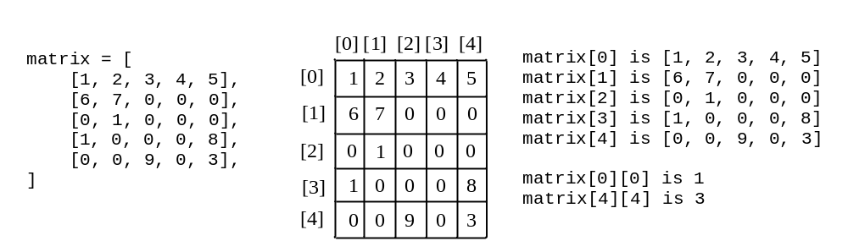
Processing Two-Dimensional lists
You can view a two-dimensional list as a list that consists of rows. Each row is a list that contains the values. The rows can be accessed using the index, conveniently called a row index. The values in each row can be accessed through another index, conveniently called a column index.

Slide 5
Processing Two-Dimensional lists
See the examples in the text.
(Initializing lists with input values)
(Initializing lists with random values)
(Printing lists)
(Summing all elements)
(Summing all elements by column)
(Which row has the largest sum)
(Random shuffling)

Slide 6
Initializing lists with input values
matrix = [] # Create an empty list
numberOfRows = eval(input("Enter the number of rows: "))
numberOfColumns = eval(input("Enter the number of columns: "))
for row in range(0, numberOfRows):
matrix.append([]) # Add an empty new row
for column in range(0, numberOfColumns):
value = eval(input("Enter an element and press Enter: "))
matrix[row].append(value)
print(matrix)

Slide 7
Initializing lists with random values
import random
matrix = [] # Create an empty list
numberOfRows = eval(input("Enter the number of rows: "))
numberOfColumns = eval(input("Enter the number of columns: "))
for row in range(0, numberOfRows):
matrix.append([]) # Add an empty new row
for column in range(0, numberOfColumns):
matrix[row].append(random.randrange(0, 100))
print(matrix)

Slide 8
Printing lists
matrix = [[1, 2, 3], [4, 5, 6], [7, 8, 9]] # Assume a list is given
for row in range(0, len(matrix)):
for column in range(0, len(matrix[row])):
print(matrix[row][column], end = " ")
print() # Print a newline

Slide 9
Summing all elements
matrix = [[1, 2, 3], [4, 5, 6], [7, 8, 9]] # Assume a list is given
total = 0
for row in range(0, len(matrix)):
for column in range(0, len(matrix[row])):
total += matrix[row][column]
print("Total is " + str(total)) # Print the total

Slide 10
Summing elements by column
matrix = [[1, 2, 3], [4, 5, 6], [7, 8, 9]] # Assume a list is given
total = 0
for column in range(0, len(matrix[0])):
for row in range(0, len(matrix)):
total += matrix[row][column]
print("Sum for column " + str(column) + " is " + str(total))

Slide 11
Summing elements by column
matrix = [[1, 2, 3], [4, 5, 6], [7, 8, 9]] # Assume a list is given
maxRow = sum(matrix[0]) # Get sum of the first row in maxRow
indexOfMaxRow = 0
for row in range(1, len(matrix)):
if sum(matrix[row]) > maxRow:
maxRow = sum(matrix[row])
indexOfMaxRow = row
print("Row " + str(indexOfMaxRow)

Slide 12
Random shuffling
import random
matrix = [[1, 2, 3], [4, 5, 6], [7, 8, 9]] # Assume a list is given
for row in range(0, len(matrix)):
for column in range(0, len(matrix[row])):
i = random.randrange(0, len(matrix))
j = random.randrange(0, len(matrix[row]))
# Swap matrix[row][column] with matrix[i][j]
matrix[row][column], matrix[i][j] = \
matrix[i][j], matrix[row][column]
print(matrix)

Slide 13
Passing Tow-Dimensional Lists to Functions
PassTwoDimensionalList

Slide 14
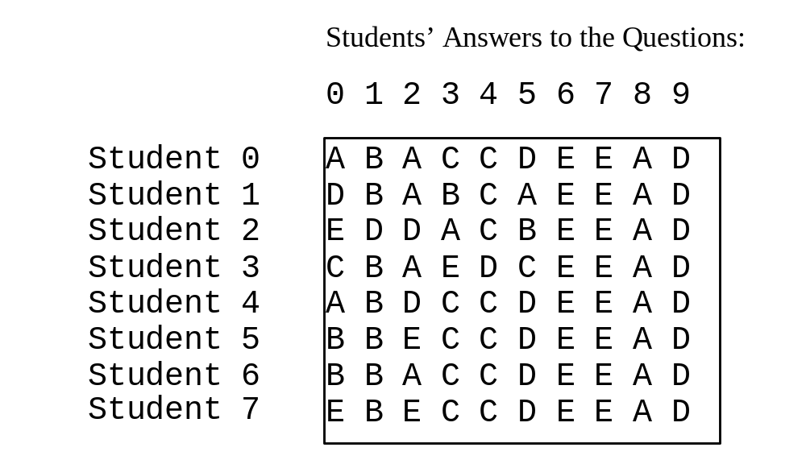
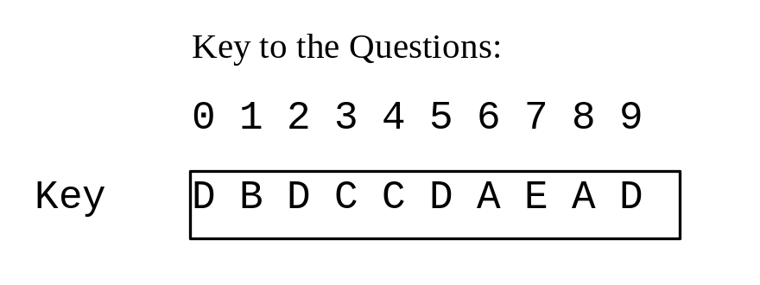
Problem: Grading Multiple-Choice Test
Objective: write a program that grades multiple-choice test.
GradeExam

Slide 15
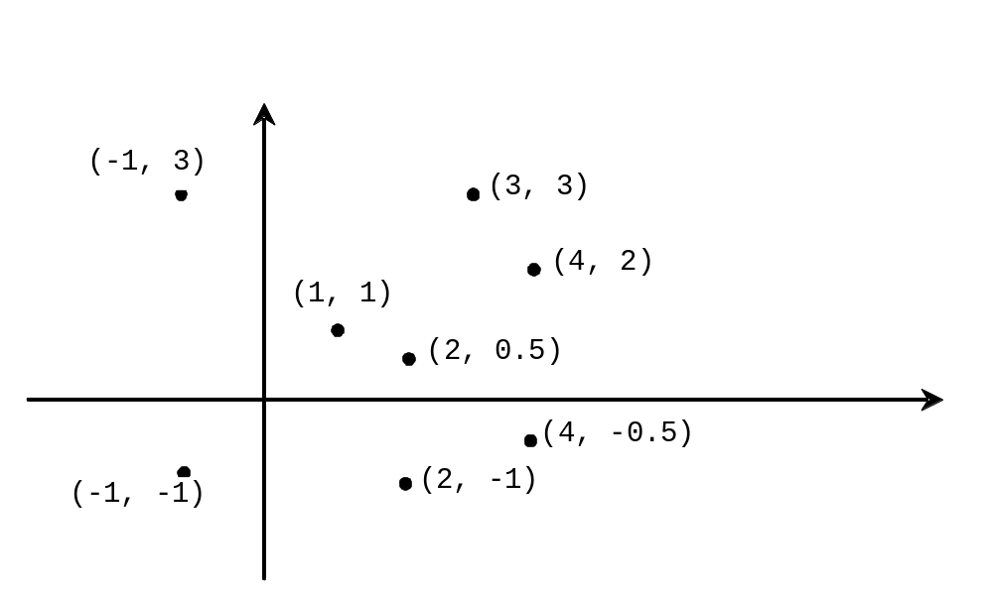
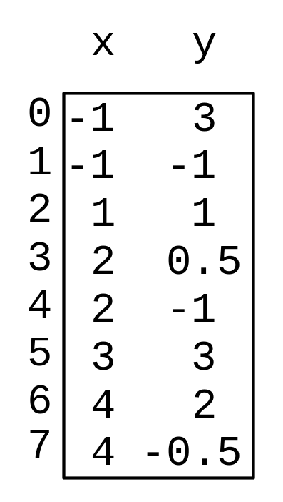
Problem: Finding Two Points Nearest to Each Other
https://liveexample.pearsoncmg.com/dsanimation/ClosestPaireBook.html
FindNearestPoints

Slide 16
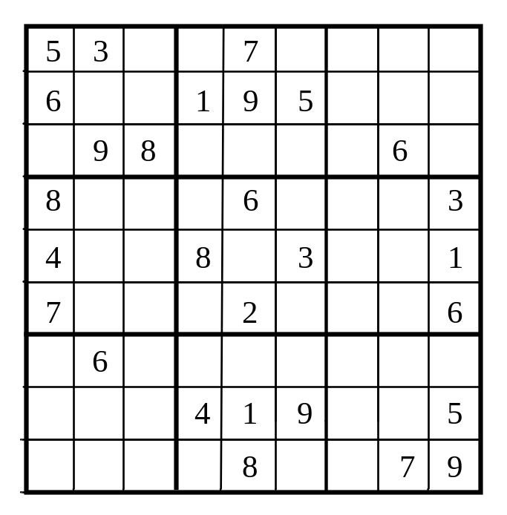
What is Sudoku?
https://liveexample.pearsoncmg.com/dsanimation/Sudoku.html

Slide 17
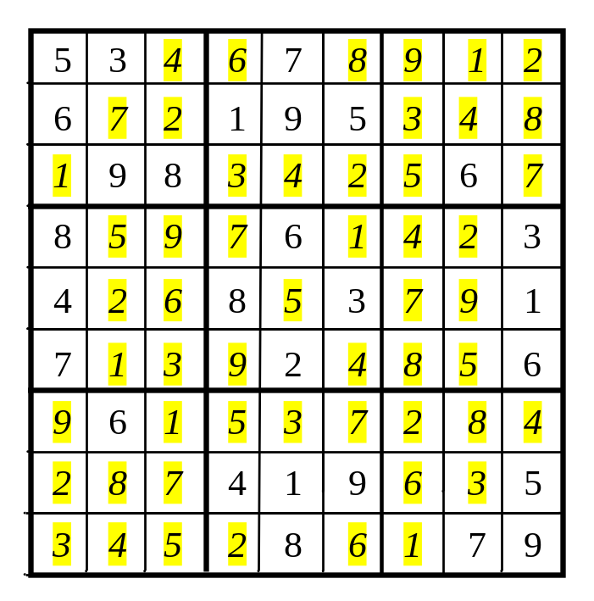
Every row contains the numbers 1 to 9

Slide 18
Every column contains the numbers 1 to 9
5 3
4
6
7
8
9
1
2
6
7
2
1 9 5
3
4
8
1
9 8
3
4
2
5
6
7
8
5
9
7
6
1
4
2
3
4
2
6
8
5
3
7
9
1
7
1
3
9
2
4
8
5
6
9
6
1
5
3
7
2
8
4
2
8
7
4 1 9
6
3
5
3
4
5
2
8
6
1
7 9

Slide 19
Every 3×3 box contains the numbers 1 to 9
5 3
4
6
7
8
9
1
2
6
7
2
1 9 5
3
4
8
1
9 8
3
4
2
5
6
7
8
5
9
7
6
1
4
2
3
4
2
6
8
5
3
7
9
1
7
1
3
9
2
4
8
5
6
9
6
1
5
3
7
2
8
4
2
8
7
4 1 9
6
3
5
3
4
5
2
8
6
1
7 9

Slide 20
Checking Whether a Solution Is Correct
CheckSudokuSolution
TestCheckSudokuSolution

Slide 21
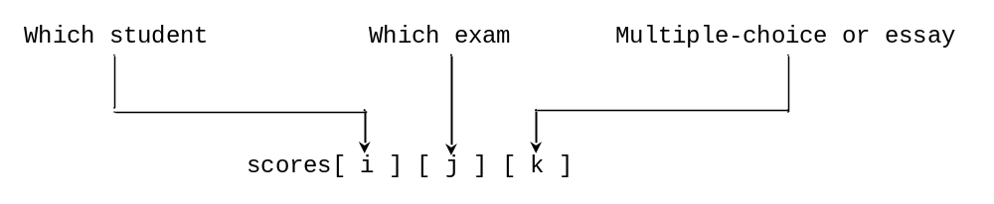
Multidimensional lists
scores = [
[[9.5, 20.5], [9.0, 22.5], [15, 33.5], [13, 21.5], [15, 2.5]],
[[4.5, 21.5], [9.0, 22.5], [15, 34.5], [12, 20.5], [14, 9.5]],
[[6.5, 30.5], [9.4, 10.5], [11, 33.5], [11, 23.5], [10, 2.5]],
[[6.5, 23.5], [9.4, 32.5], [13, 34.5], [11, 20.5], [16, 9.5]],
[[8.5, 26.5], [9.4, 52.5], [13, 36.5], [13, 24.5], [16, 2.5]],
[[9.5, 20.5], [9.4, 42.5], [13, 31.5], [12, 20.5], [16, 6.5]]]

Slide 22
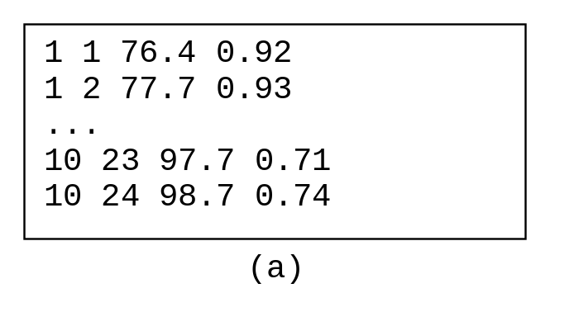
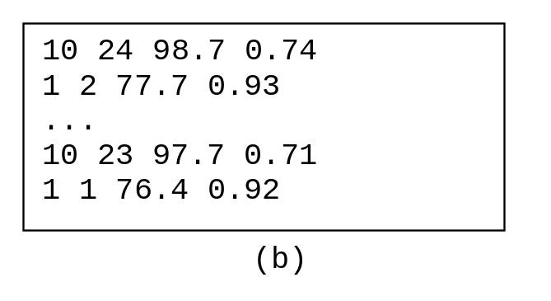
Problem: Weather Information
Suppose a meteorology station records the temperature and humidity at each hour of every day and stores the data for the past ten days in a text file named weather.txt. Each line of the file consists of four numbers that indicate the day, hour, temperature, and humidity. Your task is to write a program that calculates the average daily temperature and humidity for the 10 days.
Weather

Slide 23
Problem: Guessing Birthday
Listing 3.8, GuessBirthday.java, gives a program that guesses a birthday. The program can be simplified by storing the numbers in five sets in a three-dimensional list, and it prompts the user for the answers using a loop, as shown in Listing 8.6.
GuessBirthdayUsingList

