Slide 1
Chapter 9 Object-Oriented Programming

Slide 2

Motivations
After learning the preceding chapters, you are capable of solving many programming problems using selections, loops, and functions. However, these Python features are not sufficient for developing graphical user interfaces and large scale software systems. Suppose you want to develop a graphical user interface as shown below. How do you program it?

Slide 3
OO Programming Concepts
Object-oriented programming (OOP) involves programming using objects. An object represents an entity in the real world that can be distinctly identified. For example, a student, a desk, a circle, a button, and even a loan can all be viewed as objects. An object has a unique identity, state, and behaviors. The state of an object consists of a set of data fields (also known as properties) with their current values. The behavior of an object is defined by a set of methods.

Slide 4

Objects
An object has both a state and behavior. The state defines the object, and the behavior defines what the object does.

Slide 5
Classes
A Python class uses variables to store data fields and defines methods to perform actions. Additionally, a class provides a special type method, known as initializer, which is invoked to create a new object. An initializer can perform any action, but initializer is designed to perform initializing actions, such as creating the data fields of objects.
class ClassName:
initializer
methods
Circle
TestCircle

Slide 6
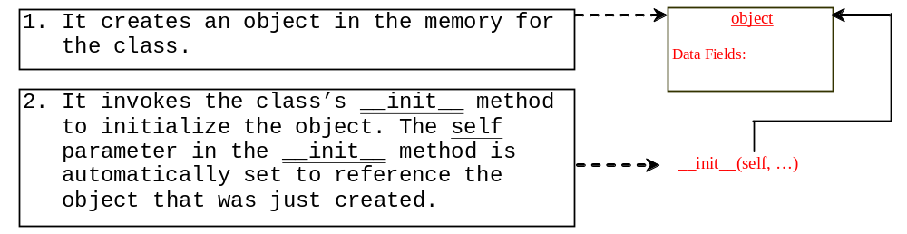
Constructing Objects
Once a class is defined, you can create objects from the class by using the following syntax, called a constructor:
ClassName(arguments)

Slide 7
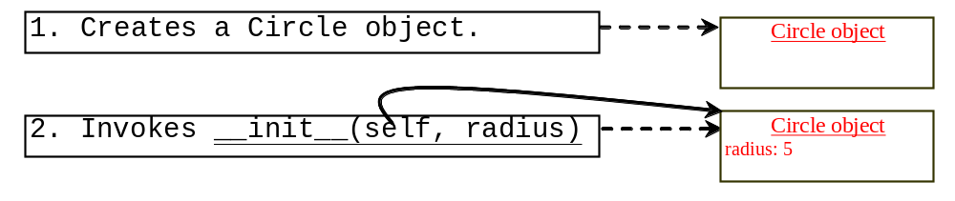
Constructing Objects
The effect of constructing a Circle object using Circle(5) is shown below:

Slide 8
Instance Methods
Methods are functions defined inside a class. They are invoked by objects to perform actions on the objects. For this reason, the methods are also called instance methods in Python. You probably noticed that all the methods including the __init__ have the first parameter self, which refers to the object that invokes the method. You can use any name for this parameter. But by convention, self is used.

Slide 9
Accessing Objects
After an object is created, you can access its data fields and invoke its methods using the dot operator (.), also known as the object member access operator. For example, the following code accesses the radius data field and invokes the getPerimeter and getArea methods.
>>> from Circle import Circle
>>> c = Circle(5)
>>> c.getPerimeter()
31.41592653589793
>>> c.radius = 10
>>> c.getArea()
314.1592653589793

Slide 10
Why self?
Note that the first parameter is special. It is used in the implementation of the method, but not used when the method is called. So, what is this parameter self for? Why does Python need it?
self is a parameter that represents an object. Using self, you can access instance variables in an object. Instance variables are for storing data fields. Each object is an instance of a class. Instance variables are tied to specific objects. Each object has its own instance variables. You can use the syntax self.x to access the instance variable x for the object self in a method.

Slide 11
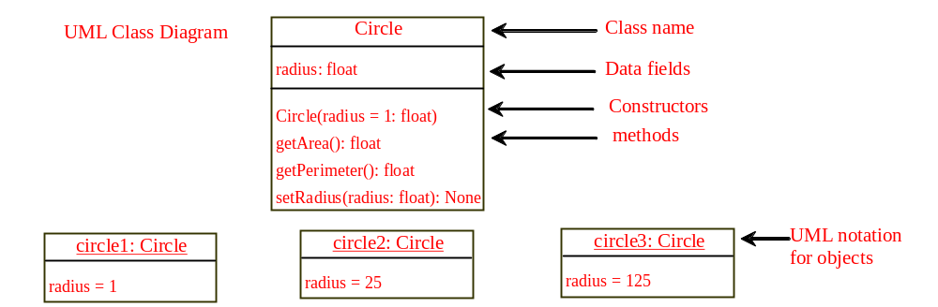
UML Class Diagram

Slide 12
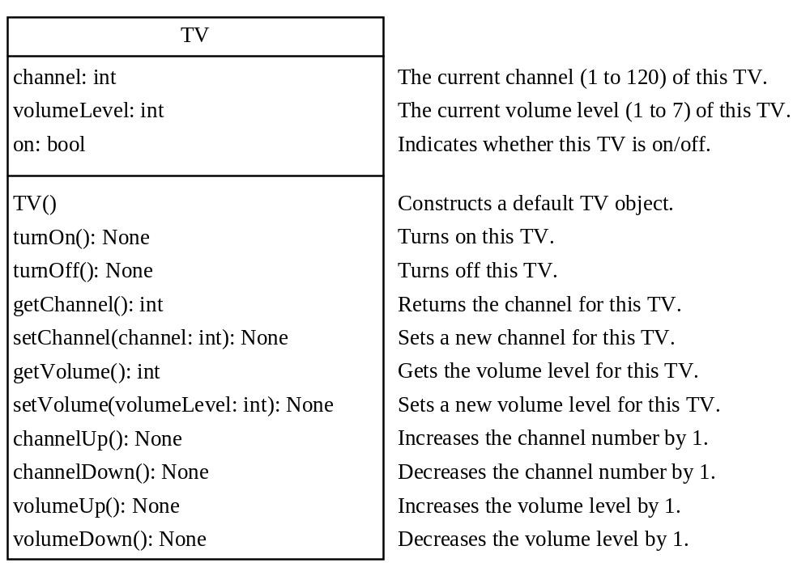
Example: Defining Classes and Creating Objects
TV
TestTV

Slide 13
Immutable Objects vs. Mutable Objects
TestPassMutableObject

Slide 14

Trace Code
animation
Assign object reference to myCircle
myCircle = Circle(5.0)
yourCircle = Circle()
yourCircle.radius = 100
myCircle
reference value

Slide 15
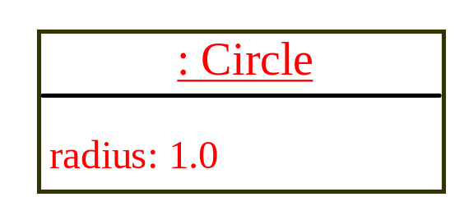
Trace Code
animation
myCircle = Circle(5.0)
yourCircle = Circle()
yourCircle.radius = 100
myCircle
reference value
Assign object reference to yourCircle
yourCircle
reference value

Slide 16
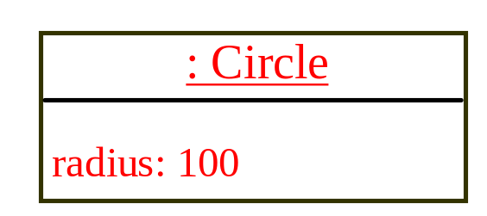
Trace Code
animation
myCircle = Circle(5.0)
yourCircle = Circle()
yourCircle.radius = 100
myCircle
reference value
Modify radius in yourCircle
yourCircle
reference value

Slide 17
The datetime Class
from datetime import datetime
d = datetime.now()
print("Current year is " + str(d.year))
print("Current month is " + str(d.month))
print("Current day of month is " + str(d.day))
print("Current hour is " + str(d.hour))
print("Current minute is " + str(d.minute))
print("Current second is " + str(d.second))

Slide 18
Data Field Encapsulation
To protect data.
To make class easy to maintain.
To prevent direct modifications of data fields, don’t let the client directly access data fields. This is known as data field encapsulation. This can be done by defining private data fields. In Python, the private data fields are defined with two leading underscores. You can also define a private method named with two leading underscores.
CircleWithPrivateRadius

Slide 19
Data Field Encapsulation
CircleWithPrivateRadius
>>> from CircleWithPrivateRadius import Circle
>>> c = Circle(5)
>>> c.__radius
AttributeError: 'Circle' object has no attribute '__radius'
>>> c.getRadius()
5

Slide 20
Design Guide
If a class is designed for other programs to use, to prevent data from being tampered with and to make the class easy to maintain, define data fields private. If a class is only used internally by your own program, there is no need to encapsulate the data fields.

Slide 21

Class Abstraction and Encapsulation
Class abstraction means to separate class implementation from the use of the class. The creator of the class provides a description of the class and let the user know how the class can be used. The user of the class does not need to know how the class is implemented. The detail of implementation is encapsulated and hidden from the user.

Slide 22
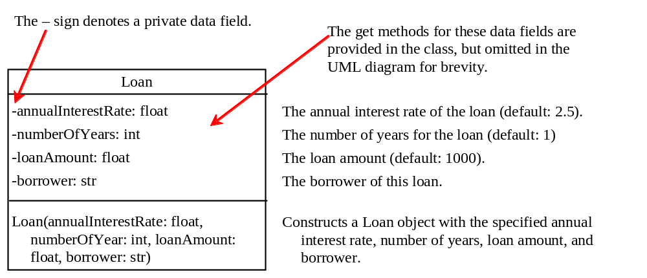
Designing the Loan Class
Loan
TestLoanClass

Slide 23
Object-Oriented Thinking
This book’s approach is to teach problem solving and fundamental programming techniques before object-oriented programming. This section will show how procedural and object-oriented programming differ. You will see the benefits of object-oriented programming and learn to use it effectively. We will use several examples in the rest of the chapter to illustrate the advantages of the object-oriented approach. The examples involve designing new classes and using them in applications.

Slide 24
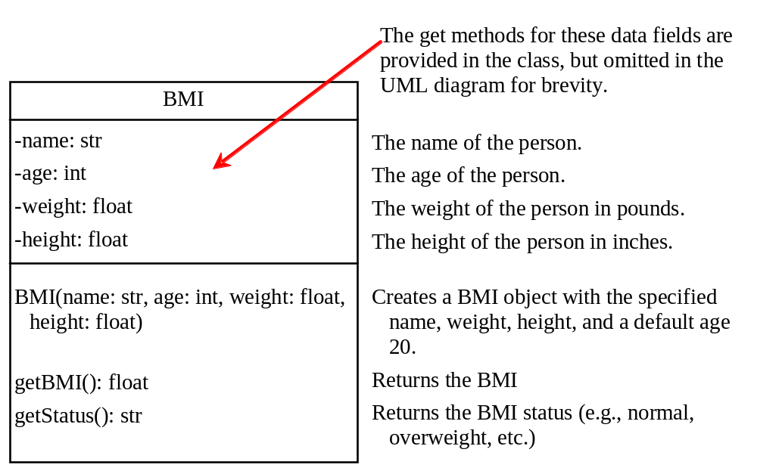
The BMI Class
BMI
UseBMIClass

Slide 25
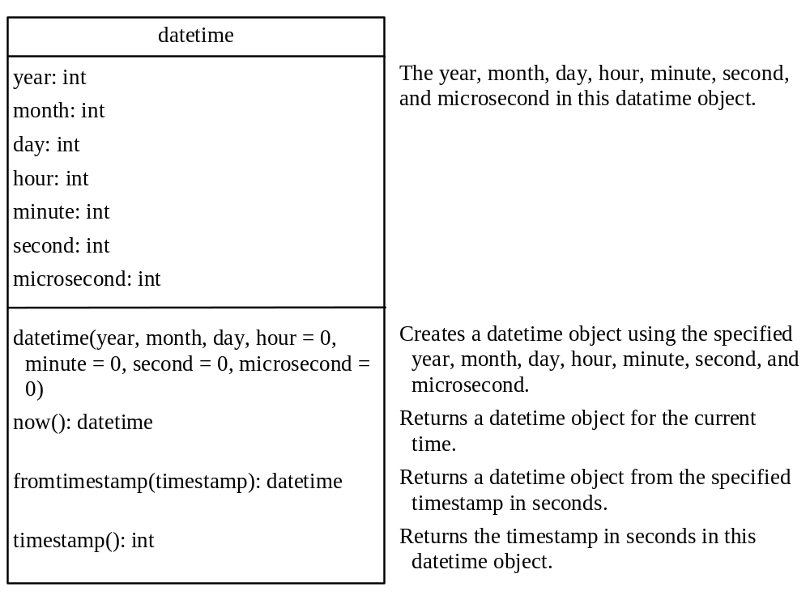
The datetime Class
DatetimeDemo

Slide 26
Procedural vs. Object-Oriented
In procedural programming, data and operations on the data are separate, and this methodology requires sending data to methods. Object-oriented programming places data and the operations that pertain to them in an object. This approach solves many of the problems inherent in procedural programming.

Slide 27
Procedural vs. Object-Oriented
The object-oriented programming approach organizes programs in a way that mirrors the real world, in which all objects are associated with both attributes and activities. Using objects improves software reusability and makes programs easier to develop and easier to maintain. Programming in Python involves thinking in terms of objects; a Python program can be viewed as a collection of cooperating objects.

