Slide 1
Chapter 10
Basic GUI Programming Using Tkinter

Slide 2
Motivations
Tkinter is not only a useful tool for developing GUI projects, but also a valuable pedagogical tool for learning object-oriented programming.

Slide 3
Objectives
To create a simple GUI application with Tkinter (§10.2).
To process events by using callback functions that are bound to a widget’s command option (§10.3).
To use labels, entries, buttons, check buttons, radio buttons, messages, and text to create graphical user interfaces (§10.4).
To draw lines, rectangles, ovals, polygons, and arcs and display text strings in a canvas (§10.5).
To use geometry managers to lay out widgets in a container (§10.6).
To lay out widgets in a grid by using the grid manager (§10.6.1).
To pack widgets side by side or on top of each other by using the pack manager (§10.6.2).
To place widgets in absolute locations by using the place manager (§10.6.3).
To write a GUI loan calculator (§10.7).
To write a GUI program for checking a Sudoku solution (§10.8).
To use images in widgets (§10.9).
To write a GUI program that displays the images of four cards (§10.9).

Slide 4
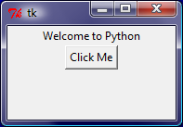
Getting Started with Tkinter
Getting started with Tkinter with a simple example.
SimpleGUI

Slide 5
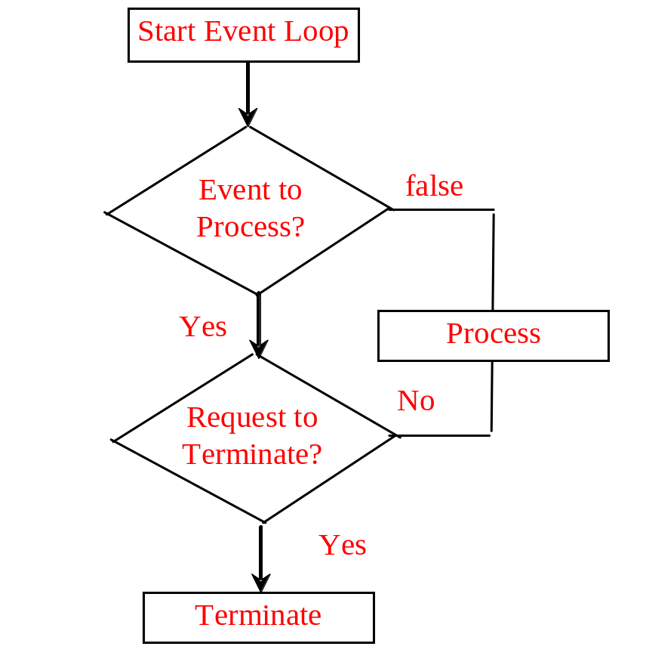

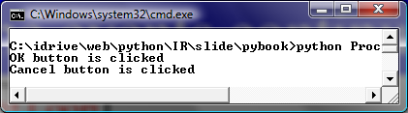
Processing Events
window.mainloop() # Create an event loop
The statement creates an event loop. The event loop processes the events continuously.
ProcessButtonEvent

Slide 6
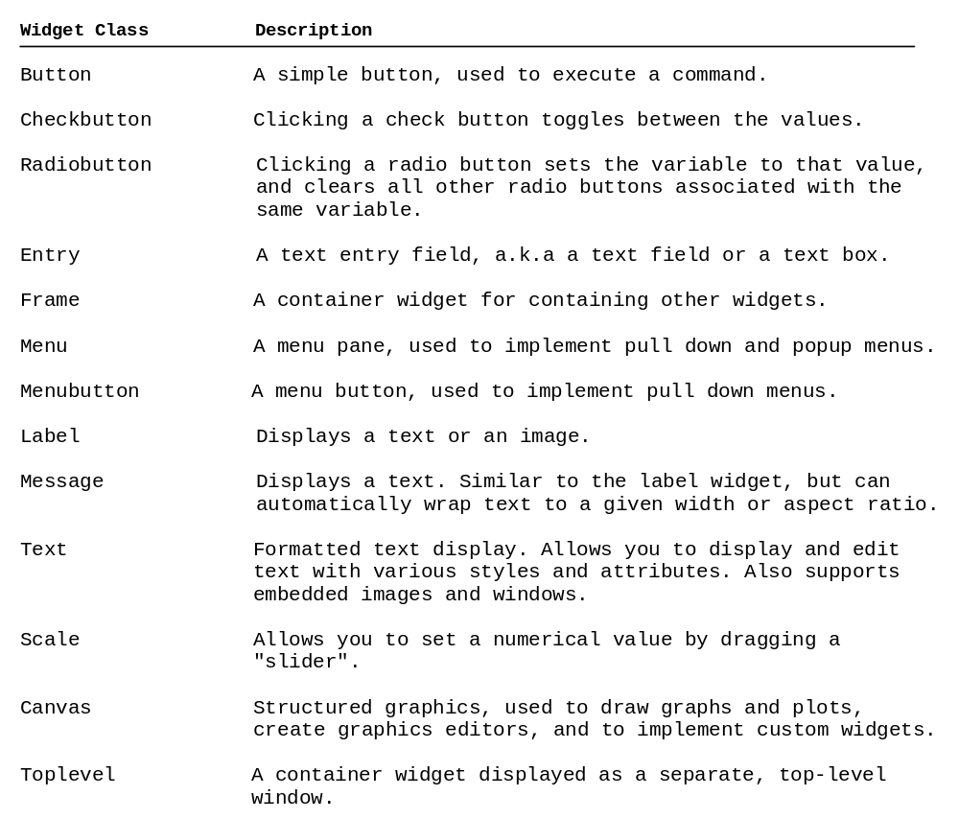
The Widget Classes

Slide 7
Color and Font
To specify a color, you can either use a color name such as red, yellow, green, blue, white, black, purple, etc, or explicitly specify the red, green, and blue (RGB) color components using a string #RRGGBB, where RR, GG, BB are hexadecimal representations of the red, green and blue values, respectively.
"Times 10 bold"
"Helvetica 10 bold italic"
"Courier New 20 bold italic"
"Courier New 20 bold italic over strike underline"

Slide 8
Text Formatting
The text in a label and a button is centered by default. You can change it by using the justify option with values LEFT, CENTER, or RIGHT. You can also display the text in multiple lines by inserting the newline character \n to separate texts.

Slide 9
Mouse Cursor
You can set a mouse cursor by using the cursor option with values such as "arrow" (default), "circle", "cross" "plus", etc.

Slide 10
Change Properties
widgetName["propertyName] = newPropertyValue
btShowOrHide = Button(window, text = "Show", bg = "white")
btShowOrHide["text"] = "Hide"
btShowOrHide["bg"] = "red"
btShowOrHide["fg"] = "#AB84F9" # Change fg color to #AB84F9
btShowOrHide["cursor"] = "plus" # Change mouse cursor to plus

Slide 11
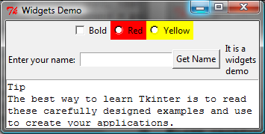
Widget Demo
WidgetsDemo

Slide 12
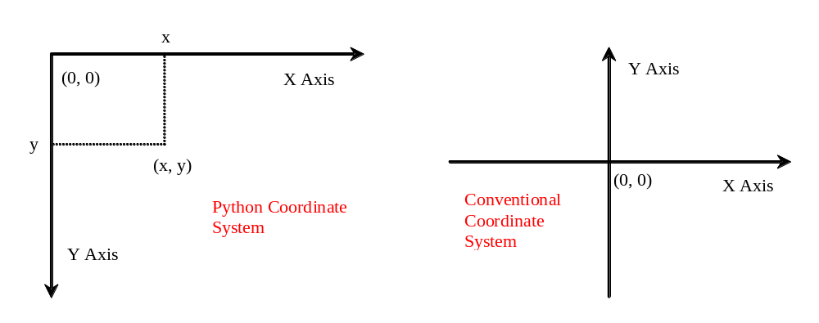
Canvas
Canvas can be used to display shapes. You can use the method such as create_rectangle, create_oval, create_arc, create_polygon, and create_line to draw a rectangle, oval, arc, polygon, and line on a canvas.

Slide 13
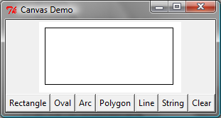
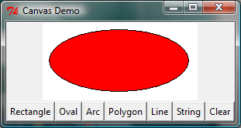
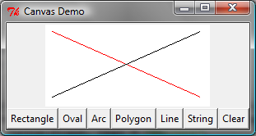
Canvas Demo
CanvasDemo

Slide 14
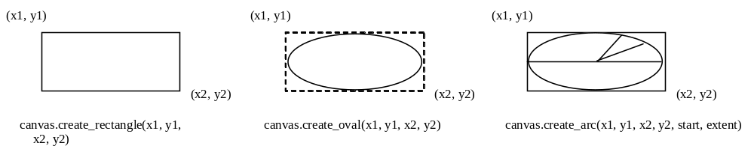
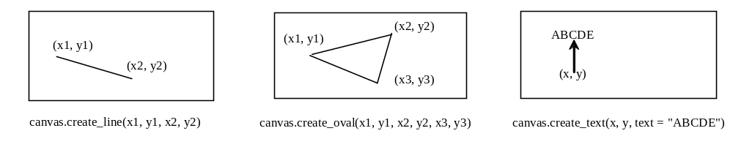
Drawing Methods

Slide 15
Geometry Managers
Grid Manager
Pack Manager
Place Manager
Since each manager has its own style of placing the widget, it is not a good practice to mix the managers for the widgets in the same container. You can use a frame as a subcontainer to achieve desired layout.

Slide 16
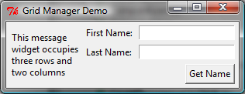
Grid Managers
GridManagerDemo

Slide 17
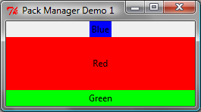
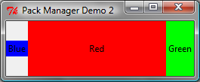
Pack Managers
PackManagerDemo1
PackManagerDemo2

Slide 18
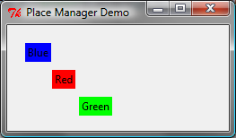
Place Managers
PlaceManagerDemo

Slide 19
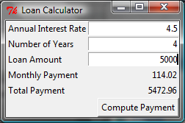
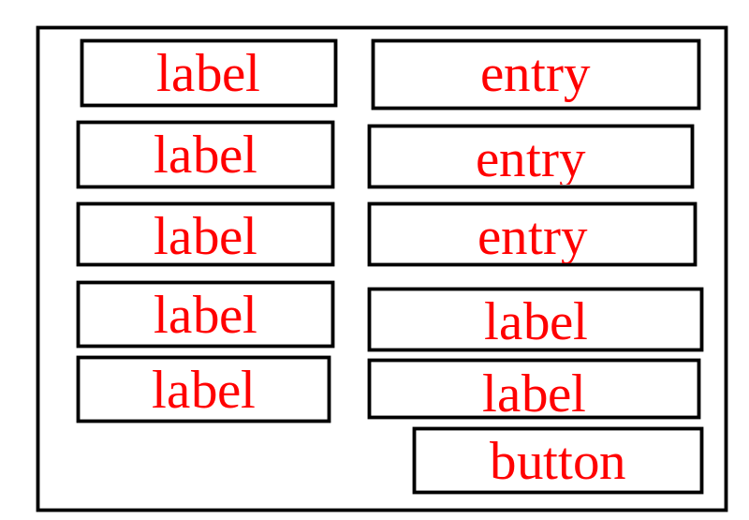
Case Study: Loan Calculator
LoanCalculator

Slide 20
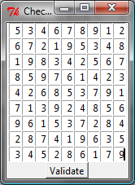
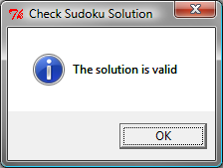
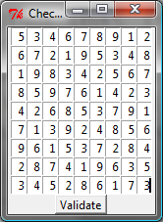
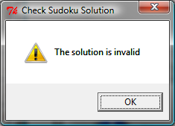
Sudoku GUI
SudokuGUI

Slide 21
Display Images
You can add an image in a label, button, check button, and radio button. To create an image, use the PhotoImage class as follows:
photo = PhotoImage(file = imagefilename)
The image file must be GIF. You can use a conversion utility to convert image files in other format into GIF.

Slide 22
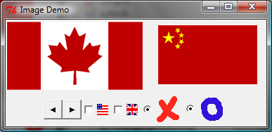
Image Example
ImageDemo

Slide 23
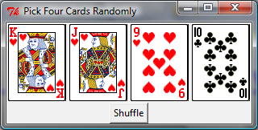
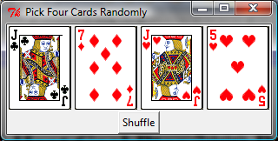
Deck of Cards GUI
DeckOfCardsGUI

