Slide 1
Chapter 11
Advanced GUI Programming Using Tkinter

Slide 2
Motivations
The preceding chapter introduced basic GUI programming using Tkinter. This chapter introduces combo boxes, menus, handling mouse and key events, animations, scrollbars, and dialog boxes.

Slide 3
Objectives
To create a combo box for selecting a single item using OptionMenu. (§11.2).
To create applications that contain menus (§11.3).
To create applications that contain popup menus (§11.4).
To bind mouse and key events on a widget to a callback function for processing events (§11.5).
To write a GUI program for finding and displaying the points that are nearest to each other (§11.6).
To develop animations (§11.7).
To write a GUI program for animating bouncing balls (§11.8).
To use scroll bars to scroll through the contents of a text widget (§11.9).
To use standard dialog boxes to display messages and accept user input (§11.10).

Slide 4
Combo Boxes
A combo box, also known as a choice list or drop-down list, contains a list of items from which the user can choose. A combo box is useful for limiting a user’s range of choices and avoids the cumbersome validation of data input. Tkinter uses the OptionMenu class to create a combo box.

Slide 5
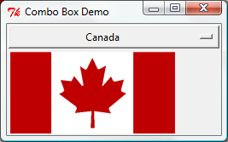
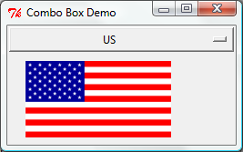
Combo Boxes
ComboBoxDemo

Slide 6
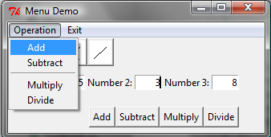
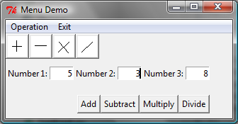
Menus
Tkinter provides a comprehensive solution for building graphical user interfaces.
MenuDemo

Slide 7
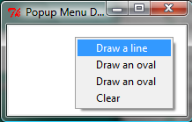
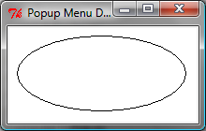
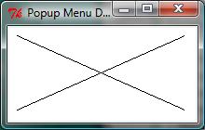
Popup Menus
PopupMenuDemo

Slide 8
Mouse and Key Events
widget.bind(event, handler)
def popup(event):
menu.post(event.x_root, event.y_root)

Slide 9
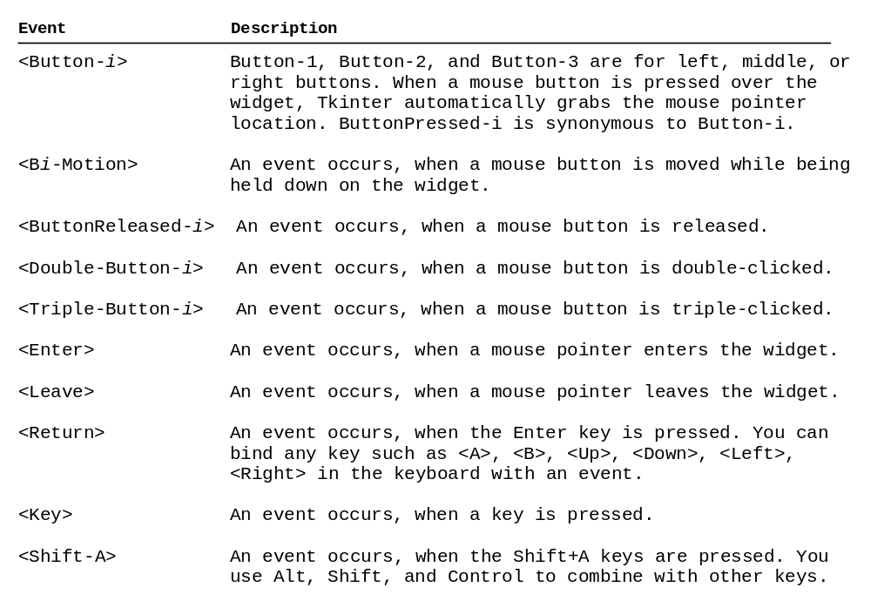
Events

Slide 10
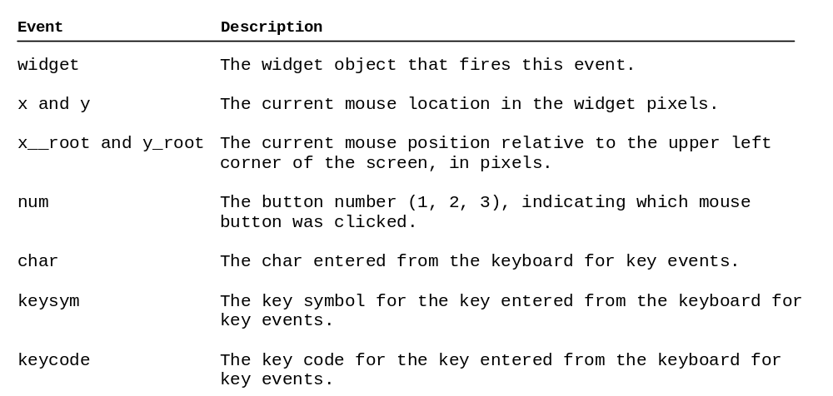
Event Properties

Slide 11
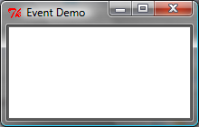
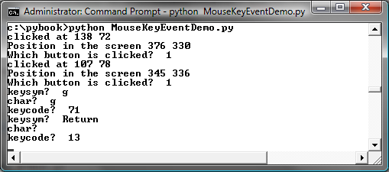
Mouse Key Event Demo
MouseKeyEventDemo

Slide 12
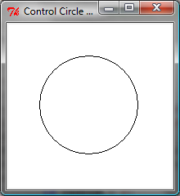
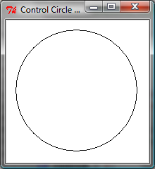
Control Circle Demo
EnlargeShrinkCircle

Slide 13
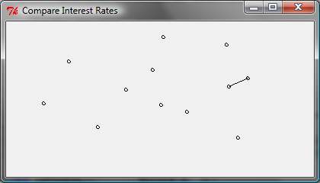
GUI: Finding Two Points Nearest to Each Other
NearestPoints

Slide 14


Animations
AnimationDemo

Slide 15
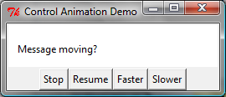
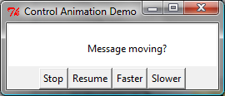
Control Animations
ControlAnimation

Slide 16
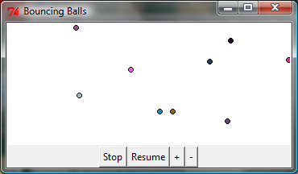
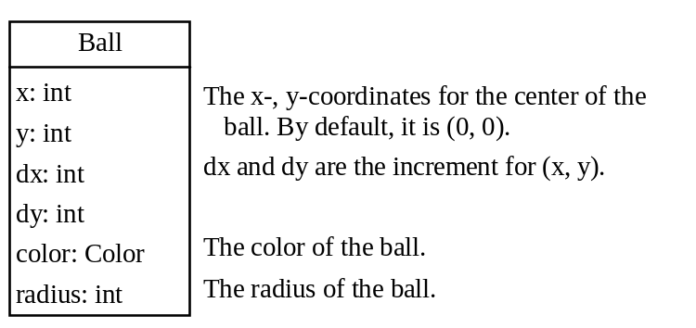
Case Studies: Bouncing Balls
BounceBalls

Slide 17
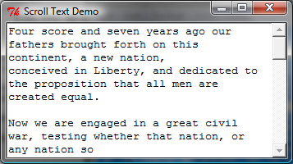
Scrollbar
ScrollText

Slide 18
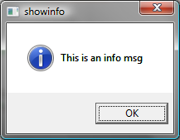
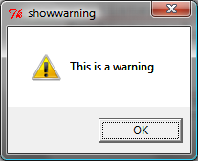
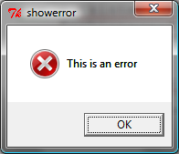
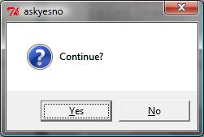
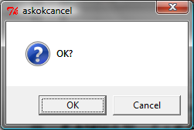
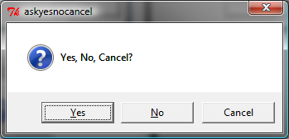
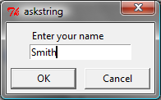
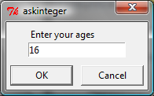
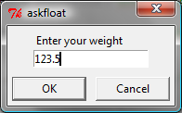
Standard Dialogs
DialogDemo

