Slide 1
Chapter 12 Inheritance and Class Design

Slide 2
Motivations
Suppose you will define classes to model circles, rectangles, and triangles. These classes have many common features. What is the best way to design these classes so to avoid redundancy? The answer is to use inheritance.

Slide 3
Objectives
    To develop a subclass from a superclass through inheritance (§12.2).
    To override methods in the subclass (§12.3).
    To explore the object class and its methods (§12.4).
    To understand polymorphism and dynamic binding (§12.5).
    To determine if an object is an instance of a class using the isinstance function (§12.6).
    To discover relationships among classes (§12.8).
    To design classes using composition and inheritance relationships (§§12.9-12.11).

Slide 4
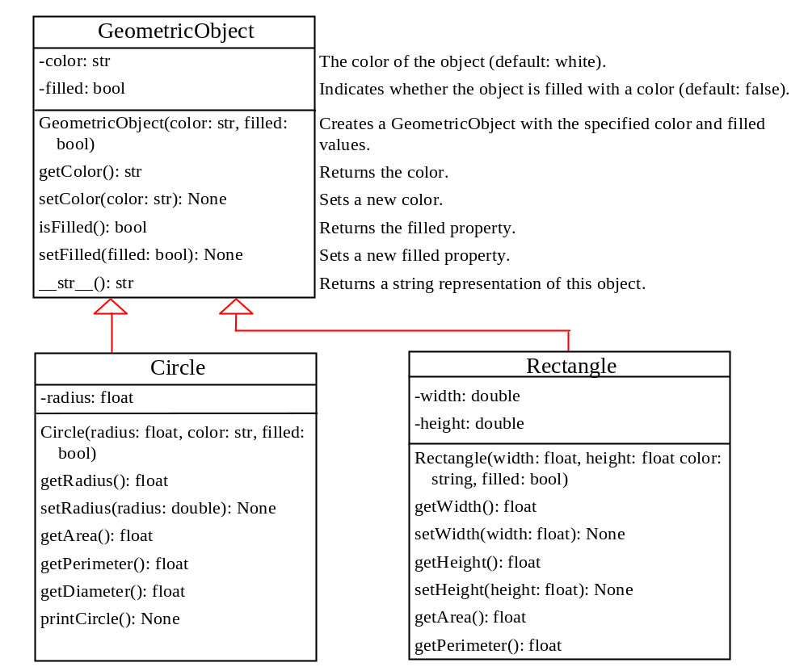
Superclasses and Subclasses
GeometricObject
Circle
Rectangle
TestCircleRectangle

Slide 5
Overriding Methods
A subclass inherits methods from a superclass. Sometimes it is necessary for the subclass to modify the implementation of a method defined in the superclass. This is referred to as method overriding.
class Circle(GeometricObject):
# Other methods are omitted
# Override the __str__ method defined in GeometricObject
def __str__(self):
return super().__str__() + " radius: " + str(radius)

Slide 6
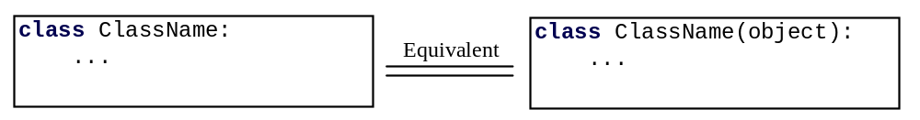
The object Class
Every class in Python is descended from the object class. If no inheritance is specified when a class is defined, the superclass of the class is object by default.
There are more than a dozen methods defined in the object class. We discuss four methods __new__(), __init__(), __str__(), and __eq__(other) here.

Slide 7
The __new__, __init__ Methods
All methods defined in the object class are special methods with two leading underscores and two trailing underscores. The __new__() method is automatically invoked when an object is constructed. This method then invokes the __init__() method to initialize the object. Normally you should only override the __init__() method to initialize the data fields defined in the new class.

Slide 8
The __str__ Method
The __str__() method returns a string representation for the object. By default, it returns a string consisting of a class name of which the object is an instance and the object’s memory address in hexadecimal.
def __str__(self):
return "color: " + self.__color + \
" and filled: " + str(self.__filled)

Slide 9
The __eq__ Method
The __eq__(other) method returns True if two objects are the same. By default, x.__eq__(y) (i.e., x == y) returns False, but x.__eq__(x) is True. You can override this method to return True if two objects have the same contents.

Slide 10
Polymorphism
The three pillars of object-oriented programming are encapsulation, inheritance, and polymorphism.
The inheritance relationship enables a subclass to inherit features from its superclass with additional new features. A subclass is a specialization of its superclass; every instance of a subclass is also an instance of its superclass, but not vice versa. For example, every circle is a geometric object, but not every geometric object is a circle. Therefore, you can always pass an instance of a subclass to a parameter of its superclass type.
PolymorphismDemo

Slide 11
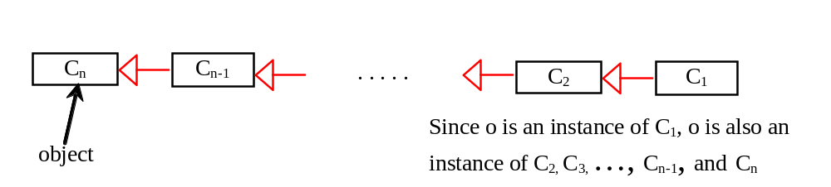
Dynamic Binding
Dynamic binding works as follows: Suppose an object o is an instance of classes C₁, C₂, ..., C_{n-1}, and C_{n}, where C₁ is a subclass of C₂, C₂ is a subclass of C₃, ..., and C_{n-1} is a subclass of C_{n}. That is, C_{n} is the most general class, and C₁ is the most specific class. In Python, C_{n} is the object class. If o invokes a method p, the JVM searches the implementation for the method p in C₁, C₂, ..., C_{n-1} and C_{n}, in this order, until it is found. Once an implementation is found, the search stops and the first-found implementation is invoked.

Slide 12
The isinstance Function
The isinstance function can be used to determine if an object is an instance of a class.
IsinstanceDemo

Slide 13
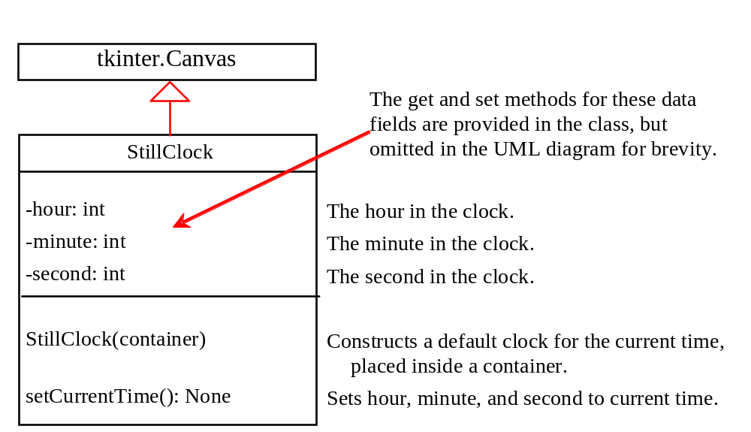
Case Study: A Reusable Clock

Slide 14
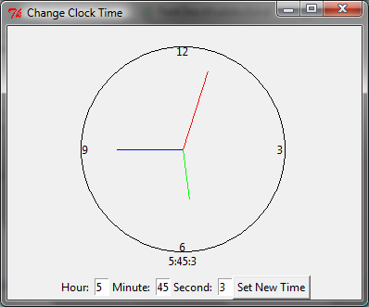
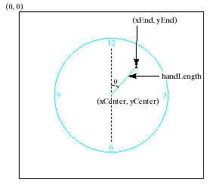
Case Study: A Reusable Clock
DisplayClock

Slide 15
Relationships among Classes
Association
Aggregation
Composition
Inheritance

Slide 16
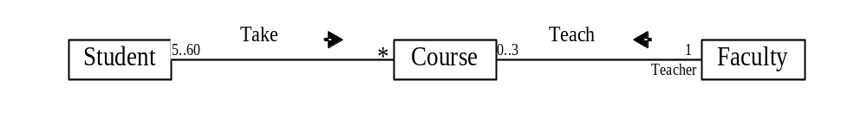
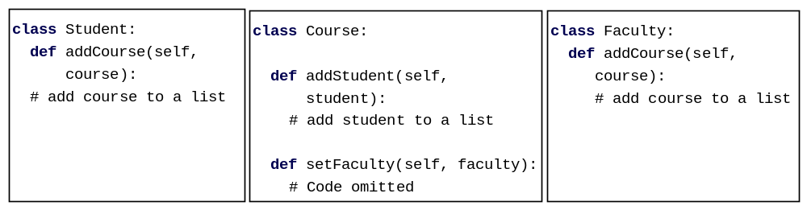
Association
Association represents a general binary relationship that describes an activity between two classes.
An association is usually represented as a data field in the class.

Slide 17

Association Between Same Class
Association may exist between objects of the same class. For example, a person may have a supervisor.

Slide 18
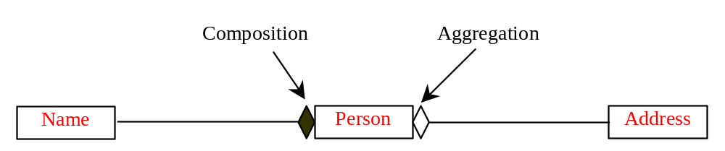
Aggregation and Composition
Aggregation is a special form of association, which represents an ownership relationship between two classes. Aggregation models the has-a relationship. If an object is exclusively owned by an aggregated object, the relationship between the object and its aggregated object is referred to as composition.

Slide 19
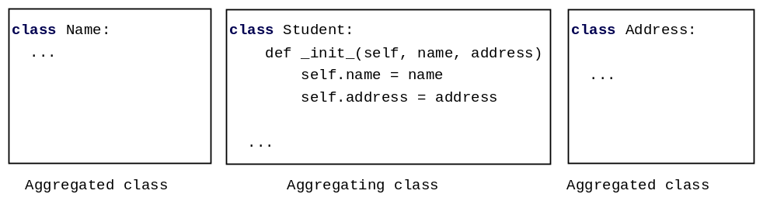
Representing Aggregation in Classes
An aggregation relationship is usually represented as a data field in the aggregated class.

Slide 20
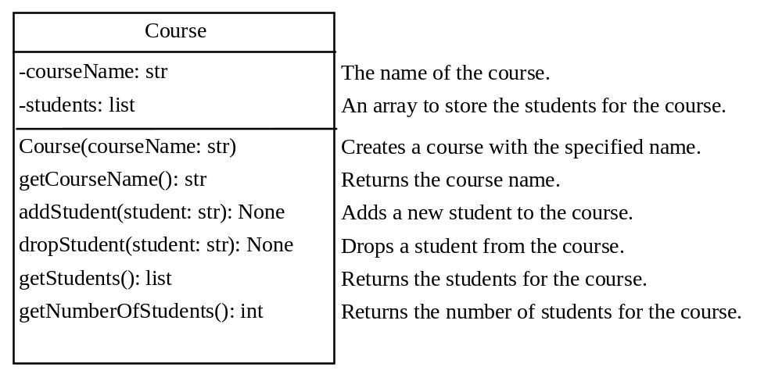
The Course Class
Course
TestCourse

Slide 21
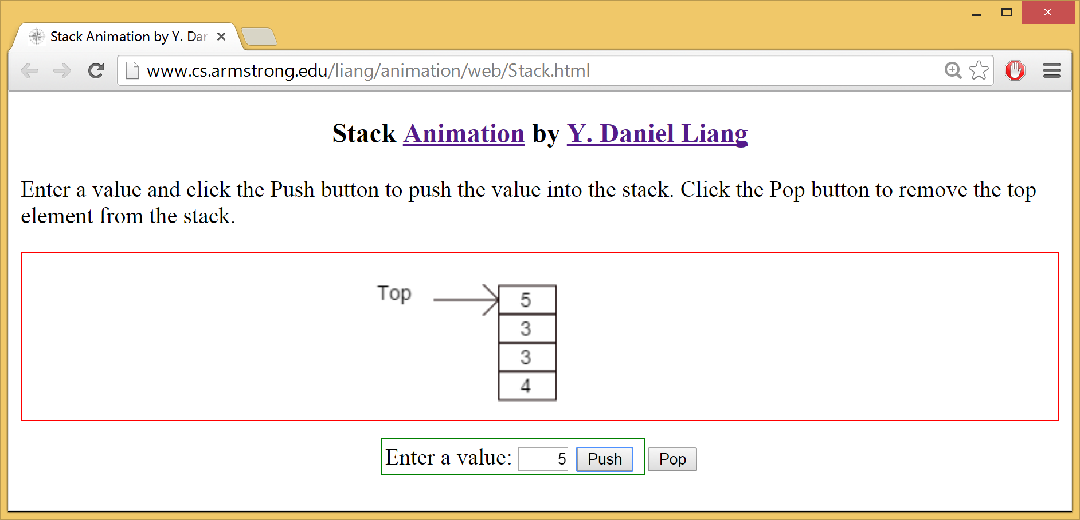
Stack Animation
https://liveexample.pearsoncmg.com/dsanimation/StackeBook.html

Slide 22
The Stack Class
You can define a class to model stacks. You can use a list to store the elements in a stack. There are two ways to design the stack and queue classes:
Using inheritance: You can define a stack class by extending list.
Using composition: You can create a list as a data field in the stack class.
Both designs are fine, but using composition is better because it enables you to define a completely new stack class without inheriting the unnecessary and inappropriate methods from the list class.

Slide 23
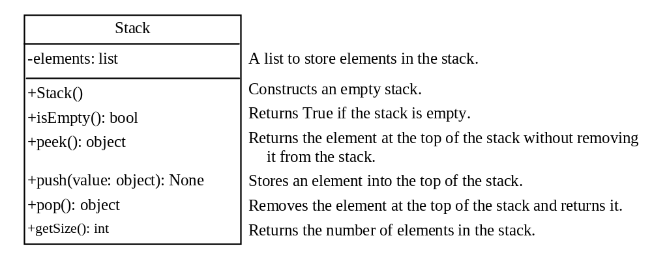
The Stack Class
Stack
TestStack

Slide 24
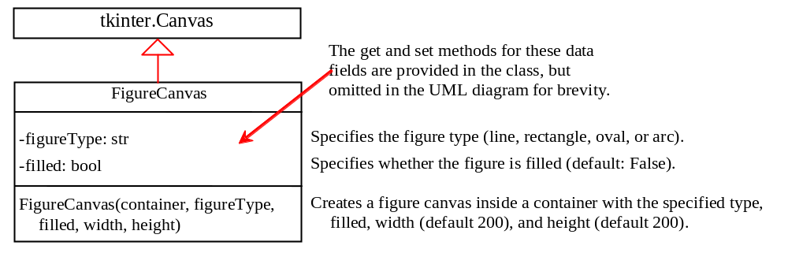
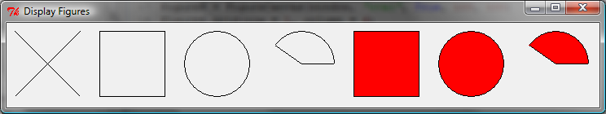
The FigureCanvas Class
FigureCanvas
DisplayFigures

