Slide 1
Chapter 13
Files and Exception Handling

Slide 2
Motivations
Data stored in the program are temporary; they are lost when the program terminates. To permanently store the data created in a program, you need to save them in a file on a disk or other permanent storage. The file can be transported and can be read later by other programs. There are two types of files: text and binary. Text files are essentially strings on disk. This chapter introduces how to read/write data from/to a text file.
When a program runs into a runtime error, the program terminates abnormally. How can you handle the runtime error so that the program can continue to run or terminate gracefully? This is the subject we will introduce in this chapter.

Slide 3
Objectives
To open a file, read/write data from/to a file (§13.2)
To use file dialogs for opening and saving data (§13.3).
To develop applications with files (§13.4)
To read data from a Web resource (§13.5).
To handle exceptions using the try/except/finally clauses (§13.6)
To raise exceptions using the raise statements (§13.7)
To become familiar with Python’s built-in exception classes (§13.8)
To access exception object in the handler (§13.8)
To define custom exception classes (§13.9)
To perform binary IO using the pickle module (§13.10)

Slide 4
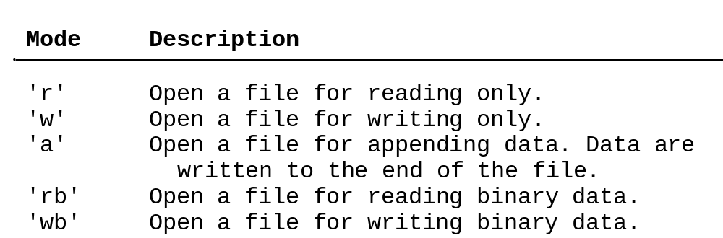
Open a File
How do you write data to a file and read the data back from a file? You need to create a file object that is associated with a physical file. This is called opening a file. The syntax for opening a file is as follows:
file = open(filename, mode)

Slide 5
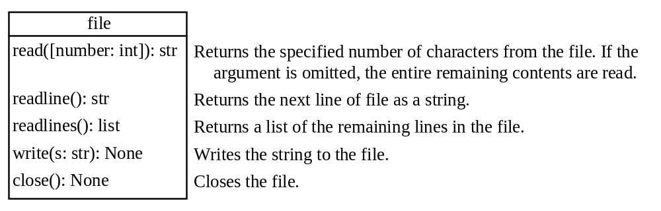
Write to a File
outfile = open("test.txt", "w")
outfile.write("Welcome to Python")
WriteDemo

Slide 6
Testing File Existence
import os.path
if os.path.isfile("Presidents.txt"):
print("Presidents.txt exists")

Slide 7
Read from a File
After a file is opened for reading data, you can use the read method to read a specified number of characters or all characters, the readline() method to read the next line, and the readlines() method to read all lines into a list.
ReadDemo

Slide 8
Append Data to a File
You can use the 'a' mode to open a file for appending data to an existing file.
AppendDemo

Slide 9
Writing/Reading Numeric Data
To write numbers, convert them into strings, and then use the write method to write them to a file. In order to read the numbers back correctly, you should separate the numbers with a whitespace character such as ' ', '\n'.
WriteReadNumbers

Slide 10
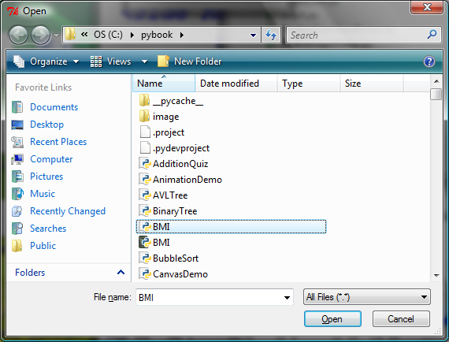
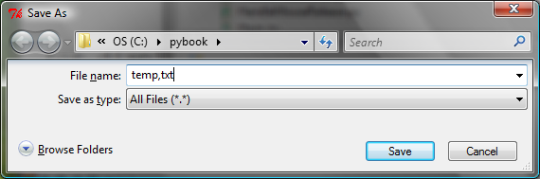
File Dialogs
from tkinter.filedialog import askopenfilename
from tkinter.filedialog import asksaveasfilename
filenameforReading = askopenfilename()
print("You can read from from " + filenameforReading)
filenameforWriting = asksaveasfilename()
print("You can write data to " + filenameforWriting)

Slide 11
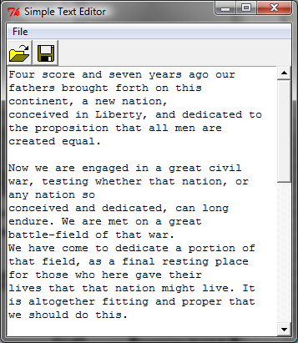
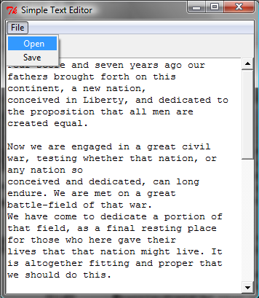
File Editor
FileEditor

Slide 12
Problem: Counting Each Letter in a File
The problem is to write a program that prompts the user to enter a file and counts the number of occurrences of each letter in the file regardless of case.
CountEachLetter

Slide 13
Retrieving Data from the Web
Using Python, you can write simple code to read data from a Website. All you need to do is to open a URL link using the urlopen function as follows:
infile = urllib.request.urlopen('http://www.yahoo.com')
import urllib.request
infile = urllib.request.urlopen('http://www.yahoo.com/index.html')
print(infile.read().decode())
CountEachLetterURL

Slide 14
Exception Handling
When you run the program in Listing 11.3 or Listing 11.4, what happens if the user enters a file or an URL that does not exist? The program would be aborted and raises an error. For example, if you run Listing 11.3 with an incorrect input, the program reports an IO error as shown below:
c:\pybook\python CountEachLetter.py
Enter a filename: newinput.txt
Traceback (most recent call last):
File "CountEachLetter.py", line 23, in <module>
main()
File "CountEachLetter.py", line 4, in main
Infile = open(filename, "r"> # Open the file
IOError: [Errno 2] No such file or directory: 'newinput.txt'

Slide 15
The try ... except Clause
try:
<body>
except <ExceptionType>:
<handler>

Slide 16
The try ... except Clause
try:
<body>
except <ExceptionType1>:
<handler1>
...
except <ExceptionTypeN>:
<handlerN>
except:
<handlerExcept>
else:
<process_else>
finally:
<process_finally>
TestException

Slide 17
Raising Exceptions
You learned how to write the code to handle exceptions in the preceding section. Where does an exception come from? How is an exception created? Exceptions are objects and objects are created from classes. An exception is raised from a function. When a function detects an error, it can create an object of an appropriate exception class and raise the object, using the following syntax:
raise ExceptionClass("Something is wrong")
RaiseException

Slide 18
Processing Exceptions Using Exception Objects
You can access the exception object in the except clause.
try
<body>
except ExceptionType as ex:
<handler>
ProcessExceptionObject

Slide 19
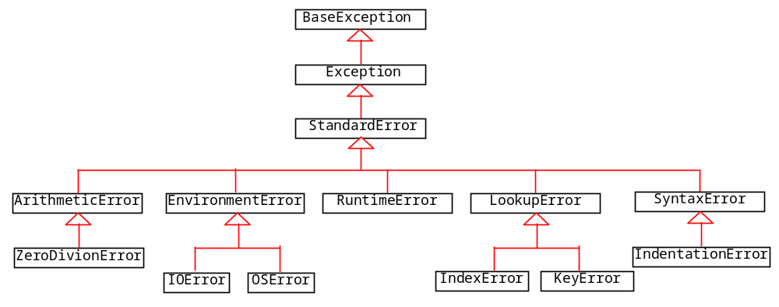
Defining Custom Exception Classes
TestCircleWithCustomException
InvalidRadiusException

Slide 20
Binary IO Using Pickling
To perform binary IO using pickling, open a file using the mode 'rb' or 'wb' for reading binary or writing binary and invoke pickle module’s dump and load functions to write and read data.
BinaryIODemo

Slide 21
Detecting End of File
If you don’t know how many objects are in the file, how do you read all the objects? You can repeatedly read an object using the load function until it throws an EOFError exception. When this exception is raised, catch it and process it to end the file reading process.
DetectEndOfFile

Slide 22
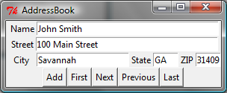
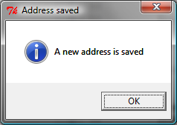
Case Study: Address Book
Now let us use object IO to create a useful project for storing and viewing an address book. The user interface of the program is shown below. The Add button stores a new address at the end of the file. The First, Next, Previous, and Last buttons retrieve the first, next, previous, and last addresses from the file, respectively.
AddressBook

